Slide 2
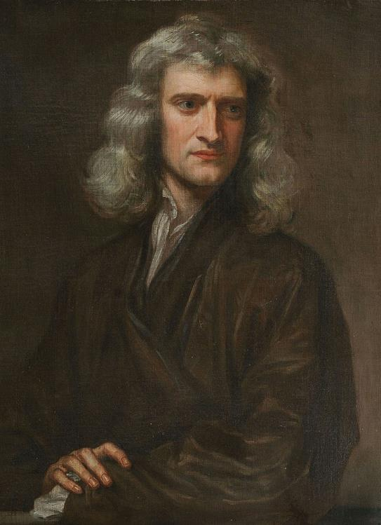
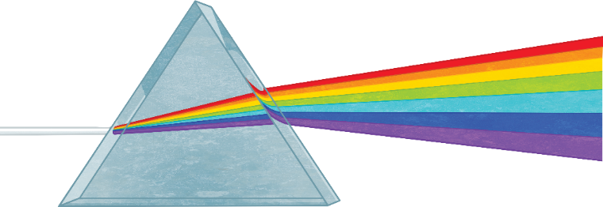


Let’s Start with a Bit of History...
Sir Isaac Newton is one of the most influential mathematicians and scientists in history. During the 1660s, he began a series of experiments with sunlight.
In a darkened room, he only allowed a small gap of light to come through the window. Using a piece of glass, shaped like a pyramid, he waited for the sun to move to the right place in the sky.
When the sun’s angle was just right, a ray of white light shot through the small gap and into the room. Newton quickly put his prism in front of it. The white light shattered and became a
rainbow of colours on the wall.

Slide 3
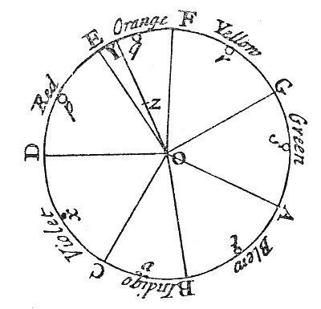

Sir Isaac Newton (1642-1727)
Newton noted down the seven different colours he saw on a rotating disc, in rainbow order. This was the first time anyone had captured the colour spectrum on a colour wheel. It’s where our modern colour wheel comes from.
Did You Know…?
If you spin a colour wheel, the human eye will only see white as the colours blend together.

Slide 4
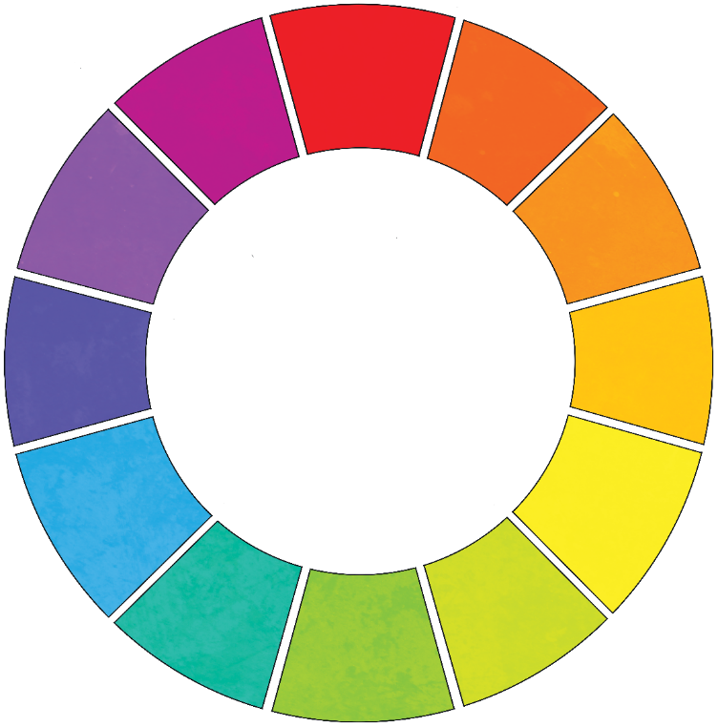
The Colour Wheel
Here is a modern version of a colour wheel.
Primary
red
The primary colours are
, and .
They are called the primary colours because they can’t be mixed from other colours.
red
yellow
blue
Primary
blue
Primary
yellow

Slide 5
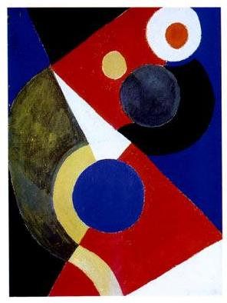

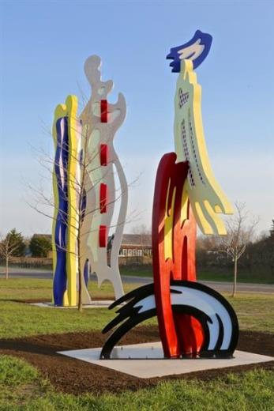
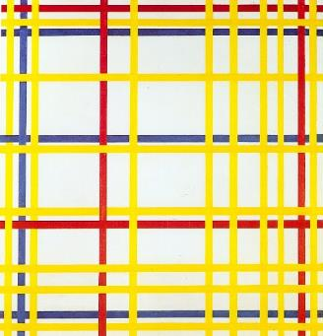
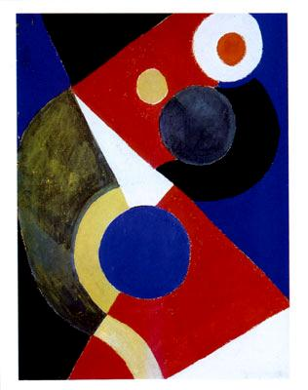
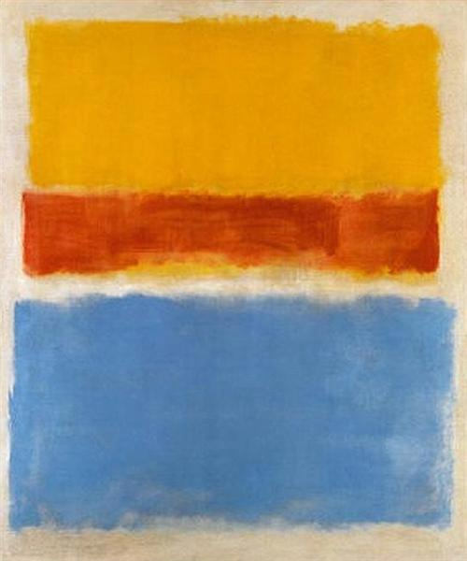
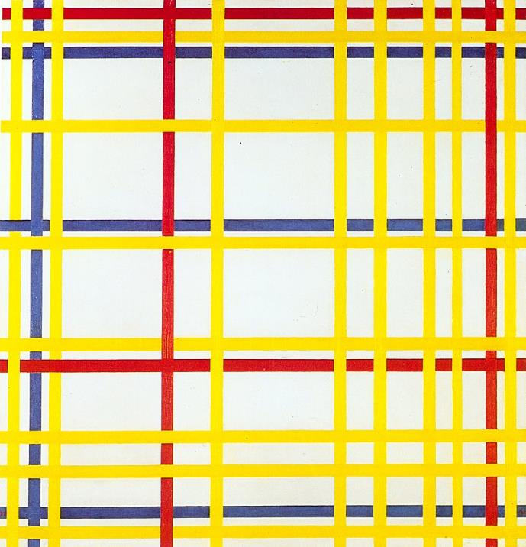
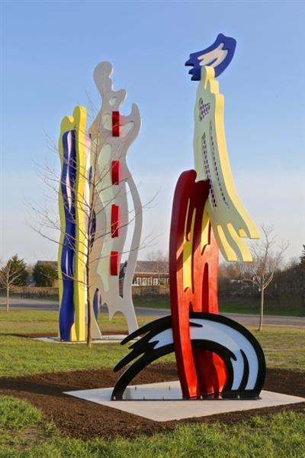

Primary Colours in Art
‘Tokyo Brushstrokes (I and II)’ by Roy Lichtenstein, 1994
‘Rhythm Colour’
by Sonia Delaunay
‘Untitled (Yellow, Red and Blue)’ by Mark Rothko, 1953
‘New York City I’
by Piet Mondrian, 1942
For educational use only
For educational use only
For educational use only
For educational use only
For educational use only
For educational use only
Click the pictures to find out more
“Tokyo Brushstrokes (I and II) – Roy Lichtenstein” by xennex is licensed under FAIR USE.
“Rhythm Colour – Sonia Delaunay” by xennex is licensed under FAIR USE.
“Untitled (Yellow, Red and Blue) – Mark Rothko” by yigruzeltil is licensed under FAIR USE.

Slide 6
Secondary Colours
The secondary colours are green, orange and purple. You create these by mixing combinations of primary colours together.
Primary
red
Secondary
purple
Secondary
orange
blue
red
purple
and make
Primary
blue
Primary
yellow
yellow
blue
green
and make
red
yellow
orange
and make
Secondary
green

Slide 7
Tertiary Colours
The tertiary colours are the colours created when mixing a primary colour with a secondary colour.
Tertiary
Tertiary
Tertiary
Tertiary
Tertiary
Tertiary

Slide 8
Warm and Cool Colours
Different colours can have very different effects on our emotions.
We can split colours into warm and cool. Warm colours, like red and yellow, usually symbolise feelings of warmth or anger, while cool colours, like green and blue, can make us feel
calm or sad.
Cold/
Cool colours
Hot/
Warm colours
Understanding the connection between colour and feelings
can help artists to create their work. Artists can use warm and cool colours to inspire certain emotions in people.

Slide 9
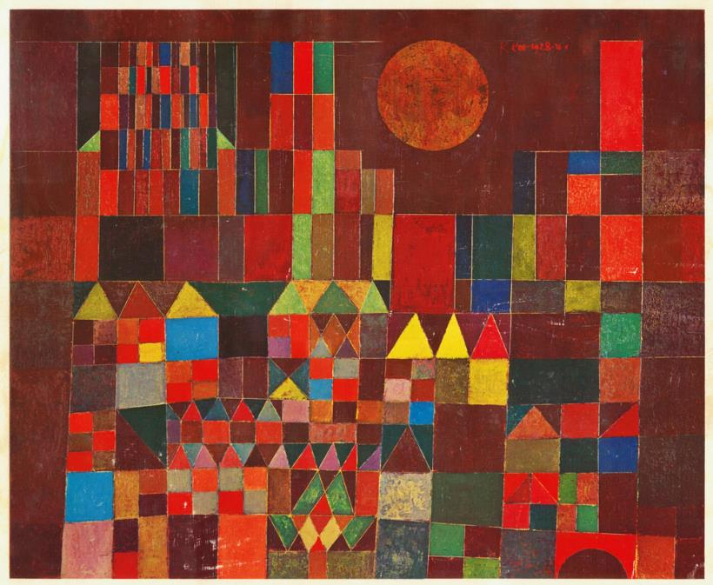
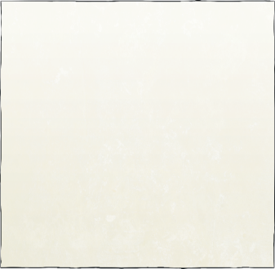
Warm Colours
Here are some of the common emotional associations for different colours:
Yellow is often associated with cowardice but also with energy, happiness and warmth.
Pink is associated with love, creativity and joy. It is also believed to have a calming effect.
Red is associated with aggression, power and danger but it’s also symbolic of excitement, love and passion.
Orange is made by combining red and yellow and as a result, is an energetic colour. It’s symbolic of enthusiasm and excitement.
‘Castle and Sun’ by Paul Klee, 1928
cowardice:
Scared and lacking courage.

Slide 10
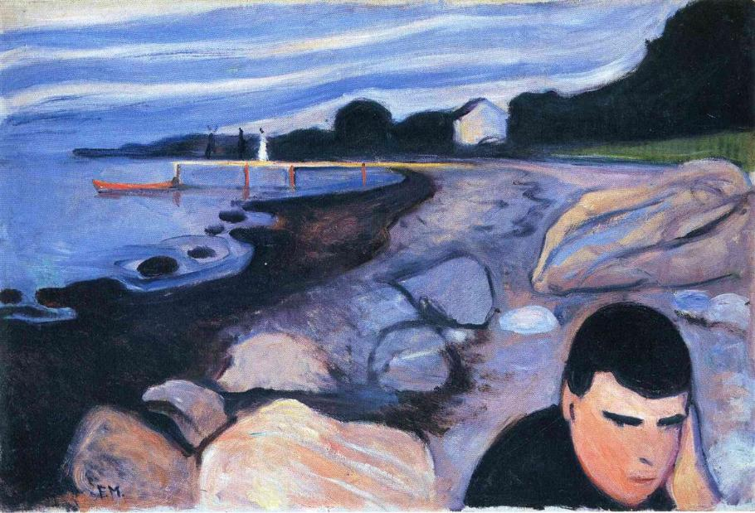

Cool Colours
Here are some of the common emotional associations for different colours:
The rich and grand tones of purple are commonly associated with wealth, royalty and bravery. It’s also one of the best colours to improve focus and creativity.
Green is a cool colour, often symbolising nature and tranquillity. It is seen as representing good health and healing. It’s also associated with luck and money, as well as jealousy.
Blue is sometimes associated with sadness but it can also be a calming colour.
Discuss It
Are there any colours that help you to concentrate or make you feel happier?
‘Melancholy’ by Edvard Munch, 1892

Slide 11

Complementary Colours
In art, complementary colours work in pairs and contrast with each other more than any other colour combination. They can be found directly opposite each other on the colour wheel, for example, purple and yellow.
Why use complementary colours?
When complementary
colours are used together they are vibrant and make images ‘pop’ and stand out. Complementary colours are difficult to use effectively; however, when used well, they make a statement in their artwork.
contrast:
A clear difference between two or more things.

Slide 12
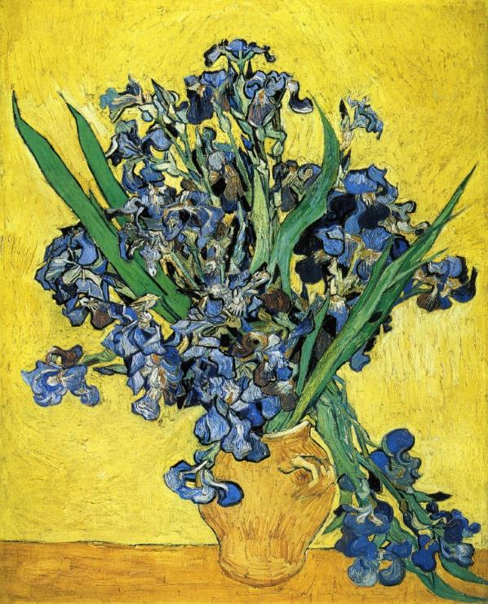
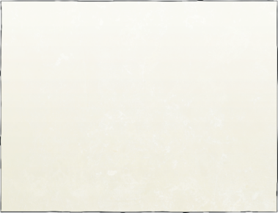
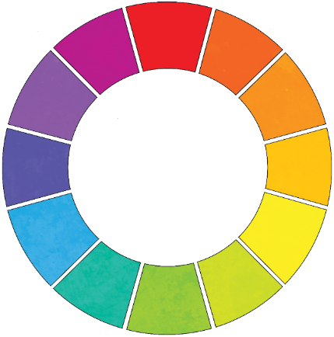
Colour Contrasts
Discuss It
Can you spot the complementary colours?
‘Still Life with Irises’ by Vincent van Gogh, 1890

Slide 13
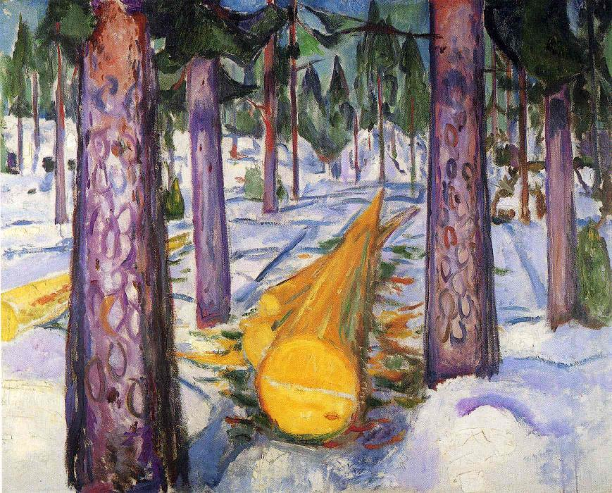
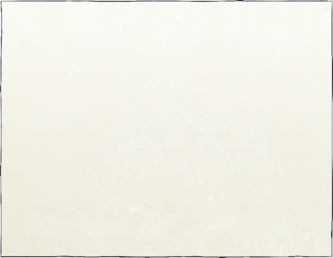
Colour Contrasts
Discuss It
Can you spot the complementary colours?
‘The yellow log’, by Edvard Munch, 1912

Slide 14
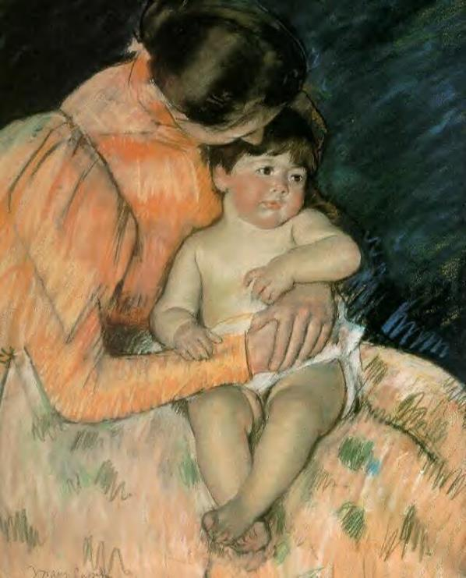
Colour Contrasts
Discuss It
Can you spot the complementary colours?
‘Mother and Child’ by Mary Cassatt, 1890

Slide 15
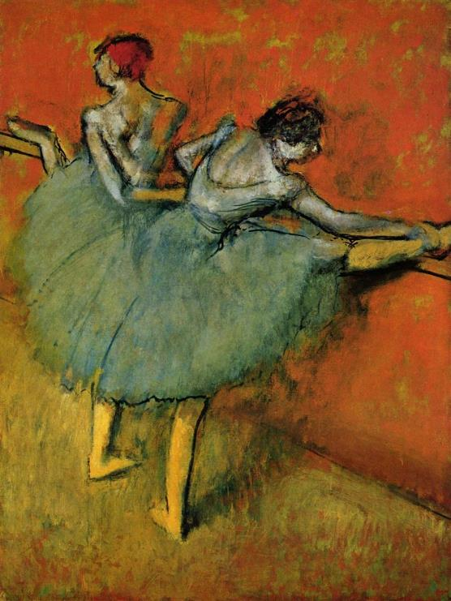
Colour Contrasts
Discuss It
Can you spot the complementary colours?
‘Dancers at the Barre’ by Edgar Degas, 1900-1905

Slide 16
Analogous Colours
In art, analogous colours are a group of colours that are next to each other on the colour wheel. It could be a group of three or four colours. The group usually shares a primary colour as a base for mixing.
Why use analogous colours?
Analogous colours are often used in paintings because the colours match well. When used together, they often give a calming and soothing effect to the painting. Analogous colours are often used best in paintings of nature.

Slide 17
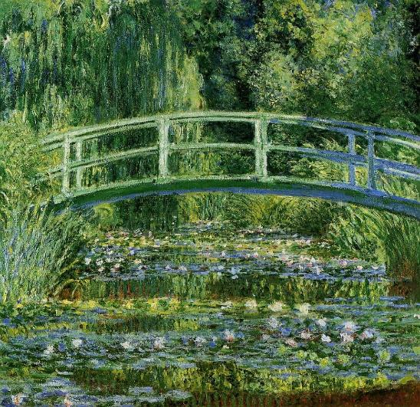
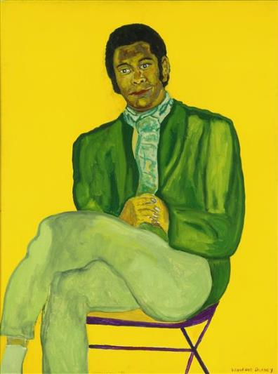
Analogous Art
For educational use only
‘The Japanese Bridge
(The Water-Lily Pond)’ by Claude Monet, 1897-1899
‘Portrait of a Young Musician’ by Beauford Delaney, 1970
“Portrait of a Young Musician – Beauford Delaney” by xennex is licensed under FAIR USE.

Slide 18
Colour Vocabulary
Hue
A hue is the pure form of a colour that hasn’t been changed in any way. It is not the tint, tone or shade of a colour.
Tint
A hue with the addition of white to lighten it to some degree.
Shade
A hue with the addition of black to darken it to some degree.
Tone
A hue with the addition of grey makes the colour less vibrant.

Slide 19
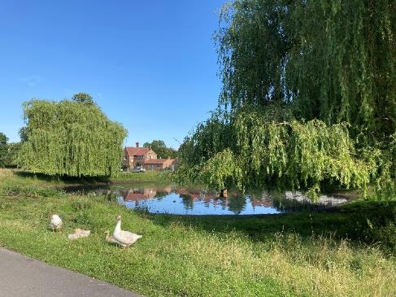
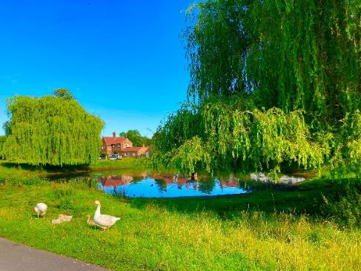
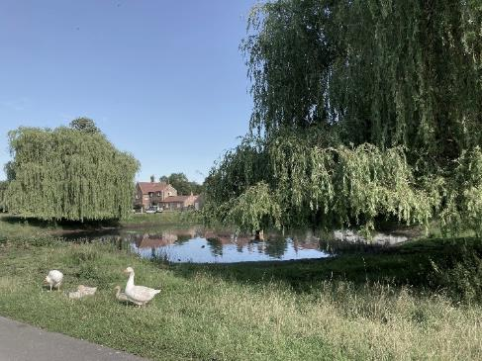
Colour Saturation
Saturation is the intensity of the colour. A highly saturated image has strong and bright colours whereas a less saturated image is paler.
The original image
High saturation
Discuss It
Which of the two images do you prefer? Why?
Low saturation

Slide 20
Colour Quiz – True or False?
1. If you spin a colour wheel, the human eye will only see black as the colours blend together.
True
False
False – The human eye will only see white as the colours blend together.
Click to find out if you’re correct
2. They are called the primary colours because they can’t be mixed from other colours.
True
False
3. The secondary colours are green, orange and black.
True
False
False – The secondary colours are green, orange and purple.
More Questions ▶

Slide 21
Colour Quiz – True or False?
4. Complementary colours are contrasting colours that are vibrant and make images ‘pop’ and stand out.
True
False
True
False
5. The complementary colour for red is orange.
False – The opposite colour on the colour wheel is green.
True
False
6. The complementary colour for purple is yellow.
More Questions ▶

Slide 22
Colour Quiz – True or False?
7. Analogous colours are often used best in paintings of nature.
True
False
8. A hue with the addition of white to lighten it to some degree is called a tint.
True
False
9. Tone is a hue with the addition of grey to make the colour more vibrant to some degree.
True
False
False – A hue with the addition of grey makes the colour less vibrant.
More Questions ▶

Slide 23
Colour Quiz – True or False?
True
False
10. Saturation is the intensity of the colour.

