Slide 1

Trydydd
Person

Slide 2
Chwarae
Playing

Slide 3

BERF: CHWARAE
Mae e’n ….. Mae hi’n ….. Mae Bob yn ….
hoffi chwarae…
likes playing …
mwynhau chwarae …
enjoy playing …
dwlu ar chwarae…
adores playing …
Dydy e/hi/Bob ddim yn hoffi chwarae…
likes playing …
casáu gwneud …
hate playing …

Slide 4
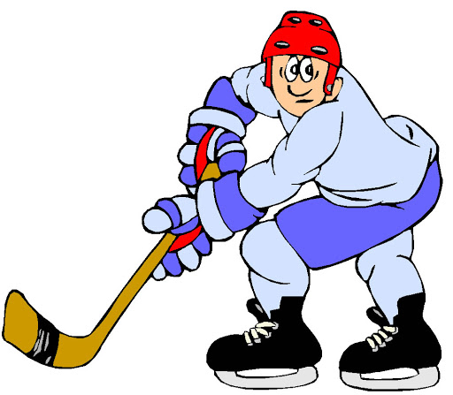





GEIRFA
chwarae hoci iâ
chwarae pêl-fasged
Chwarae
chwarae hoci
chwarae golff
chwarae rownderi
chwarae criced

Slide 5

GÊM: Beat the Teacher
Notes:
Point at one of the images/English phrases (option here to also read it aloud in English) and then you slowly say the Welsh aloud. Students repeat. However sometimes you will ‘get it wrong’ and say the Welsh for a different phrase, so if you get it wrong, students must NOT repeat it or you get a point, so the aim for you is to ‘trick’ them and for them not to be tricked.

Slide 6
CWESTIWN AC ATEB
hoci iâ
pêl-fasged
Beth ydy e/hi/Bob yn chwarae?
Mae e’n/hi’n/Bob yn chwarae…
hoci
golff
rownderi
criced

Slide 7
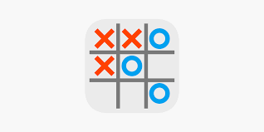
GÊM: 0s and Xs
Notes:
children make a 3x3 grid that may just have a topic word in it and alongside they have a list of achos reasons. In order to win the box they have to describe in a full sentence why they like or dislike the topic word in the box.

Slide 8

ACHOS …
achos …
mae’n anturus
it’s adventurous
mae’n gêm hwyl i chwarae gyda ffrindiau
it’s a fun game to play with friends
mae’n helpu fi cadw’n heini
it helps me to keep fit

Slide 9
DECHRAU BRAWDDEG
Yn fy marn i
In my opinion
A bod yn onest
To be honest

Slide 10

GÊM: First Letter Oral Translation
Notes:
Provide English sentences to translate into Welsh.
For each one give the first letter of each word in Welsh to help reinforce the correct word and jog memory.
E.g.
I like eating apples. D i h b a

Slide 11

GÊM: Bob Up
Notes:
Split the class down the middle and give students on each side a number or letter so there is a student on either side with the same number/letter.
Ask for the translation of a word or sentence and then shout out a number/letter.
The first student to shout out correctly wins a point for their team.

