Slide 1

Trydydd Person

Slide 2
Gwisgo Wearing

Slide 3

BERF: GWISGO
Mae e’n ….. Mae hi’n ….. Mae Bob yn ….
hoffi gwisgo…
likes wearing …
mwynhau gwisgo …
enjoy wearing …
dwlu ar wisgo…
adores wearing …
Dydy e/hi/Bob ddim yn hoffi gwisgo…
doesn’t like wearing…
casáu gwisgo …
hates wearing …

Slide 4

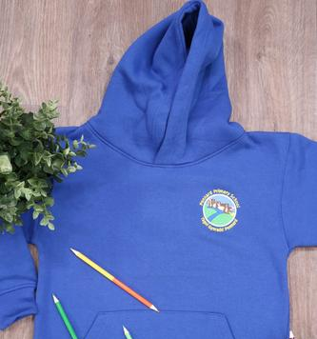
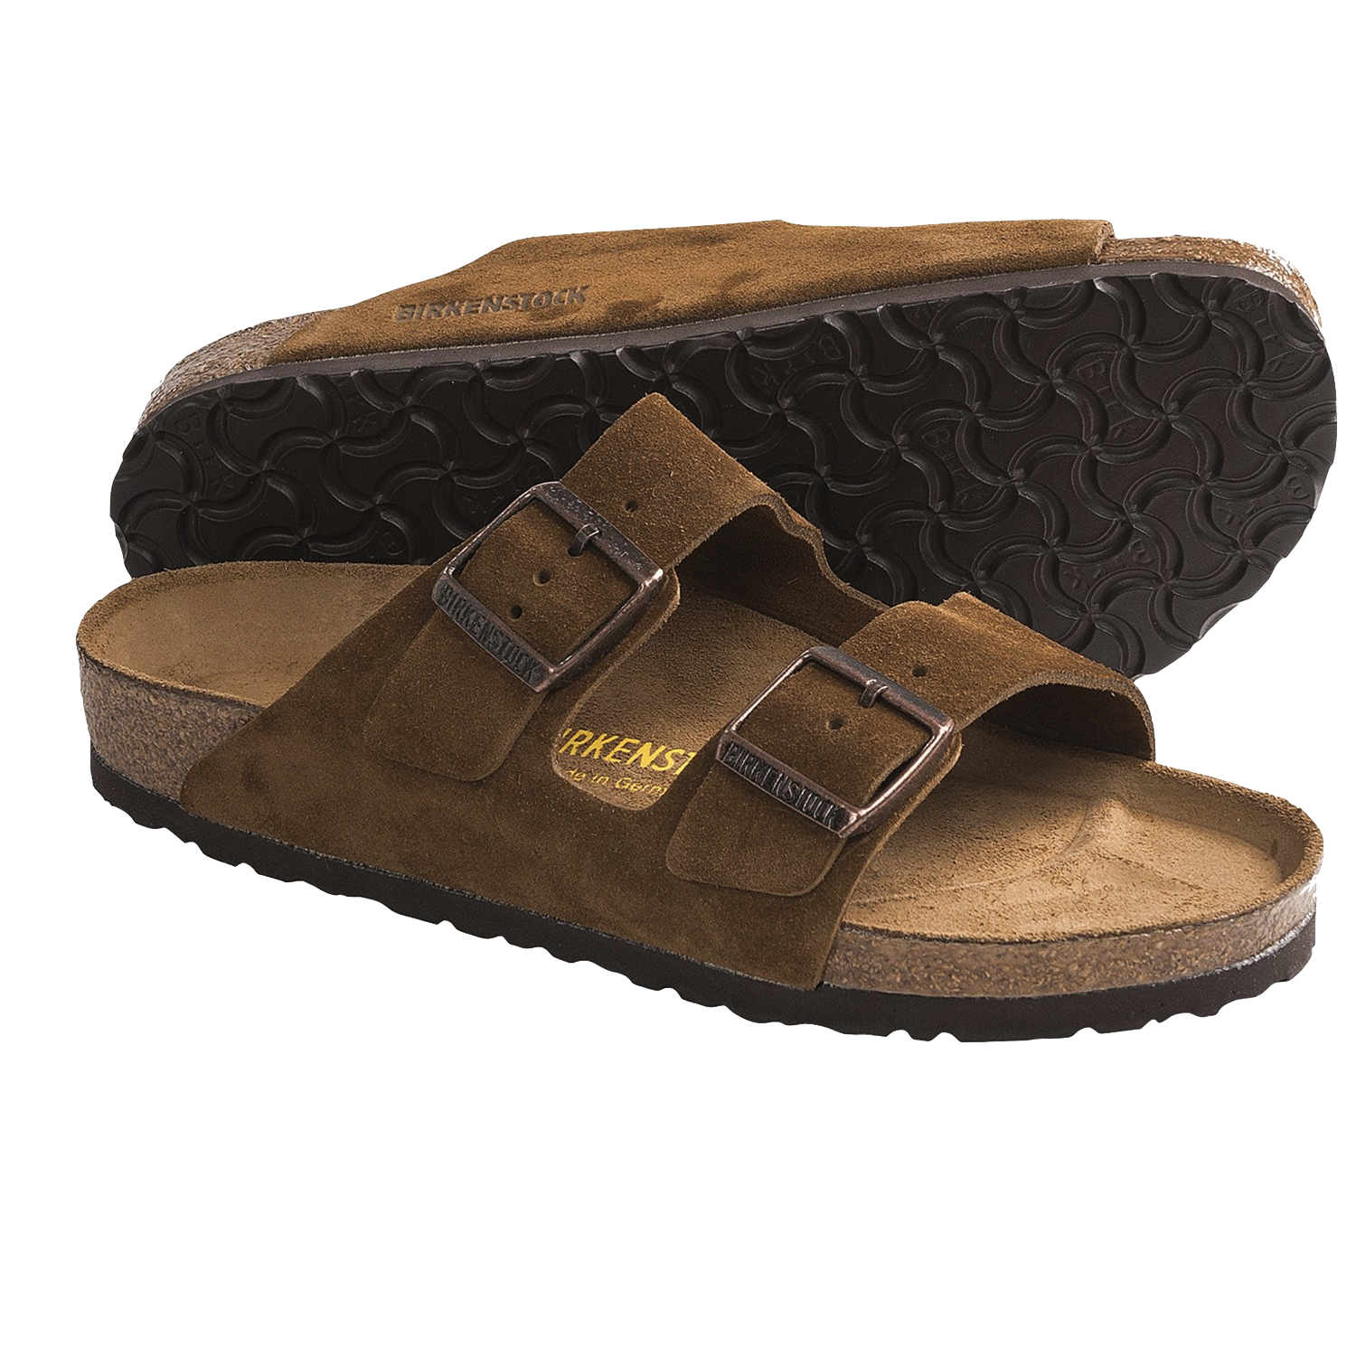
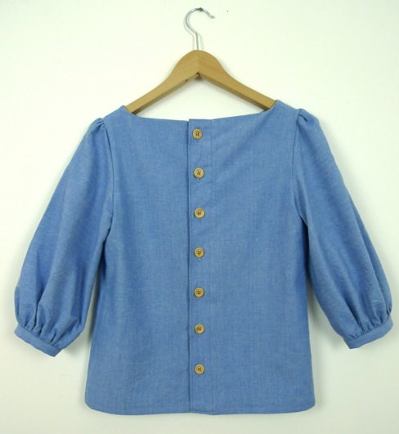

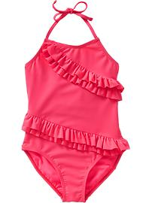
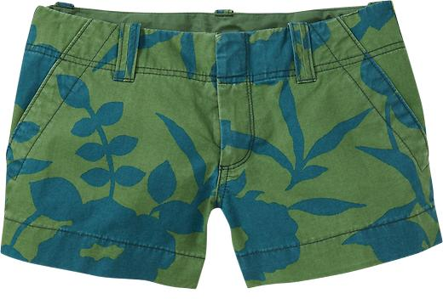
GEIRFA
llopanau
gwisg ysgol
Dillad
blows
sandalau
socasau
gwisg nofio

Slide 5

GÊM: Pêl Tân
Notes:
Choose five of the topic words from previous slide (e.g. blows, gwisg ysgol, socasau, sandalau, llopanau) and choose one of these words to be your fireball word (e.g. socasau). Children to stand in a circle and repeat the topic words chosen one by one as they go around the circle. If a child is due to say the fireball word then they must say ‘tân’ instead then the next child says the next topic word in the list as expected. If the child says the fireball word then they are out and the next child must start with the first word in the list again.

Slide 6
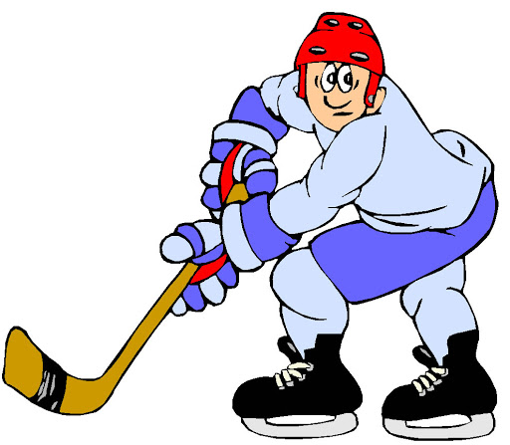


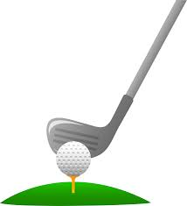


CWESTIWN AC ATEB
hoci iâ
pêl-fasged
Beth ydy e/hi/Bob yn chwarae?
Mae e’n/hi’n/Bob yn chwarae…
hoci
golff
rownderi
criced

Slide 7

ACHOS …
achos …
mae’n hawdd i
wisgo
it’s easy to wear
mae’n cyfforddus
it’s comfortable
mae’n ffasiynol
It’s fashionable/stylish

Slide 8
Unjumble
He enjoys wearing school uniform because it’s very smart.
iawn. mae’n gwisgo Mae gwisg
e’n ysgol mwynhau achos smart
2. She enjoys wearing a blouse because it is fashionable.
mae’n gwisgo Mae ffasiynol.
hi’n blows mwynhau achos
3. Bob enjoys wearing sandals because they are comfortable.
mwynhau gwisgo Bob maen cyfforddus.
Mae yn sandalau achos nhw’n
4. He enjoys wearing a swim suit because he likes swimming.
Mae gwisgo gwisg mwynhau mae hoffi
achos e’n sandalau achos nofio e’n nofio.
5. She enjoys wearing leggings because they are fashionable and easy to wear.
hi’n gwisgo nhw’n mwynhau wisgo. socasau
achos i ffasiynol maen hawdd Mae ac yn

Slide 9

Pasio’r Bom
Notes:
Set a 30 second timer on the IWB. Give the children a range of different topic pictures to use in a sentence of their choice using the language pattern that you have been teaching. If the ‘bomb’ goes off whilst they are in the middle of translating their sentence then the child loses a life (they have 3 lives in total). Continue for a set time or until there is an overall winner.

Slide 10
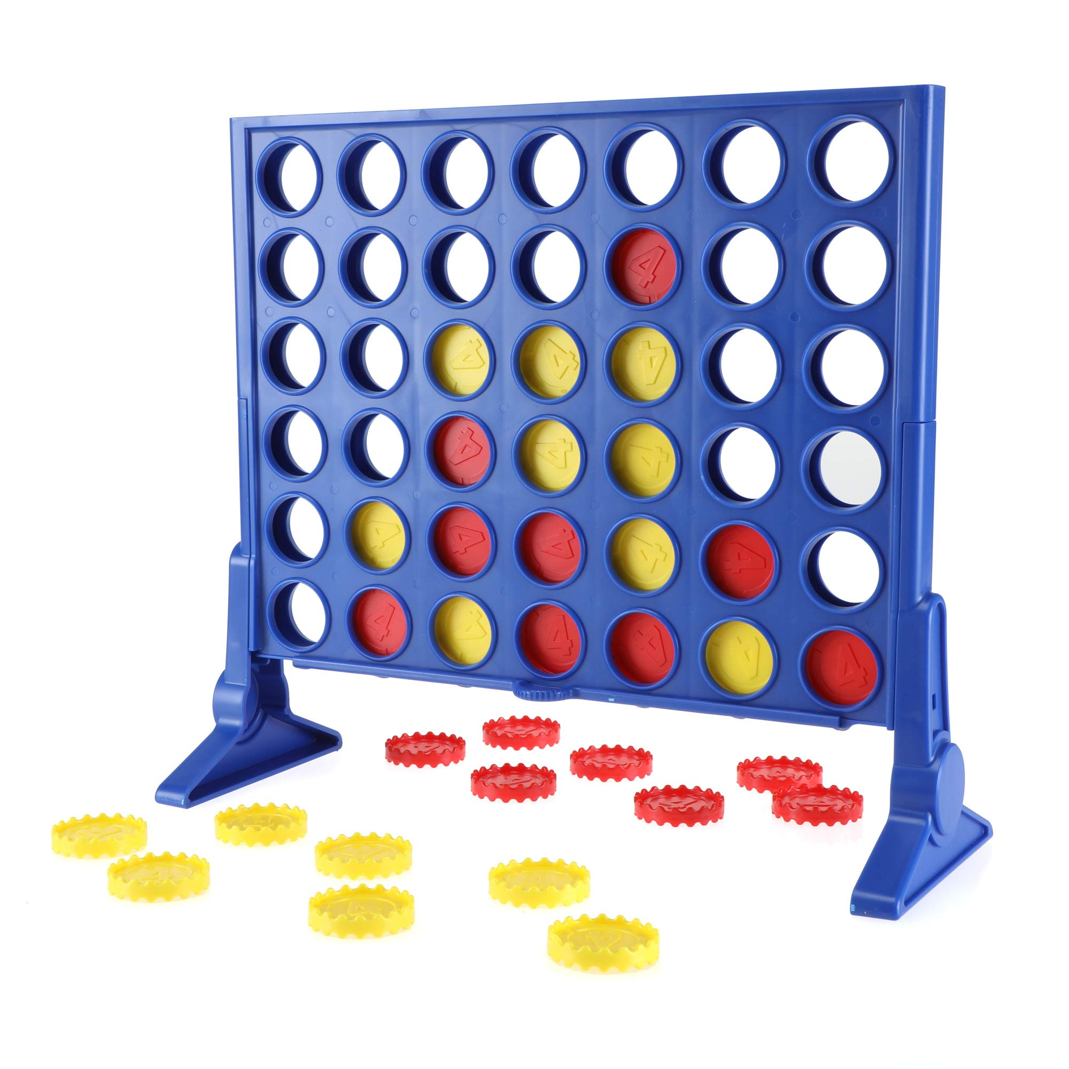
Cysylltu 4
https://www.bryanbraun.com/connect-four/
Notes:
Give the children a range of different topic pictures to use in a sentence of their choice using the language pattern that you have been teaching. Once the child has correctly constructed the sentence then they can add a disc to the board. Normal rules for this game then apply. The winner is the first player to have four in a row. This game can either be played as a whole class that are split into two teams or on chrome books where children play in pairs.

