Slide 1

Cymraeg

Slide 2
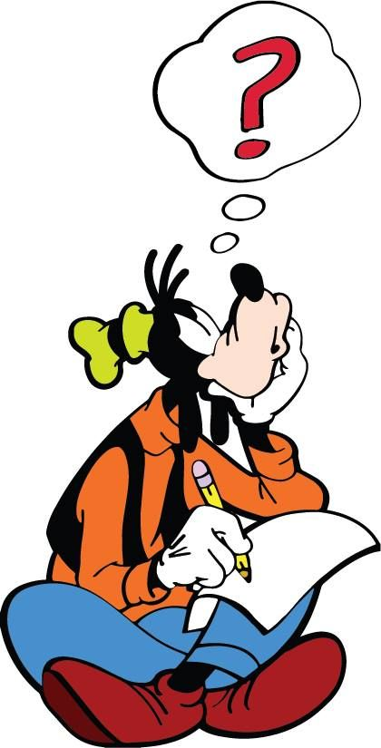
AMSER COFIO
Word Wall: Quiz
https://wordwall.net/resource/35071347

Slide 3
Wythnos 2
Yfed
Drinking

Slide 4
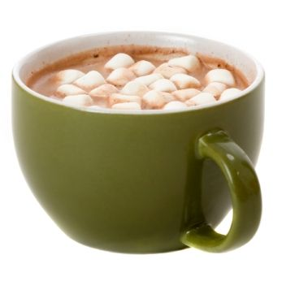
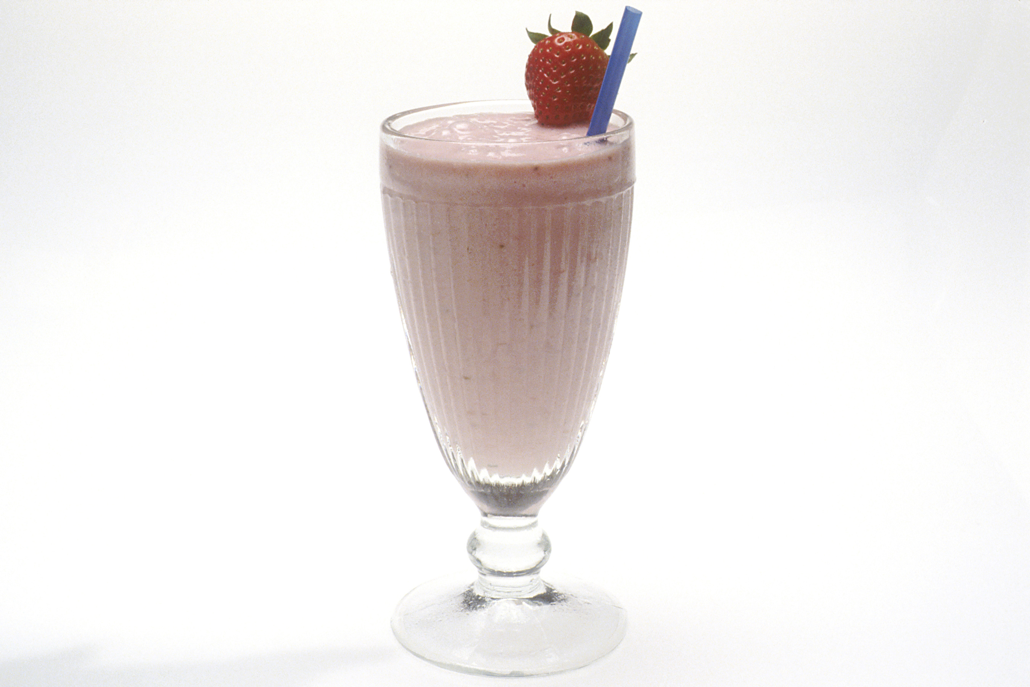
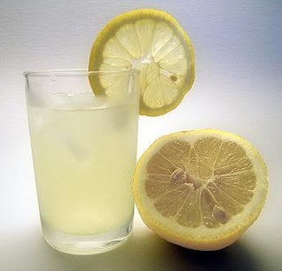
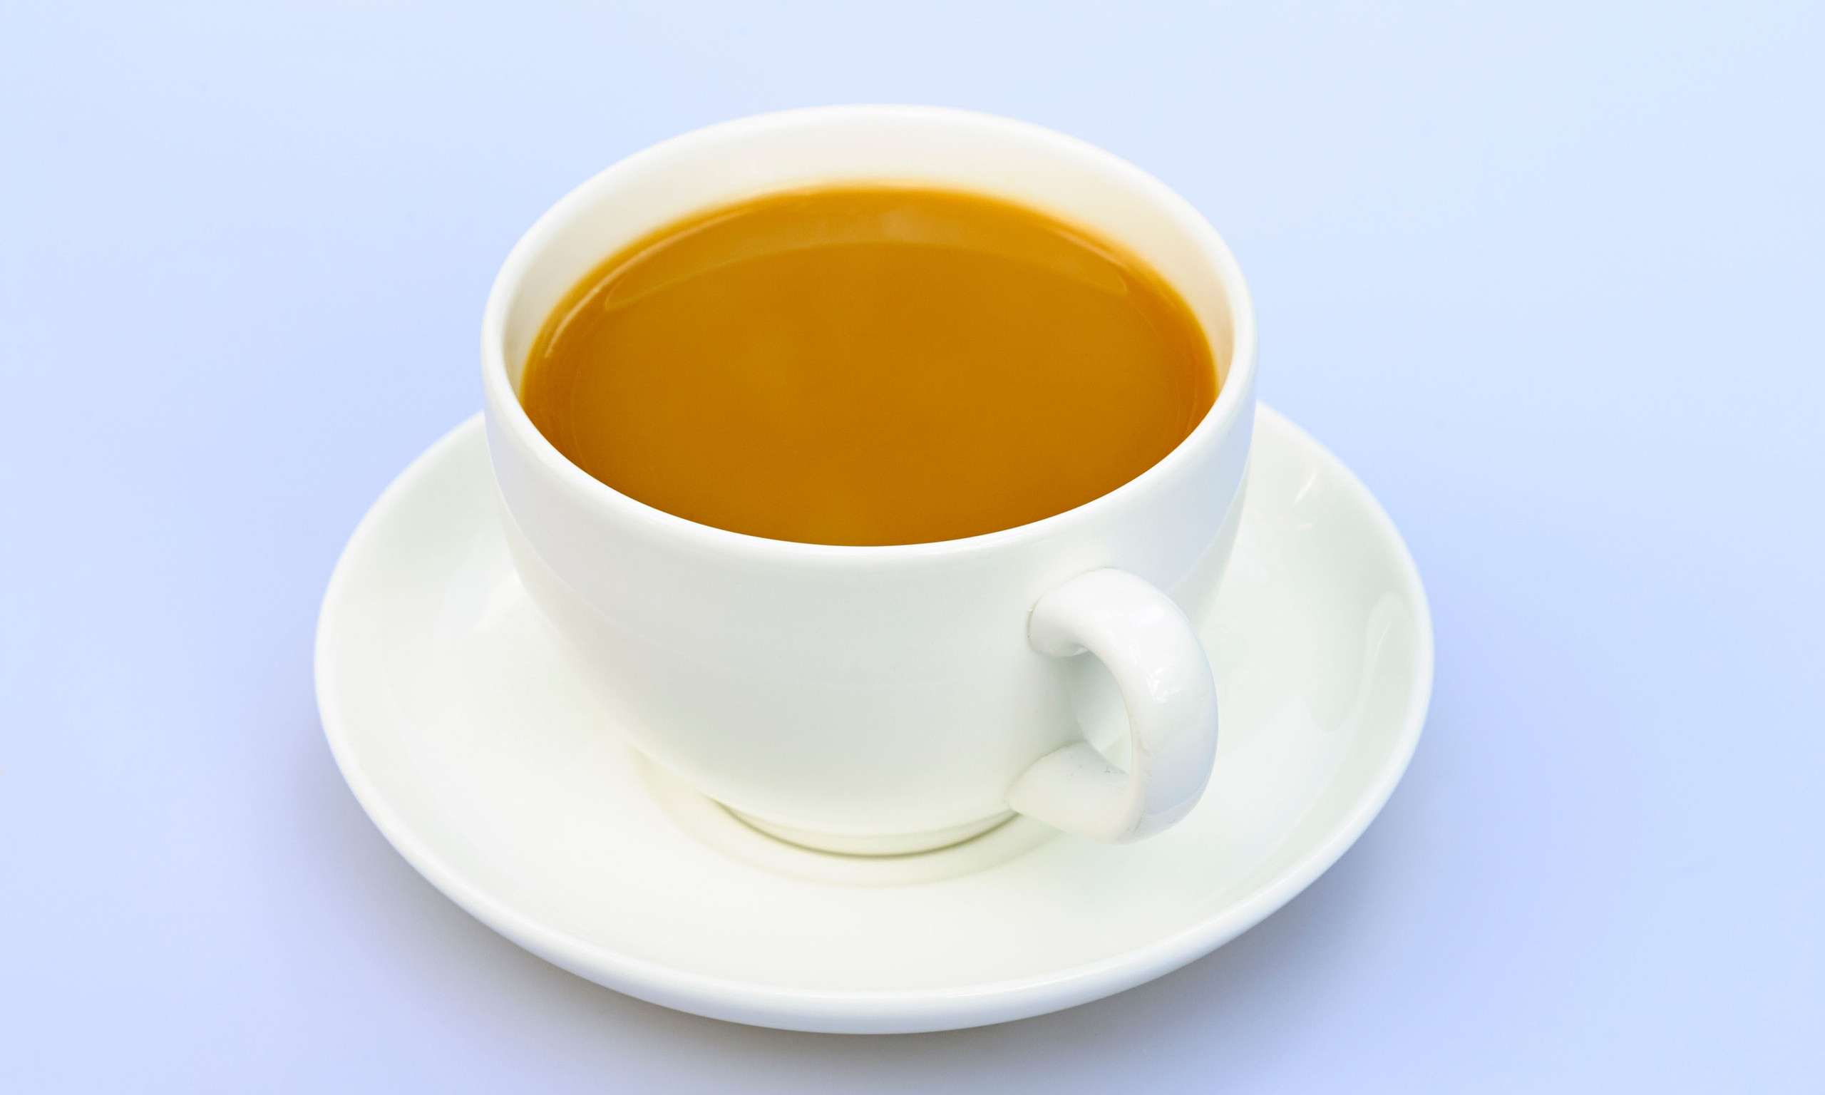

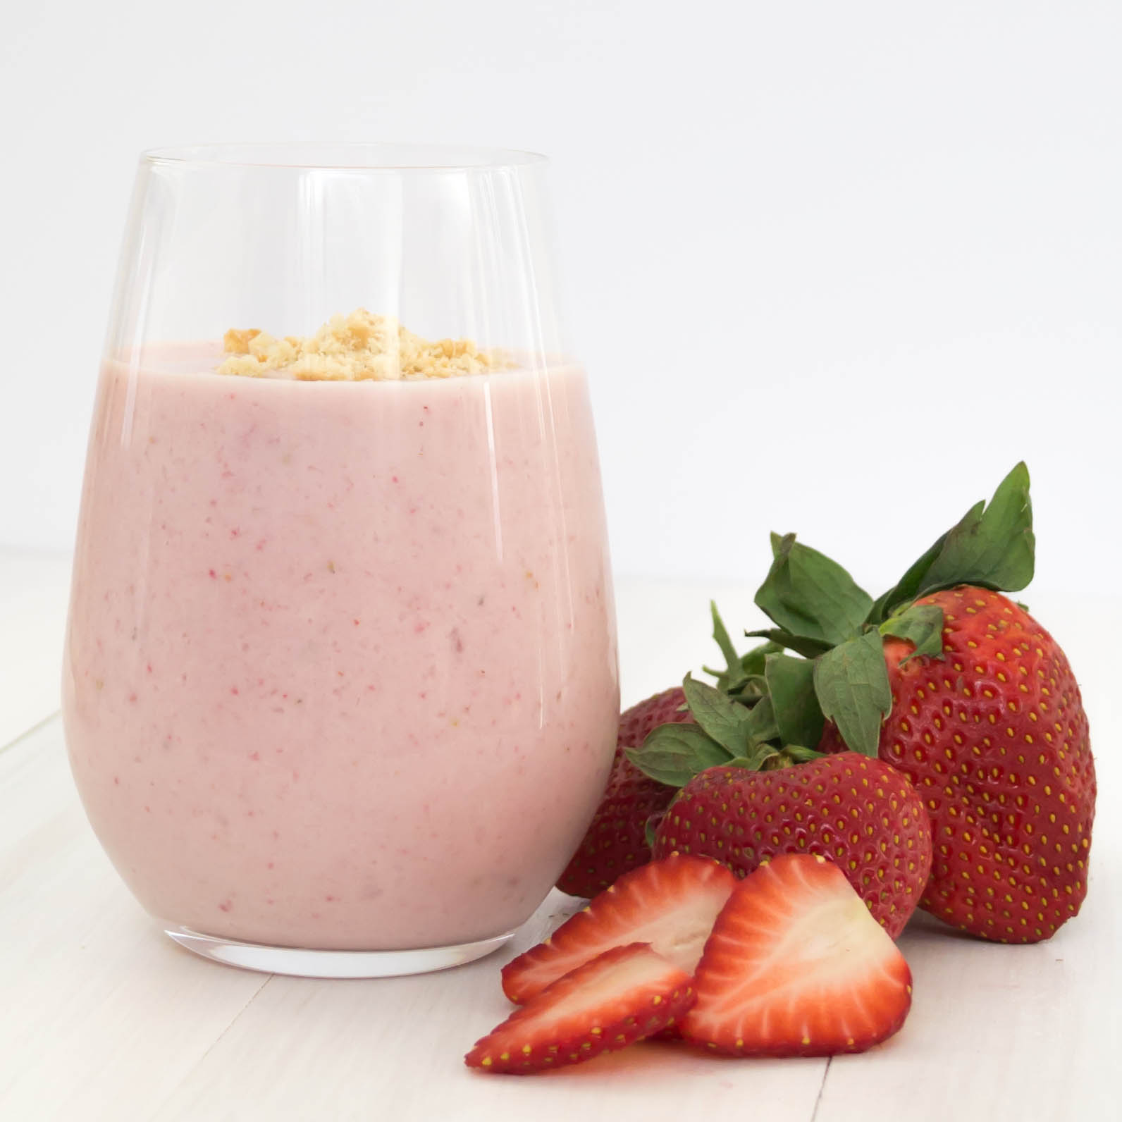
GEIRFA
siocled poeth
ysgytllaeth
Yfed
te
lemonêd
smwddi
coffi

Slide 5
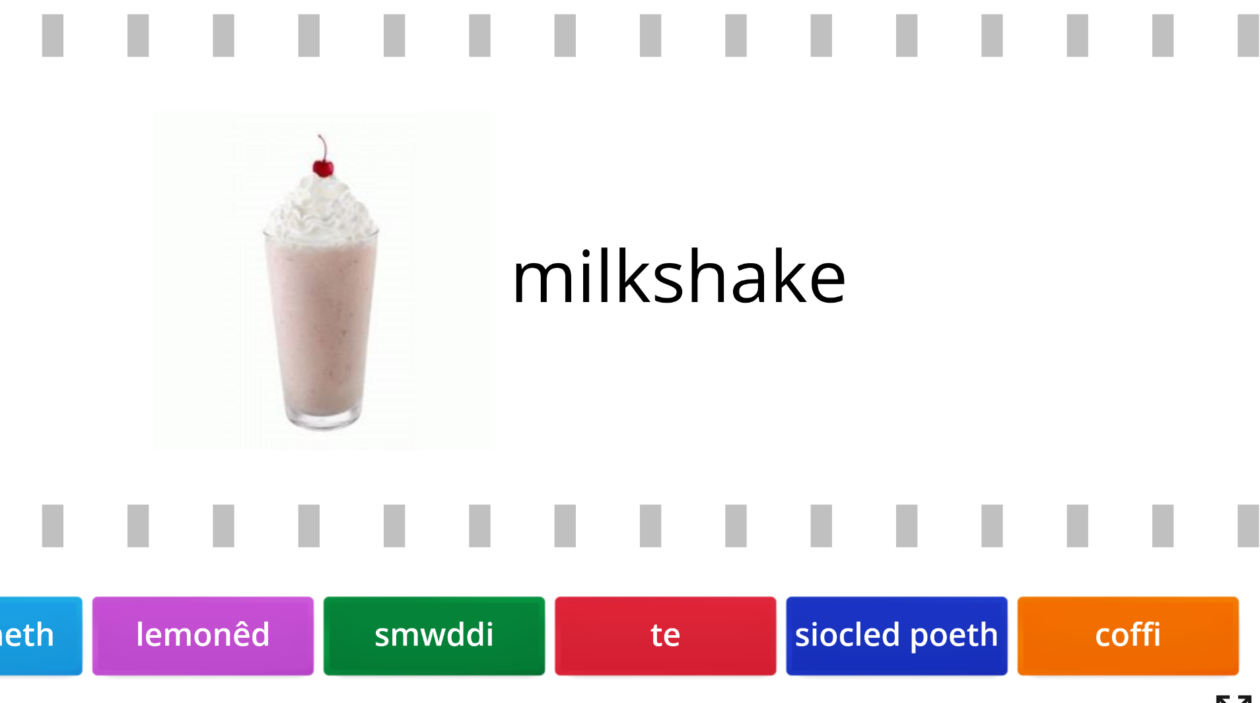
GÊM
Word Wall: Find the match
https://wordwall.net/resource/2581635

Slide 6
CWESTIWN AC ATEB
Dw i’n mwynhau yfed siocled poeth.
Dw i’n mwynhau yfed ysgytllaeth.
Beth wyt ti’n mwynhau yfed?
Dw i’n mwynhau yfed lemonêd.
Dw i’n mwynhau yfed te.
Dw i’n mwynhau yfed
smwddi.
Dw i’n mwynhau
yfed coffi.

Slide 7
CWESTIWN AC ATEB
Dw i’n casáu yfed siocled poeth.
Dw i’n casáu yfed ysgytllaeth.
Beth wyt ti’n casáu yfed?
Dw i’n casáu yfed lemonêd.
Dw i’n casáu yfed te.
Dw i’n casáu
yfed coffi.
Dw i’n casáu yfed
smwddi.

Slide 8
BERF: YFED
Dw i’n hoffi yfed…
I like drinking …
Dw i ddim yn hoffi yfed…
I don’t like drinking …
Dw i’n mwynhau yfed …
I enjoy drinking …
Dw i’n casáu yfed …
I hate drinking …
Dw i’n dwlu ar yfed…
I adore drinking …
Yfais i …
I drank …

Slide 9
DECHRAU BRAWDDEG
Weithiau …
Sometimes …
O dro i dro…
From time to time …

Slide 10

Copyright (c)​
I enjoy
drinking tea.
I enjoy drinking
lemonade
but I hate drinking coffee.
I hate drinking a milkshake but I
enjoy drinking hot chocolate. I like drinking coffee.
I love drinking a smoothie but I don’t like drinking lemonade.
I like drinking tea but sometimes I like drinking coffee.
I enjoy drinking a milkshake but I hate drinking tea.
I like drinking coffee but sometimes I like drinking hot chocolate.
From time to time I like drinking lemonade in the park.
I enjoy drinking hot chocolate but I hate drinking lemonade.
I like drinking a smoothie but sometimes I like drinking a milkshake.
From time to time I like drinking coffe in the park.
I am happy drinking tea in the sun.

Slide 11
Copyright (c)​
Dw i’n
mwynhau
yfed
te.
Dw i’n
mwynhau yfed lemonêd
ond dw i’n casáu yfed coffi.
Dw i’n casáu yfed ysgytllaeth
ond dw i’n mwynhau yfed siocled poeth. Dw
i’n hoffi yfed coffi.
Dw i’n dwlu ar yfed smwddi
ond dw i ddim yn hoffi yfed lemonêd. Dw
i’n hoffi yfed te ond weithiau dw i’n hoffi yfed coffi.
Dw i’n mwynhau yfed ysgytllaeth
ond dw i’n casáu yfed te. Dw
i’n hoffi yfed coffi ond weithiau dw i’n hoffi yfed siocled poeth. O dro i dro dw i’n hoffi
yfed lemonêd yn y parc.
Dw i’n mwynhau yfed siocled poeth
ond dw i’n casáu yfed lemonêd . Dw
i’n hoffi yfed smwddi ond weithiau dw i’n hoffi yfed ysgytllaeth. O dro i dro dw i’n hoffi
yfed coffi yn y parc. Dw i’n hapus yfed te yn yr haul.

