Slide 1
DCF Unplugged - Algorithms
LO:

Slide 2
Objectives
I can follow instructions
I can create a sequence of instructions for people to follow (an algorithm)
I understand that the order of instructions is important

Slide 3
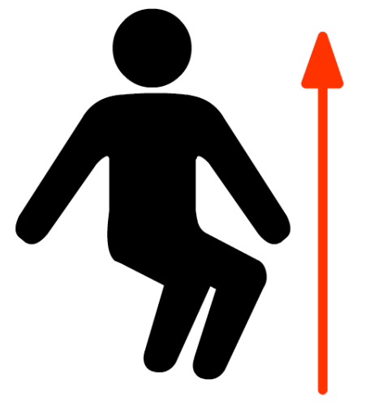
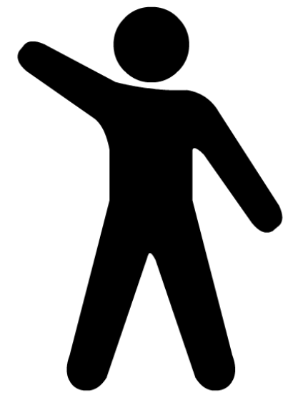
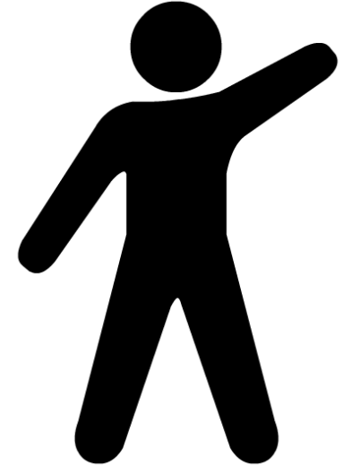
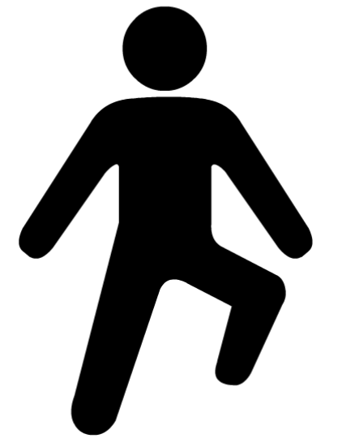
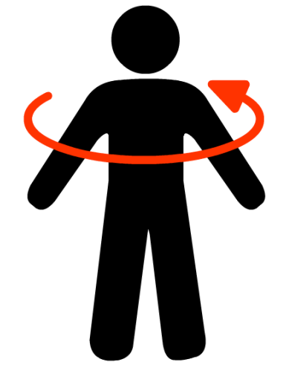
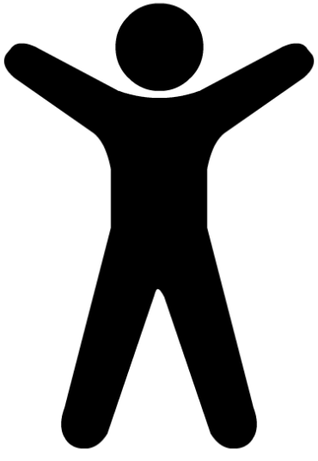
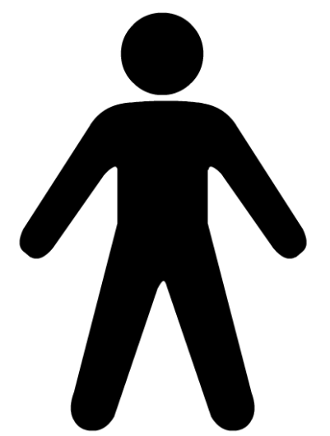
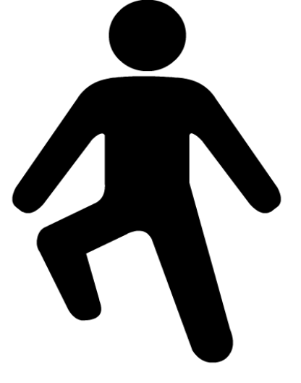
Introduction
Let’s Practice the dance moves

Slide 4
Main Activity
In groups of 3 you are going to create your own dance
Make sure you practice the dance!
Time to perform!
Creating a sequence of instructions is called an algorithm

Slide 5

Extension
Now create a longer sequence and split the sections up between you.

Slide 6
Plenary
What is an algorithm?
Why is the order of your instructions important?
What would happen if you swapped the moves around?

