Slide 1
ages 7-11
An Introduction to variables:
What’s the score?

Slide 2
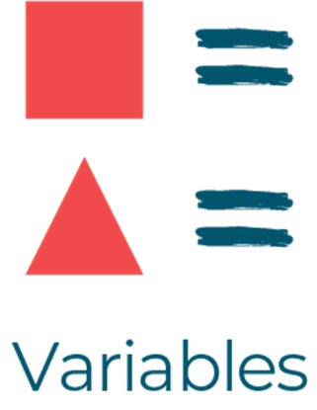
Today we are learning about…
Newidynnau
I can describe what a variable is
I can describe how a score variable is used

Slide 3
Introduction
2 pupils to demonstrate activity
You can play rock paper scissors or quick fire times tables
2 more pupils to track scores on whiteboards (These will act as variables)
Make sure to write the name of the pupils who's score you will be tracking.
Whip of and replace score each time player wins a point.
This is exactly how we name variables in a computer (such as health, username or level)

Slide 4
Main Activity
Get into groups of 5.
You now have 15 mins to play the game in your groups.
Top scores list (this shows how programs will use variables data and store it)
Create and add other variables such as bonus points.

Slide 5
Plenary
In this lesson you have created and stored variables like a programmer would use and create variables on a computer.
Score is just one way computers use variables.
Can you think of any other you may have seen?

Slide 6
Discussion
How did you show whose score you were keeping track of? What did you do when a new player started?
Explain what you did when your player scored a point?
How could you tell how many points your player had?
Notes:
Lead a class discussion using the 5 questions on this slide to review key aspects about variables work. Supporting notes appear below:
Question 1
Answer - We kept track of the names for the variables and changed the names when a new player started.
Teacher notes - Naming variables makes sure that the right information is stored in the right place and we can tell the program to recall the right information when we need it.
Question 2:
Answer - We rubbed off the old score and wrote the new score on to the whiteboard (the variable).
Teacher notes - As programs run they can change the value stored in variables at any time.
Question 3:
Answer - We looked to see what information was stored in the variable.
Teacher notes - A program can look to see what value is in a variable at any time. This doesn’t remove or alter the value in the variable.
Question 4:
Answer - The value in the variable was used to tell when a player had won and to create the class league table.
Teacher notes - Programs can use the data which is stored in variables as they run, for displaying a player’s score for example. This doesn’t remove or alter the value in the variable.
Question 5:
Answer - 0 because each time a new game is started the players start with 0 points.
Teacher notes - When programming it is important to remember to set the starting values for variables (called initialisation). Here, a new player would start with the last player’s high score if we didn’t reset the score variables each time.

