Slide 1


Slide 3
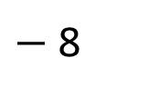
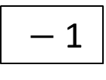
1) Write the missing function in the function machine.
2) Calculate the missing inputs and outputs for the function machine.
Input
Output
36
9
100
25
Input
Output
127
$−$ 8
2
$−$ 1

Slide 4
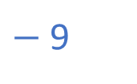
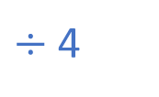
1) Write the missing function in the function machine.
2) Calculate the missing inputs and outputs for the function machine.
Input
Output
36
9
$÷$4
100
25
Input
Output
127
119
10
$−$ 8
2
$−$ 1
$−$ 9

Slide 6

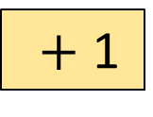
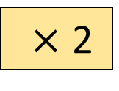
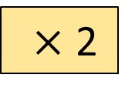
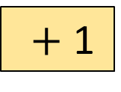
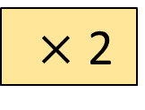



A function machine is a way of writing rules.
Input
Output
3
$×$ 2
$+$ 1
?
7
10
$×$ 2
$+$ 1
?
50
$×$ 2
$+$ 1
?
?
$×$ 2
$+$ 1
11
Have a think

Slide 7

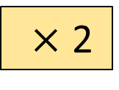
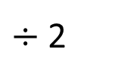
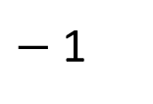
A function machine is a way of writing rules.
Input
Output
3
$×$ 2
$+$ 1
7
10
$×$ 2
$+$ 1
?
21
50
$×$ 2
$+$ 1
?
101
?
5
$×$ 2
$+$ 1
11
$÷$ 2
$−$ 1

Slide 8





Input
Functions
Output
$×$ 2
$+$ 1
$+$ 1
$×$ 2
I wonder if it makes a difference which order the functions are in …
Have a think

Slide 9








Input
Functions
Output
$×$ 2
2
$×$ 2
$+$ 1
3
$+$ 1
1
3
$+$ 1
2
$+$ 1
$×$ 2
4
$×$ 2
1
4

Slide 10
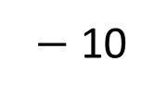
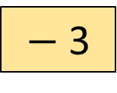
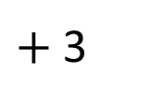
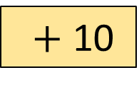
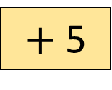
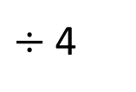
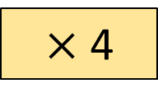
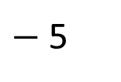
Work out the missing inputs.
Input
Output
1
$+$ 10
$−$ 3
8
$−$ 10
$+$ 3
2
$×$ 4
$+$ 5
13
$÷$ 4
$−$ 5
Have a think

Slide 11
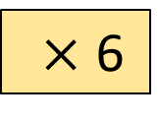
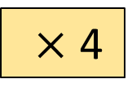
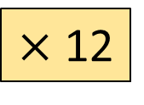

True or False?
These function machines will give the same output if the input is the same.
Output
$×$ 4
$×$ 6
$×$ 2
$×$ 12
Have a think

Slide 12
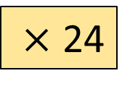
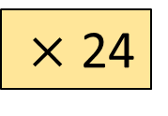
True or False?
These function machines will give the same output if the input is the same.
$×$ 24
Output
2
$×$ 4
$×$ 6
48
2
$×$ 2
$×$ 12
48
$×$ 24

Slide 13


Eva is ordering some crayons online. She needs to buy 22 crayons altogether.
How much will it cost for 22 crayons including delivery?
30p each
£1.60 to deliver
Create a function machine to help you.
Have a think

Slide 14
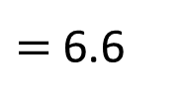
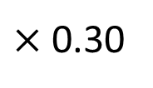
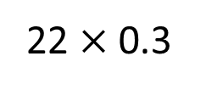
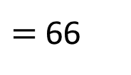
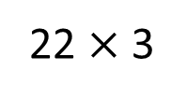
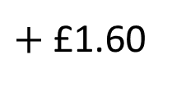
Eva is ordering some crayons online. She needs to buy 22 crayons altogether.
How much will it cost for 22 crayons including delivery?
£8.20
30p each
£1.60 to deliver
Input
Output
22
$×$ 0.30
$+$ £1.60
£8.20
£6.60
22 $×$ 3
$=$ 66
22 $×$ 0.3
$=$ 6.6

Slide 15
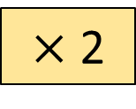
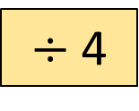
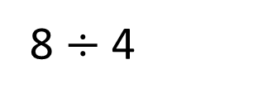
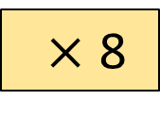
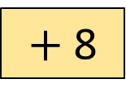
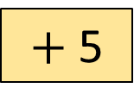
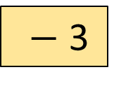
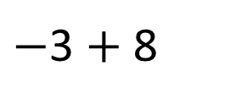
For each function machine, write a single step that would give the same output.
8 $÷$ 4
Output
$×$ 2
$×$ 8
$÷$ 4
$−$ 3
$+$ 8
$−$3 $+$ 8
$+$ 5
Have a think

