Slide 1


Slide 3
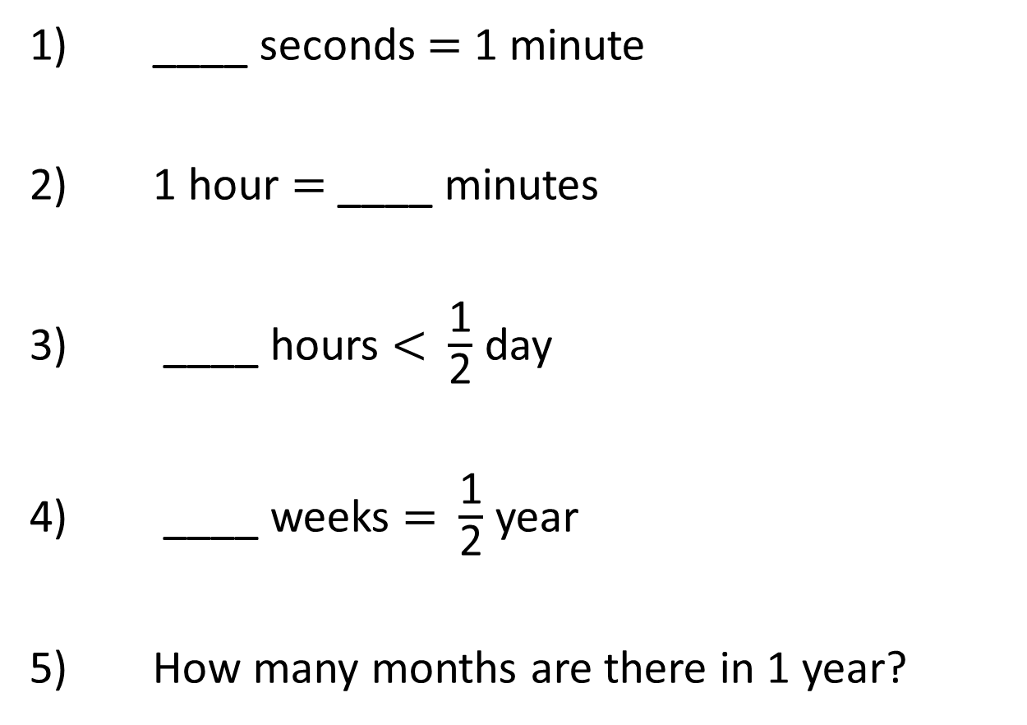
1) ____ seconds $=$ 1 minute
2) 1 hour $=$ ____ minutes
3) ____ hours $<$ $\frac{\text{1}}{\text{2}}$ day
4) ____ weeks $=$ $\frac{\text{1}}{\text{2}}$ year
5) How many months are there in 1 year?

Slide 4
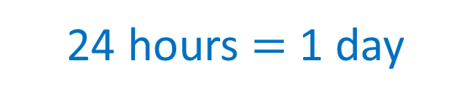

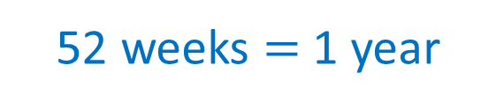
60
1) ____ seconds $=$ 1 minute
2) 1 hour $=$ ____ minutes
3) ____ hours $<$ $\frac{\text{1}}{\text{2}}$ day
4) ____ weeks $=$ $\frac{\text{1}}{\text{2}}$ year
5) How many months are there in 1 year?
60
24 hours $=$ 1 day
0 - 11
12 hours $=$ $\frac{\text{1}}{\text{2}}$ day
26
52 weeks $=$ 1 year
12

Slide 6
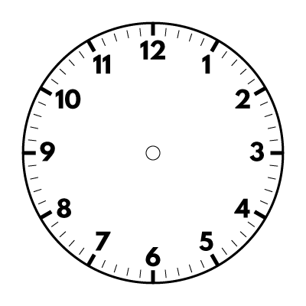
How can you put the units of measurements for time in order?
What units of measure are there for measuring time?

Slide 7
Complete the sentences.
60
There are __ seconds in a minute.
60
There are __ minutes in a hour.
24
There are __ hours in a day.
7
There are __ days in a week.
365
There are ___ days in a year.
52
There are __ weeks in a year.
12
There are __ months in a year.

Slide 8





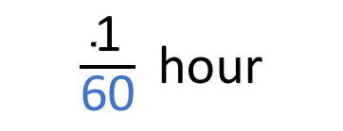

60 seconds
$$=$$
1 minute
60 minutes
$$=$$
1 hour
Have a think
120 seconds
$$=$$
2 minutes
360 seconds
$$=$$
6 minutes
1 minute
$\frac{\text{1}}{\text{60}}$hour
$$=$$
30 minutes
$$=$$
0.5 hours

Slide 9
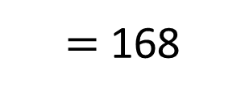
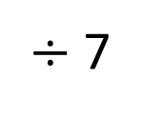



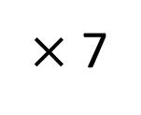
$÷$ 7
7 days
$$=$$
1 week
$×$ 7
Have a think
How can you convert from days to weeks?
7
14
28
98
140
147
294
days
weeks
1
2
4
14
20
21
42
1 week
$$=$$
168 hours
24 hours
$=$ 168
$×$ 7

Slide 10
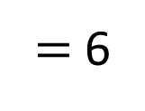

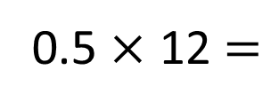
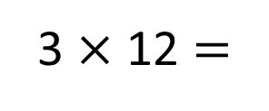
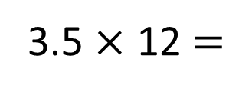
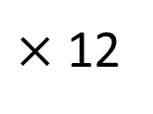
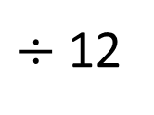
Complete the double number line.
12
36
42
120
months
years
1
3
3.5
10
$÷$ 12
12 months
$$=$$
1 year
$×$ 12
3.5 $×$ 12 $=$
3 $×$ 12 $=$
36
0.5 $×$ 12 $=$
half of 12
$=$ 6
Have a think

Slide 11
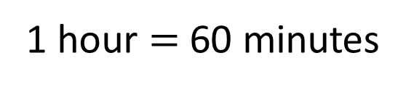
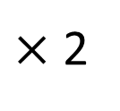
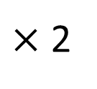
Complete the conversions.
1 hour $=$ 60 minutes
Hours | Minutes
2 hours
2.5 hours
 | 240 minutes
10 hours
12.5 hours
120 minutes
$×$ 2
150 minutes
$×$ 2
4 hours
600 minutes
750 minutes
Have a think

