Slide 1


Slide 3







Match each number to a description.
Each number can be matched with more than one description.
$\frac{\text{1}}{\text{3}}$
$\frac{\text{9}}{\text{2}}$
$\frac{\text{8}}{\text{3}}$
$\frac{\text{4}}{\text{7}}$
$\frac{\text{2}}{\text{5}}$
$\text{2}$
$\text{7}$
Non-unit fraction
Unit fraction
Improper fraction
Proper fraction
Less than 1
Mixed number
Greater than 1
Incorrectly written

Slide 4
Match each number to a description.
Each number can be matched with more than one description.
$\frac{\text{1}}{\text{3}}$
$\frac{\text{9}}{\text{2}}$
$\frac{\text{8}}{\text{3}}$
$\frac{\text{4}}{\text{7}}$
$\frac{\text{2}}{\text{5}}$
$\text{2}$
$\text{7}$
Non-unit fraction
Unit fraction
Improper fraction
Proper fraction
Less than 1
Mixed number
Greater than 1
Incorrectly written

Slide 5
Match each number to a description.
Each number can be matched with more than one description.
$\frac{\text{1}}{\text{3}}$
$\frac{\text{9}}{\text{2}}$
$\frac{\text{8}}{\text{3}}$
$\frac{\text{4}}{\text{7}}$
$\frac{\text{2}}{\text{5}}$
$\text{2}$
$\text{7}$
Non-unit fraction
Unit fraction
Improper fraction
Proper fraction
Less than 1
Mixed number
Greater than 1
Incorrectly written

Slide 6




Match each number to a description.
Each number can be matched with more than one description.
$\frac{\text{2}}{\text{3}}$
$\frac{\text{1}}{\text{3}}$
$\frac{\text{9}}{\text{2}}$
$\frac{\text{8}}{\text{3}}$
$\frac{\text{4}}{\text{7}}$
$\frac{\text{2}}{\text{5}}$
$\text{4}$
$\text{2}$
$\text{7}$
Non-unit fraction
Unit fraction
Improper fraction
Proper fraction
Less than 1
Mixed number
Greater than 1
Incorrectly written

Slide 7
Match each number to a description.
Each number can be matched with more than one description.
$\frac{\text{1}}{\text{3}}$
$\frac{\text{9}}{\text{2}}$
$\frac{\text{8}}{\text{3}}$
$\frac{\text{4}}{\text{7}}$
$\frac{\text{2}}{\text{5}}$
$\text{2}$
$\text{7}$
Non-unit fraction
Unit fraction
Improper fraction
Proper fraction
Less than 1
Mixed number
Greater than 1
Incorrectly written

Slide 8
Match each number to a description.
Each number can be matched with more than one description.
$\frac{\text{1}}{\text{3}}$
$\frac{\text{9}}{\text{2}}$
$\frac{\text{8}}{\text{3}}$
$\frac{\text{4}}{\text{7}}$
$\frac{\text{2}}{\text{5}}$
$\text{2}$
$\text{7}$
Non-unit fraction
Unit fraction
Improper fraction
Proper fraction
Less than 1
Mixed number
Greater than 1
Incorrectly written

Slide 10








$$\frac{\text{4}}{\text{5}}$$
2 $\frac{\text{1}}{\text{5}}$ $+$ 3 $\frac{\text{3}}{\text{5}}$ $=$
$$\frac{\text{29}}{\text{5}}$$
$$=$$
5
2 $\frac{1}{5}$ $=$ $\frac{11}{5}$
3 $\frac{3}{5}$ $=$ $\frac{18}{5}$
$\frac{11}{5}$ $+$ $\frac{18}{5}$ $=$ $\frac{29}{5}$
I’m going to convert both mixed numbers to improper fractions first

Slide 11

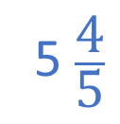



2 $\frac{\text{1}}{\text{5}}$ $+$ 3 $\frac{\text{3}}{\text{5}}$ $=$
5 $\frac{\text{4}}{\text{5}}$
I’m going to add my whole numbers and fractions separately.
The mixed numbers can be partitioned into a whole part and a fractional part.
2 $+$ 3 $=$ 5
$\frac{\text{1}}{\text{5}}$ $+$ $\frac{\text{3}}{\text{5}}$ $=$ $\frac{\text{4}}{\text{5}}$

Slide 12


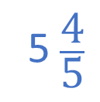
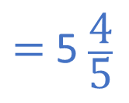






I’m going to convert them both to improper fractions first
2 $\frac{\text{1}}{\text{5}}$ $=$ $\frac{\text{1}\text{1}}{\text{5}}$
3 $\frac{\text{3}}{\text{5}}$ $=$ $\frac{\text{18}}{\text{5}}$
$\frac{\text{11}}{\text{5}}$ $+$ $\frac{\text{18}}{\text{5}}$ $=$
$$\frac{\text{29}}{\text{5}}$$
$=$ 5 $\frac{\text{4}}{\text{5}}$
I’m going to add my whole numbers and fractions separately.
2 $+$ 3 $=$ 5
$\frac{\text{1}}{\text{5}}$ $+$ $\frac{\text{3}}{\text{5}}$ $=$ $\frac{\text{4}}{\text{5}}$
2 $\frac{\text{1}}{\text{5}}$ $+$ 3 $\frac{\text{3}}{\text{5}}$ $=$
5 $\frac{\text{4}}{\text{5}}$
Have a think
Whose method do you prefer? Why?

Slide 13
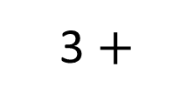

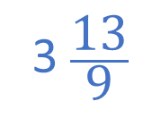

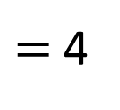



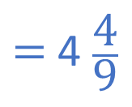


Have a think
$=$ 4 $\frac{\text{4}}{\text{9}}$
1 $\frac{\text{2}}{\text{3}}$ $+$ 2 $\frac{\text{7}}{\text{9}}$ $=$
3 $\frac{\text{13}}{\text{9}}$
$=$ 4
$$\frac{\text{4}}{\text{9}}$$
1 $+$ 2
$\frac{\text{2}}{\text{3}}$ $+$ $\frac{\text{7}}{\text{9}}$
3 $+$
$\frac{\text{6}}{\text{9}}$ $+$ $\frac{\text{7}}{\text{9}}$
$$=$$
$$3 \frac{\text{13}}{\text{9}}$$
The fractional part of the answer is an improper fraction, so needs converting to a mixed number.
The mixed numbers can be partitioned into a whole part and a fractional part.
I will make the denominators 9

Slide 14


Have a think
$$\frac{\text{1}}{\text{15}}$$
2 m
$$\frac{\text{4}}{\text{5}}$$
1 m
In this rectangle each longer side is longer than each shorter side.
What is the perimeter of the rectangle?

Slide 15













$$\frac{\text{1}}{\text{15}}$$
2 m
$$\frac{\text{1}}{\text{15}}$$
$$\frac{\text{4}}{\text{5}}$$
$$\frac{\text{13}}{\text{15}}$$
$$\frac{\text{12}}{\text{15}}$$
2
+
1
=
3
m
$$\frac{\text{13}}{\text{15}}$$
3
m
$$\frac{\text{1}}{\text{15}}$$
2 m
$$\frac{\text{4}}{\text{5}}$$
1 m
In this rectangle each longer side is longer than each shorter side.
What is the perimeter of the rectangle?
$$\frac{\text{1}}{\text{15}}$$
$$\frac{\text{1}}{\text{15}}$$
$$\frac{\text{13}}{\text{15}}$$
$$\frac{\text{28}}{\text{15}}$$
2
+
$$\frac{\text{13}}{\text{15}}$$
$$\frac{\text{13}}{\text{15}}$$
11
2
+
3
+
3
=
10
m

Slide 16
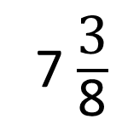
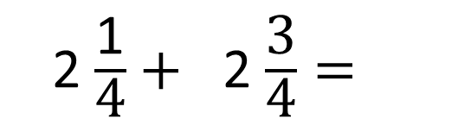

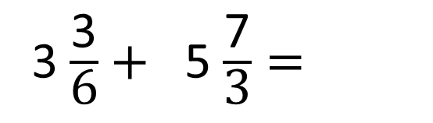
2
1
1
2
2 $\frac{\text{1}}{\text{4}}+$ 2 $\frac{\text{3}}{\text{4}}=$
3
7 $\frac{\text{3}}{\text{8}}$
6
1
5
4
2
4
3 $\frac{\text{3}}{\text{6}}+$ 5 $\frac{\text{7}}{\text{3}}=$
$\frac{\text{7}}{\text{6}} =$
6
Have a think

Slide 17

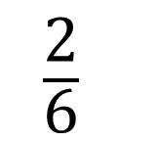
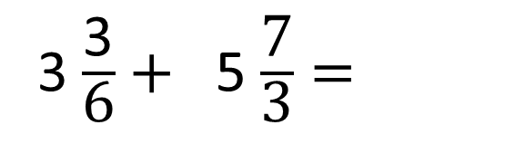
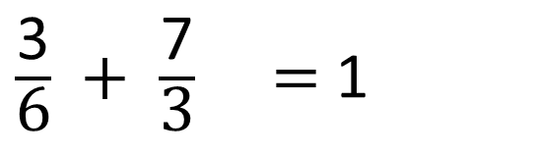
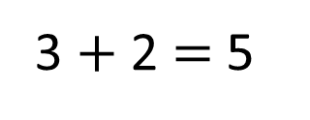
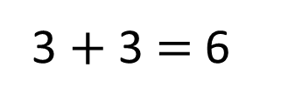
4
1
36
3 $\frac{\text{3}}{\text{6}}+$ 5 $\frac{\text{7}}{\text{3}}=$
3
$\frac{\text{7}}{\text{6}} =$
2
6
3 $+$ 2 $=$ 5
3 $+$ 3 $=$ 6
4
1
$\frac{\text{3}}{\text{6}} +$ $\frac{\text{7}}{\text{3}} =$ 1
$\frac{\text{2}}{\text{6}}$

