Slide 1


Slide 3
Find the common factors of 12 and 18
2) What fraction of the bar is shaded orange?
3) What fraction of the bar is shaded blue?
4) What do you notice?

Slide 4
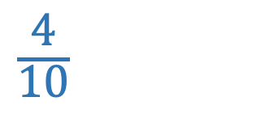
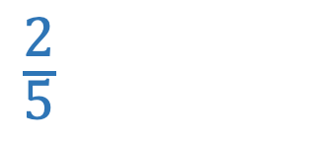
Find the common factors of 12 and 18
2) What fraction of the bar is shaded orange?
3) What fraction of the bar is shaded blue?
4) What do you notice?
Factors of 12: 1, 2, 3, 4, 6, 12
Factors of 18: 1, 2, 3, 6, 9, 18
$\frac{\text{2}}{\text{5}}$
$\frac{\text{4}}{\text{10}}$
The same amount of the bar is shaded
The fractions are equivalent

Slide 6

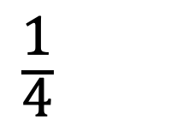
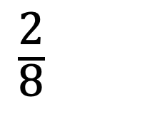
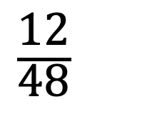
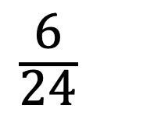
What do you notice about these fractions?
$\frac{\text{2}}{\text{8}}$
$\frac{\text{12}}{\text{48}}$
$\frac{\text{1}}{\text{4}}$
$\frac{\text{6}}{\text{24}}$
equivalent
These fractions are all __________
Have a think
Which fraction is in its simplest form?

Slide 7
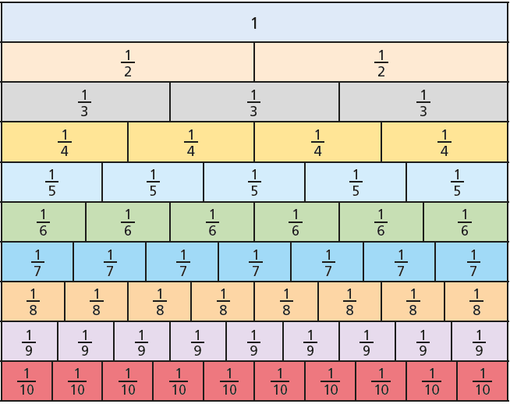
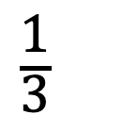
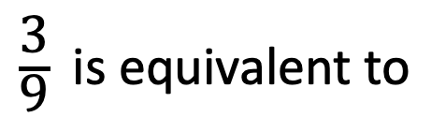
$\frac{\text{3}}{\text{9}}$ is equivalent to
$\frac{\text{1}}{\text{3}}$

Slide 8

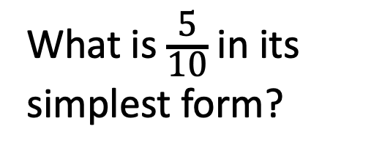
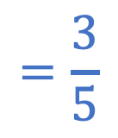
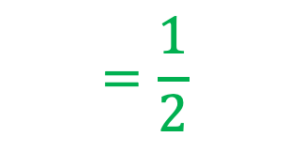
Use the fraction wall to simplify
Have a think
What is $\frac{\text{5}}{\text{10}}$ in its simplest form?
$$\frac{\text{5}}{\text{10}} \frac{\text{6}}{\text{10}} \frac{\text{5}}{\text{7}}$$
$$=\frac{\text{1}}{\text{2}}$$
$$=\frac{\text{3}}{\text{5}}$$

Slide 9
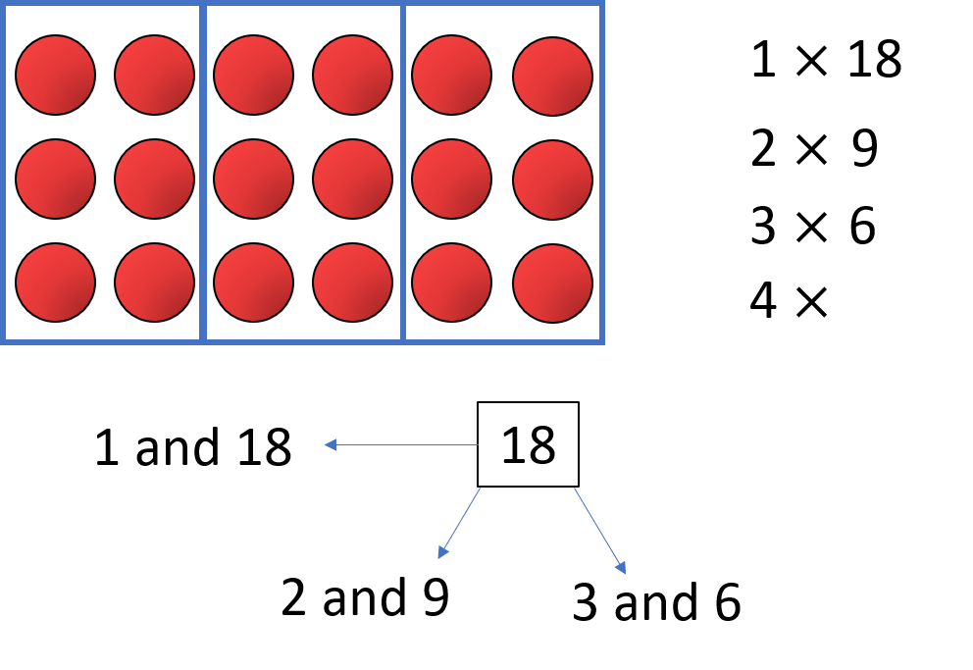

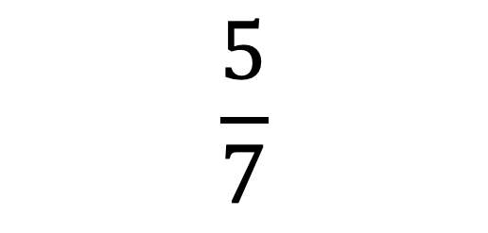


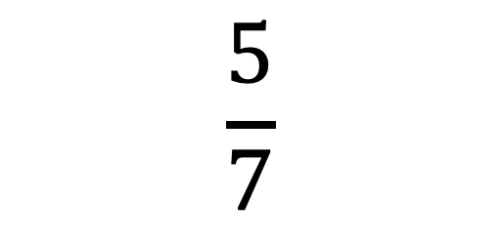
$÷$ 1
$$\frac{\text{5}}{\text{7}}$$
$$\frac{\text{5}}{\text{7}}$$
$$=$$
$÷$ 1
Factors of 5
Factors of 7
1
1
5
7

Slide 10
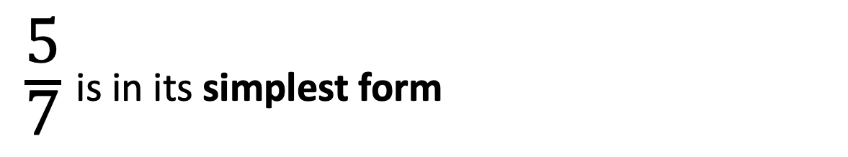
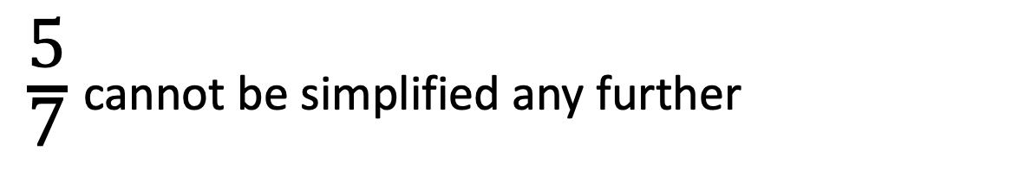
$\frac{\text{5}}{\text{7}}$ cannot be simplified any further
$\frac{\text{5}}{\text{7}}$ is in its simplest form
A fraction is in its simplest form if the numerator and denominator have no common factors other than one.

Slide 11
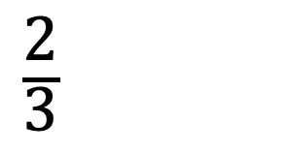
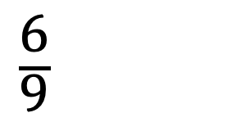
$\frac{\text{6}}{\text{9}}$
$\frac{\text{2}}{\text{3}}$

Slide 12

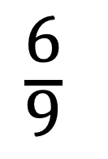



$÷$ 3
$\frac{\text{6}}{\text{9}}$
$\frac{\text{2}}{\text{3}}$
$$=$$
$÷$ 3
What are the common factors of 6 and 9?
Factors of 6: 1, 2, 3, 6
Factors of 9: 1, 3, 9

Slide 13
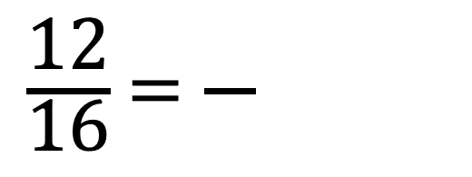
Have a think
Simplify the fraction using the bar models.
$\frac{\text{12}}{\text{16}}$ $=\frac{}{}$

Slide 14
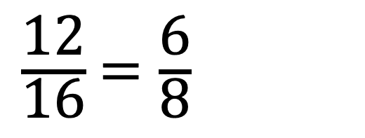
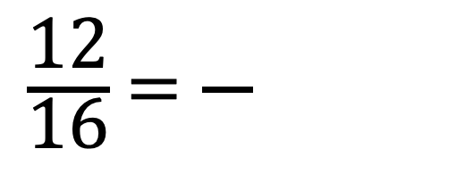
Simplify the fraction using the bar models.
$\frac{\text{12}}{\text{16}}$ $=\frac{\text{6}}{\text{8}}$
$\frac{\text{12}}{\text{16}}$ $=\frac{}{}$

Slide 15
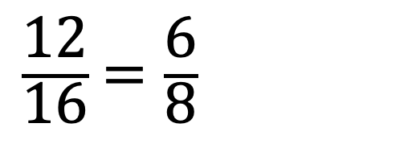
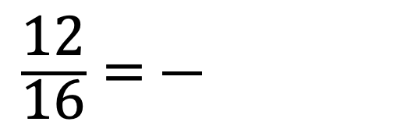
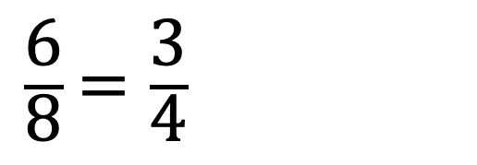
Simplify the fraction using the bar models.
$\frac{\text{12}}{\text{16}}=\frac{}{}$
$\frac{\text{12}}{\text{16}}$ $=\frac{\text{6}}{\text{8}}$
$\frac{\text{6}}{\text{8}}$ $=\frac{\text{3}}{\text{4}}$

Slide 16
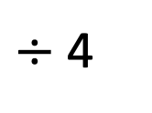
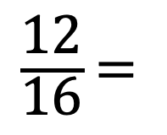
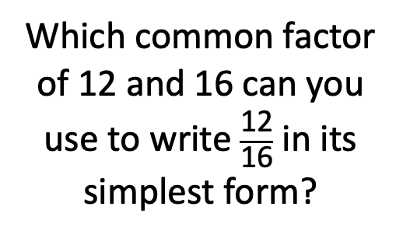
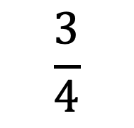
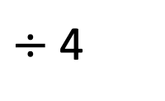
Simplify the fraction using the bar models.
$÷$ 4
Which common factor of 12 and 16 can you use to write $\frac{\text{12}}{\text{16}}$ in its simplest form?
Factors of 12: 1, 2, 3, 4, 6, 12
$\frac{\text{12}}{\text{16}}$ $=$
$$\frac{\text{3}}{\text{4}}$$
Factors of 16: 1, 2, 4, 8, 16
$÷$ 4

Slide 17


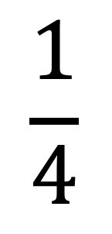


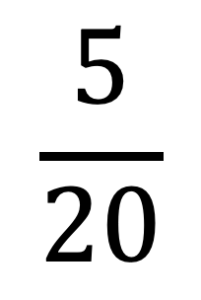
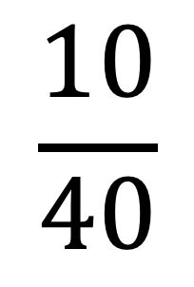
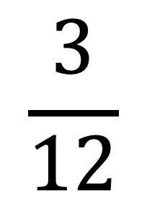
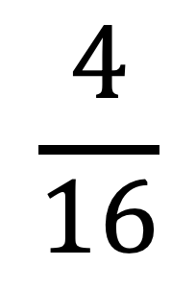
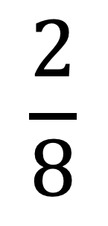
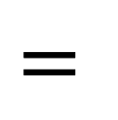
Have a think
$$\frac{\text{1}}{\text{4}}$$
$$\frac{\text{2}}{\text{8}}$$
$$\frac{\text{3}}{\text{12}}$$
$$\frac{\text{5}}{\text{20}}$$
$$\frac{\text{?}}{\text{?}}$$
$$\frac{\text{4}}{\text{16}}$$
$$\frac{\text{10}}{\text{40}}$$
$$=$$
$$=$$
$$=$$
$$=$$

Slide 18
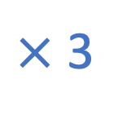
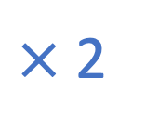
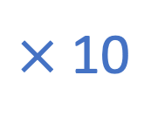

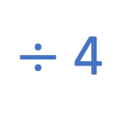

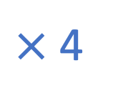
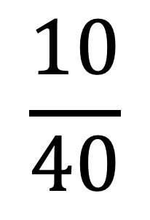

Have a think
What do you notice?
$×$ 2
$×$ 3
$×$ 5
$×$ 10
$$\frac{\text{1}}{\text{4}}$$
$$\frac{\text{2}}{\text{8}}$$
$$\frac{\text{3}}{\text{12}}$$
$$\frac{\text{5}}{\text{20}}$$
$$\frac{\text{10}}{\text{40}}$$
$×$ 4
$$=$$
$$=$$
$$=$$
$$=$$
$÷$ 4
$×$ 2
$×$ 3
$×$ 5
$×$ 10

Slide 19


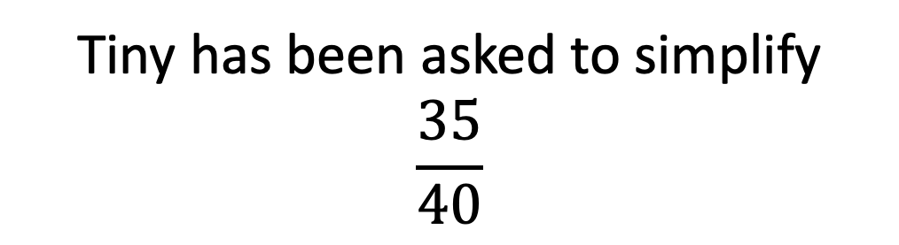
Tiny has been asked to simplify
$$\frac{\text{35}}{\text{40}}$$
$$\frac{\text{35}}{\text{40}}=\frac{\text{7}}{\text{10}}$$
Is Tiny correct?
Have a think

Slide 20
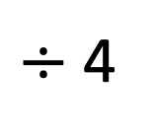

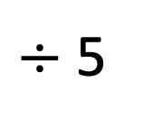


Tiny has been asked to simplify
$$\frac{\text{35}}{\text{40}}$$
$÷$ 5
$÷$ 5
$$\frac{\text{35}}{\text{40}}=\frac{\text{7}}{\text{10}}$$
$$\frac{\text{35}}{\text{40}}=\frac{}{}$$
$$\frac{\text{35}}{\text{40}}=\frac{\text{7}}{\text{8}}$$
$÷$ 4
$÷$ 5
Factors of 35: 1, 5, 7, 35
Factors of 40: 1, 2, 4, 5, 8, 10, 20, 40

Slide 21


Slide 23










1) Complete the number line.
2) a) 3 ones $+$ 3 ones $+$ 3 ones $+$ 3 ones $=$
b) 3 fifths $+$ 3 fifths $+$ 3 fifths $+$ 3 fifths $=$
c)
Write your answer as a mixed number.
0
1
2
$\frac{\text{3}}{\text{5}}$
$\frac{\text{3}}{\text{5}}$
$\frac{\text{3}}{\text{5}}$
$\frac{\text{3}}{\text{5}}$
$$+$$
$$+$$
$$+$$
$$=$$

Slide 24






1) Complete the number line.
2) a) 3 ones $+$ 3 ones $+$ 3 ones $+$ 3 ones $=$
b) 3 fifths $+$ 3 fifths $+$ 3 fifths $+$ 3 fifths $=$
c)
Write your answer as a mixed number.
0
$\frac{\text{1}}{\text{2}}$
1
1 $\frac{\text{1}}{\text{2}}$
2
2 $\frac{\text{1}}{\text{2}}$
12 ones
12 fifths
$\frac{\text{3}}{\text{5}}$
$\frac{\text{3}}{\text{5}}$
$\frac{\text{3}}{\text{5}}$
$\frac{\text{3}}{\text{5}}$
$\frac{\text{12}}{\text{5}}$
$$+$$
$$+$$
$$+$$
$$=$$
2 $\frac{\text{2}}{\text{5}}$

Slide 26







Label each interval on the number line
1
$\frac{\text{1}}{\text{6}}$
$$÷$$
6
0
$\frac{\text{2}}{\text{6}}$
$\frac{\text{3}}{\text{6}}$
$\frac{\text{4}}{\text{6}}$
$\frac{\text{5}}{\text{6}}$
1

Slide 27





Label each interval on the number line
1
$\frac{\text{1}}{\text{3}}$
$$÷$$
3
0
$\frac{\text{2}}{\text{3}}$
1
1 $\frac{\text{1}}{\text{3}}$
1 $\frac{\text{2}}{\text{3}}$
2

Slide 28










Label each interval on the number line
2
$\frac{\text{2}}{\text{8}}$
$\frac{\text{1}}{\text{4}}$
Have a think
$$÷$$
8
1
$$÷$$
4
$\frac{\text{2}}{\text{4}}$
$\frac{\text{3}}{\text{4}}$
1 $\frac{\text{1}}{\text{4}}$
1 $\frac{\text{2}}{\text{4}}$
1 $\frac{\text{3}}{\text{4}}$
0
$\frac{\text{4}}{\text{8}}$
1
2

Slide 29













Where would this representation go on the number line?
$\frac{\text{1}}{\text{3}}$
0
$\frac{\text{1}}{\text{9}}$
$\frac{\text{2}}{\text{9}}$
$\frac{\text{3}}{\text{9}}$
$\frac{\text{4}}{\text{9}}$
$\frac{\text{5}}{\text{9}}$
$\frac{\text{6}}{\text{9}}$
$\frac{\text{7}}{\text{9}}$
$\frac{\text{8}}{\text{9}}$
1
$×$ 3
$\frac{\text{1}}{\text{3}}$
$$=$$
$\frac{\text{3}}{\text{9}}$
$×$ 3

Slide 30








Fill in the missing boxes.
$+$ $\frac{\text{3}}{\text{5}}$
$+$ $\frac{\text{3}}{\text{5}}$
$+$ $\frac{\text{3}}{\text{5}}$
1 $\frac{\text{6}}{\text{5}}$
0
$\frac{\text{2}}{\text{5}}$
1 $\frac{\text{3}}{\text{5}}$
2 $\frac{\text{1}}{\text{5}}$
1

Slide 31


Slide 32







Question 5
A
B
C
D
E
$\frac{\text{1}}{\text{10}}$
$\frac{\text{2}}{\text{10}}$
$\frac{\text{8}}{\text{10}}$
A $=$
$\frac{\text{2}}{\text{10}}$
$=$ $\frac{\text{1}}{\text{5}}$

Slide 33




B
C
D
E
$\frac{\text{2}}{\text{10}}$
$\frac{\text{8}}{\text{10}}$
A $=$
$\frac{\text{2}}{\text{10}}$
$=$ $\frac{\text{1}}{\text{5}}$
B $=$
$\frac{\text{6}}{\text{10}}$
$=$ $\frac{\text{3}}{\text{5}}$

Slide 34





C
D
E
$\frac{\text{8}}{\text{10}}$
1 $\frac{\text{2}}{\text{10}}$
A $=$
$\frac{\text{2}}{\text{10}}$
$=$ $\frac{\text{1}}{\text{5}}$
$\frac{\text{6}}{\text{10}}$
$=$ $\frac{\text{3}}{\text{5}}$
B $=$
$\frac{\text{4}}{\text{10}}$
$=$ $\frac{\text{2}}{\text{5}}$
C $=$

Slide 35










D
E
1 $\frac{\text{4}}{\text{20}}$
1 $\frac{\text{19}}{\text{20}}$
1 $\frac{\text{2}}{\text{10}}$
$÷$ 5
$\frac{\text{2}}{\text{10}}$
$=$ $\frac{\text{1}}{\text{5}}$
D $=$
$\frac{\text{15}}{\text{20}}$
$\frac{\text{3}}{\text{4}}$
A $=$
$\frac{\text{6}}{\text{10}}$
$=$ $\frac{\text{3}}{\text{5}}$
$÷$ 5
B $=$
$\frac{\text{4}}{\text{10}}$
$=$ $\frac{\text{2}}{\text{5}}$
E $=$
$\frac{\text{1}}{\text{20}}$
C $=$

