Slide 1


Slide 2
1) What fraction of each shape is shaded?
2) How many sevenths are there in one?
3) How many tenths are there in two?

Slide 3



1) What fraction of each shape is shaded?
$$\frac{\text{5}}{\text{9}}$$
$$\frac{\text{1}}{\text{4}}$$
$$\frac{\text{1}}{\text{1}}$$
or 1
2) How many sevenths are there in one?
7
3) How many tenths are there in two?
20

Slide 5













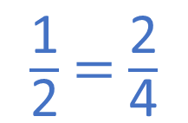








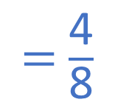
$\frac{\text{1}}{\text{2}}$
$\frac{\text{1}}{\text{2}}$
$\frac{\text{1}}{\text{4}}$
$\frac{\text{1}}{\text{4}}$
$\frac{\text{1}}{\text{4}}$
$\frac{\text{1}}{\text{4}}$
$\frac{\text{1}}{\text{6}}$
$\frac{\text{1}}{\text{6}}$
$\frac{\text{1}}{\text{6}}$
$\frac{\text{1}}{\text{6}}$
$\frac{\text{1}}{\text{6}}$
$\frac{\text{1}}{\text{6}}$
$\frac{\text{1}}{\text{8}}$
$\frac{\text{1}}{\text{8}}$
$\frac{\text{1}}{\text{8}}$
$\frac{\text{1}}{\text{8}}$
$\frac{\text{1}}{\text{8}}$
$\frac{\text{1}}{\text{8}}$
$\frac{\text{1}}{\text{8}}$
$\frac{\text{1}}{\text{8}}$
$\frac{\text{1}}{\text{2}}$ $=$ $\frac{\text{2}}{\text{4}}$
$=$ $\frac{\text{3}}{\text{6}}$
$=$ $\frac{\text{4}}{\text{8}}$

Slide 6




$\frac{\text{6}}{\text{8}}$
$\frac{\text{3}}{\text{4}}$ $=$
$\frac{\text{3}}{\text{4}}$ $=$
$\frac{\text{9}}{\text{12}}$

Slide 7





$\frac{\text{4}}{\text{8}}$
$\frac{\text{2}}{\text{4}}$ $=$
Have a think
$\frac{\text{2}}{\text{4}}$ $=$
$\frac{\text{6}}{\text{12}}$

Slide 8
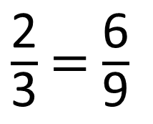
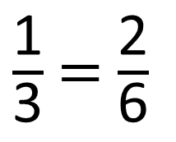
2
$\frac{\text{1}}{\text{3}}$ = $\frac{\text{2}}{\text{6}}$
6
$\frac{\text{2}}{\text{3}}$ = $\frac{\text{6}}{\text{9}}$

Slide 9













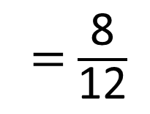


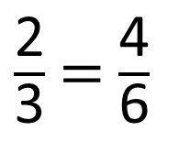






$\frac{\text{1}}{\text{3}}$
$\frac{\text{1}}{\text{3}}$
$\frac{\text{1}}{\text{3}}$
$\frac{\text{1}}{\text{6}}$
$\frac{\text{1}}{\text{6}}$
$\frac{\text{1}}{\text{6}}$
$\frac{\text{1}}{\text{6}}$
$\frac{\text{1}}{\text{6}}$
$\frac{\text{1}}{\text{6}}$
$\frac{\text{1}}{\text{12}}$
$\frac{\text{1}}{\text{12}}$
$\frac{\text{1}}{\text{12}}$
$\frac{\text{1}}{\text{12}}$
$\frac{\text{1}}{\text{12}}$
$\frac{\text{1}}{\text{12}}$
$\frac{\text{1}}{\text{12}}$
$\frac{\text{1}}{\text{12}}$
$\frac{\text{1}}{\text{12}}$
$\frac{\text{1}}{\text{12}}$
$\frac{\text{1}}{\text{12}}$
$\frac{\text{1}}{\text{12}}$
$\frac{\text{2}}{\text{3}}$ = $\frac{\text{4}}{\text{6}}$
= $\frac{\text{8}}{\text{12}}$

Slide 10
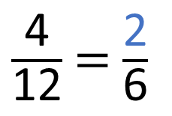
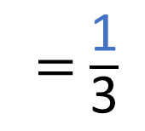
$\frac{\text{1}}{\text{3}}$
$\frac{\text{1}}{\text{3}}$
$\frac{\text{1}}{\text{3}}$
$\frac{\text{1}}{\text{6}}$
$\frac{\text{1}}{\text{6}}$
$\frac{\text{1}}{\text{6}}$
$\frac{\text{1}}{\text{6}}$
$\frac{\text{1}}{\text{6}}$
$\frac{\text{1}}{\text{6}}$
$\frac{\text{1}}{\text{12}}$
$\frac{\text{1}}{\text{12}}$
$\frac{\text{1}}{\text{12}}$
$\frac{\text{1}}{\text{12}}$
$\frac{\text{1}}{\text{12}}$
$\frac{\text{1}}{\text{12}}$
$\frac{\text{1}}{\text{12}}$
$\frac{\text{1}}{\text{12}}$
$\frac{\text{1}}{\text{12}}$
$\frac{\text{1}}{\text{12}}$
$\frac{\text{1}}{\text{12}}$
$\frac{\text{1}}{\text{12}}$
$\frac{\text{4}}{\text{12}}$ = $\frac{\text{2}}{\text{6}}$
= $\frac{\text{1}}{\text{3}}$
Have a think

Slide 11

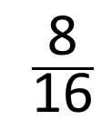

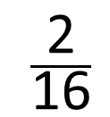
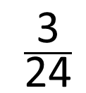

$\frac{\text{8}}{\text{16}}$
$\frac{\text{2}}{\text{16}}$
$\frac{\text{3}}{\text{24}}$
$\frac{\text{4}}{\text{32}}$
Two of the fractions are equivalent to and have an even numerator.
$\frac{\text{1}}{\text{8}}$

Slide 12




$\frac{\text{2}}{\text{5}}$
Dexter is finding equivalent fractions to
Have a think
$\frac{\text{2}}{\text{5}}$
$\frac{\text{2}}{\text{4}}$
Do you agree with Dexter that is equal to ?

Slide 13
Is this statement always, sometimes or never true?
Fractions equivalent to one half have even denominators.
Have a think

Slide 14














1
$\frac{\text{1}}{\text{2}}$
$\frac{\text{1}}{\text{3}}$
$\frac{\text{1}}{\text{4}}$
$\frac{\text{1}}{\text{5}}$
$\frac{\text{1}}{\text{6}}$
$\frac{\text{1}}{\text{7}}$
$\frac{\text{1}}{\text{8}}$
$\frac{\text{1}}{\text{9}}$
$\frac{\text{1}}{\text{10}}$
$\frac{\text{1}}{\text{11}}$
$\frac{\text{1}}{\text{12}}$
$\frac{\text{1}}{\text{2}}$ = $\frac{\text{3}}{\text{6}}$ $=$
$\frac{\text{4}}{\text{8}}$ = $\frac{\text{5}}{\text{10}}$ $=$
$\frac{\text{6}}{\text{12}}$

