Slide 1
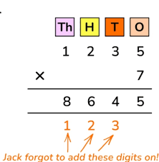

Multiplication
LO: I can multiply 2 digit numbers by 1 digit numbers and complete reasoning about multiplication.
I can multiply 2 & 3 digit numbers by 1 digit numbers and demonstrate efficient multiplication skills.
I can multiply 2 & 3 digit numbers by 2 digit numbers and solve problems using multiplication.
I can multiply 4 digit numbers by 1 & 2 digit numbers and solve problems using multiplication.

Slide 2
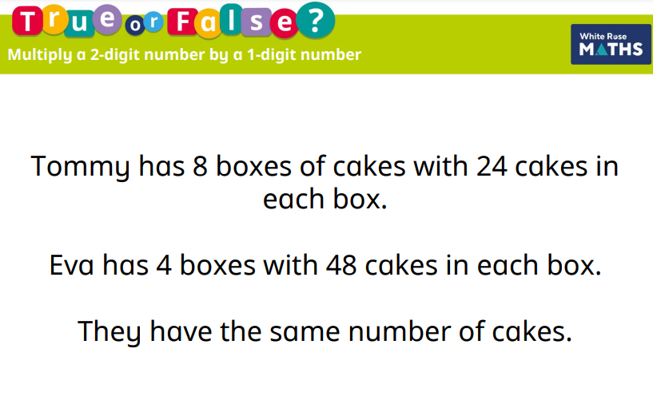

True or False?

Slide 3
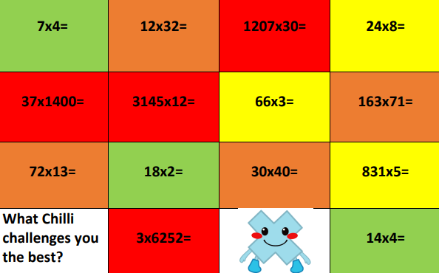
Warm Up: Activity

Slide 4
Answers
Green Chilli Yellow Chilli Orange Chilli Red Chilli
7x4= 28 24x8= 192 12x32= 384 1207x30= 36210
18x2= 36 66x3= 198 72x13= 936 37x1400= 51800
14x4= 56 831x5= 4155 30x40= 1200 3145x12= 37740
163x71= 11573 3x6252= 18756

