Slide 1
Conversion

Slide 2
kilometre
km
kilogram
kg
‘kilo-’ means one thousand
What might you measure using kilograms or kilometres?

Slide 3
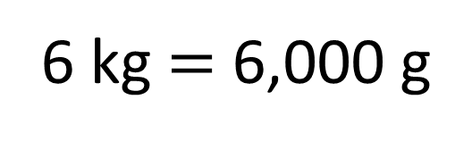
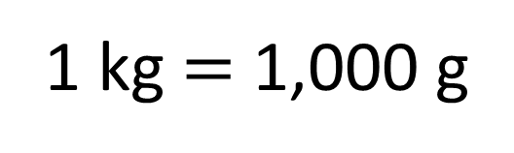
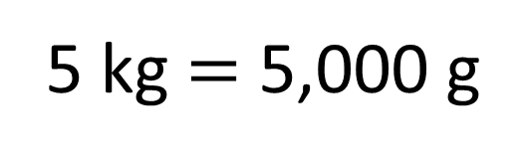
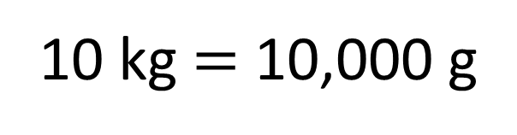
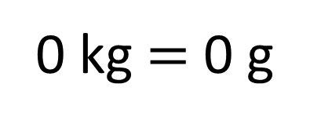
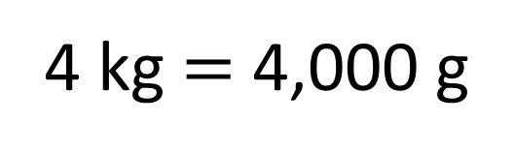
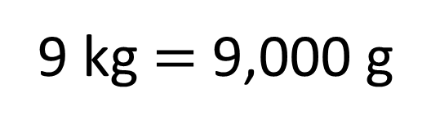
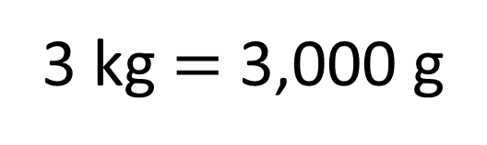
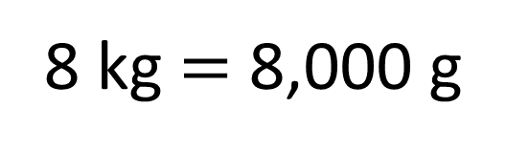
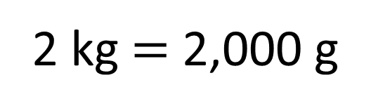
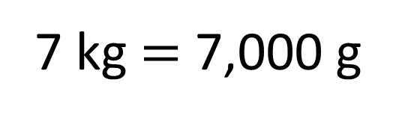
kilograms
0
1
2
3
4
5
6
7
8
9
10
0
1,000
2,000
3,000
4,000
5,000
6,000
7,000
8,000
9,000
10,000
10 kg $=$ 10,000 g
5 kg $=$ 5,000 g
6 kg $=$ 6,000 g
7 kg $=$ 7,000 g
8 kg $=$ 8,000 g
9 kg $=$ 9,000 g
1 kg $=$ 1,000 g
2 kg $=$ 2,000 g
3 kg $=$ 3,000 g
4 kg $=$ 4,000 g
0 kg $=$ 0 g
grams
To convert from kilograms to grams, I _______ by 1,000
multiply
What patterns do you spot?
To convert from grams to kilograms, I ______ by 1,000
divide

Slide 4

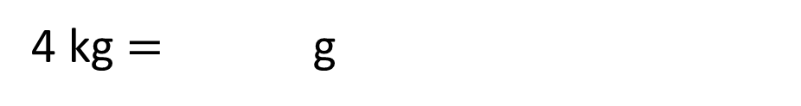
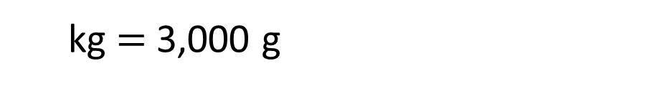
The bar model shows 1 kg $=$ 1,000 g
1 kg
1,000 g
Use the bar model to complete the conversions.
4 kg $=$ g
4,000
1 kg
1 kg
1 kg
1 kg
1,000 g
1,000 g
1,000 g
1,000 g
Have a think
3
kg $=$ 3,000 g
1 kg
1 kg
1 kg
1,000 g
1,000 g
1,000 g

Slide 5
millimetre
mm
millilitre
ml
‘milli’ means one-thousandth
What is the same and what is different about the prefixes “milli-” and “kilo-”?
What might you measure using millimetres or metres?

Slide 6
metres
litres
0
1
2
3
4
5
6
7
8
9
10
0
1,000
2,000
3,000
4,000
5,000
6,000
7,000
8,000
9,000
10,000
0 m $=$ 0 mm
1 m $=$ 1,000 mm
2 m $=$ 2,000 mm
3 m $=$ 3,000 mm
4 m $=$ 4,000 mm
5 m $=$ 5,000 mm
6 m $=$ 6,000 mm
7 m $=$ 7,000 mm
8 m $=$ 8,000 mm
9 m $=$ 9,000 mm
10 m $=$ 10,000 mm
10 l $=$ 10,000 ml
millimetres
millilitres
multiply
To convert from litres to millilitres, I _______ by 1,000
To convert from millimetres to metres, I ______ by 1,000
divide
What patterns do you spot?

Slide 7
The bar model shows 1 l $=$ 1,000 ml
1 l
1,000 ml
Use the bar model to complete the conversions.
4 l $=$ ml
4,000
1 l
1 l
1 l
1 l
1,000 ml
1,000 ml
1,000 ml
1,000 ml
3
Have a think
l $=$ 3,000 ml
1 l
1 l
1 l
1,000 ml
1,000 ml
1,000 ml

Slide 8
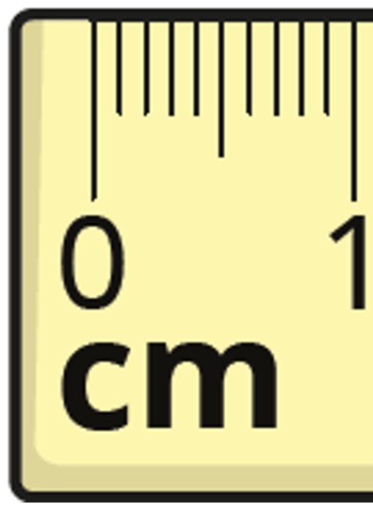
10 mm $=$ 1 cm
millimetres
mm
centimetres
cm

Slide 9
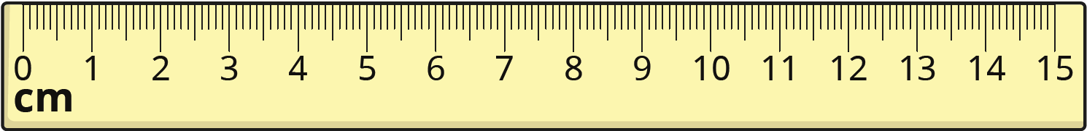
How long is each line?
9 cm
5 mm
7 cm
1 mm
How do you use a ruler to measure accurately?

