Slide 1


Slide 2
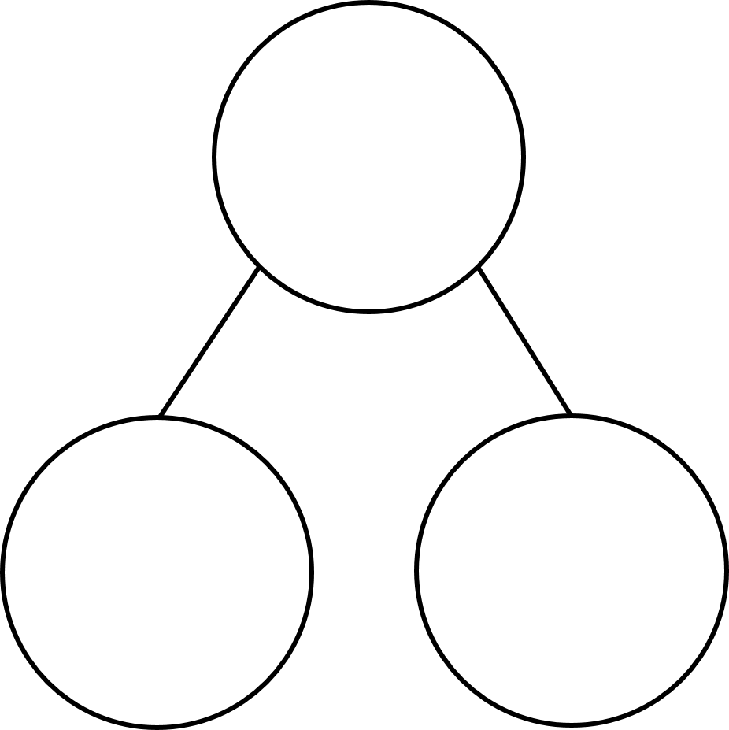

137 $+$ ____ $=$ 180
180 $−$ ____ $=$ 34
Complete the part-whole models.
180
360
318
27
166
42

Slide 3
43
137 $+$ ____ $=$ 180
180 $−$ ____ $=$ 34
Complete the part-whole models.
146
180
360
318
360
27
153
194
166
42

Slide 5
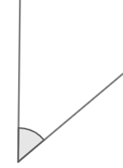
An angle is a measure of the amount of turn between two lines.

Slide 6
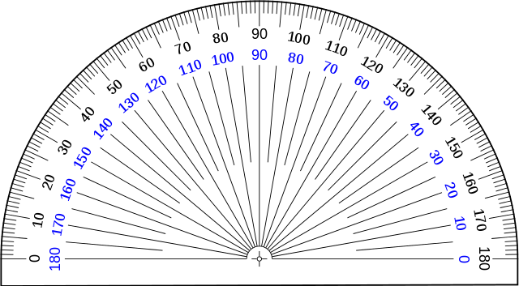
This is a protractor.
We can use it to measure the degrees of turn between two lines.

Slide 7
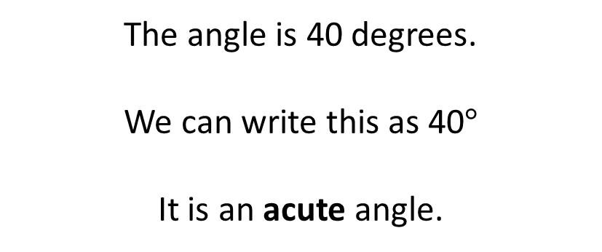
Outer scale
Inner scale
The angle is 40 degrees.
We can write this as 40$°$
It is an acute angle.

Slide 8
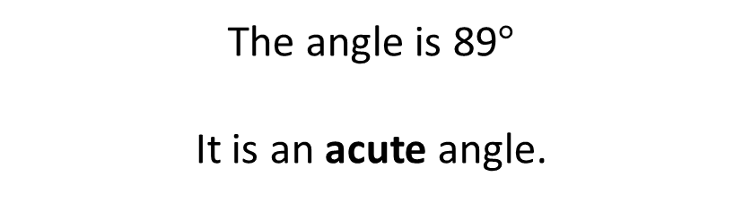
The angle is 89$°$
It is an acute angle.

Slide 9

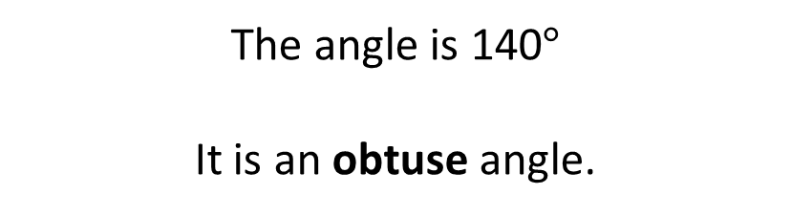
The angle is 90$°$
It is a right angle.
The angle is 140$°$
It is an obtuse angle.

Slide 10
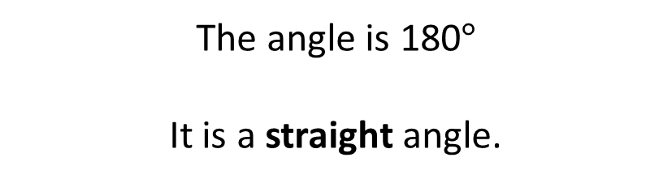
The angle is 180$°$
It is a straight angle.

Slide 11

180$°$ $+$ 40$°$ $=$ 220$°$
It is a reflex angle.

Slide 12
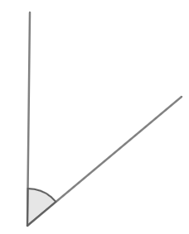

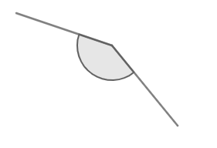

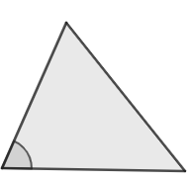
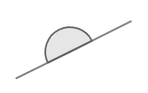
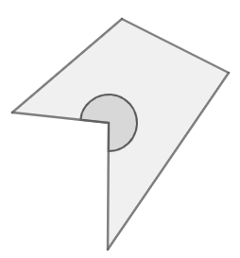
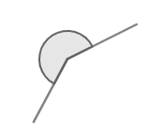
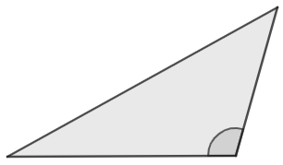
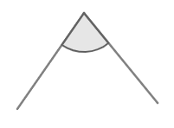
Are the angles acute, obtuse, straight or reflex?
Have a think
A
I
F
B
D
H
E
G
C
J
J

Slide 13
Acute angle
Obtuse angle
I
F
A
D
C
J
Straight angle
Reflex angle
B
E
H
G

Slide 14
This is the origin; we place this on the vertex where two lines meet.

Slide 15
The baseline is placed on one of the lines.

Slide 16
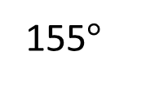
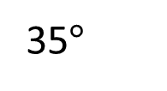
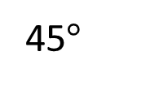
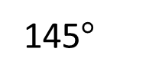
Have a think
What is the size of the angle?
A
B
C
D
155$°$
145$°$
45$°$
35$°$

Slide 17
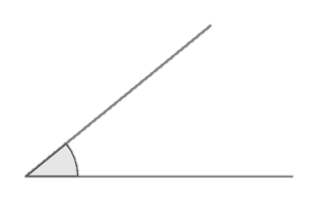
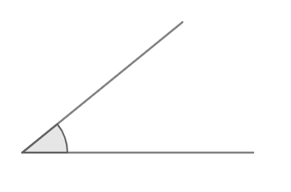
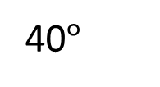
Have a think
40$°$
A
B
C
Which is the greatest angle?

Slide 18
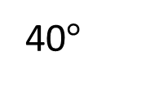
40$°$
40$°$
A
B
C
Which is the greatest angle?

Slide 19
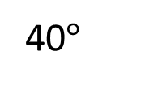
40$°$
40$°$
40$°$
A
B
C
Which is the greatest angle?

Slide 20



90°
Angles in a right angle add up to ____
Use this fact to work out the size of angles $a, b$ and $c$.
12°
$$b$$
$$a$$
79°
23°
$$c$$
Have a think

Slide 21
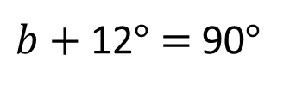
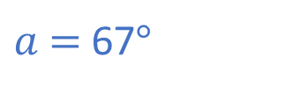
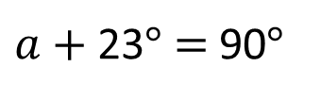
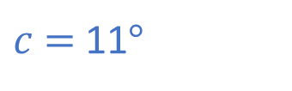
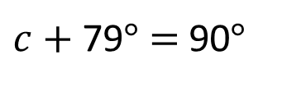
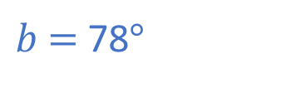
90°
Angles in a right angle add up to ____
Use this fact to work out the size of angles $a, b$ and $c$.
12°
$$b$$
$$a$$
79°
23°
$$c$$
$a$ $+$ 23$°$ $=$ 90$°$
$b$ $+$ 12$°$ $=$ 90$°$
$c$ $+$ 79$°$ $=$ 90$°$
$a$ $=$ 67$°$
$b$ $=$ 78$°$
$c$ $=$ 11$°$

Slide 22
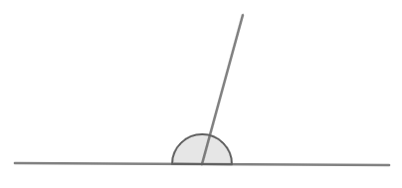
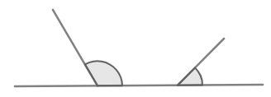

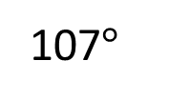

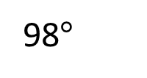
Adjacent angles on a straight line sum to ____$°$
180
$$b$$
98$°$
$$a$$
107$°$
Can you calculate the missing angles?
Have a think

Slide 23
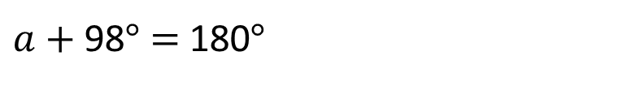
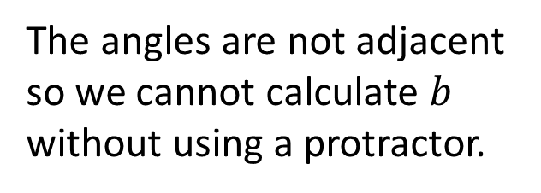
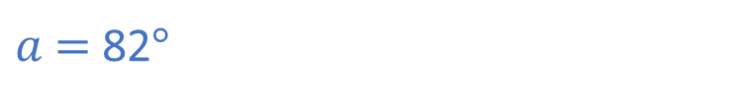
Adjacent angles on a straight line sum to ____$°$
180
$$b$$
98$°$
$$a$$
107$°$
The angles are not adjacent so we cannot calculate $b$ without using a protractor.
$a$ $+$ 98$°$ $=$ 180$°$
$a$ $=$ 82$°$

Slide 24
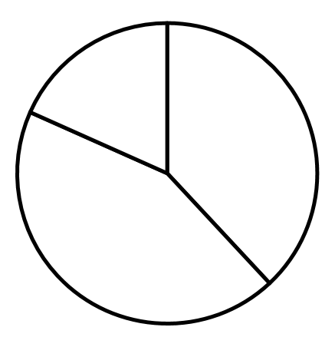
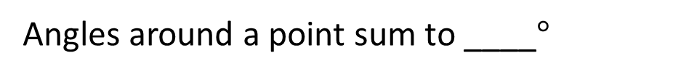


Angles around a point sum to ____$°$
360
Calculate the missing angles.
113°
51°
$$a$$
72°
$$b$$
162°
Have a think

Slide 25
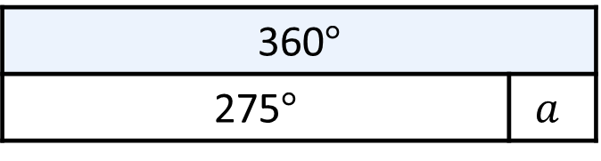
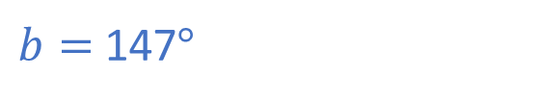
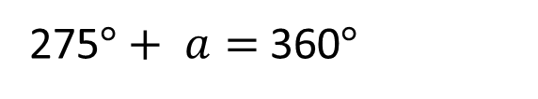
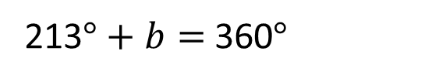
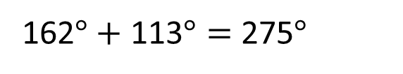
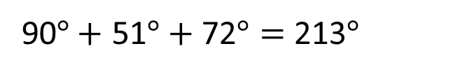
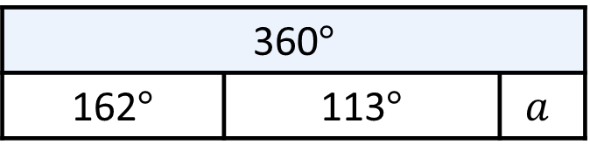
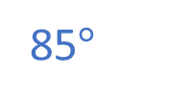
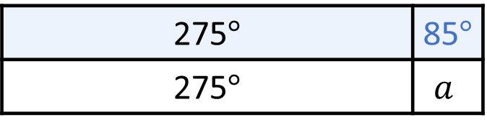
Angles around a point sum to ____$°$
360
Calculate the missing angles.
51°
90°
85$°$
113°
$$a$$
72°
$$b$$
162°
90$°+$ 51$°+$72$°=$ 213$°$
360$°$
162$°$ | 113$°$ | $$a$$
360$°$
275$°$ | $$a$$
275$°$ | 85$°$
275$°$ | $$a$$
213$°+$ $b=$ 360$°$
$b=$ 147$°$
275$°+$ $a=$ 360$°$
162$°+$ 113$°=$ 275$°$

Slide 27
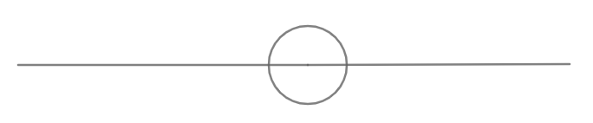





Have a think
$$w$$
$$x$$
$$z$$
$$y$$
What do you predict about the sizes of angles $w, x, y$and $z$?

Slide 28




What do you predict about the sizes of angles $w, x, y$and $z$?
$$w$$
$$x$$
130$°$
50$°$
50$°$
$$z$$
$$y$$
130$°$

Slide 29




What do you predict now?
Which angles will have increased? Which angles will have decreased?
140$°$
40$°$
40$°$
140$°$
Have a think

Slide 30
Have a think
140$°$
40$°$
40$°$
140$°$
What do you predict now?

Slide 31




140$°$
40$°$
40$°$
140$°$

Slide 32




Have a think
140$°$
40$°$
70$°$
30$°$
40$°$
140$°$
40$°$
110$°$
What do you predict now?

Slide 33

These are called vertically opposite angles.
Vertically opposite angles are equal in size.

Slide 34


How many pairs of vertically opposite angles can you find?
2 pairs
1 pair

