Slide 1


Slide 3
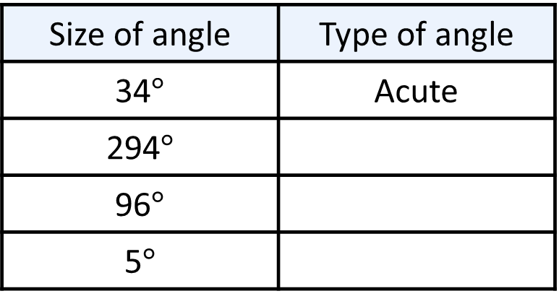

Complete the table.
2) 26 $+$ 89 $+$ ____ $=$ 180
3) 49.7 $+$ 69.4 $+$ ____ $=$ 180
Size of angle | Type of angle
34$°$ | Acute
294$°$
96$°$
5$°$

Slide 4
Complete the table.
2) 26 $+$ 89 $+$ ____ $=$ 180
3) 49.7 $+$ 69.4 $+$ ____ $=$ 180
Size of angle | Type of angle
34$°$ | Acute
294$°$
96$°$
5$°$
Reflex
Obtuse
Acute
65
60.9

Slide 6
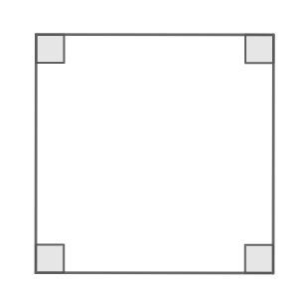

What are the angles inside a square?

Slide 7

Have a think
A right-angled triangle is formed by splitting the square into two equal parts.
What are the sizes of the angles in the right-angled triangle?

Slide 8
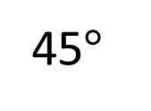
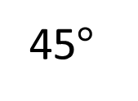
A right-angled triangle is formed by splitting the square into two equal parts.
45$°$
What are the sizes of the angles in the right-angled triangle?
45$°$

Slide 9

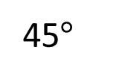
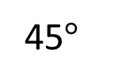
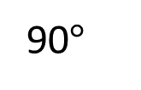
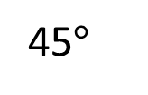
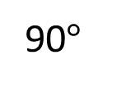
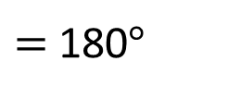
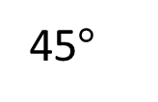

45$°$
45$°$
90$°$
90$°$
45$°$
45$°$
$$+$$
$$+$$
$=$ 180$°$

Slide 10
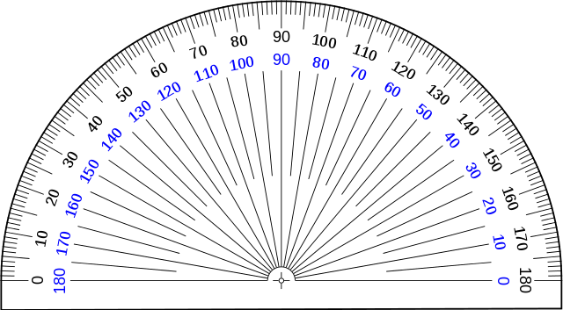
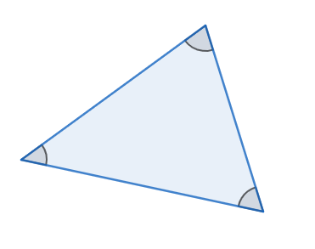
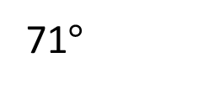
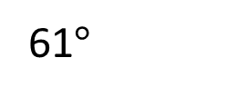
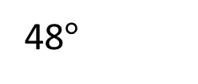
71$°$
48$°$
61$°$
What about the angles inside this triangle?
48$°+$ 71$°+$ 61$°$ $=$ 180$°$

Slide 11

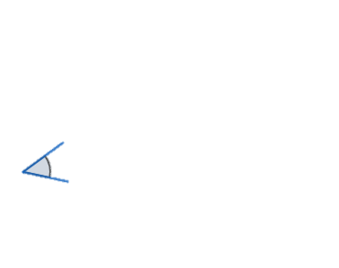
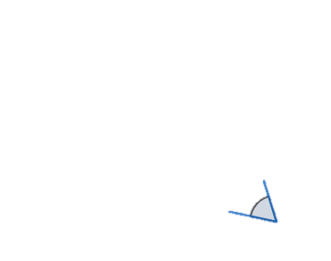

Slide 12
The internal angles of a triangle sum to 180$°$

Slide 13
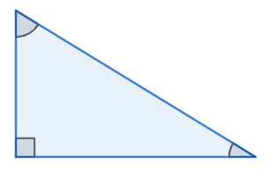

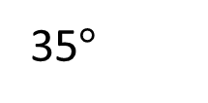
$$x$$
35$°$
What is the size of angle $x?$
The internal angles of a triangle sum to 180$°$
Have a think

Slide 14
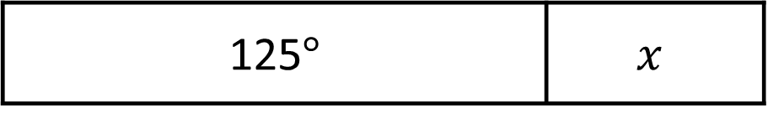
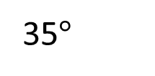
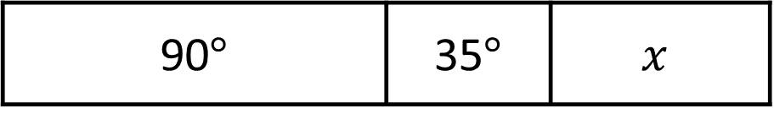
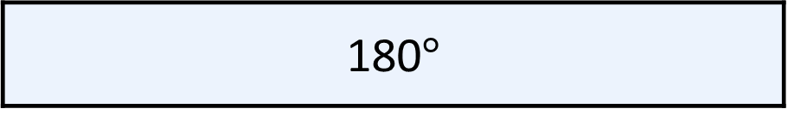
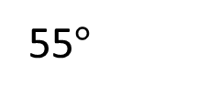
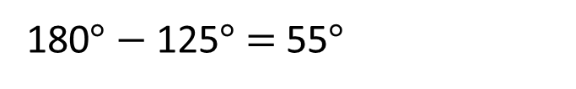
$$x$$
55$°$
35$°$
180$°$
What is the size of angle $x?$
90$°$ | 35$°$ | $$x$$
125$°$ | $$x$$
180$°$ $−$ 125$°$ $=$ 55$°$

Slide 15
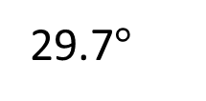

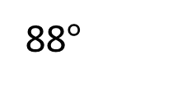
29.7$°$
88$°$
$$x$$
What is the size of angle $x?$
The internal angles of a triangle sum to 180$°$
Have a think

Slide 16
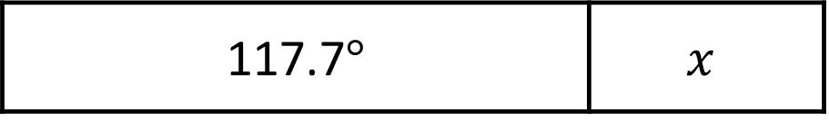
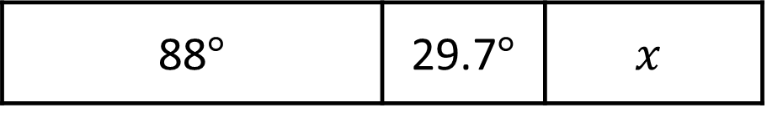
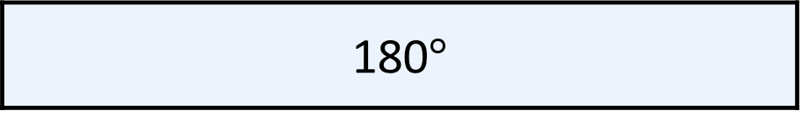
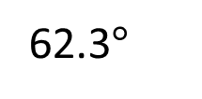
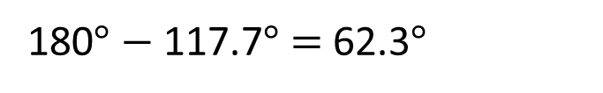
29.7$°$
88$°$
62.3$°$
$$x$$
180$°$
88$°$ | 29.7$°$ | $$x$$
117.7$°$ | $$x$$
180$°$ $−$ 117.7$°$ $=$ 62.3$°$

Slide 17

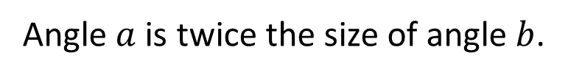

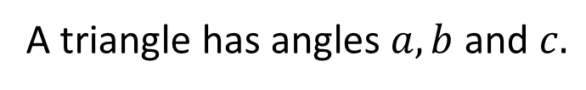
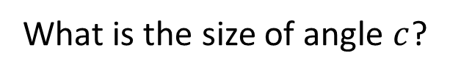
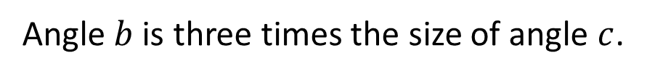
A triangle has angles $a, b$ and $c.$
Angle $a$ is twice the size of angle $b$.
Angle $b$ is three times the size of angle $c$.
What is the size of angle $c$?
$$a$$
$$b$$
Have a think

Slide 18

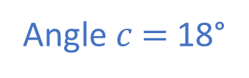
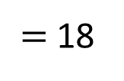
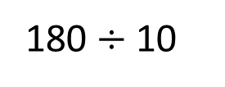
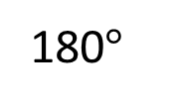
A triangle has angles $a, b$ and $c.$
Angle $a$ is twice the size of angle $b$.
Angle $b$ is three times the size of angle $c$.
What is the size of angle $c$?
$$a$$
180 $÷$ 10
$=$ 18
18°
18°
18°
18°
18°
18°
$$b$$
18°
18°
18°
180$°$
$$c$$
18°
Angle$c$ $=$ 18°
?

Slide 19



Slide 20
Have a go at questions

Slide 21
I do
You do

Slide 22
















Rosie
Alex
Amir
Whitney
Ron
Dexter
Annie
Tommy
Mo
Jack
Eva
Teddy
Max
Kim
Jo
Sam

Slide 23



Speech bubble text – replace with any character head.
Speech bubble text – replace with any character head.
Bee
Diddy
Tiny

Slide 24
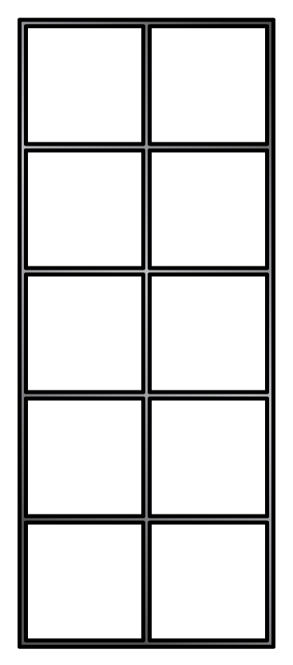
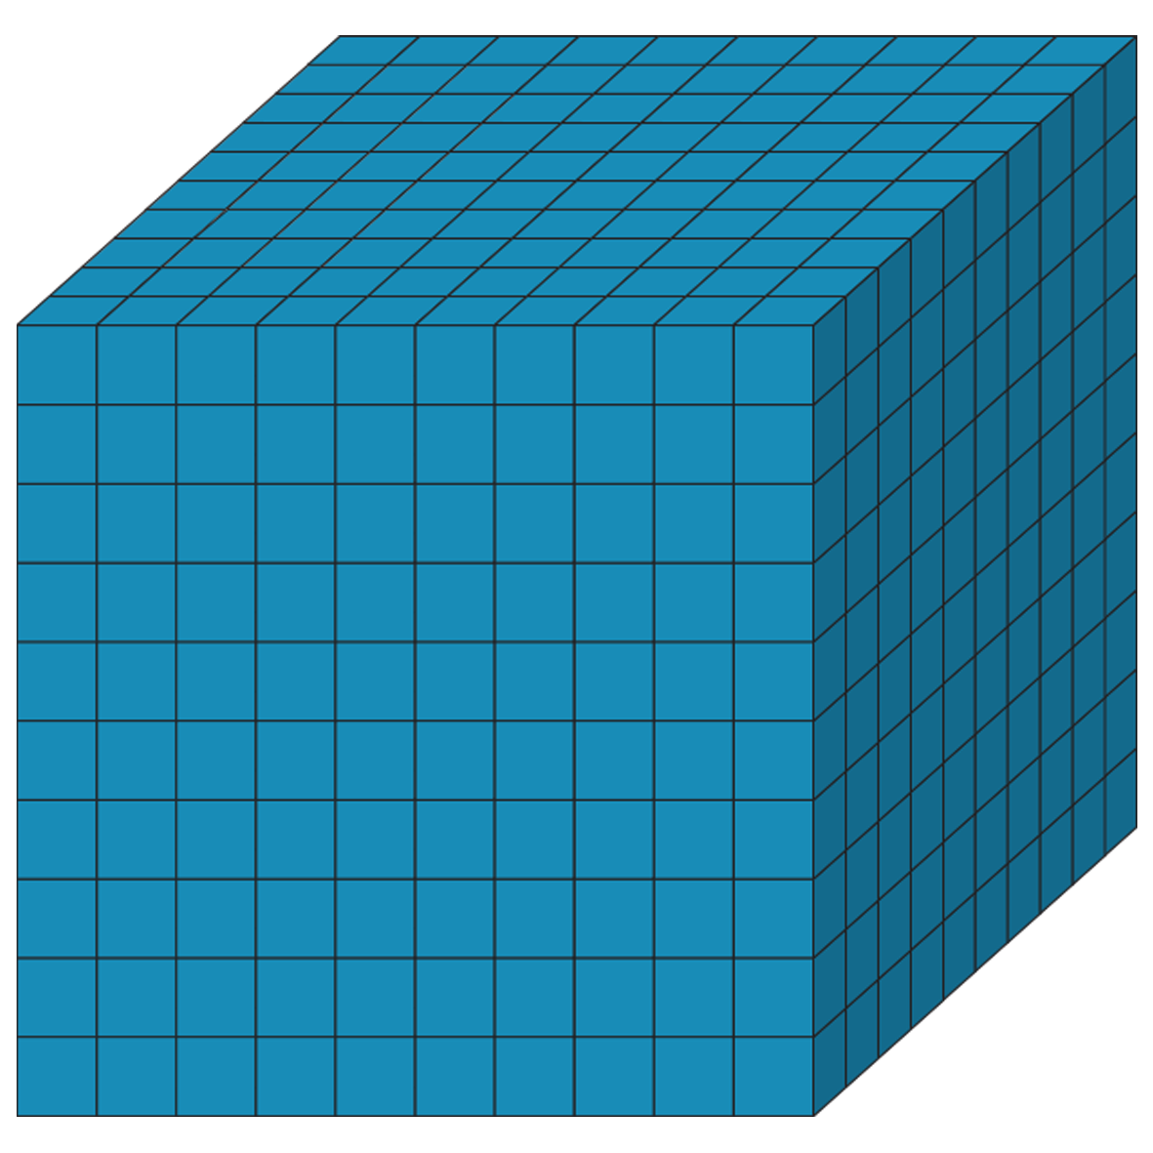


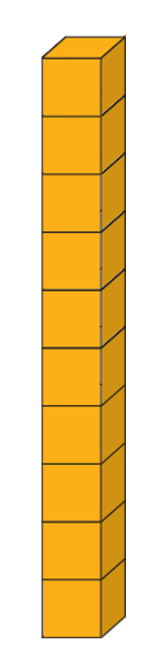


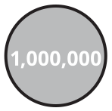












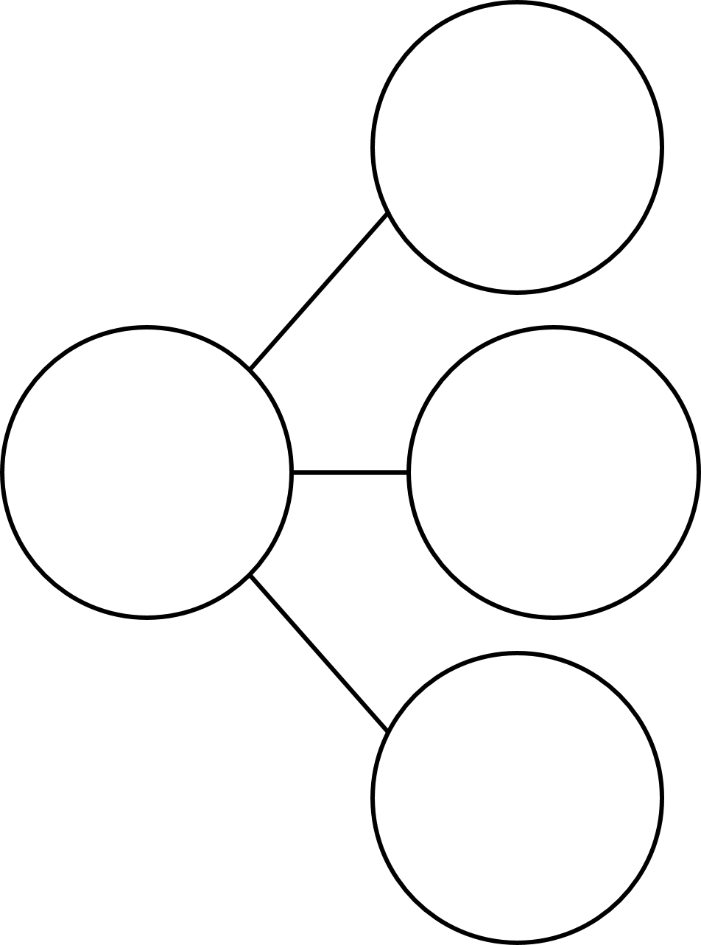
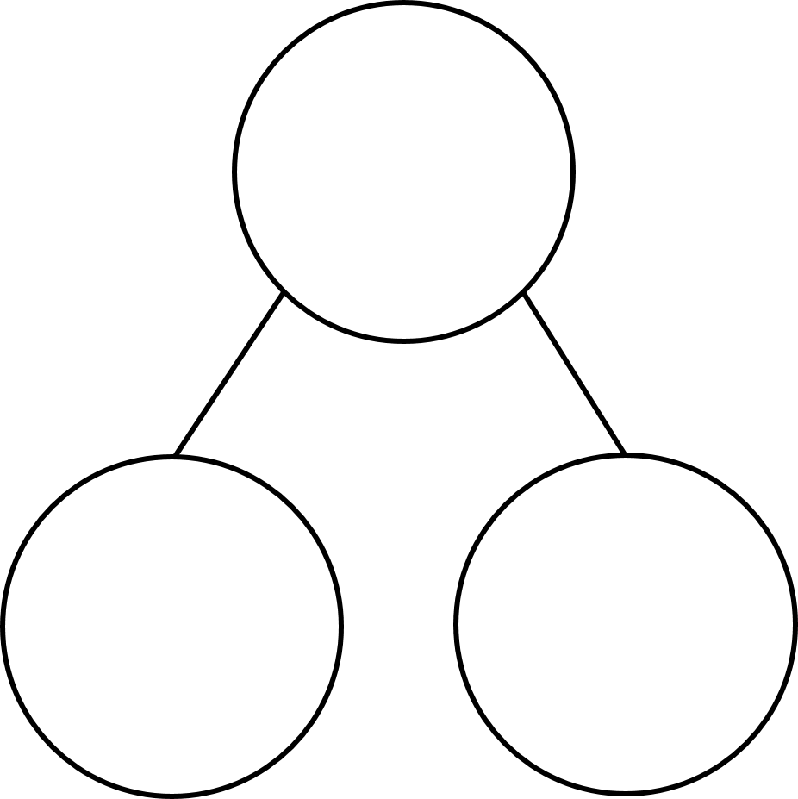
M | HTh | TTh | Th | H | T | O | Tth | Hth | Thth
100
40 | 60
Millions | Thousands |  |  | Ones
O | H | T | O | H | T | O

Slide 25




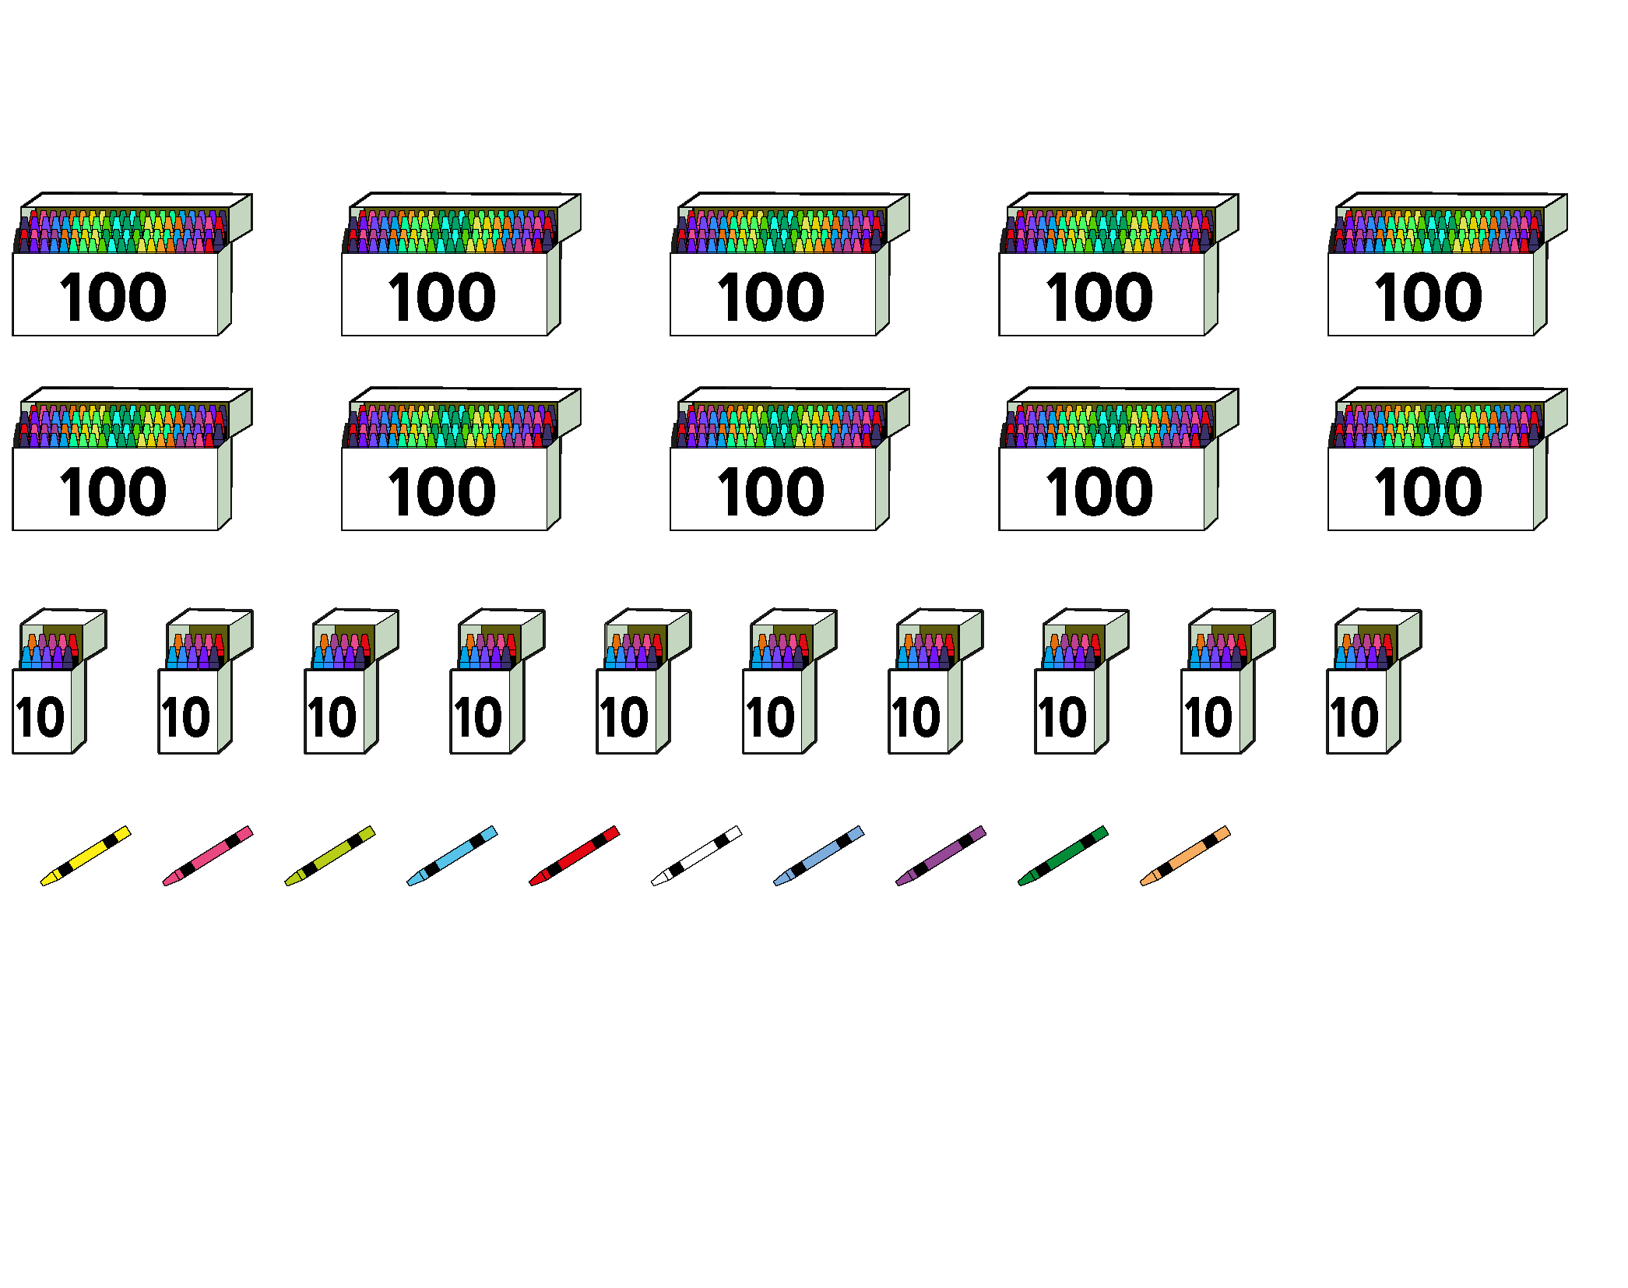
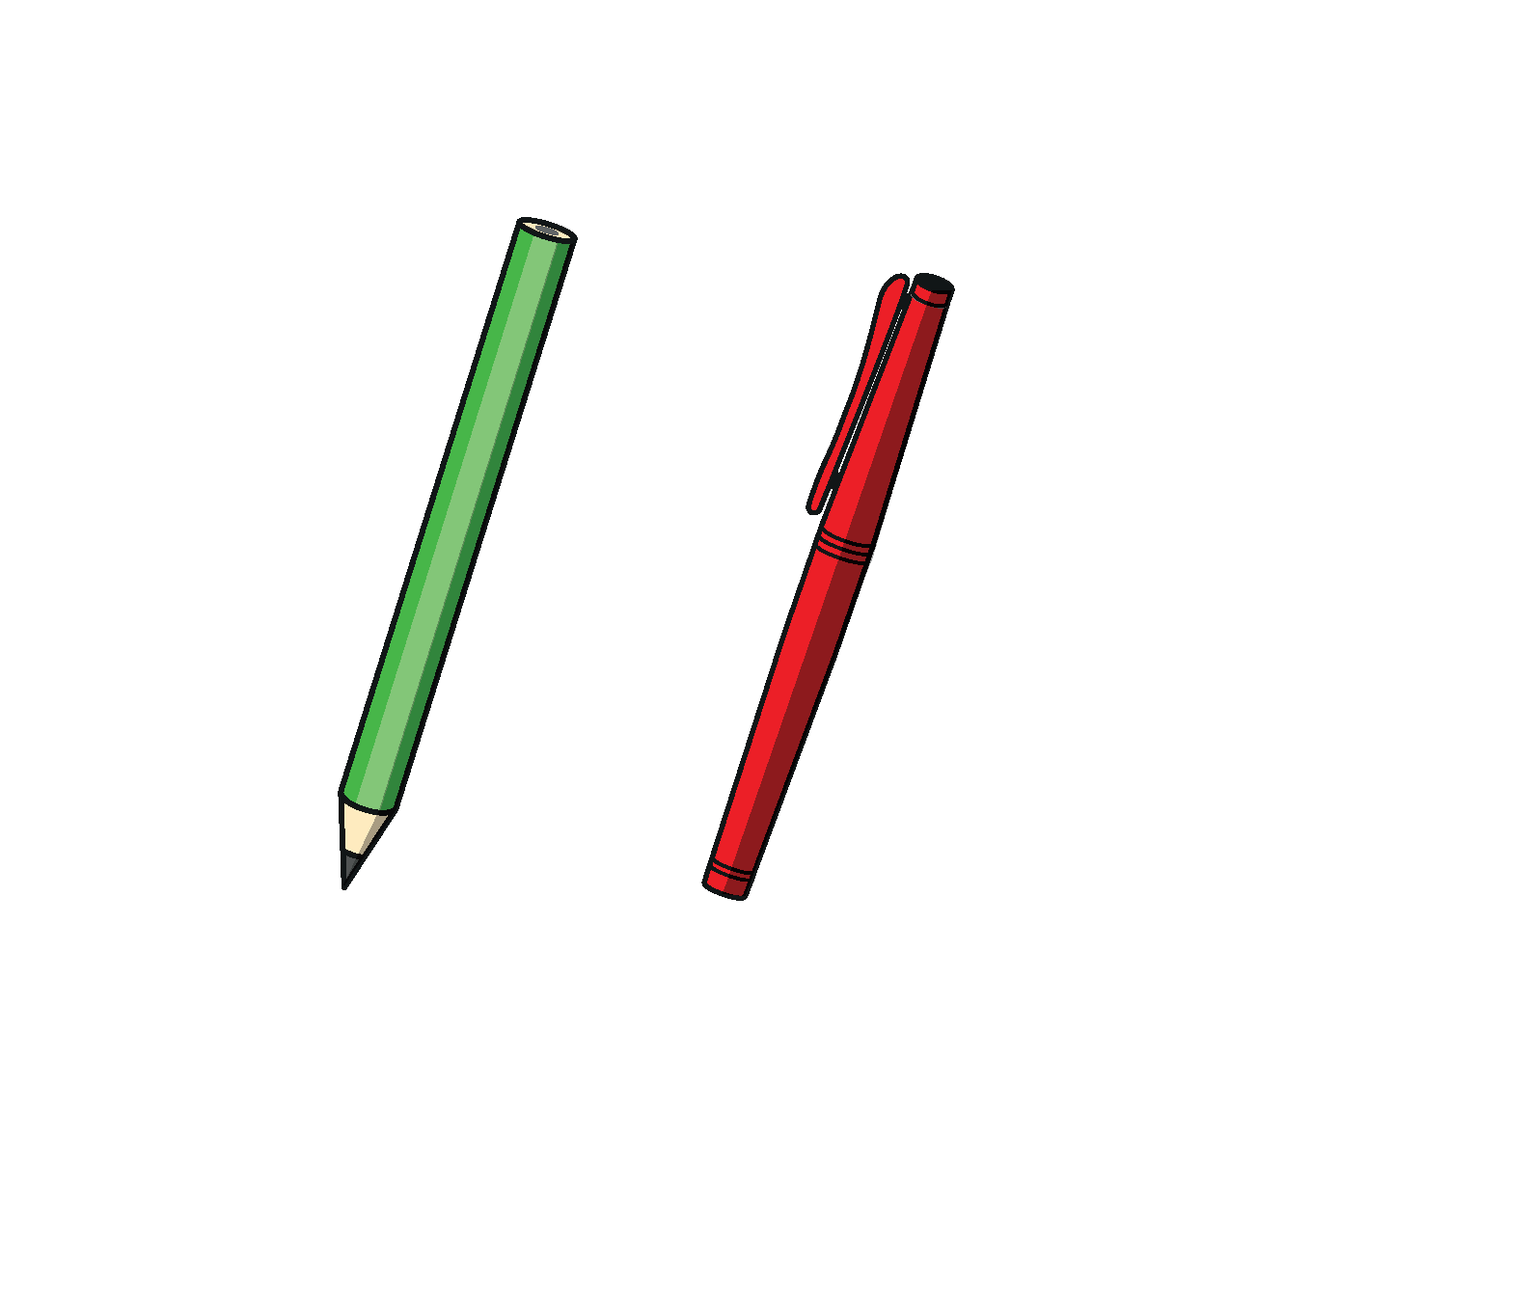



































Slide 26


























































