Slide 1


Slide 2




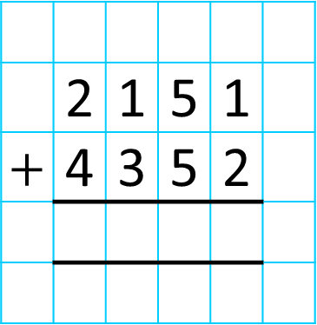
Th | H | T | O
 | 2 | 1 | 5 | 1
$+$ | 4 | 3 | 5 | 2
6
5
0
3
1
6
5
0
3
5
I have ___ tens, so I ___ need
to make an exchange.
do
I have ___ hundreds, so I ______ need
to make an exchange.
do not
I have ___ thousands, so I ______ need
to make an exchange.
10
I have ___ ones, so I ______ need
to make an exchange.
6
3
do not
do not

Slide 3
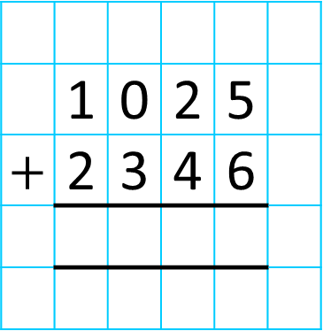
Th | H | T | O
 | 1 | 0 | 2 | 5
$+$ | 2 | 3 | 4 | 6
3
3
7
1
1
3
3
7
1

Slide 4

Solve the calculations and complete the table.
1) 2,022 + 7,085
2) 813 + 2,471
3) 8,610 + 1,283
Have a think
4) 3,657 + 5,227
No exchange | Exchange ten 100s for 1,000 | Exchange ten 10s for 100 | Exchange ten 1s for 10
3)
2)
1)
4)

Slide 5
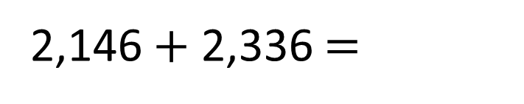
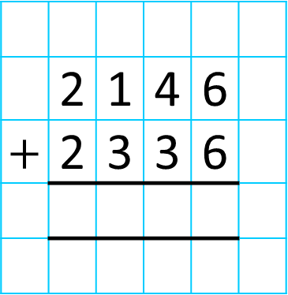
2,146 $+$ 2,336 $=$
44,712
Th | H | T | O
 | 2 | 1 | 4 | 6
$+$ | 2 | 3 | 3 | 6
Have a think
4
4
8
7
1
2
2
1
4
4
8
2

Slide 6


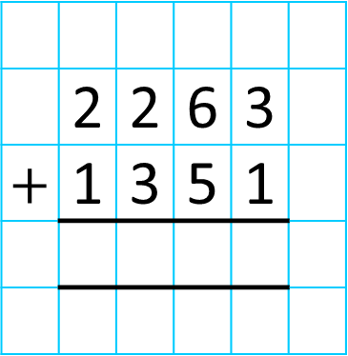
Teddy runs 1,351 metres.
Whitney runs 2,263 metres.
How many metres do they run altogether?
3,614
Th | H | T | O
 | 2 | 2 | 6 | 3
$+$ | 1 | 3 | 5 | 1
3
6
1
4
1
3
6
1
4

Slide 7



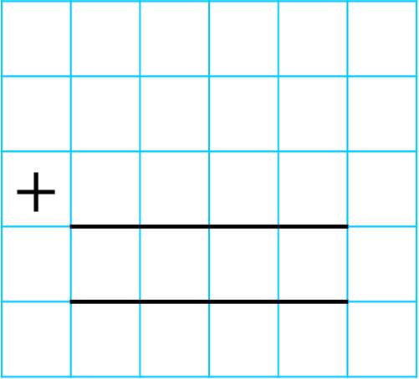



Fill in the missing digits.
$+$
5
1
0
3
3
3
4
8
8
4
5
1
1
__ thousands $+$ 3 thousands $=$ 8 thousands
__ tens $+$ 4 tens $+$ 1 ten $=$ 5 tens
3 ones $+$ __ ones $=$ 1 ones
__ tens $+$ 4 tens $=$ 5 tens
1 hundred $+$ __ hundreds $=$ 4 hundreds
3 ones $+$ __ ones $=$ 11 ones
5
0
3
8

Slide 8
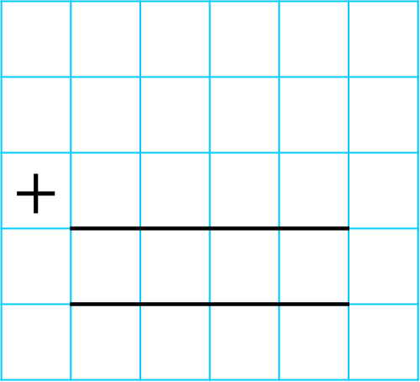
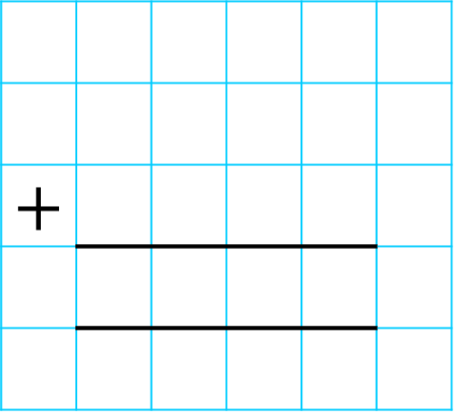
Have a think
$+$
$+$
1
1
5
6
5
7
0
5
3
1
5
2
2
5
1
1
4
3
0
8
8
2
1
6
1
1

Slide 9



Slide 10
Have a go at questions

Slide 11
I do
You do

Slide 12
















Rosie
Alex
Amir
Whitney
Ron
Dexter
Annie
Tommy
Mo
Jack
Eva
Teddy
Max
Kim
Jo
Sam

Slide 13



Speech bubble text – replace with any character head.
Speech bubble text – replace with any character head.
Bee
Diddy
Tiny

Slide 14

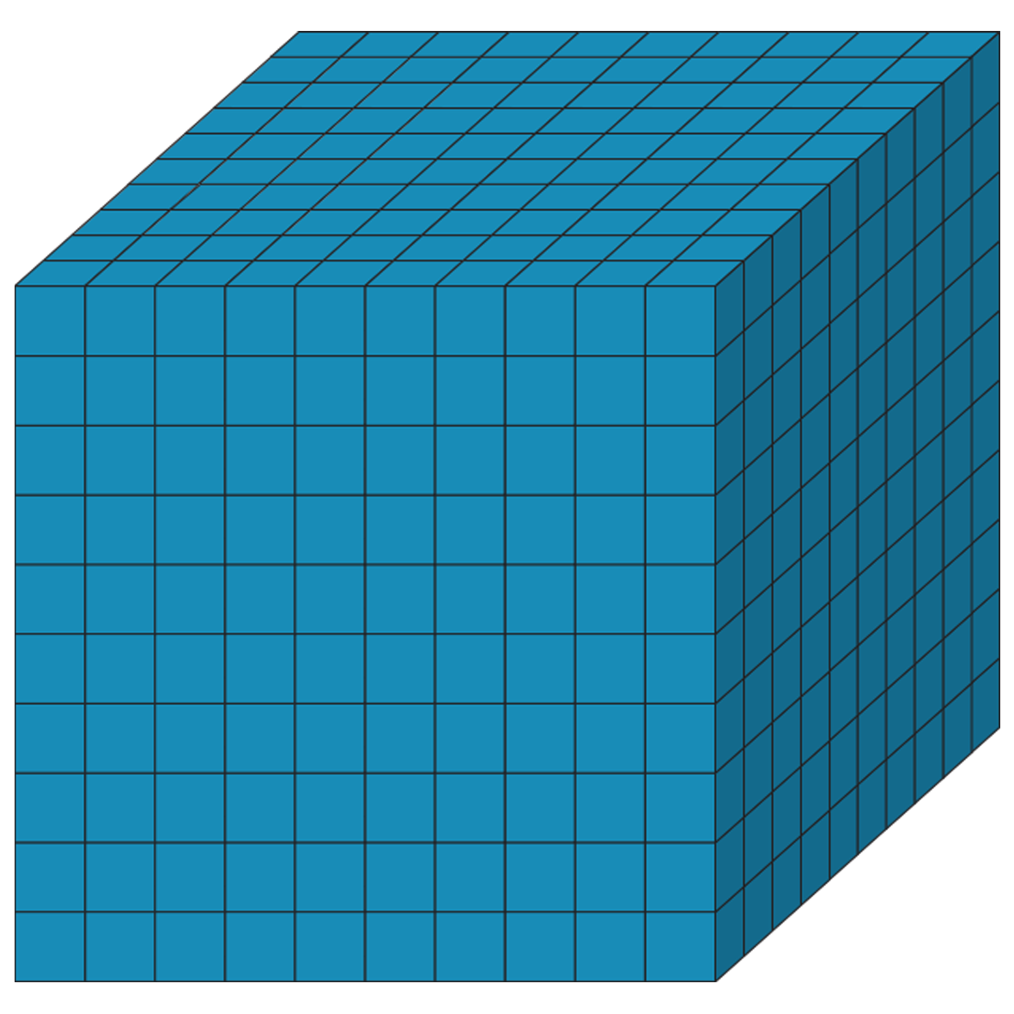


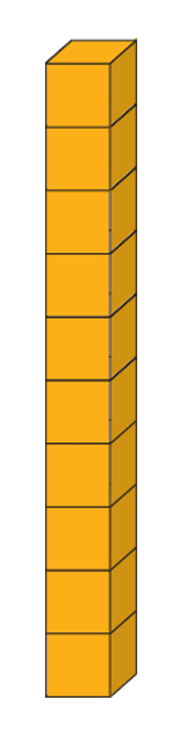








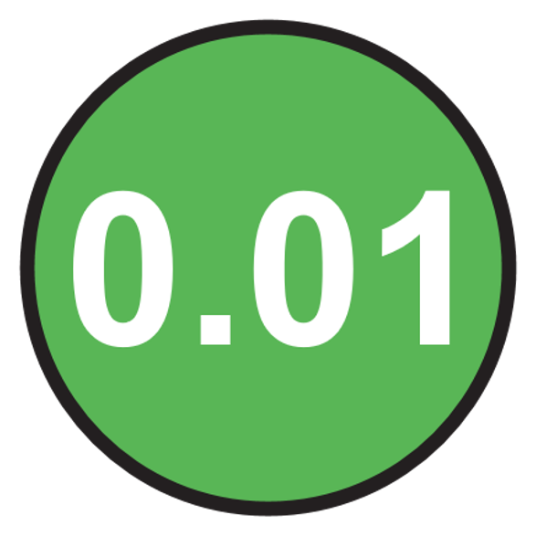


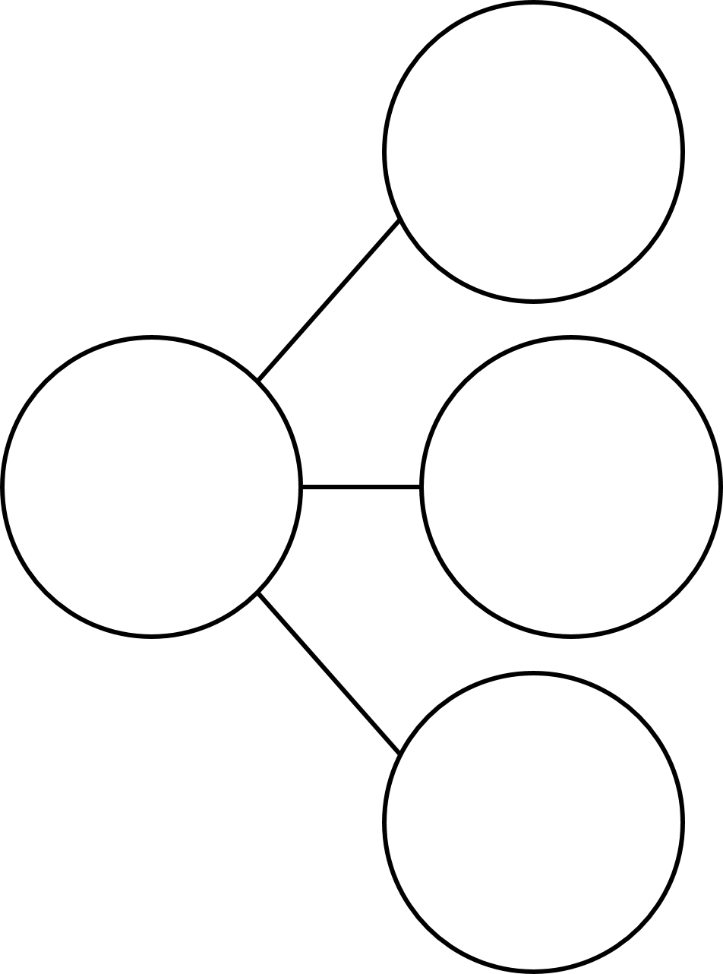
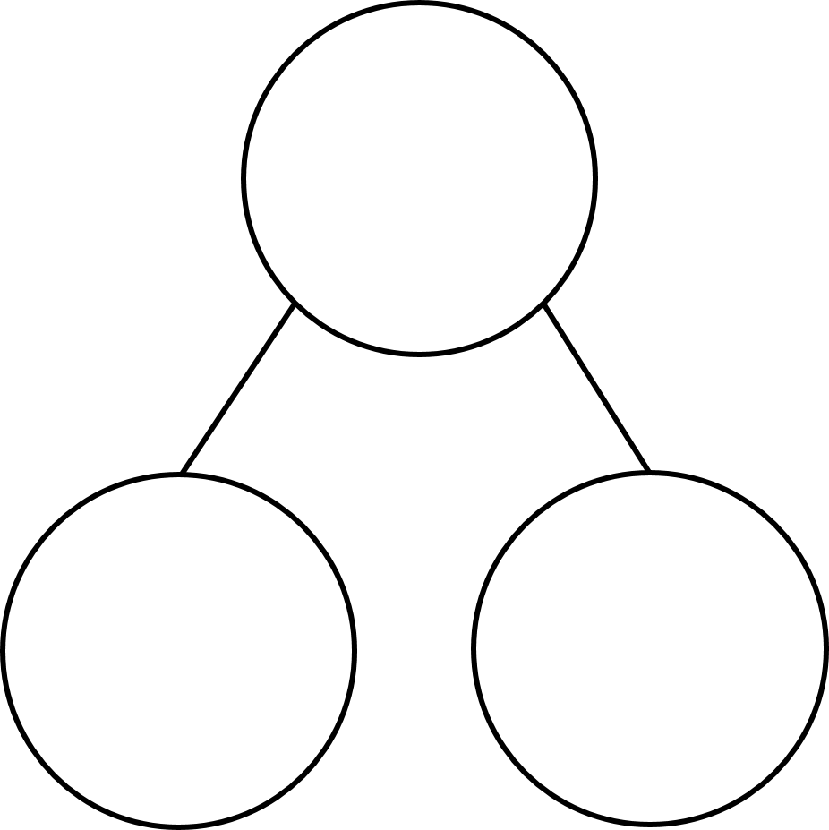
100
40 | 60
TTh | Th | H | T | O | Tth | Hth

Slide 15




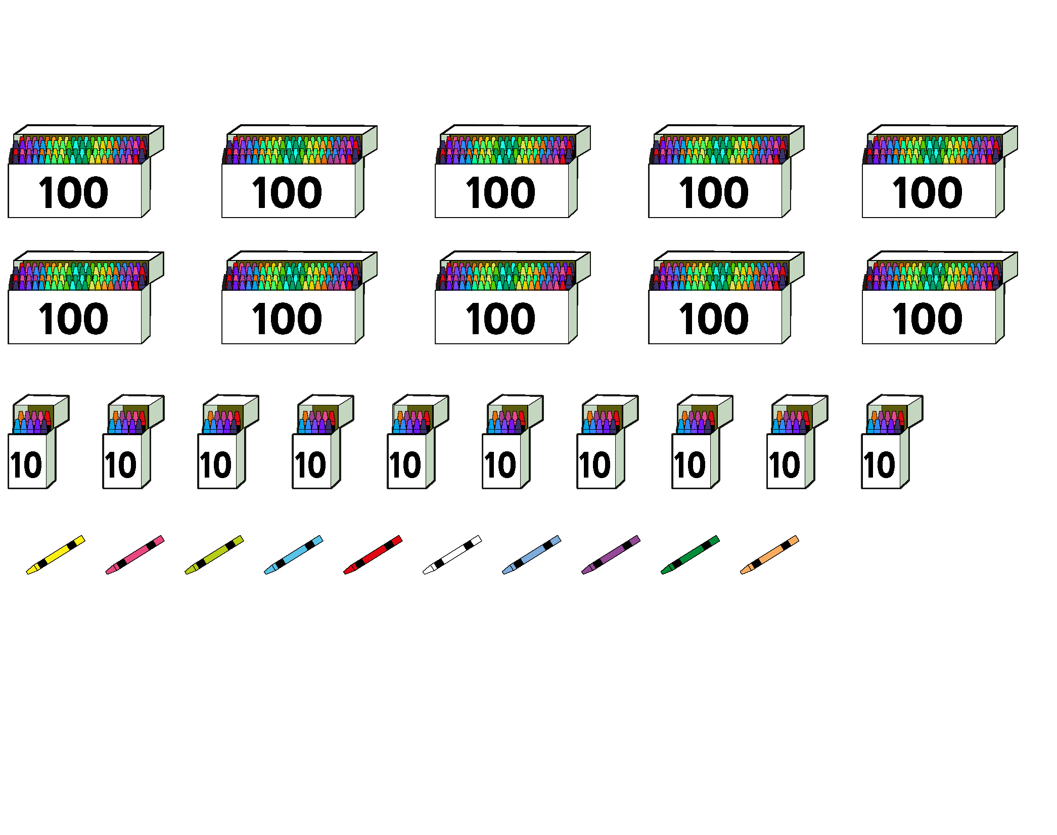
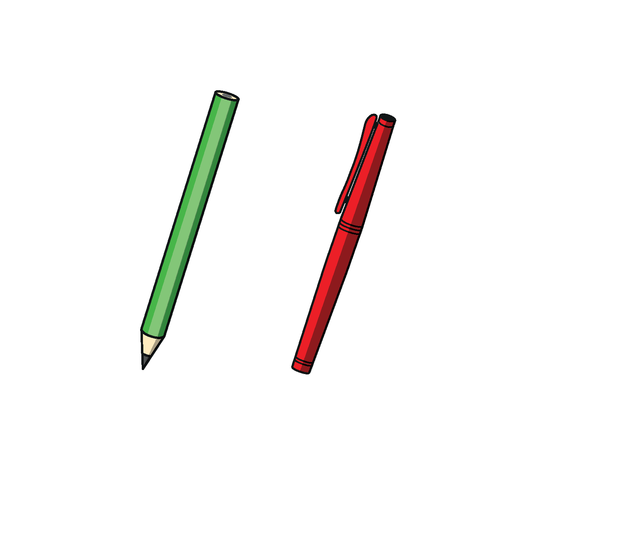


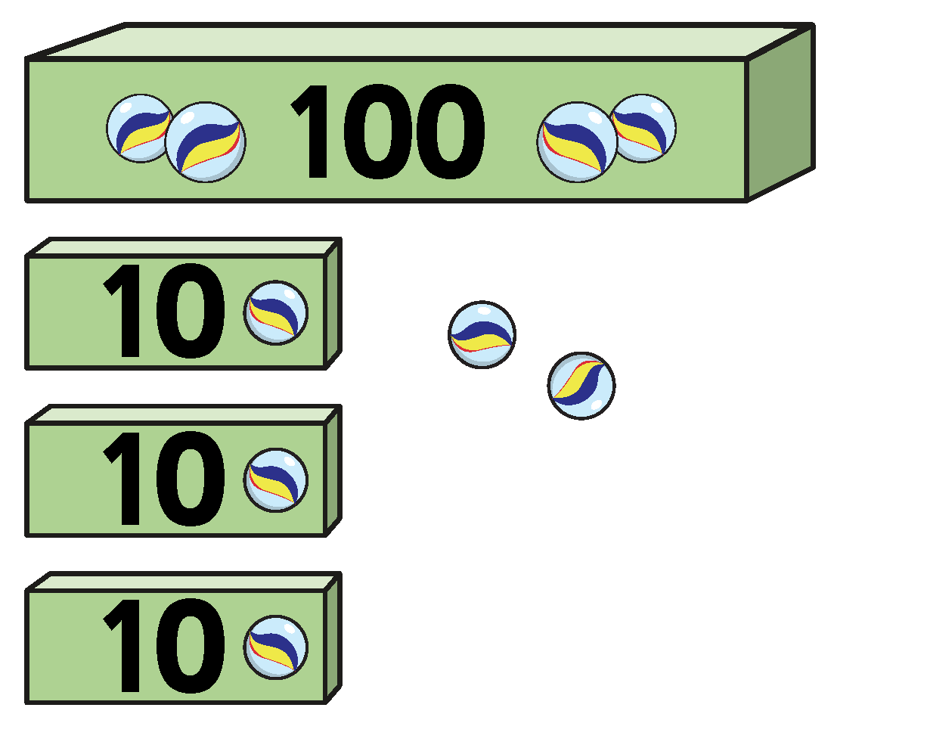
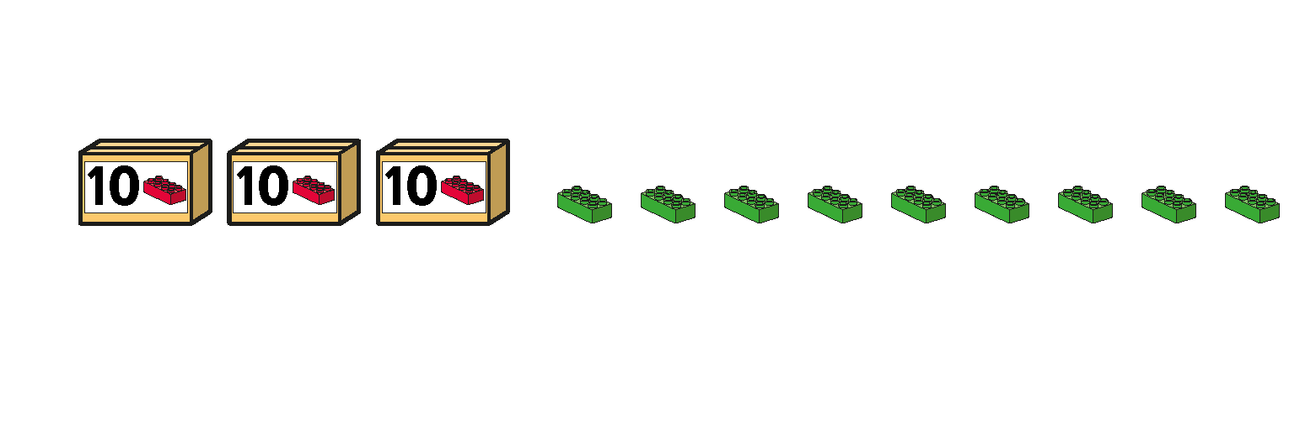
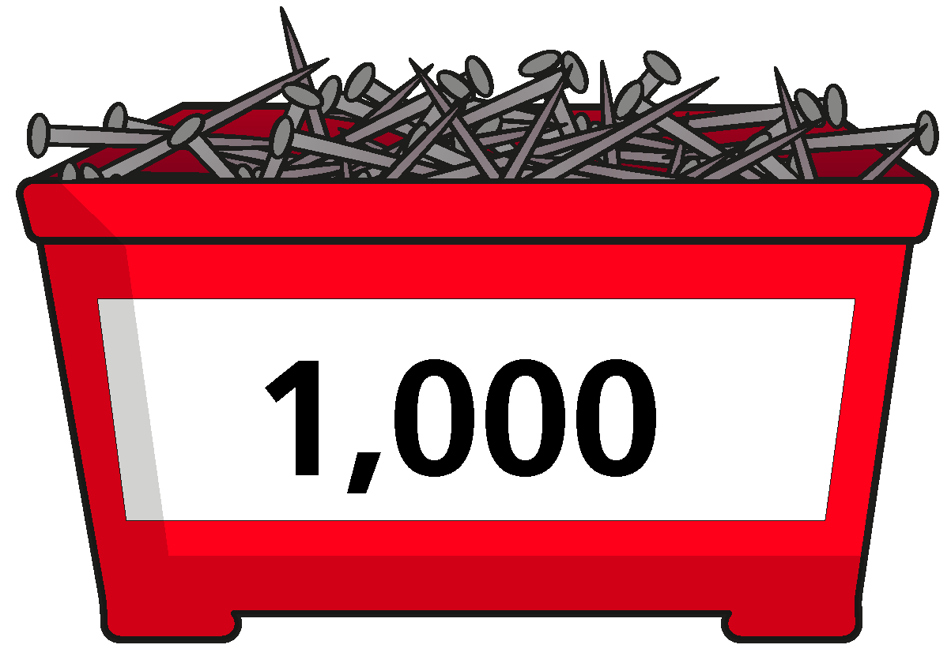
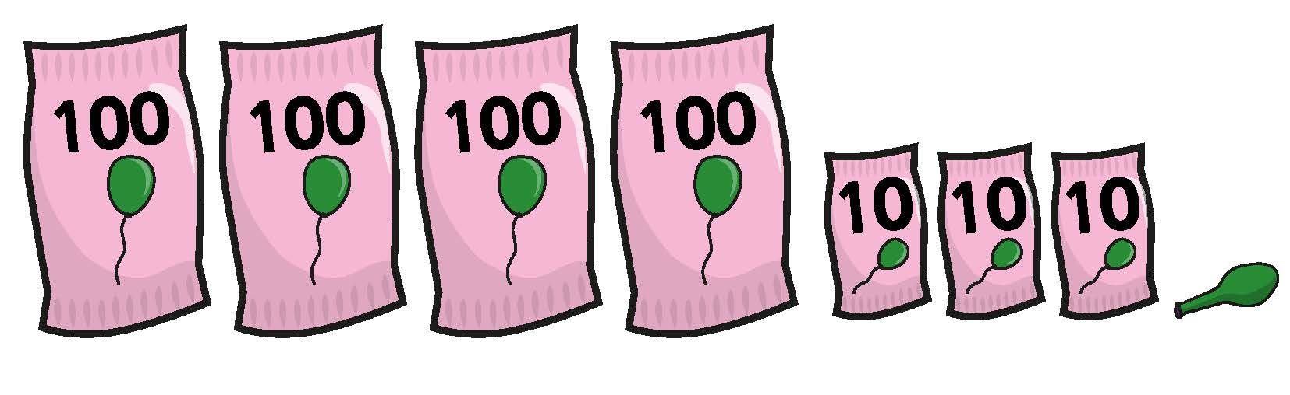
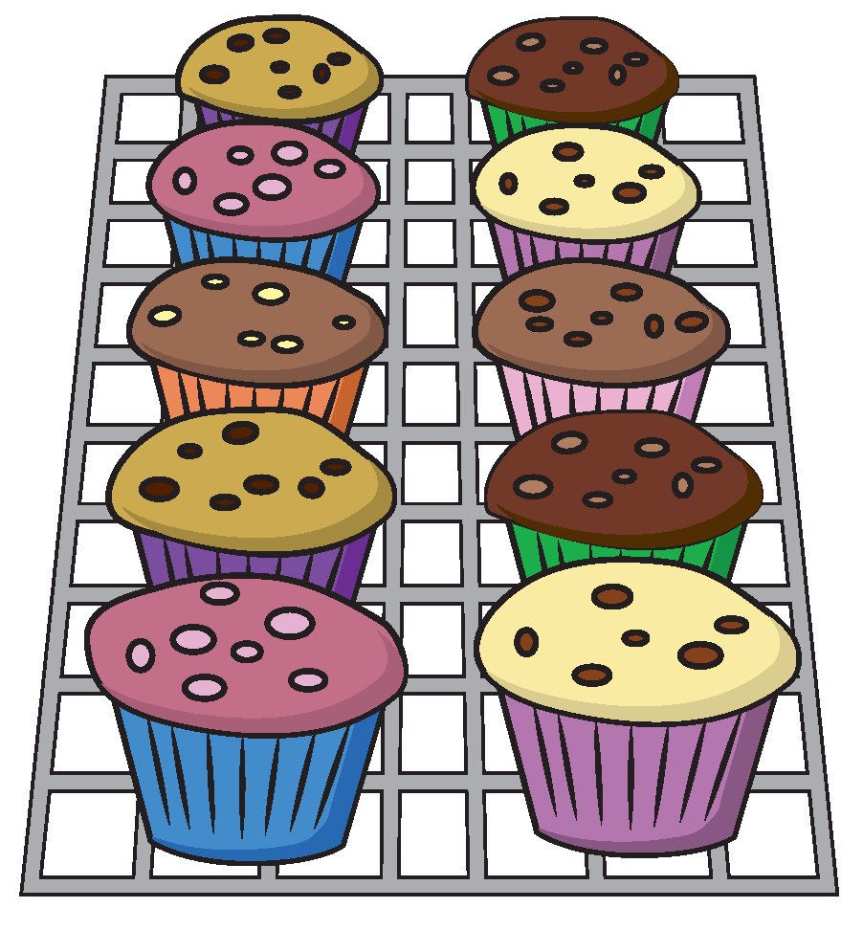
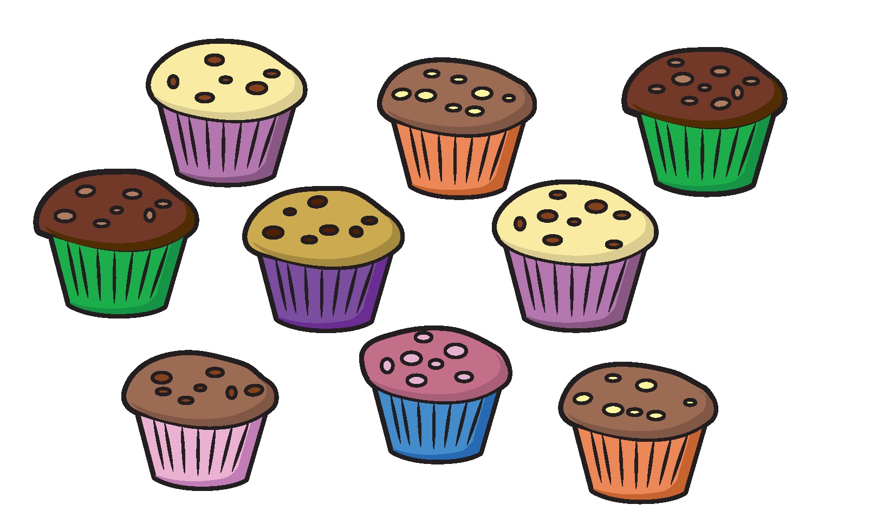






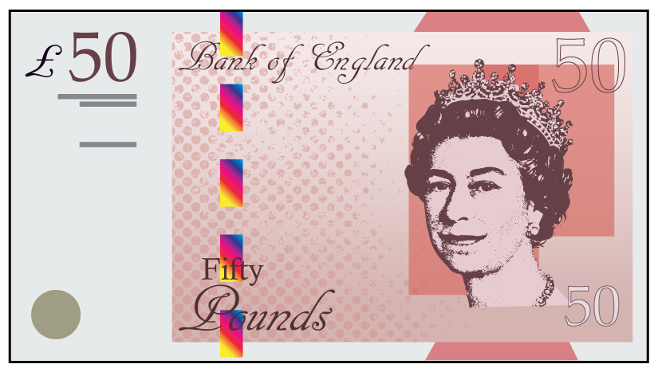

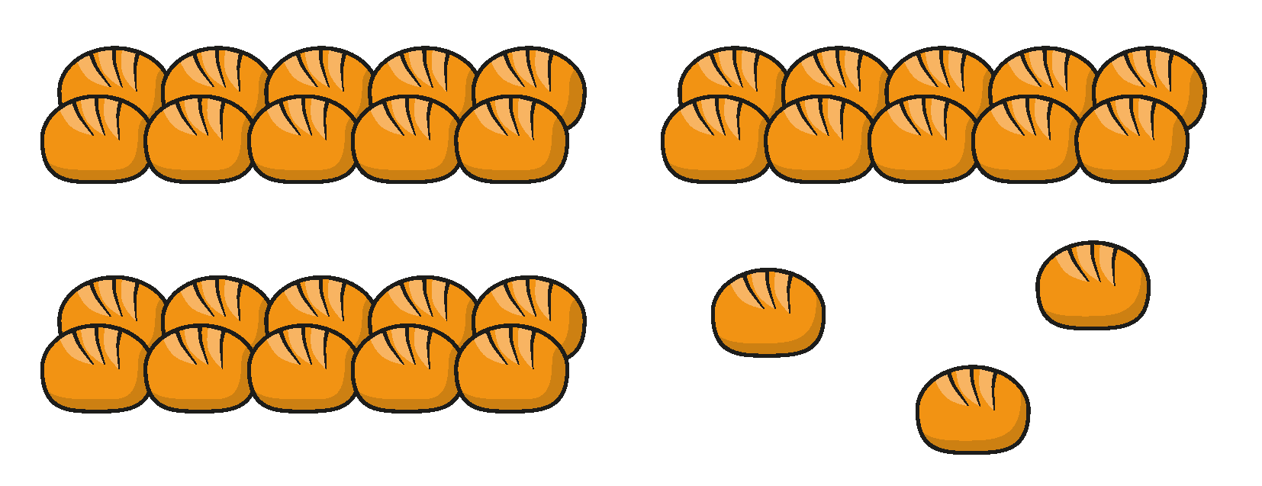

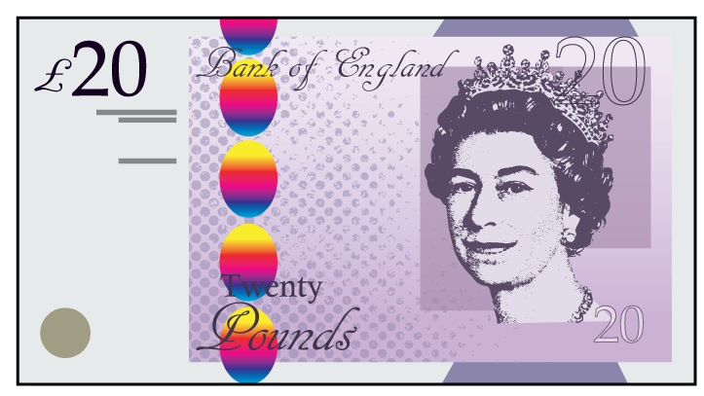

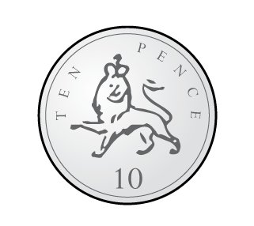





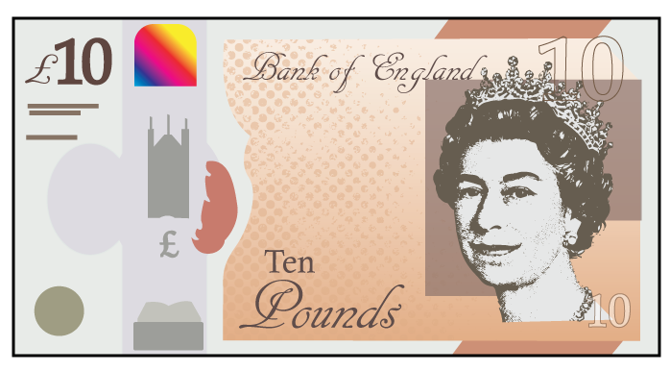




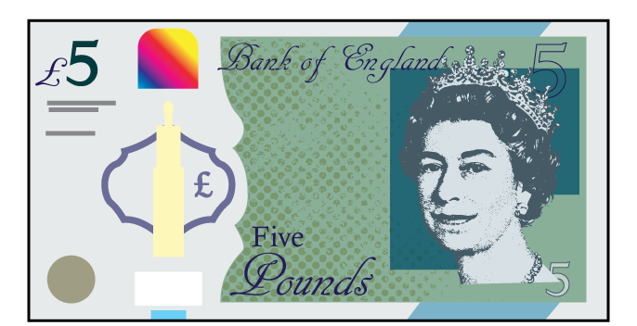
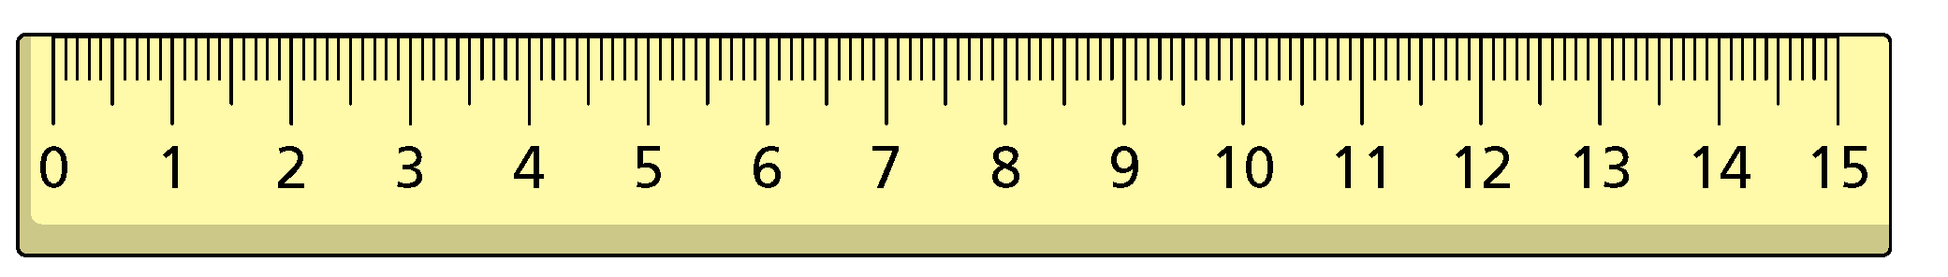
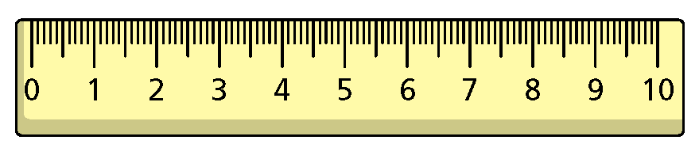

Slide 16
