Slide 2
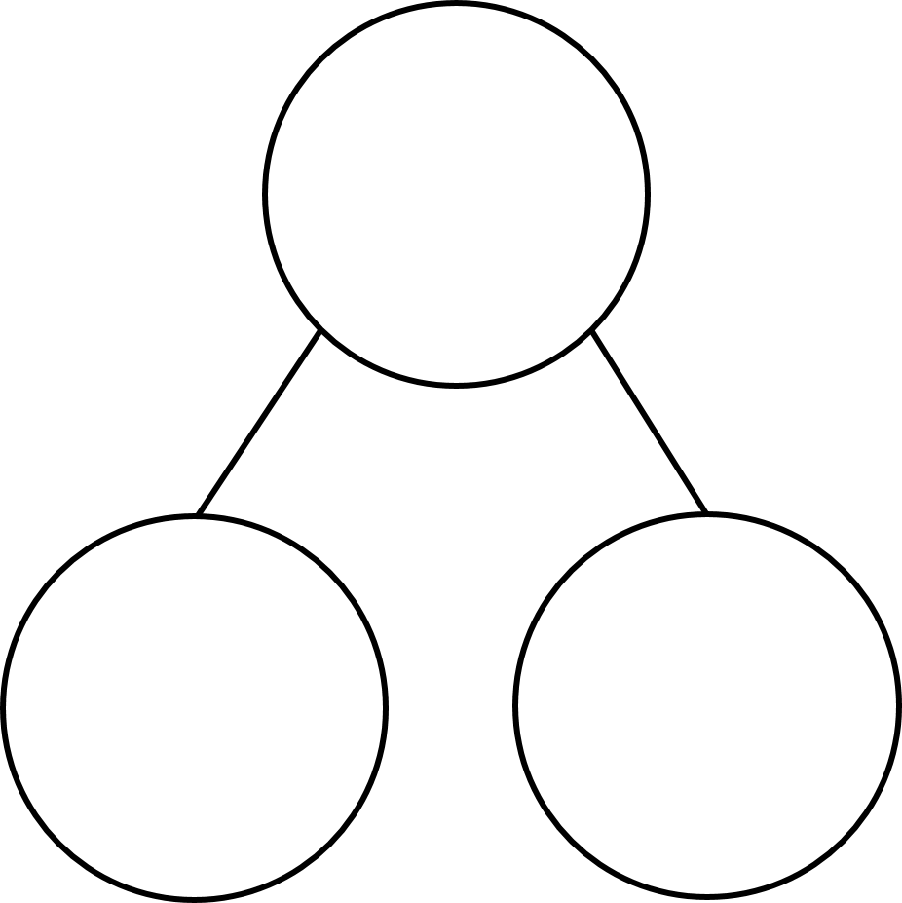

1) 42,384 $+$ 32,313 $=$
2) 22,357 $−$ 12,144 $=$
3) Calculate the missing number.
13,523
?
2,313

Slide 3
1) 42,384 $+$ 32,313 $=$
2) 22,357 $−$ 12,144 $=$
3) Calculate the missing number.
74,697
10,213
13,523
11,210
?
2,313

Slide 5

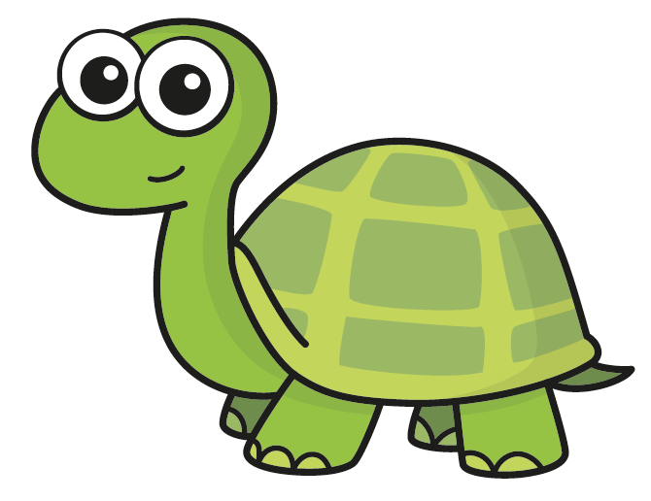
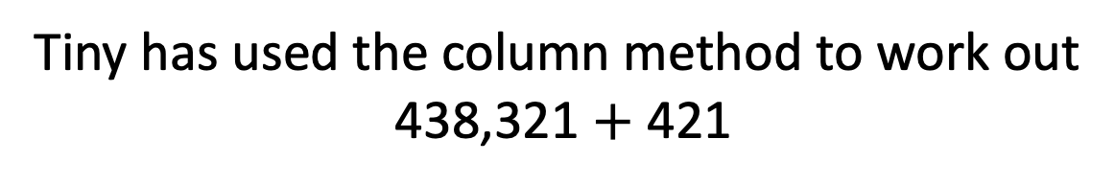
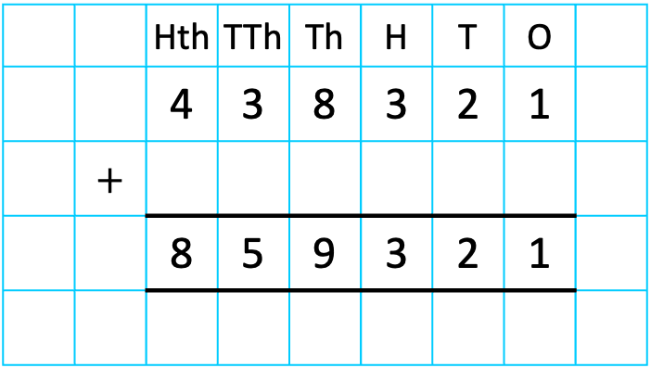
Tiny has used the column method to work out
438,321 $+$ 421
 |  | Hth | TTh | Th | H | T | O
 |  | 4 | 3 | 8 | 3 | 2 | 1
 | $+$
 |  | 8 | 5 | 9 | 3 | 2 | 1
4
2
1
Have a think
The answer is 859,321
What mistake has Tiny made?

Slide 6
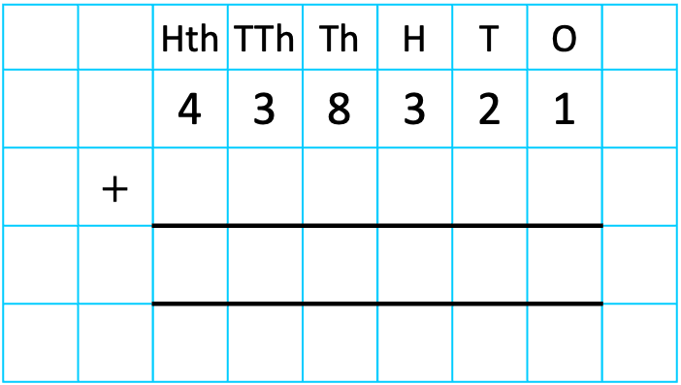
Tiny has used the column method to work out
438,321 $+$ 421
 |  | Hth | TTh | Th | H | T | O
 |  | 4 | 3 | 8 | 3 | 2 | 1
 | $+$
4
2
1
4
3
8
7
4
2
The answer is 859,321
The answer is 438,742

Slide 7
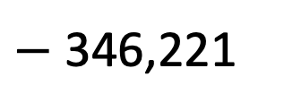
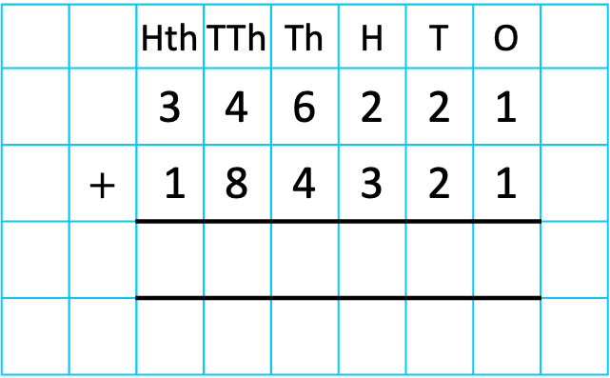


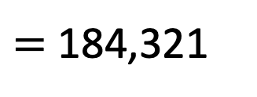
530,542
$−$ 346,221
346,221
$=$ 184,321
184,321
 |  | Hth | TTh | Th | H | T | O
 |  | 3 | 4 | 6 | 2 | 2 | 1
 | $+$ | 1 | 8 | 4 | 3 | 2 | 1
?
5
3
0
5
4
2
1
1
Part $+$ part $=$ whole
Whole $−$ part $=$ part

Slide 8
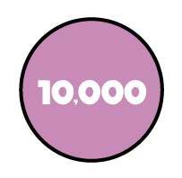
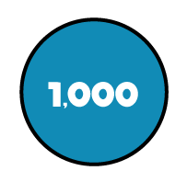

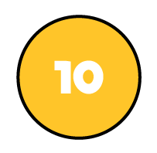


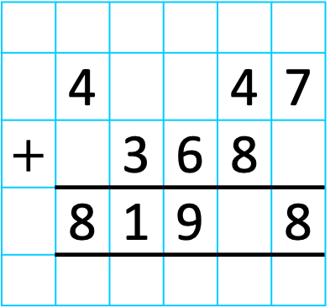
 | 4 |  |  | 4 | 7
$+$ |  | 3 | 6 | 8
 | 8 | 1 | 9 |  | 8
TTh | Th | H | T | O
8
2
3
1
2
1
1
$$+$$
8
1
9
2
8

Slide 9
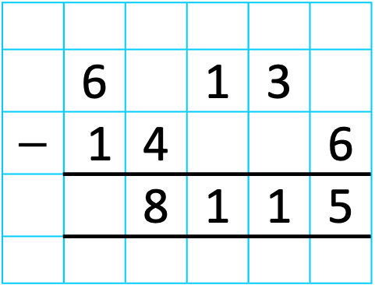
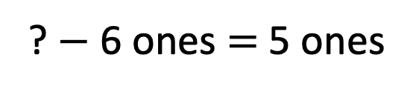
? $−$ 6 ones $=$ 5 ones
 | 6 |  | 1 | 3
$−$ | 1 | 4 |  |  | 6
 |  | 8 | 1 | 1 | 5
2
1
11 ones
1
?
0
1
5 ones
6 ones
TTh | Th | H | T | O

Slide 10
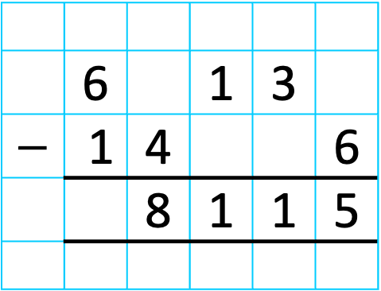
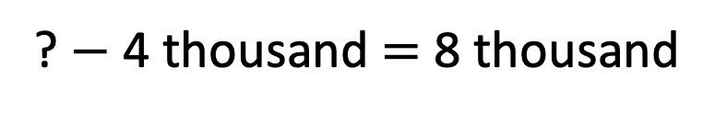
? $−$ 4 thousand $=$ 8 thousand
 | 6 |  | 1 | 3
$−$ | 1 | 4 |  |  | 6
 |  | 8 | 1 | 1 | 5
5
1
2
1
12 thousand
2
1
?
0
1
4
8 Th
4 Th
TTh | Th | H | T | O

Slide 11

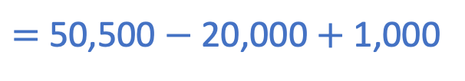
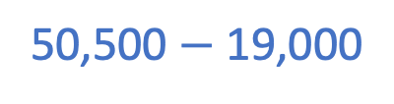

19,000
Find the difference between A and B.
A
6,000 $÷$ 6 $=$ 1,000
20,000
26,000
B
32,500
42,500
10,000 $÷$ 5 $=$ 2,000
50,500
50,500 $−$ 19,000
$=$ 50,500 $−$ 20,000 $+$ 1,000
31,500
Have a think

Slide 12

Have a think
I’m thinking of a number.
I add half a million to it, then subtract 100,000 and I get three million.
What is my number?

Slide 13
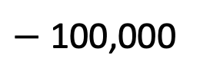
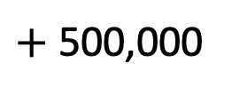
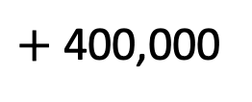
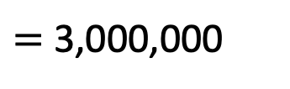
?
I’m thinking of a number.
I add half a million to it, then subtract 100,000 and I get three million.
What is my number?
Whole
$+$ 500,000
$−$ 100,000
$=$ 3,000,000
?
2,600,000
$+$ 400,000
3,000,000
?
400,000

