Slide 1


Slide 3
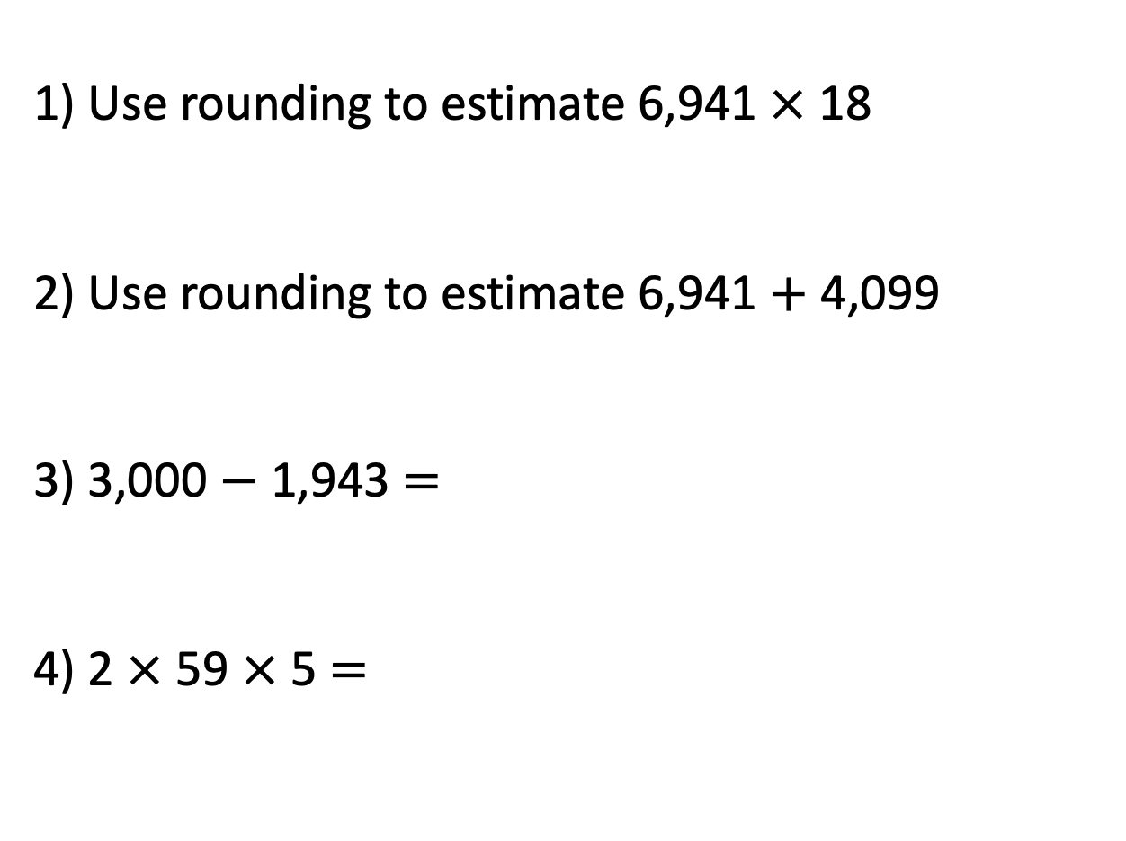
1) Use rounding to estimate 6,941 $×$ 18
2) Use rounding to estimate 6,941 $+$ 4,099
3) 3,000 $−$ 1,943 $=$
4) 2 $×$ 59 $×$ 5 $=$

Slide 4

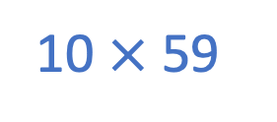
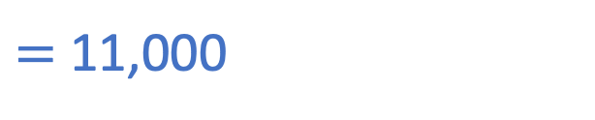

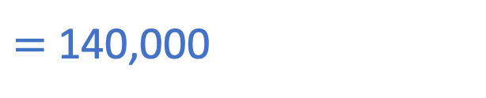
1) Use rounding to estimate 6,941 $×$ 18
2) Use rounding to estimate 6,941 $+$ 4,099
3) 3,000 $−$ 1,943 $=$
4) 2 $×$ 59 $×$ 5 $=$
7,000 $×$ 20
$=$ 140,000
7,000 $+$ 4,000
$=$ 11,000
1,057
590
10
10 $×$ 59

Slide 6

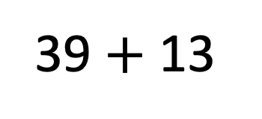
In your head…
39 $+$ 13
How did you do it?
Have a think

Slide 7
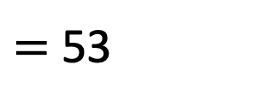
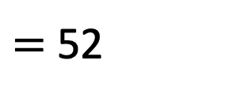
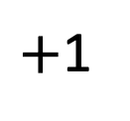
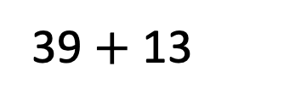
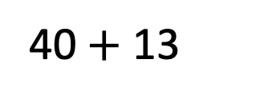
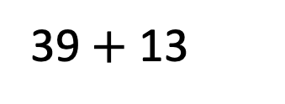
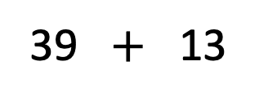
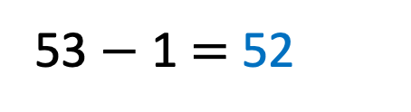
39 $+$ 13
$=$ 52
Strategy 1 – Partitioning and adding
Strategy 2 –
Round then add
39 $+$ 13
39 $+$ 13
$+$1
30
9
10
3
40 $+$ 13
$=$ 53
53 $−$ 1 $=$ 52
40
12
52

Slide 8
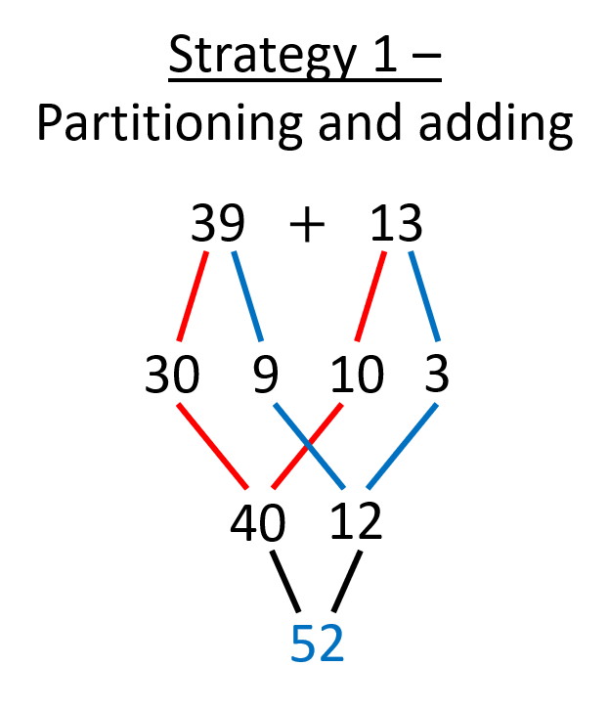
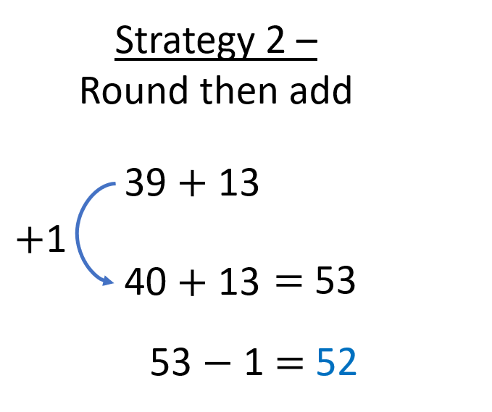
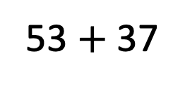
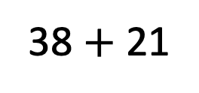
Have a think
Which strategy might you use for these calculations?
38 $+$ 21
53 $+$ 37

Slide 9
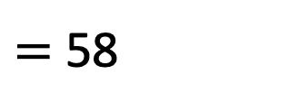
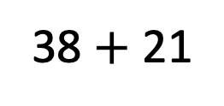

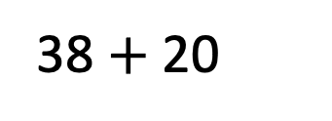
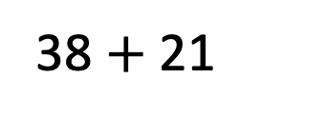
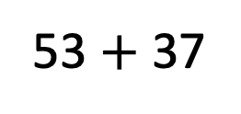
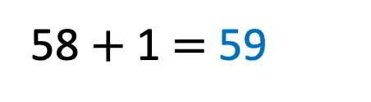
Which strategy might you use for these calculations?
38 $+$ 21
53 $+$ 37
38 $+$ 21
$−$1
38 $+$ 20
$=$ 58
58 $+$ 1 $=$ 59

Slide 10


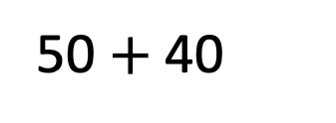
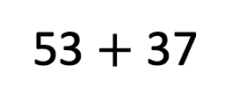
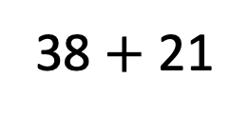
Which strategy might you use for these calculations?
38 $+$ 21
53 $+$ 37
$−$3
$+$3
50 $+$ 40
50
3
30
7
80
10
90

Slide 11
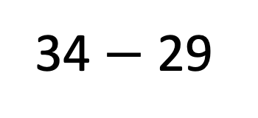
In your head…
34 $−$ 29
How did you do it?
Have a think

Slide 12
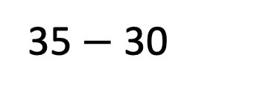
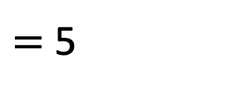
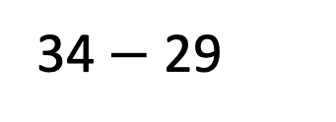
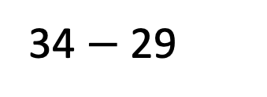
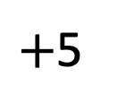
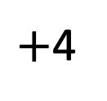
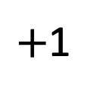
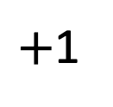
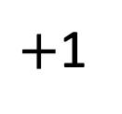
34 $−$ 29
$=$ 5
Strategy 1 –
Count on
Strategy 2 –
Constant difference
34 $−$ 29
$+$1
$+$1
$+$1
$+$5
$+$4
35 $−$ 30
29
30
34

Slide 13
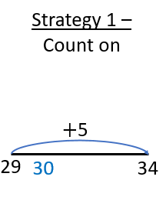
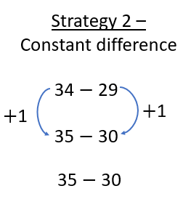
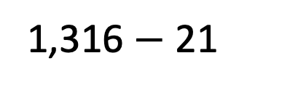
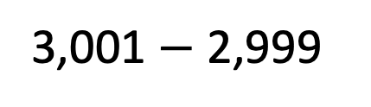
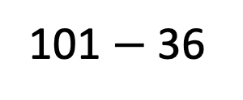
Have a think
Which strategy might you use for these calculations?
3,001 $−$ 2,999
101 $−$ 36
1,316 $−$ 21

Slide 14
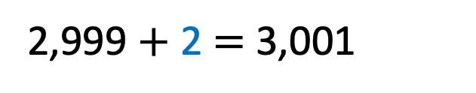
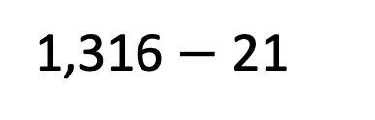
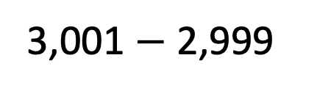
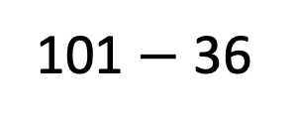
Which strategy might you use for these calculations?
3,001 $−$ 2,999
101 $−$ 36
2,999 $+$ 2 $=$ 3,001
1,316 $−$ 21

Slide 15
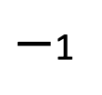
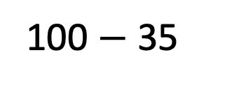
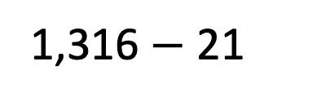
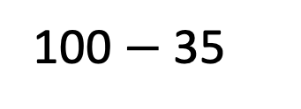
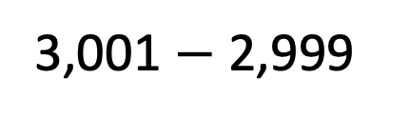



Which strategy might you use for these calculations?
3,001 $−$ 2,999
101 $−$ 36
$−$1
$−$1
100 $−$ 35
100 $−$ 35
$=$ 65
1,316 $−$ 21

Slide 16






Which strategy might you use for these calculations?
3,001 $−$ 2,999
101 $−$ 36
16
5
1,316 $−$ 21
1,316 $−$ 16 $−$ 5
$=$ 1,295
1,300 $−$ 5

Slide 17

In your head…
36 $×$ 5
How did you do it?
Have a think

Slide 18















36 $×$ 5
$=$ 180
Partition
30
6
Strategy 1 –
Double and halve
30 $×$ 5 $=$ 150
Strategy 2 –
Factors
6 $×$ 5 $=$ 30
36 $×$ 5
36 $×$ 5
150 $+$ 30 $=$ 180
$÷$2
$×$2
2 $×$ 18 $×$ 5
18 $×$ 10
$=$ 180
2 $×$ 5 $×$ 18
$=$ 180
10 $×$ 18

Slide 19




Have a think
Which strategy might you use for these calculations?
20 $×$ 37
15 $×$ 14

Slide 20




Which strategy might you use for these calculations?
20 $×$ 37
15 $×$ 14
10 $×$ 74
$=$ 740

Slide 21







Which strategy might you use for these calculations?
20 $×$ 37
15 $×$ 14
$$×$$
2 $×$ 7
3 $×$ 5
$$×$$
10
21
$=$ 210

Slide 22



Slide 23
Have a go at questions

Slide 24
I do
You do

Slide 25
















Rosie
Alex
Amir
Whitney
Ron
Dexter
Annie
Tommy
Mo
Jack
Eva
Teddy
Max
Kim
Jo
Sam

Slide 26



Speech bubble text – replace with any character head.
Speech bubble text – replace with any character head.
Bee
Diddy
Tiny

Slide 27






















M | HTh | TTh | Th | H | T | O | Tth | Hth | Thth
100
40 | 60
Millions | Thousands |  |  | Ones
O | H | T | O | H | T | O

Slide 28









































Slide 29


























































