Slide 1
Santa has sent out party invitations for your Pod party next week, but as he was delivering them, they fell out of his sleigh! Now, they’re scattered around, and Santa needs your help to find them!

Slide 2
Question 1:
2 + 8 =

Slide 3
10

Slide 4

Clue:

Slide 5
Question 2:
7 + ? = 10

Slide 6
3

Slide 7

Clue:

Slide 8
Question 3:
4 + ? = 10

Slide 9
6

Slide 10
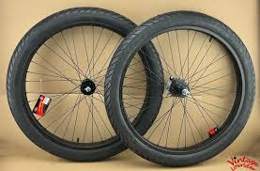
Clue:

Slide 11
Question 4:
5 + ? = 10

Slide 12
5

Slide 13

Clue:

Slide 14
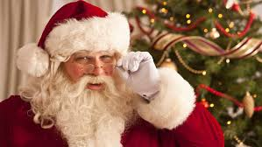

Well done!

