Slide 1

Notes:
Sally Holland is the Children’s Commissioner for Wales. She is the third children’s commissioner in Wales and has held the post since 2015.

Slide 2
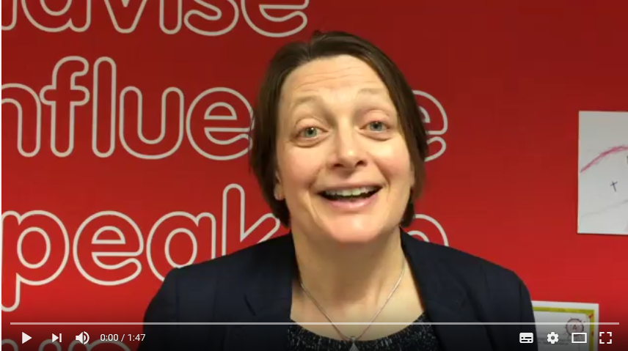
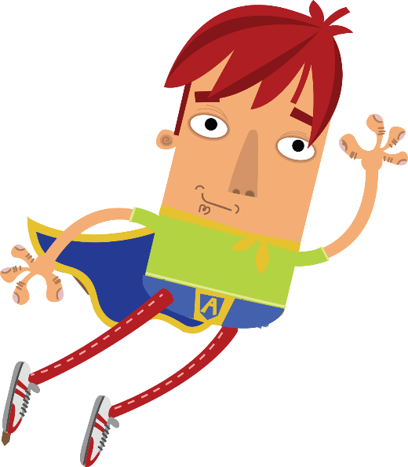
This is Sally
The Children’s Commissioner for Wales
Sally Holland
Notes:
This is Sally Holland, the Children’s Commissioner for Wales. Sally is the third children’s commissioner in Wales. Play the video to hear Sally explain her role as Children’s Commissioner.

Slide 3
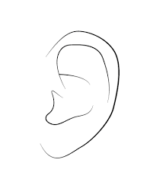
It’s Sally’s job to:
Listen to what you have to say
Notes:
Sally has five important jobs. The first is to listen to what children in Wales think and hear about their experiences.

Slide 4

It’s Sally’s job to:
Speak Up for children in Wales
Notes:
The second job is to speak up for children so that adults consider children when they make decisions.

Slide 5

It’s Sally’s job to:
Tell you about your rights.
Notes:
Sally tells children and young people about their rights in lots of ways. An important way is through the Super Ambassador scheme. Super Ambassadors need to make sure that children in their school know that they have rights and what their rights are.

Slide 6

It’s Sally’s job to:
Help you to get your rights
Notes:
Sally and her team work to make sure that all children in Wales get their rights.

Slide 7

It’s Sally’s job to:
Talk to you if you have a problem
Notes:
There is a free phone number you can call to talk to Sally’s team. We’ll show it at the end of the presentation and you can also find it on the Children’s Rights posters in school.

Slide 8
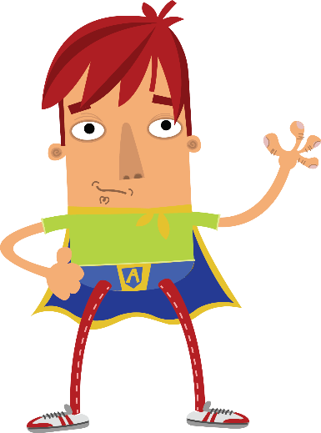

What are children’s rights?
These are the things you need to be happy, healthy and safe.
They are written down in the Convention of the Rights of the Child
Notes:
Children’s rights are the things that all children should experience to be happy, healthy and safe. Every child under 18 has rights.

Slide 9

Notes:
This video shows how the United Nations and the different countries of the world developed the list of things that all children and young people need to be happy, healthy and safe. This is called the Convention on the Rights of the Child. CLICK ON THE PICTURE TO PLAY:
[Hyperlinked to http://www.uncrcletsgetitright.co.uk/index.php/training-materials/videos]

Slide 10

Super Ambassadors have three jobs:
Tell you about your rights
Tell you about Sally and her job
Do a special mission every term
Notes:
The Super Ambassadors in this school are…..
[This is a good opportunity to tell everyone the names of the Ambassadors in your school]
Come and talk to us if you want to find out more about your rights or if you’d like to help us with our jobs.
[This is a good opportunity to get other children involved with any current activities]

Slide 11
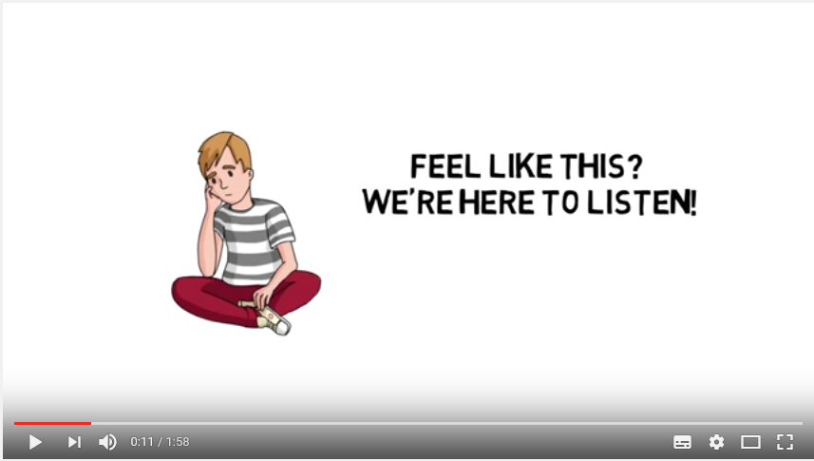
Notes:
Sally can also help you if you think you are being treated unfairly.
CLICK ON THE VIDEO and it will explain how Sally’s office does this: https://youtu.be/GtBF5DgTajo
You can call Sally’s office if you are worried you are not getting your rights.
Any adult that is worried about a child can also call Sally’s office on the same number.

Slide 12
01792 765600
Children’s Commissioner for Wales
Oystermouth House
Phoenix Way
Llansamlet
Swansea, SA7 9FS
@childcomwales
Investigations and Advice Line
0808 8011000
Let us know if you’ve shared this presentation by tweeting @childcomwales and using the hashtag #RightsHour
Notes:
You can also contact the Children’s Commissioner in any of these ways.

