Slide 1


Slide 3



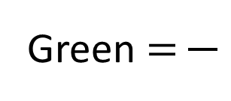

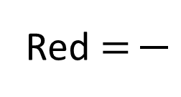
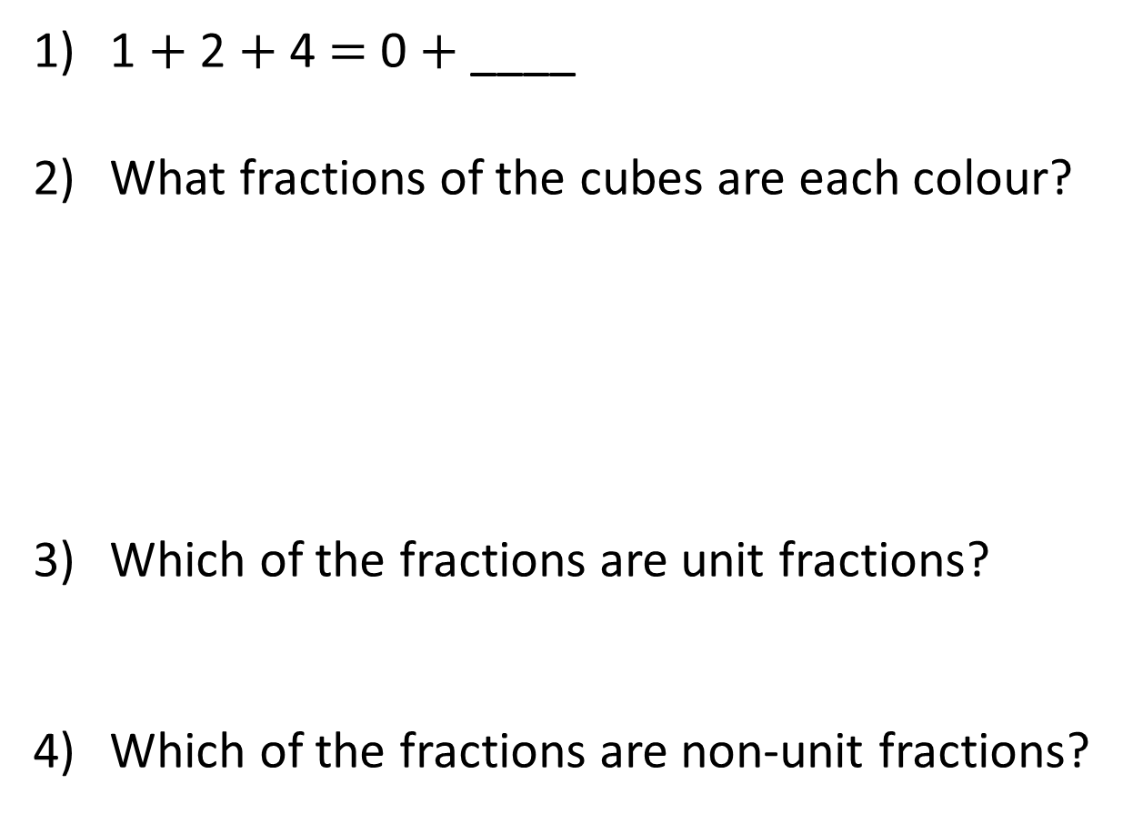
1 $+$ 2 $+$ 4 $=$ 0 $+$ ____
What fractions of the cubes are each colour?
Which of the fractions are unit fractions?
Which of the fractions are non-unit fractions?
Yellow $=$
Red $=$
Green $=$

Slide 4


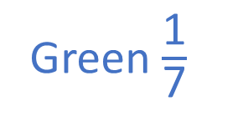
1 $+$ 2 $+$ 4 $=$ 0 $+$ ____
What fractions of the cubes are each colour?
Which of the fractions are unit fractions?
Which of the fractions are non-unit fractions?
7
4
2
1
Yellow $=$
Red $=$
Green $=$
7
7
7
Green $\frac{\text{1}}{\text{7}}$
Yellow $\frac{\text{4}}{\text{7}}$
Red $\frac{\text{2}}{\text{7}}$

Slide 6

Which shapes show equal parts?
Have a think

Slide 7

The whole has been divided into ____ equal parts.
4
$\frac{\text{1}}{\text{4}}$
Each part is worth

Slide 8

The whole has been divided into ____ equal parts.
8
Have a think
$\frac{\text{1}}{\text{8}}$
Each part is worth

Slide 9


What fraction of the shape is shaded?
$\frac{\text{3}}{\text{5}}$
What fraction of the shape is not shaded?
$\frac{\text{2}}{\text{5}}$

Slide 10


What fraction of the shape is shaded?
$\frac{\text{10}}{\text{10}}$
What fraction of the shape is not shaded?
$\frac{\text{0}}{\text{10}}$
Have a think

Slide 11


Have a think
What fraction of the shape is shaded?
$\frac{\text{4}}{\text{7}}$
What fraction of the shape is not shaded?
$\frac{\text{3}}{\text{7}}$

Slide 12




Shade the bar model to make one whole.
3
To make 1 whole, ___ equal parts are shaded.
$\frac{\text{7}}{\text{10}}$
$$+$$
$\frac{\text{3}}{\text{10}}$
$$=$$
1

Slide 13


Shade the bar model to make one whole.
5
To make 1 whole, ___ equal parts are shaded.
$\frac{\text{2}}{\text{7}}$
$$+$$
$\frac{\text{5}}{\text{7}}$
$$=$$
1
Have a think

Slide 14






$\frac{\text{7}}{\text{8}}$
Is a small or large part of the whole?
Who do you agree with?
Have a think

Slide 15

Eva spills paint over her diagram.
What fraction could be shaded?
$\frac{\text{5}}{\text{6}}$

Slide 16

Eva spills paint over her diagram.
What fraction could be shaded?
$\frac{\text{6}}{\text{8}}$

Slide 17



Slide 18
Have a go at questions

Slide 19
I do
You do

Slide 20
















Rosie
Alex
Amir
Whitney
Ron
Dexter
Annie
Tommy
Mo
Jack
Eva
Teddy
Max
Kim
Jo
Sam

Slide 21



Speech bubble text – replace with any character head.
Speech bubble text – replace with any character head.
Bee
Diddy
Tiny

Slide 22


















100
40 | 60
TTh | Th | H | T | O | Tth | Hth

Slide 23









































Slide 24


























































