Slide 1


Slide 3
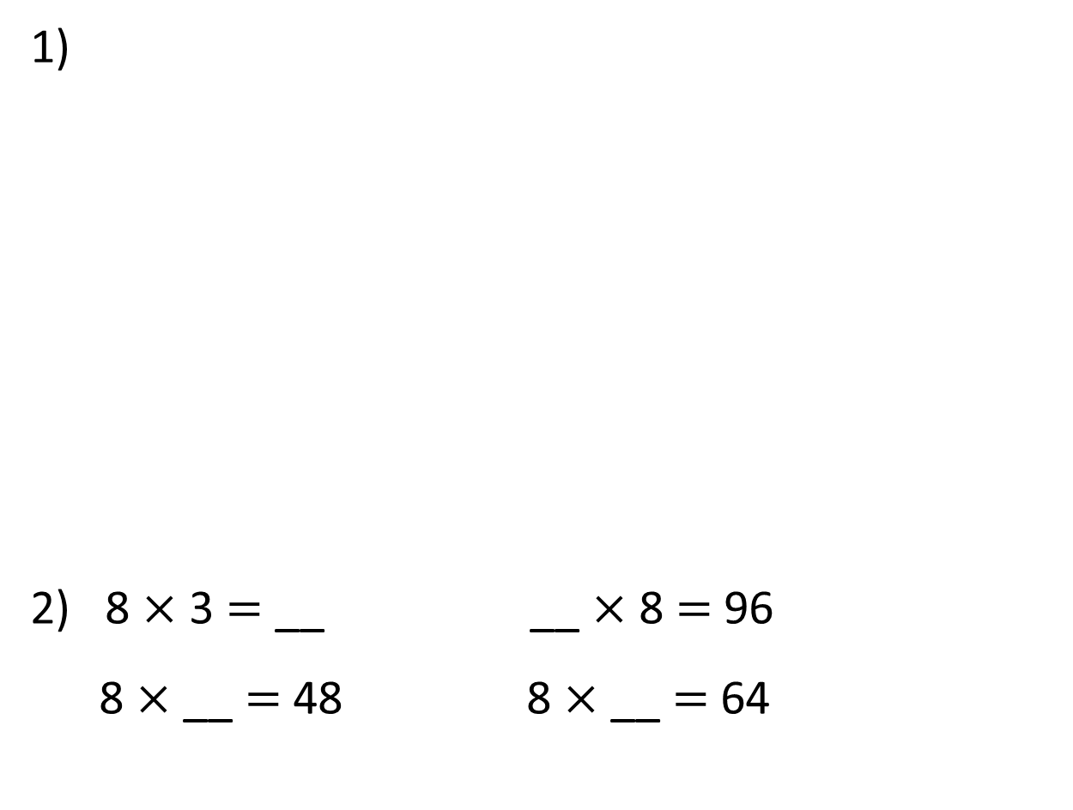
1)
2) 8 $×$ 3 $=$ __ __ $×$ 8 $=$ 96
8 $×$ __ $=$ 48 8 $×$ __ $=$ 64
What fractions are represented?
0
1

Slide 4



1)
2) 8 $×$ 3 $=$ __ __ $×$ 8 $=$ 96
8 $×$ __ $=$ 48 8 $×$ __ $=$ 64
What fractions are represented?
$\frac{1}{4}$
$\frac{1}{3}$
$\frac{1}{5}$
0
1
24
12
6
8

Slide 6


Dora and Dexter each have a strip of paper.
They each fold their paper in half.
Dexter then folds his in half again.
Dora
Dexter

Slide 7

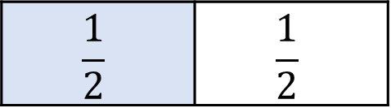
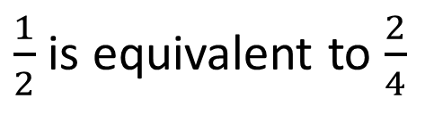
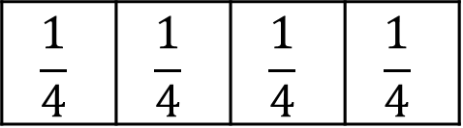
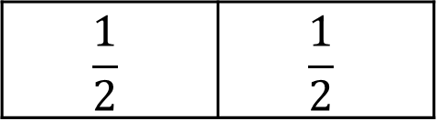
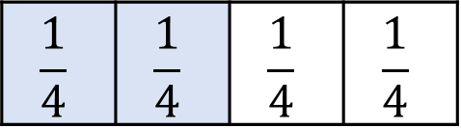
Have a think
What do you notice?
What fractions can you see on their strips of paper?
$$\frac{1}{2}$$ | $$\frac{1}{2}$$
$$\frac{1}{2}$$ | $$\frac{1}{2}$$
$$\frac{1}{4}$$ | $$\frac{1}{4}$$ | $$\frac{1}{4}$$ | $$\frac{1}{4}$$
$$\frac{1}{4}$$ | $$\frac{1}{4}$$ | $$\frac{1}{4}$$ | $$\frac{1}{4}$$
$\frac{1}{2}$ is equivalent to $\frac{2}{4}$
Dora
Dexter

Slide 8
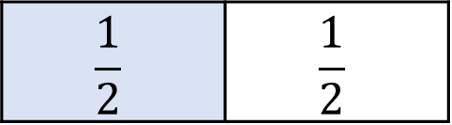
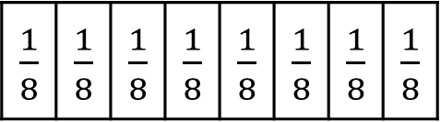
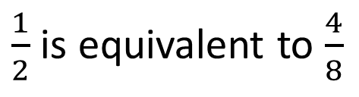
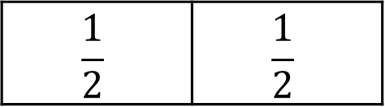
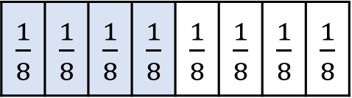
Have a think
Dexter folds his paper in half again.
Now what do you notice?
$$\frac{1}{2}$$ | $$\frac{1}{2}$$
$$\frac{1}{2}$$ | $$\frac{1}{2}$$
$\frac{1}{8}$ | $\frac{1}{8}$ | $\frac{1}{8}$ | $\frac{1}{8}$ | $\frac{1}{8}$ | $\frac{1}{8}$ | $\frac{1}{8}$ | $\frac{1}{8}$
$\frac{1}{8}$ | $\frac{1}{8}$ | $\frac{1}{8}$ | $\frac{1}{8}$ | $\frac{1}{8}$ | $\frac{1}{8}$ | $\frac{1}{8}$ | $\frac{1}{8}$
$\frac{1}{2}$ is equivalent to $\frac{4}{8}$
Dora
Dexter

Slide 9
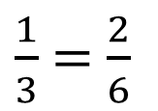
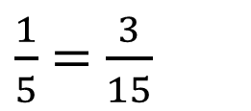
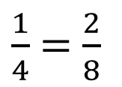
What equivalent fractions can you see from these strips of paper?
Have a think
$\frac{1}{3}$ $=$ $\frac{2}{6}$
$\frac{1}{5}$ $=$ $\frac{3}{15}$
$\frac{1}{4}$ $=$ $\frac{2}{8}$

Slide 10





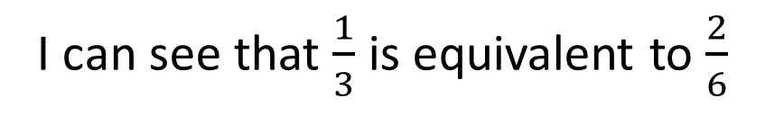


0
$\frac{1}{3}$
$\frac{2}{3}$
1
0
$\frac{1}{6}$
$\frac{2}{6}$
$\frac{3}{6}$
$\frac{4}{6}$
$\frac{5}{6}$
1
You can also show equivalent fractions on a number line.
I can see that $\frac{1}{3}$ is equivalent to $\frac{2}{6}$

Slide 11

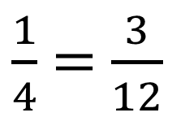

$×$ 3
$\frac{1}{4}$ $=$ $\frac{3}{12}$
$×$ 3
I notice that with equivalent fractions, you multiply the numerator and the denominator by the same amount.

Slide 12

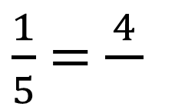


Have a think
$×$ 4
$\frac{1}{5}$ $=$ $\frac{4}{}$
$$20$$
$×$ 4
4
The numerator has been multiplied by ___, so if the denominator is multiplied by ___, then the fractions will be equivalent.
4

Slide 13


$\frac{1}{4}$ $=$ $\frac{3}{12}$
$×$ 4
$×$ 4
I notice two fractions are equivalent if both numerators multiply by the same number to make the denominators.

Slide 14

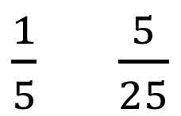
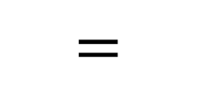

$\frac{1}{5}$ $\frac{5}{25}$
$$=$$
$×$ 5
$×$ 5
5
The denominator is ___ times the numerator in both fractions, so the fractions are _________ .
equivalent

Slide 15





Are the fractions equivalent?
$×$ 3
$\frac{1}{6}$ $=$ $\frac{3}{18}$ $=$ $\frac{2}{12}$
$×$ 6
$×$ 6
$×$ 3

Slide 16







What are the missing numbers?
Have a think
$×$ 4
$\frac{1}{2}$ $=$ $\frac{4}{}$ $=$ $\frac{}{10}$
$$5$$
$÷$ 2
$÷$ 2
$$8$$
$×$ 4

Slide 17



Slide 18
Have a go at questions

Slide 19
I do
You do

Slide 20
















Rosie
Alex
Amir
Whitney
Ron
Dexter
Annie
Tommy
Mo
Jack
Eva
Teddy
Max
Kim
Jo
Sam

Slide 21



Speech bubble text – replace with any character head.
Speech bubble text – replace with any character head.
Bee
Diddy
Tiny

Slide 22






















M | HTh | TTh | Th | H | T | O | Tth | Hth | Thth
100
40 | 60
Millions | Thousands |  |  | Ones
O | H | T | O | H | T | O

Slide 23










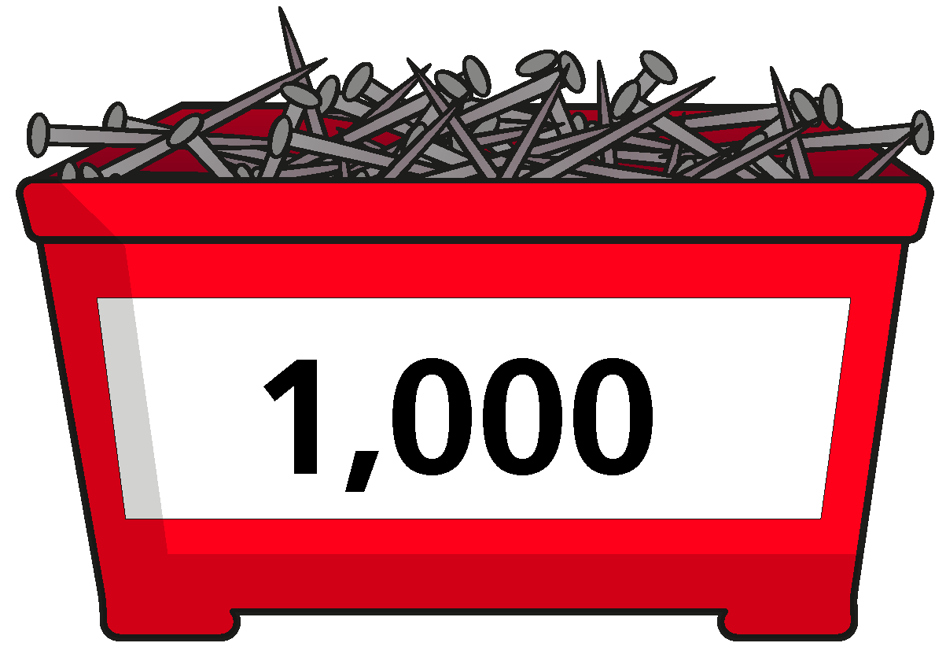
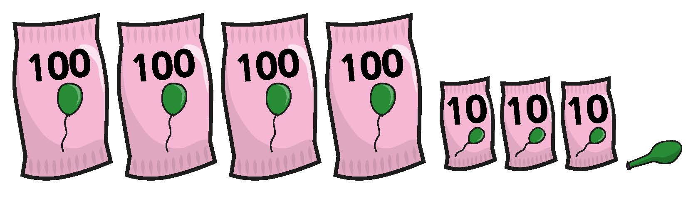

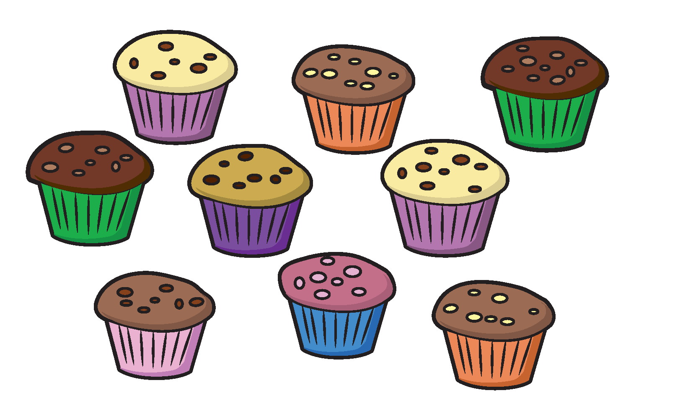



























Slide 24


























































