Slide 1


Slide 2
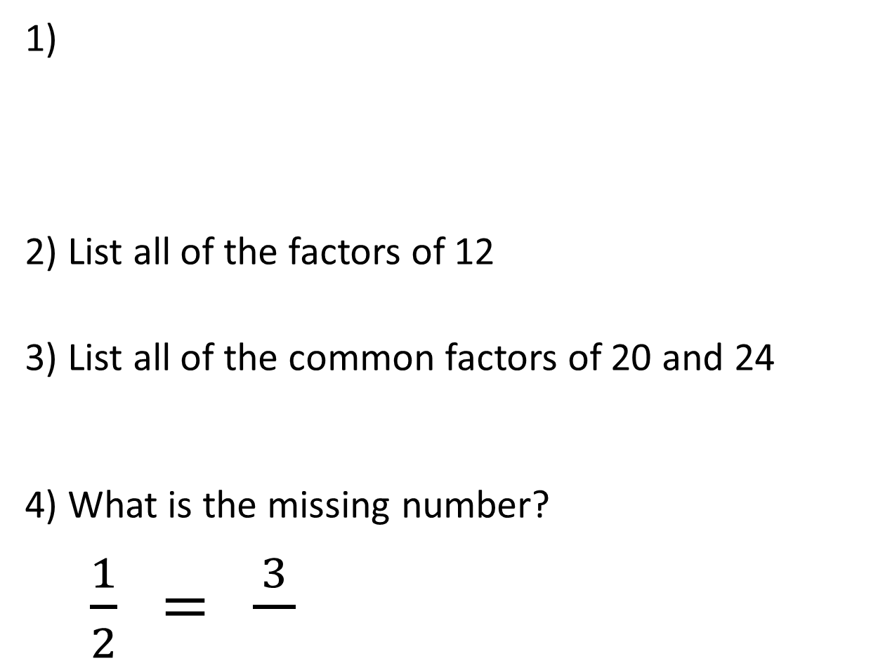
1)
2) List all of the factors of 12
3) List all of the common factors of 20 and 24
4) What is the missing number?
$\frac{1}{2}$ $=$ $\frac{3}{}$
What fraction is represented?

Slide 3


1)
2) List all of the factors of 12
3) List all of the common factors of 20 and 24
4) What is the missing number?
$\frac{1}{2}$ $=$ $\frac{3}{}$
What fraction is represented?
$\frac{3}{7}$
1, 2, 3, 4, 6, 12
1, 2, 4
$$6$$

Slide 5

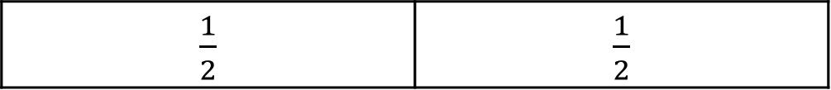
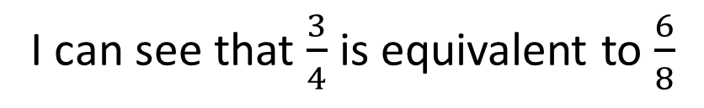
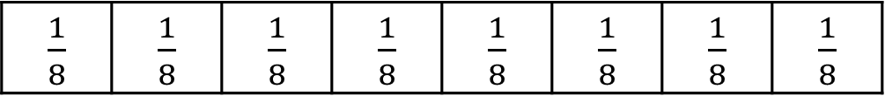
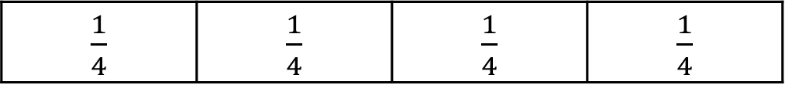
Ron is making fraction walls to help him find equivalent fractions.
1 whole
$\frac{1}{2}$ | $\frac{1}{2}$
$\frac{1}{4}$ | $\frac{1}{4}$ | $\frac{1}{4}$ | $\frac{1}{4}$
$\frac{1}{8}$ | $\frac{1}{8}$ | $\frac{1}{8}$ | $\frac{1}{8}$ | $\frac{1}{8}$ | $\frac{1}{8}$ | $\frac{1}{8}$ | $\frac{1}{8}$
I can see that $\frac{3}{4}$ is equivalent to $\frac{6}{8}$

Slide 6
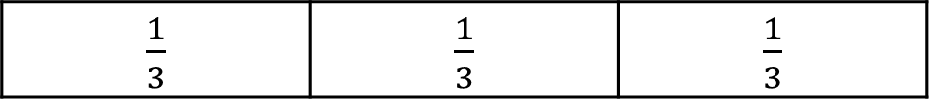
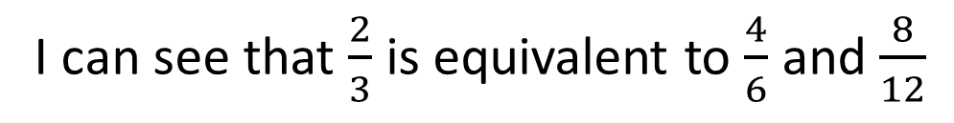
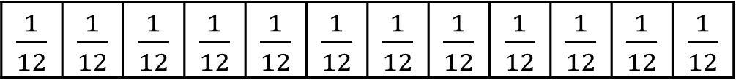
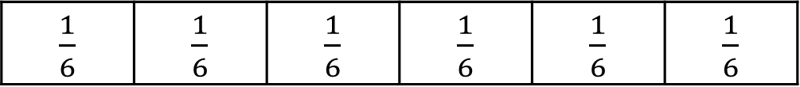
Ron is making fraction walls to help him find equivalent fractions.
1 whole
$\frac{1}{3}$ | $\frac{1}{3}$ | $\frac{1}{3}$
$\frac{1}{6}$ | $\frac{1}{6}$ | $\frac{1}{6}$ | $\frac{1}{6}$ | $\frac{1}{6}$ | $\frac{1}{6}$
$\frac{1}{12}$ | $\frac{1}{12}$ | $\frac{1}{12}$ | $\frac{1}{12}$ | $\frac{1}{12}$ | $\frac{1}{12}$ | $\frac{1}{12}$ | $\frac{1}{12}$ | $\frac{1}{12}$ | $\frac{1}{12}$ | $\frac{1}{12}$ | $\frac{1}{12}$
I can see that $\frac{2}{3}$ is equivalent to $\frac{4}{6}$ and $\frac{8}{12}$

Slide 7

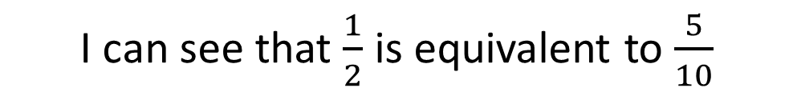
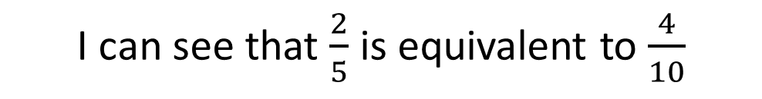
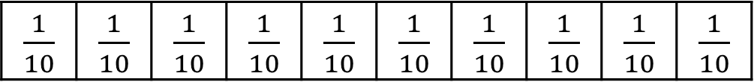
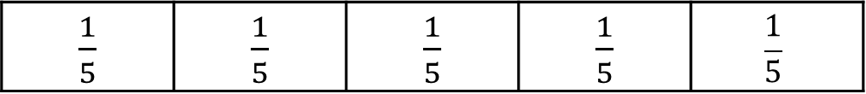
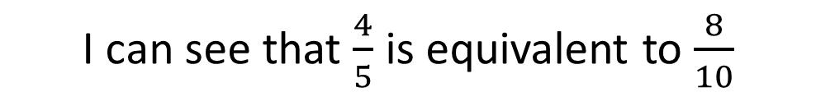
Have a think
What equivalent fractions can you see?
1 whole
$\frac{1}{2}$ | $\frac{1}{2}$
$\frac{1}{5}$ | $\frac{1}{5}$ | $\frac{1}{5}$ | $\frac{1}{5}$ | $$\frac{1}{5}$$
$\frac{1}{10}$ | $\frac{1}{10}$ | $\frac{1}{10}$ | $\frac{1}{10}$ | $\frac{1}{10}$ | $\frac{1}{10}$ | $\frac{1}{10}$ | $\frac{1}{10}$ | $\frac{1}{10}$ | $\frac{1}{10}$
I can see that $\frac{1}{2}$ is equivalent to $\frac{5}{10}$
I can see that $\frac{2}{5}$ is equivalent to $\frac{4}{10}$
I can see that $\frac{4}{5}$ is equivalent to $\frac{8}{10}$

Slide 8




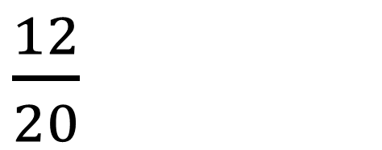
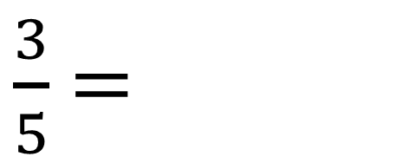
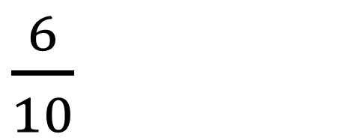

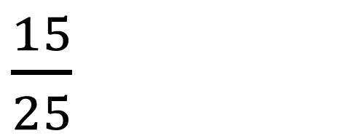


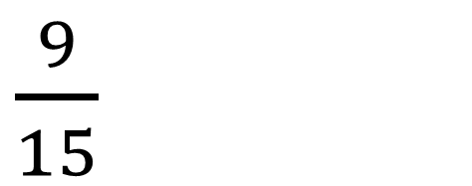

$×$ 4
$×$ 3
$×$ 2
$×$ 5
$\frac{3}{5}$ $=$
$\frac{12}{20}$
$\frac{9}{15}$
$\frac{6}{10}$
$\frac{15}{25}$
$×$ 4
$×$ 3
$×$ 2
$×$ 5
I know that if you multiply the numerator and the denominator by the same amount, the fractions will be equivalent.

Slide 9


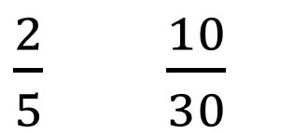



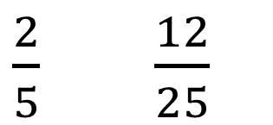

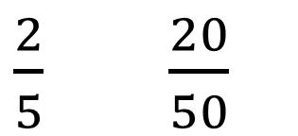


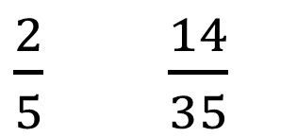


Which of these pairs of fractions are equivalent?
Have a think
$×$ 5
$×$ 10
$\frac{2}{5}$ $\frac{10}{30}$
$\frac{2}{5}$ $\frac{20}{50}$
$$=$$
$×$ 6
$×$ 10
$×$ 7
$×$ 6
$\frac{2}{5}$ $\frac{14}{35}$
$\frac{2}{5}$ $\frac{12}{25}$
$$=$$
`
$×$ 7
$×$ 5

Slide 10
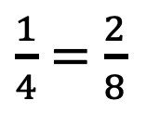
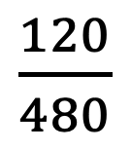
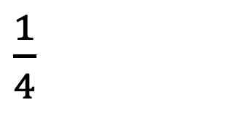
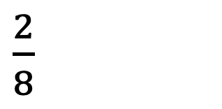
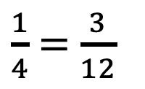
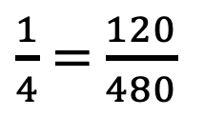
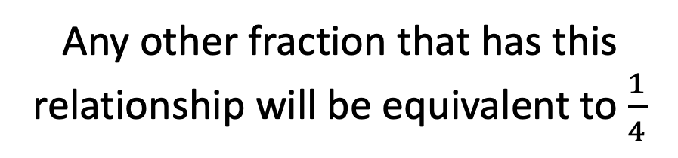





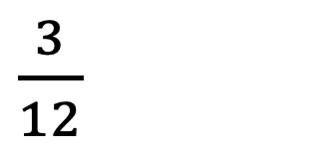

$\frac{3}{12}$
$\frac{1}{4}$
$\frac{2}{8}$
$\frac{120}{480}$
$×$ 4
$×$ 4
$×$ 4
$×$ 4
$÷$ 4
$÷$ 4
$÷$ 4
$÷$ 4
$\frac{1}{4}$ $=$ $\frac{2}{8}$
$\frac{1}{4}$ $=$ $\frac{3}{12}$
$\frac{1}{4}$ $=$ $\frac{120}{480}$
Any other fraction that has this relationship will be equivalent to $\frac{1}{4}$
The numerator is 4 times greater than the denominator.

Slide 11

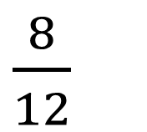

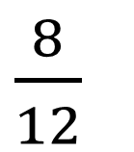
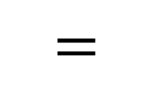
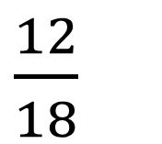
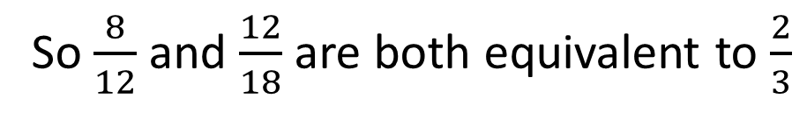
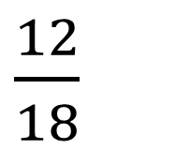

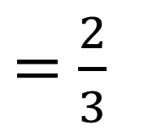

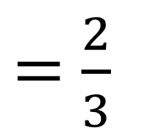



Are these fractions equivalent?
Have a think
$÷$ 4
$×$ ?
$÷$ 6
$\frac{8}{12}$
$=$ $\frac{2}{3}$
$\frac{8}{12}$
$\frac{12}{18}$
$\frac{12}{18}$
$=$ $\frac{2}{3}$
$$=$$
$×$ ?
$÷$ 4
$÷$ 6
4
6
___ is a common factor of the numerator and the denominator, so I can divide both of these by ___ to find an equivalent fraction.
___ is a common factor of the numerator and the denominator, so I can divide both of these by ___ to find an equivalent fraction.
8 doesn’t go into 12 so they can’t be equivalent.
So $\frac{8}{12}$ and $\frac{12}{18}$ are both equivalent to $\frac{2}{3}$
4
6

