Slide 1
Instructions
For best results, play the PowerPoint as a slideshow.
Read the number that the dragon is asking for.
Look at the number shapes. Choose the number shape that matches the number the dragon wants.
Click on the ‘check’ button to check your answer.

Slide 3
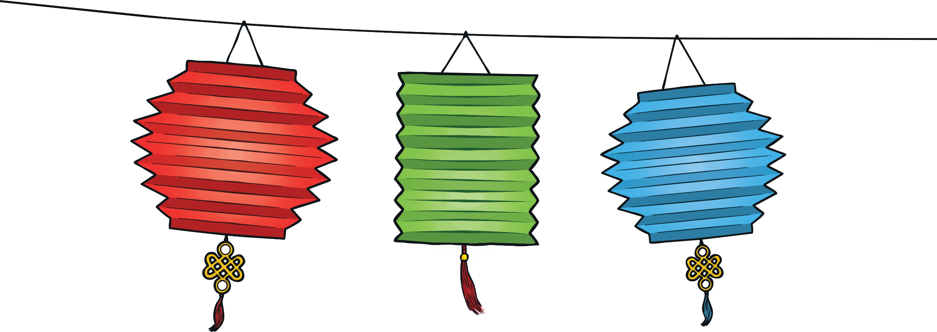




2
Try Again
Try Again

Slide 4




2
Well Done

Slide 5




4
Try Again
Try Again

Slide 6


4
Well Done

Slide 7


1
Try Again
Try Again

Slide 8
1
Well Done

Slide 9




5
Try Again
Try Again

Slide 10
5
Well Done

Slide 11


3
Try Again
Try Again

Slide 12
3
Well Done

Slide 13


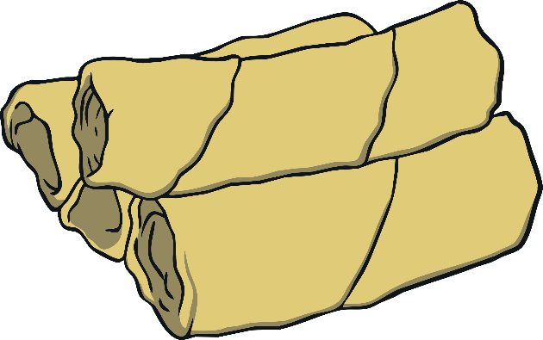
8
Try Again
Try Again

Slide 14


8
Well Done

Slide 15


7
Try Again
Try Again

Slide 16
7
Well Done

Slide 17
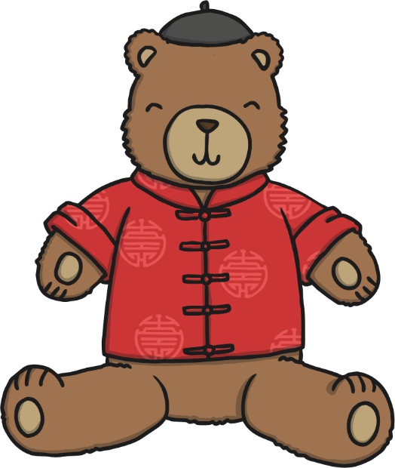
9
Try Again
Try Again

Slide 18
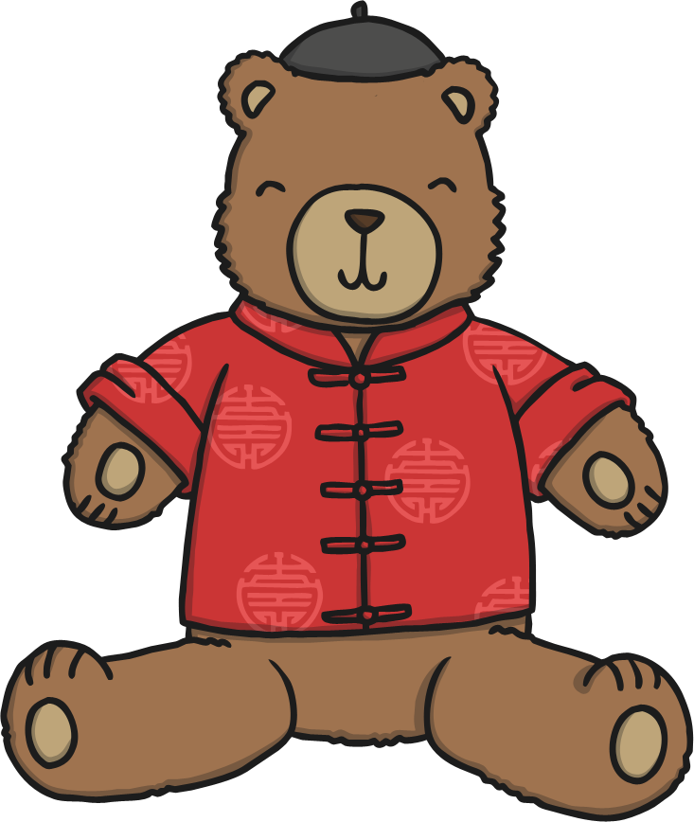
9
Well Done

Slide 19

6
Try Again
Try Again

Slide 20


6
Well Done

Slide 21


10
Try Again
Try Again

Slide 22


10
Well Done
Finish

