Slide 2

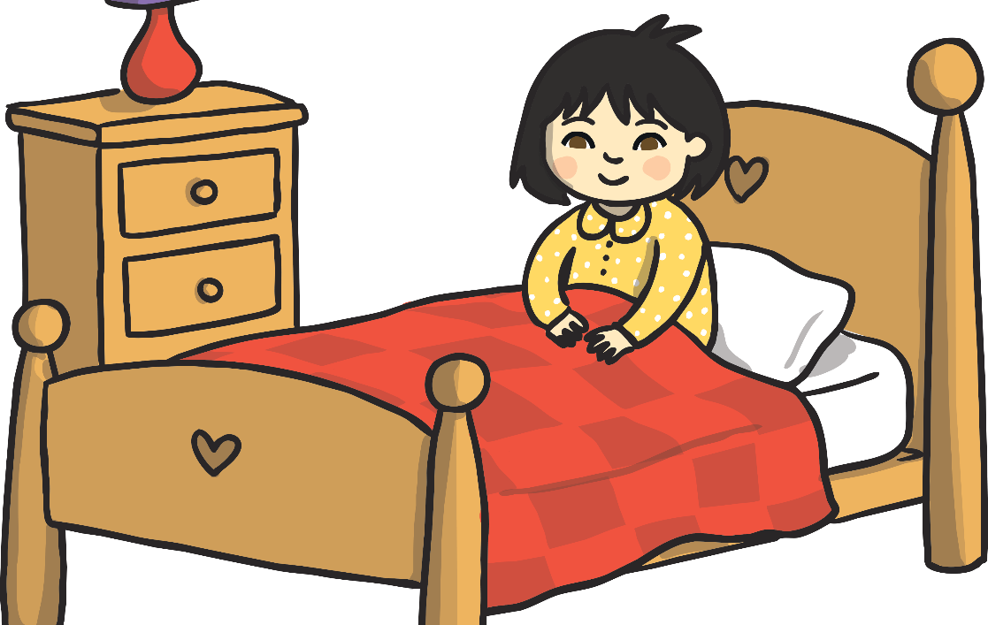
Samantha woke up early. She quickly got washed and dressed. She was excited because it was her favourite day of Chinese New Year: her grandparents were coming for dinner and they were all going to see the dragon and lion dances!

Slide 3

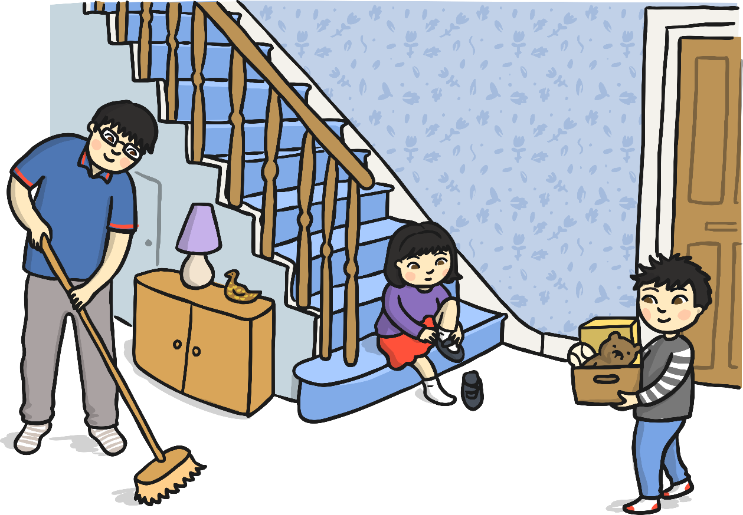
After breakfast, Mum asked, “Do you want to help me with the shopping Samantha?” Samantha nodded happily and went to get her coat and shoes on. “While we are out, Stanley and Dad are going to finish the tidying. Everything needs to be nice and clean for the New Year!”

Slide 4

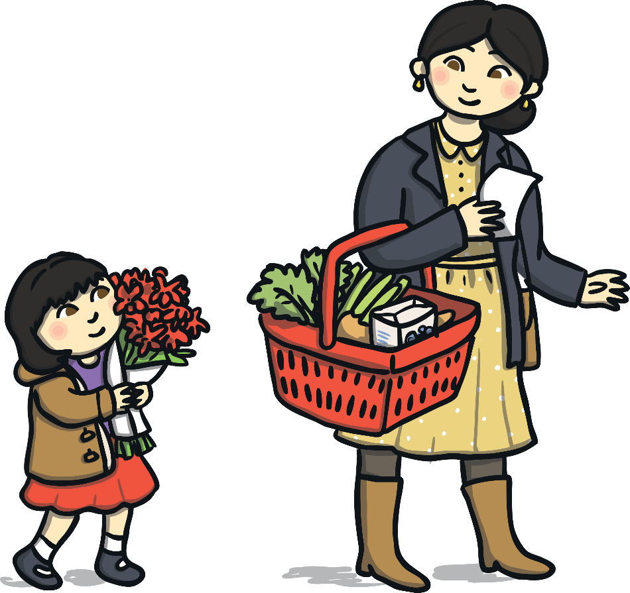
At the shops, Samantha helped Mum to buy lots of food ready for when Nanny and Grandpa arrived. They bought lots of vegetables, noodles, rice and dumplings. Mum also bought a box of biscuits, which she explained were a special treat for later on. Samantha chose some flowers to buy. She chose a bright red bunch. “Perfect!” said Mum as she paid for the shopping. “These will look lovely on the table!”

Slide 5

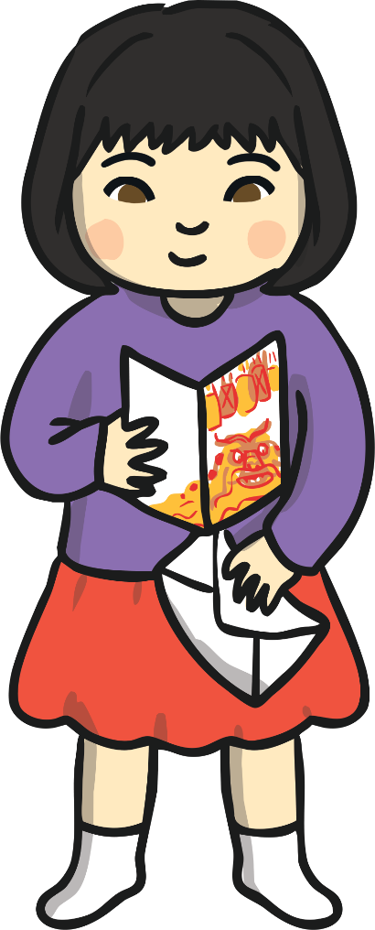
Back at home, Dad and Stanley had almost finished the tidying. “Look what came in the post,” said Stanley as he held out an envelope to Samantha. Samantha quickly opened the envelope and inside was a dragon card from her cousins in China!

Slide 6

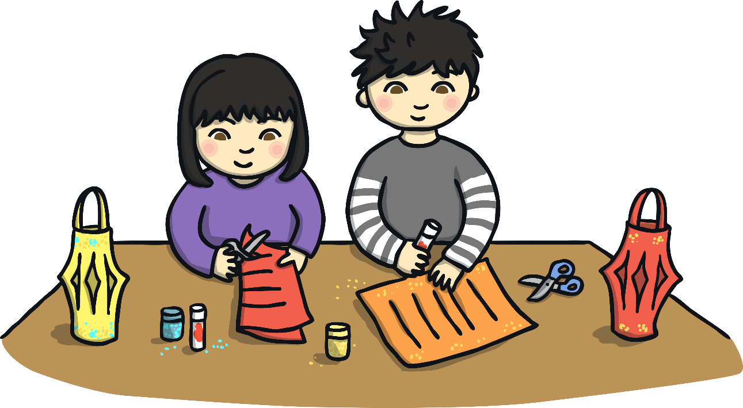
Next Stanley and Samantha made some paper lanterns to decorate the house. They worked hard to cut and decorate the paper, and soon they had made lots of colourful lanterns! Dad hung the lanterns around the room. “These look great!” he said. “They should bring us lots of luck for the New Year!”

Slide 7

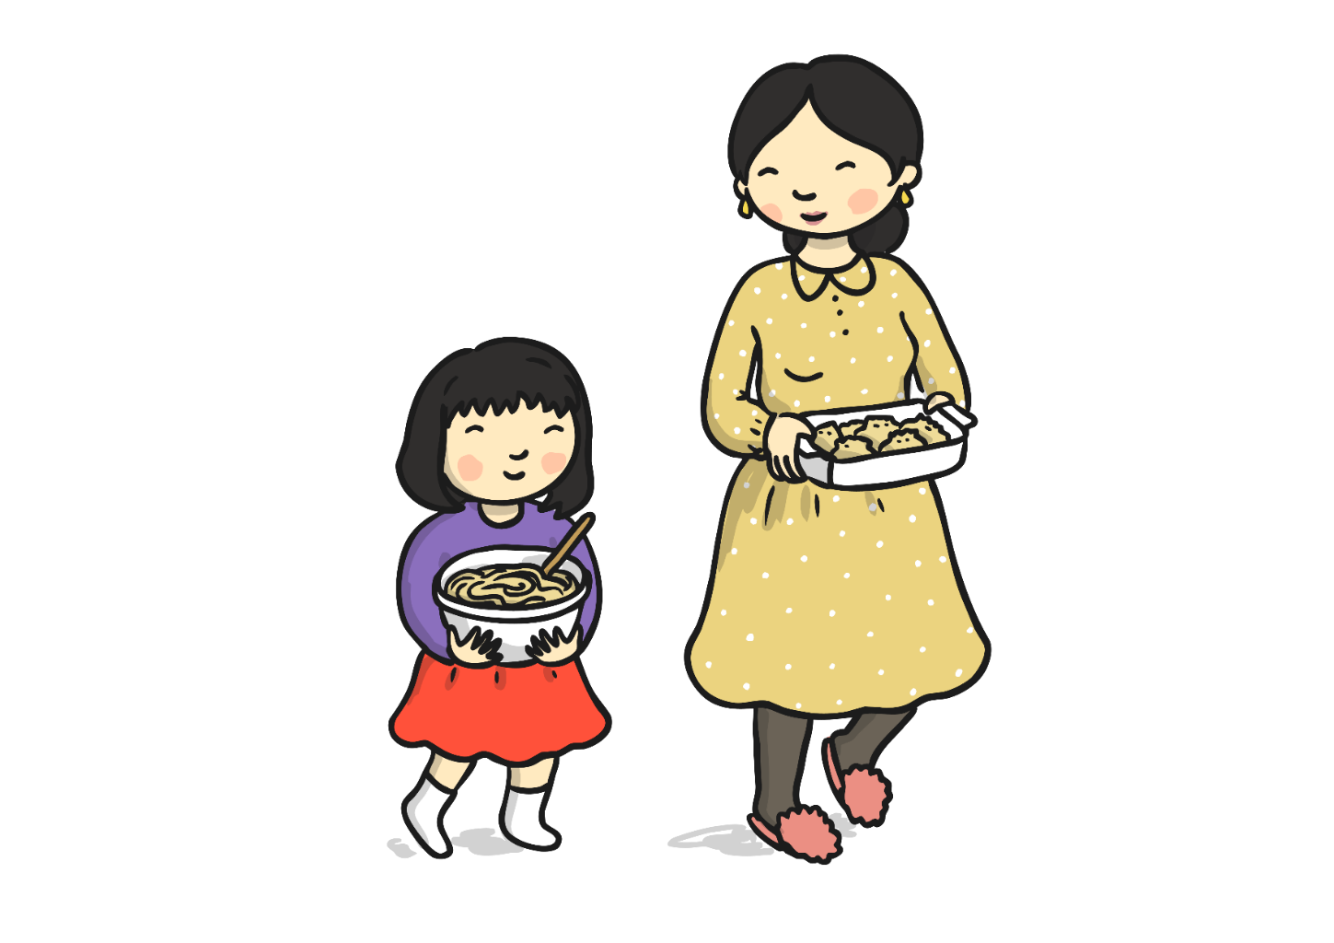


Then Samantha went to help Mum finish making lunch. “Yummy! Lots of tangerines, my favourites!” said Samantha, as she popped a piece into her mouth. Samantha helped Mum to put the long noodles into a bowl with all the stir-fry vegetables, “Dumplings too, great!”

Slide 8
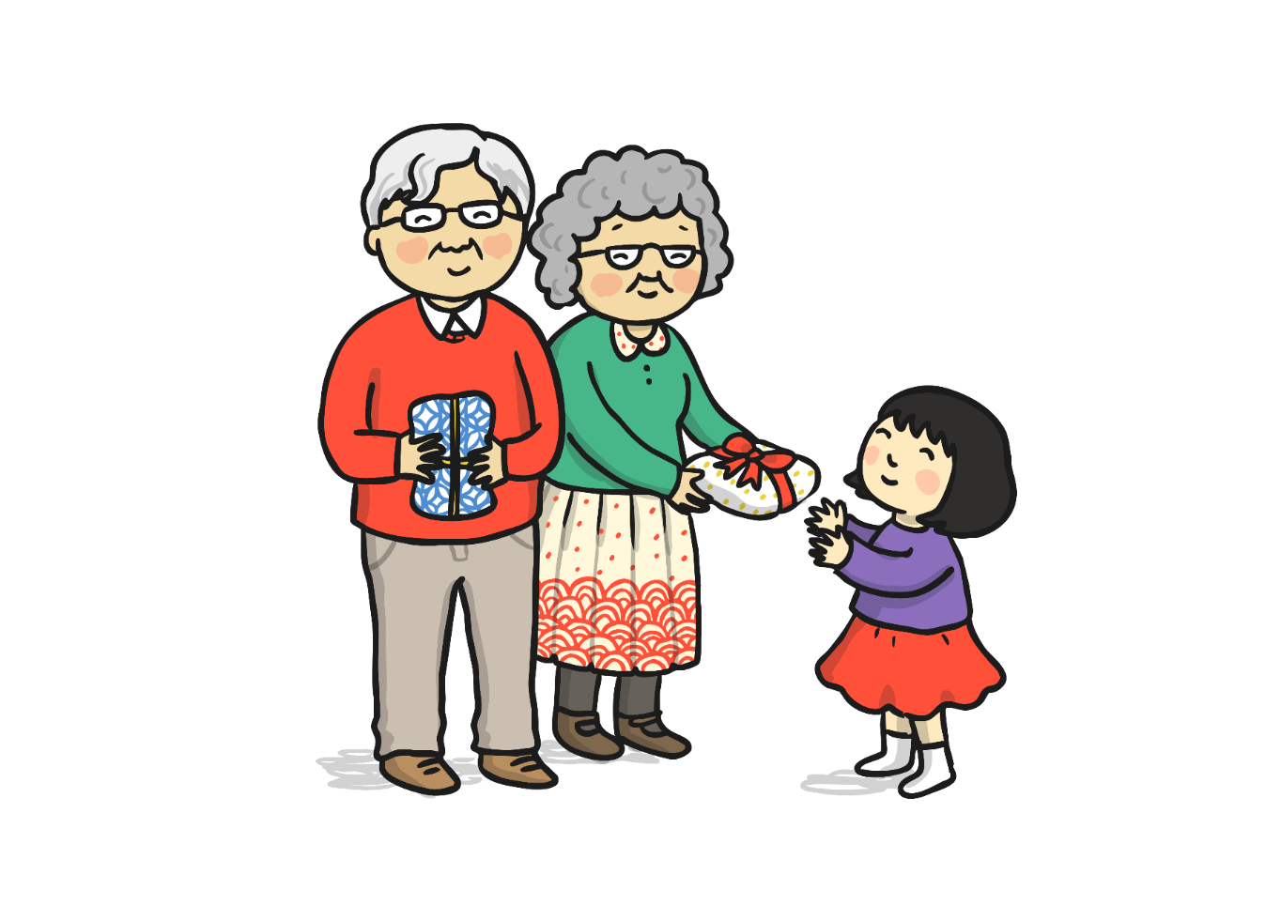





Just then, the doorbell rang. It was Nanny and Grandad! “Hello everyone,” said Nanny. “Gung hay fat choy!” (Which is a greeting often heard at New Year, it means best wishes/wishing you fortune and a good year.) Nanny gave Samantha a present. Inside was a lovely new dress for her to wear! Stanley had some new clothes too, perfect for the New Year!

Slide 9
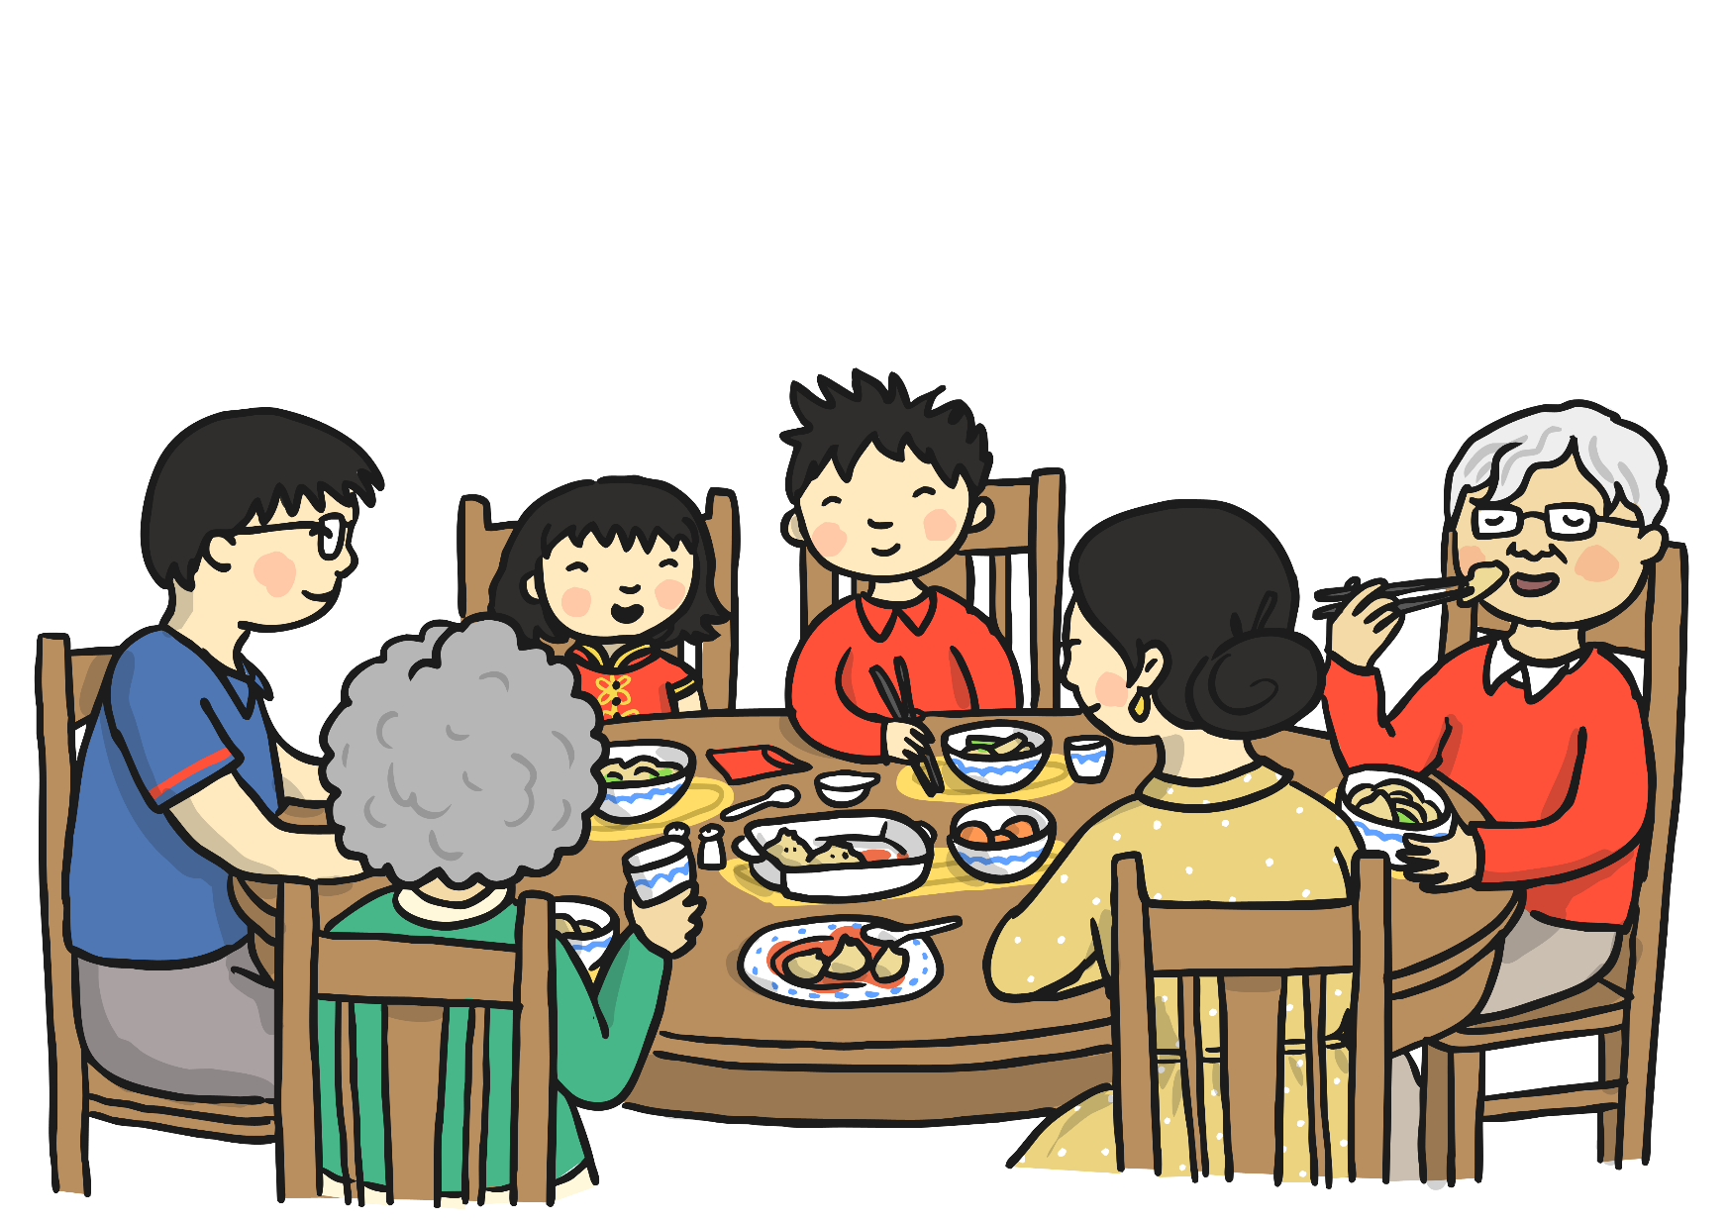




When they came back downstairs, Nanny and Grandpa had another surprise for them: a lucky red envelope! Inside was a shiny £2 coin. “Thank you!” both Samantha and Stanley shouted! Everyone had a delicious lunch with fortune cookies afterwards. There were special messages inside the cookies!
for the New Year!”

Slide 10

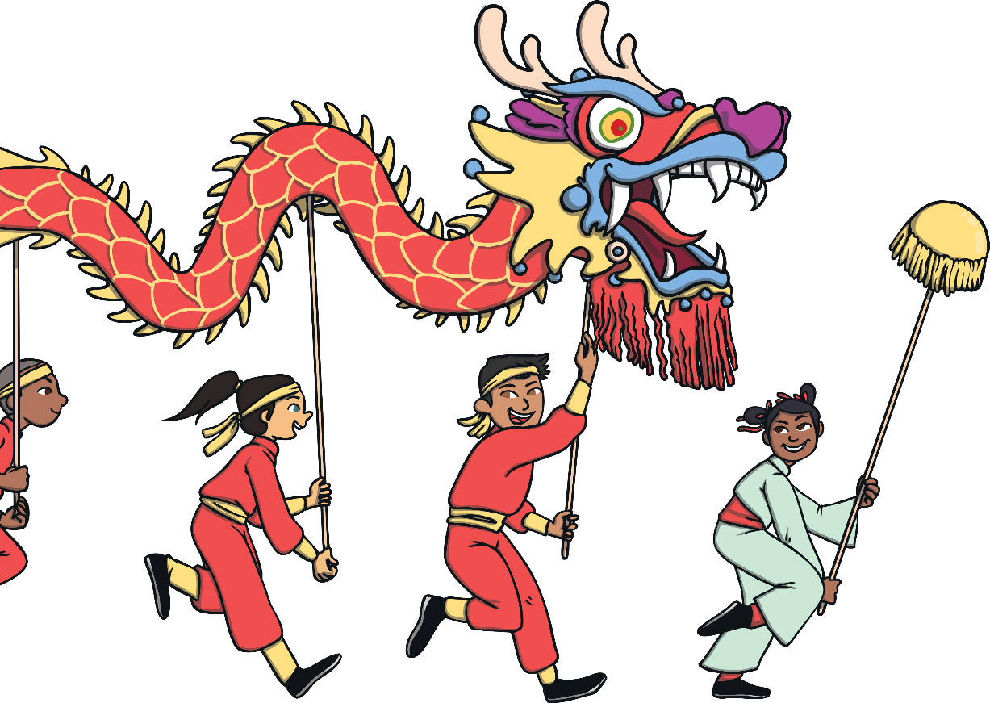
Then it was time to go to see the lion and dragon dances! Samantha put on her shoes and jacket, then skipped happily along the road to where the parade was taking place. She could hear the drums and firecrackers. Samantha loved to see the dragons and lions! Grandpa bought Samantha and Stanley a small paper dragon to hold. They were made of colourful folded paper with sticks at each end to make their mini dragons dance, just like the big dragons!

Slide 11

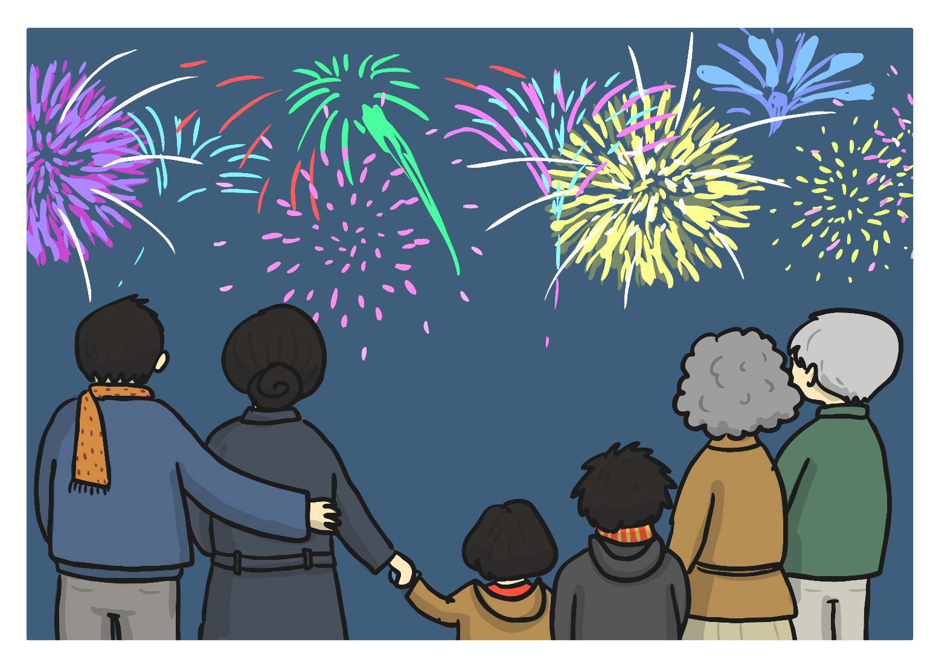
Soon it started to get dark and the fireworks began! Loud rockets lit up the sky in colourful showers of sparkles. The end of the display was very bright and colourful, with lots of crackly fireworks and booming rockets. Everyone clapped and cheered!

Slide 12
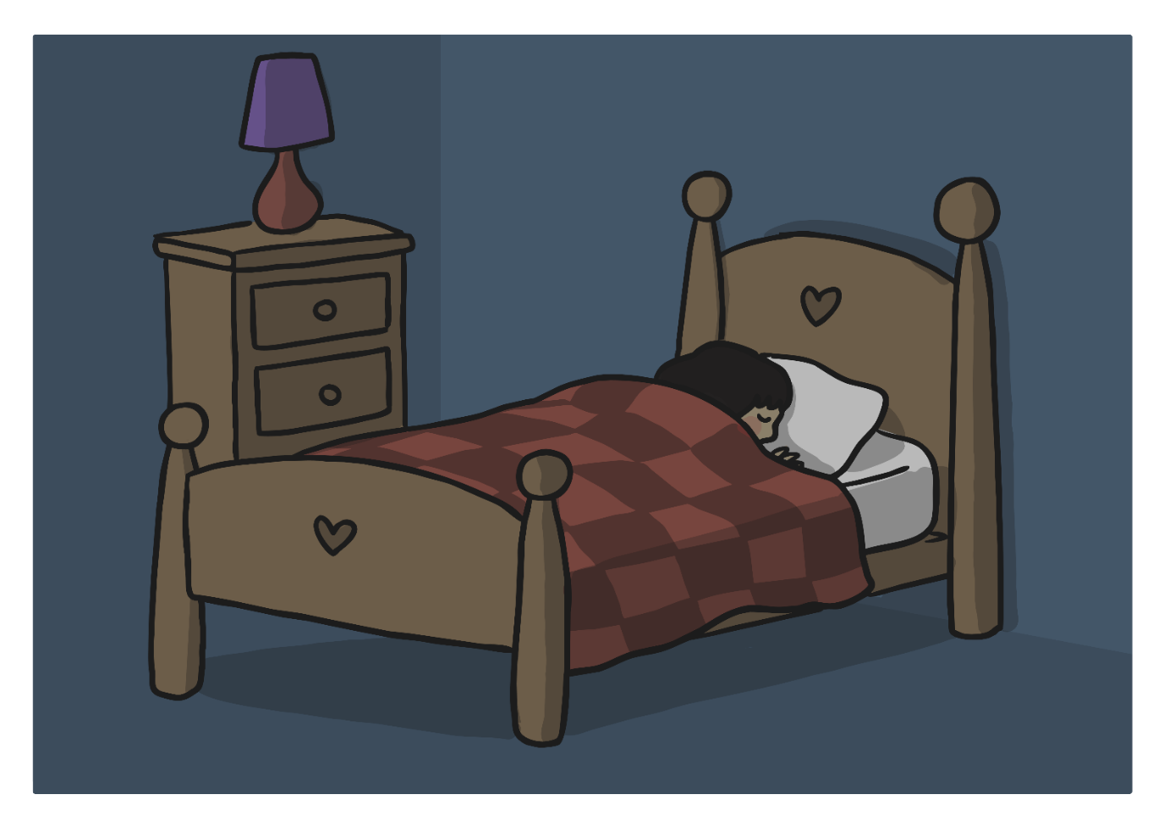
After the fireworks, the family headed home for dinner. Samantha had some rice and spring rolls (and another tangerine!) and then showed Nanny and Grandpa the lanterns she and Stanley had made. Soon it was time for bed. Samantha was very tired and slowly drifted off to sleep, thinking about all the fun things she had done for Chinese New Year.

