Slide 1


Slide 3

1) What could the size of this angle be?
A B C D
2) There are ________ degrees in a half turn.
3) Complete the part-whole models.
47⁰
147⁰
90⁰
68⁰
180
180
138
27
166
42

Slide 4
1) What could the size of this angle be?
A B C D
2) There are ________ degrees in a half turn.
3) Complete the part-whole models.
Acute
47⁰
147⁰
90⁰
68⁰
180
180
180
138
180
27
153
14
166
42

Slide 6

Have a think
B
A
D
C
Acute
Right
Obtuse
Half a turn

Slide 7
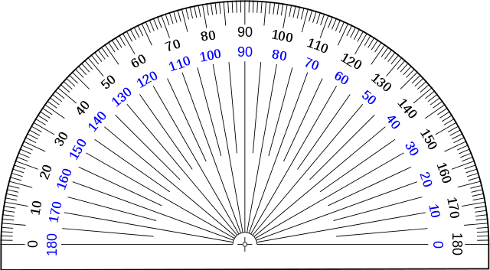
This is a protractor.
We can use it to measure the degrees of turn between two lines.

Slide 8
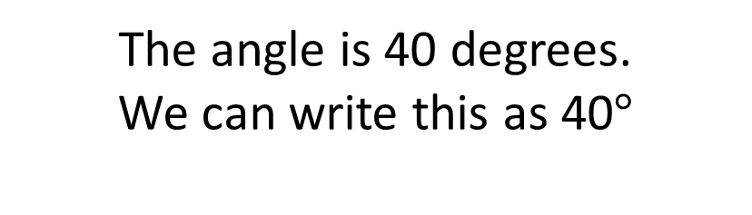
Outer scale
Inner scale
It is an acute angle.
It is less than 90 degrees.
The angle is 40 degrees.
We can write this as 40$°$

Slide 9
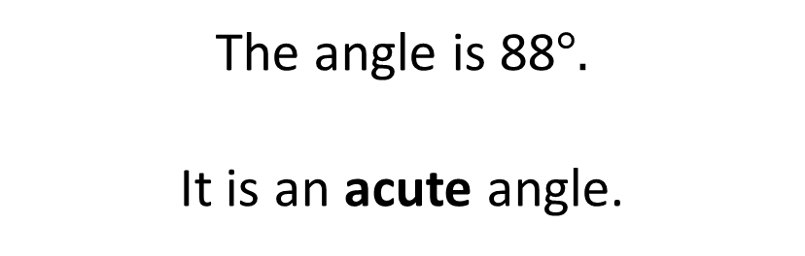
The angle is 88$°.$
It is an acute angle.

Slide 10

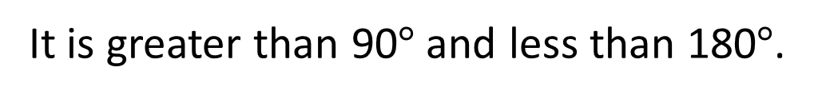

It is an obtuse angle.
The angle is 90$°.$
It is greater than 90$°$and less than 180$°$.
It is a right angle.
The angle is 140$°$.

Slide 11

The angle is 180$°$
It is a straight line.

Slide 12
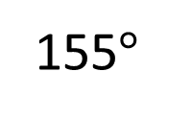
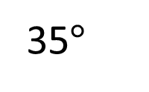
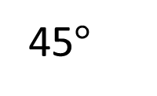
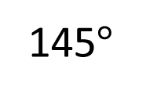
Is the angle acute or obtuse?
Have a think
Inner scale
What is the size of the angle?
A
B
C
D
155$°$
145$°$
45$°$
35$°$

Slide 13
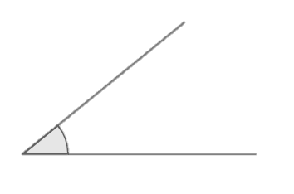
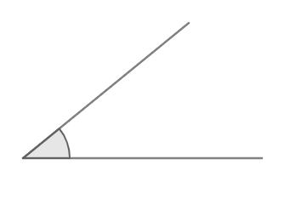
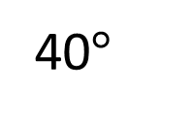
Have a think
40$°$
A
B
C
Which is the greatest angle?

Slide 14
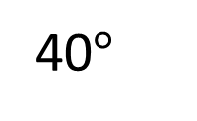
40$°$
40$°$
A
B
C
Which is the greatest angle?

Slide 15
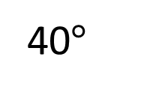
40$°$
40$°$
40$°$
A
B
C
Which is the greatest angle?

Slide 16
This is the origin. We place this on the vertex where two lines meet.
The baseline is placed on one of the lines that make the angle.

Slide 17
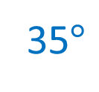
35$°$
The origin is on the vertex of the angle.
The baseline is on one of the lines that make the angle.

Slide 18
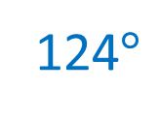
A
Is the angle acute or obtuse?
B
C
Have a think
Which diagram or diagrams show the correct way to measure the angle?
B and C
What is the size of the angle?
124$°$

Slide 19


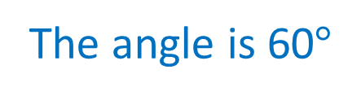
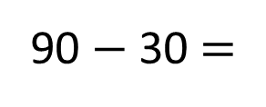
Neither of the lines are lined up with the protractor’s baseline, so we cannot find the size of this angle.
We don’t need to move the protractor – there’s a calculation we can perform!
Have a think
90 $−$ 30 =
60
The angle is 60$°$

Slide 20
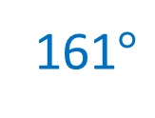
Have a think
161$°$
Describe how this protractor is being used incorrectly.
The origin of the protractor is not placed at
the vertex.

Slide 21



Slide 22
Have a go at questions

Slide 23
I do
You do

Slide 24












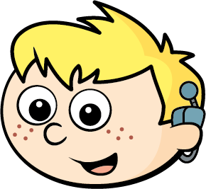



Rosie
Alex
Amir
Whitney
Ron
Dexter
Annie
Tommy
Mo
Jack
Eva
Teddy
Max
Kim
Jo
Sam

Slide 25


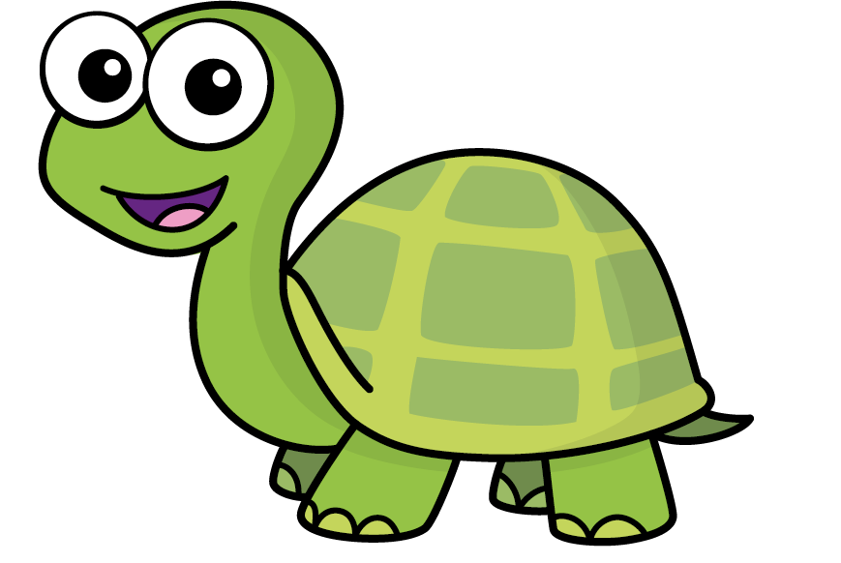
Speech bubble text – replace with any character head.
Speech bubble text – replace with any character head.
Bee
Diddy
Tiny

Slide 26





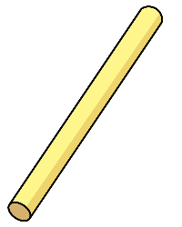

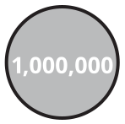
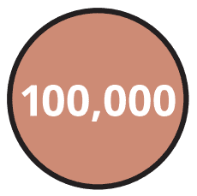
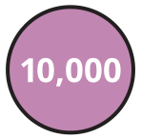


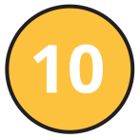
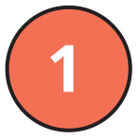
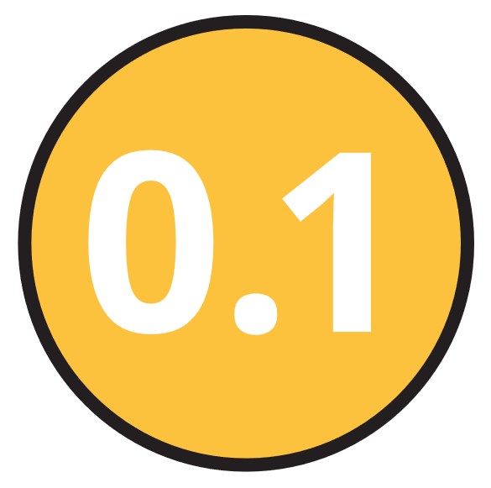
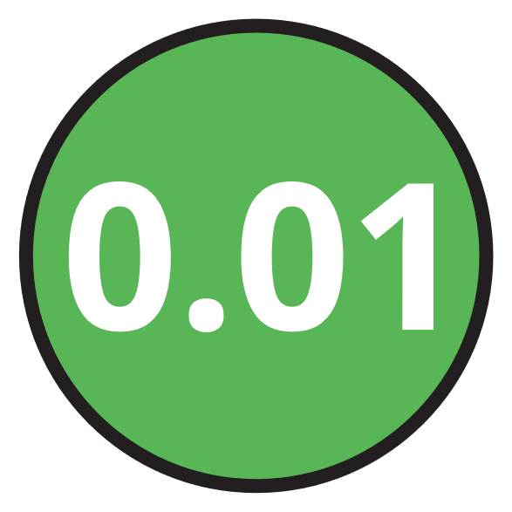
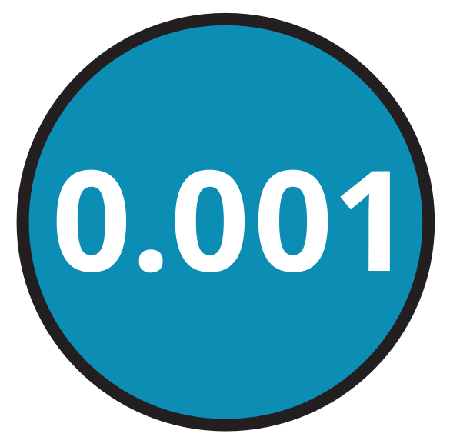




M | HTh | TTh | Th | H | T | O | Tth | Hth | Thth
100
40 | 60
Millions | Thousands |  |  | Ones
O | H | T | O | H | T | O

Slide 27





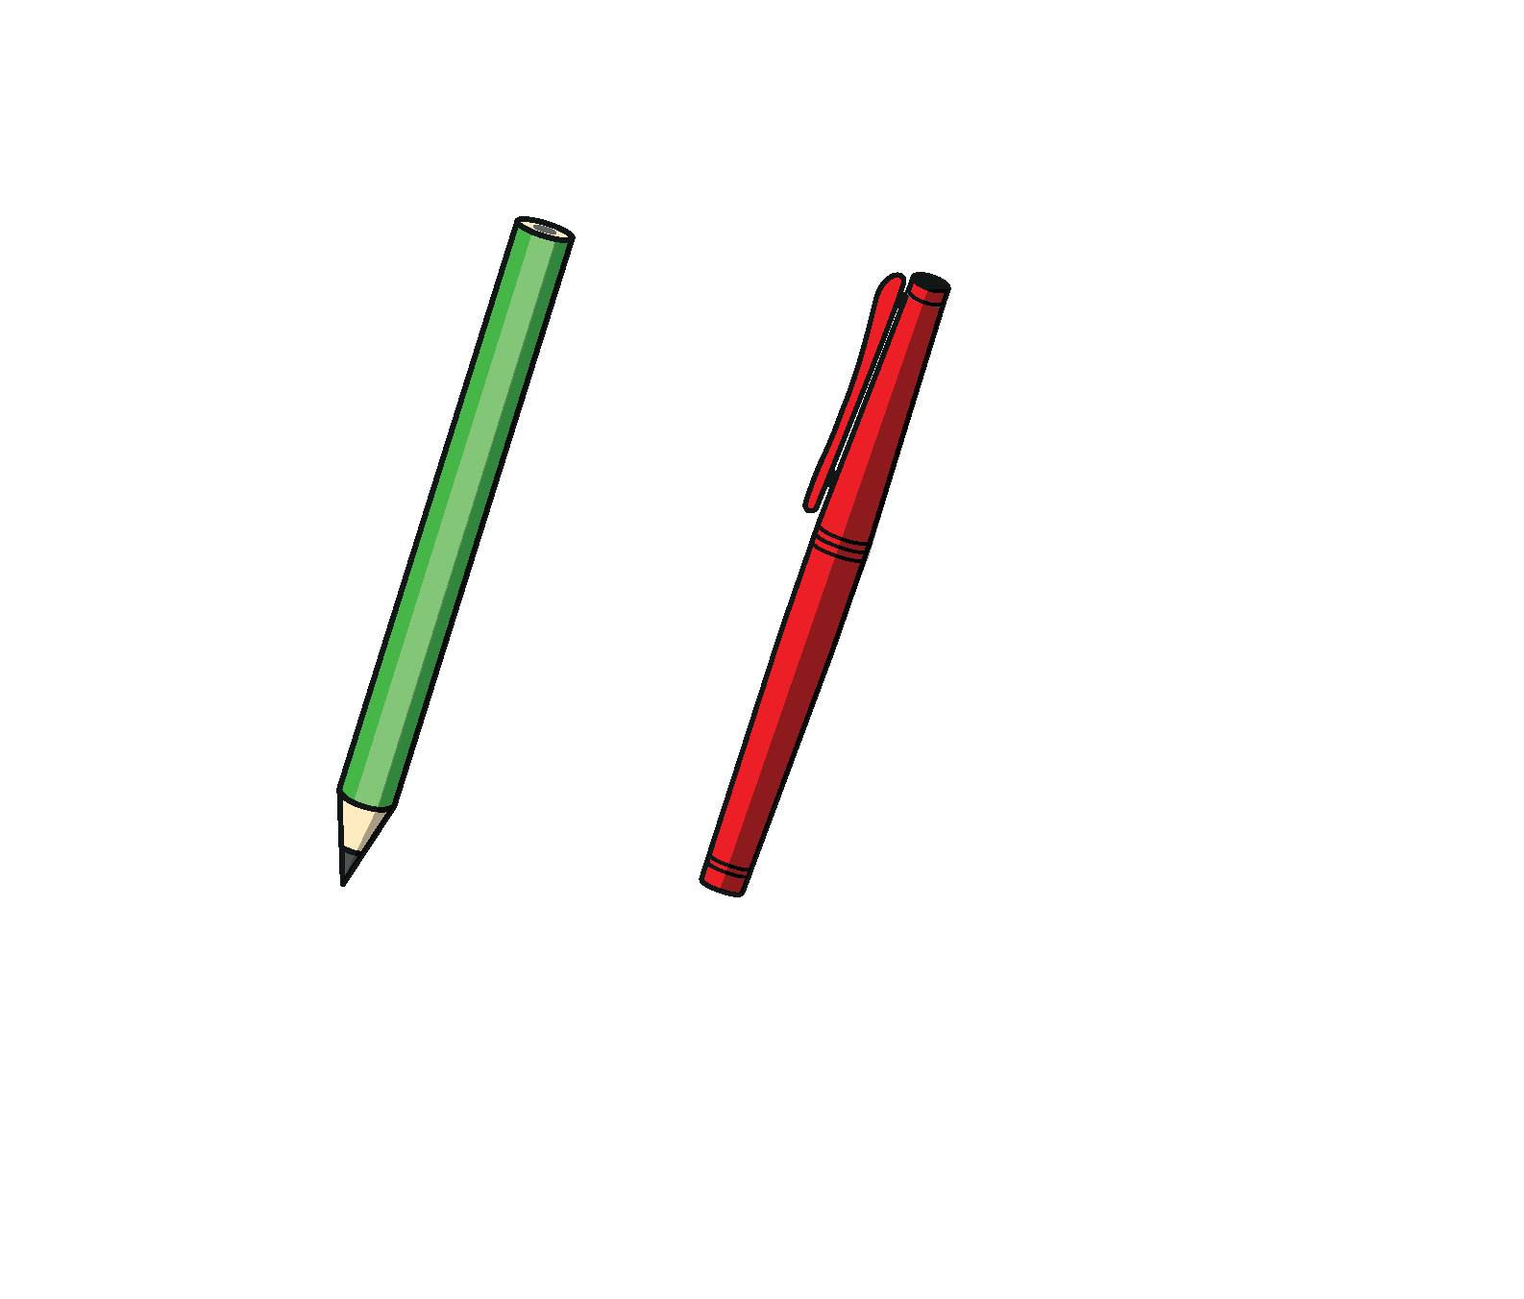

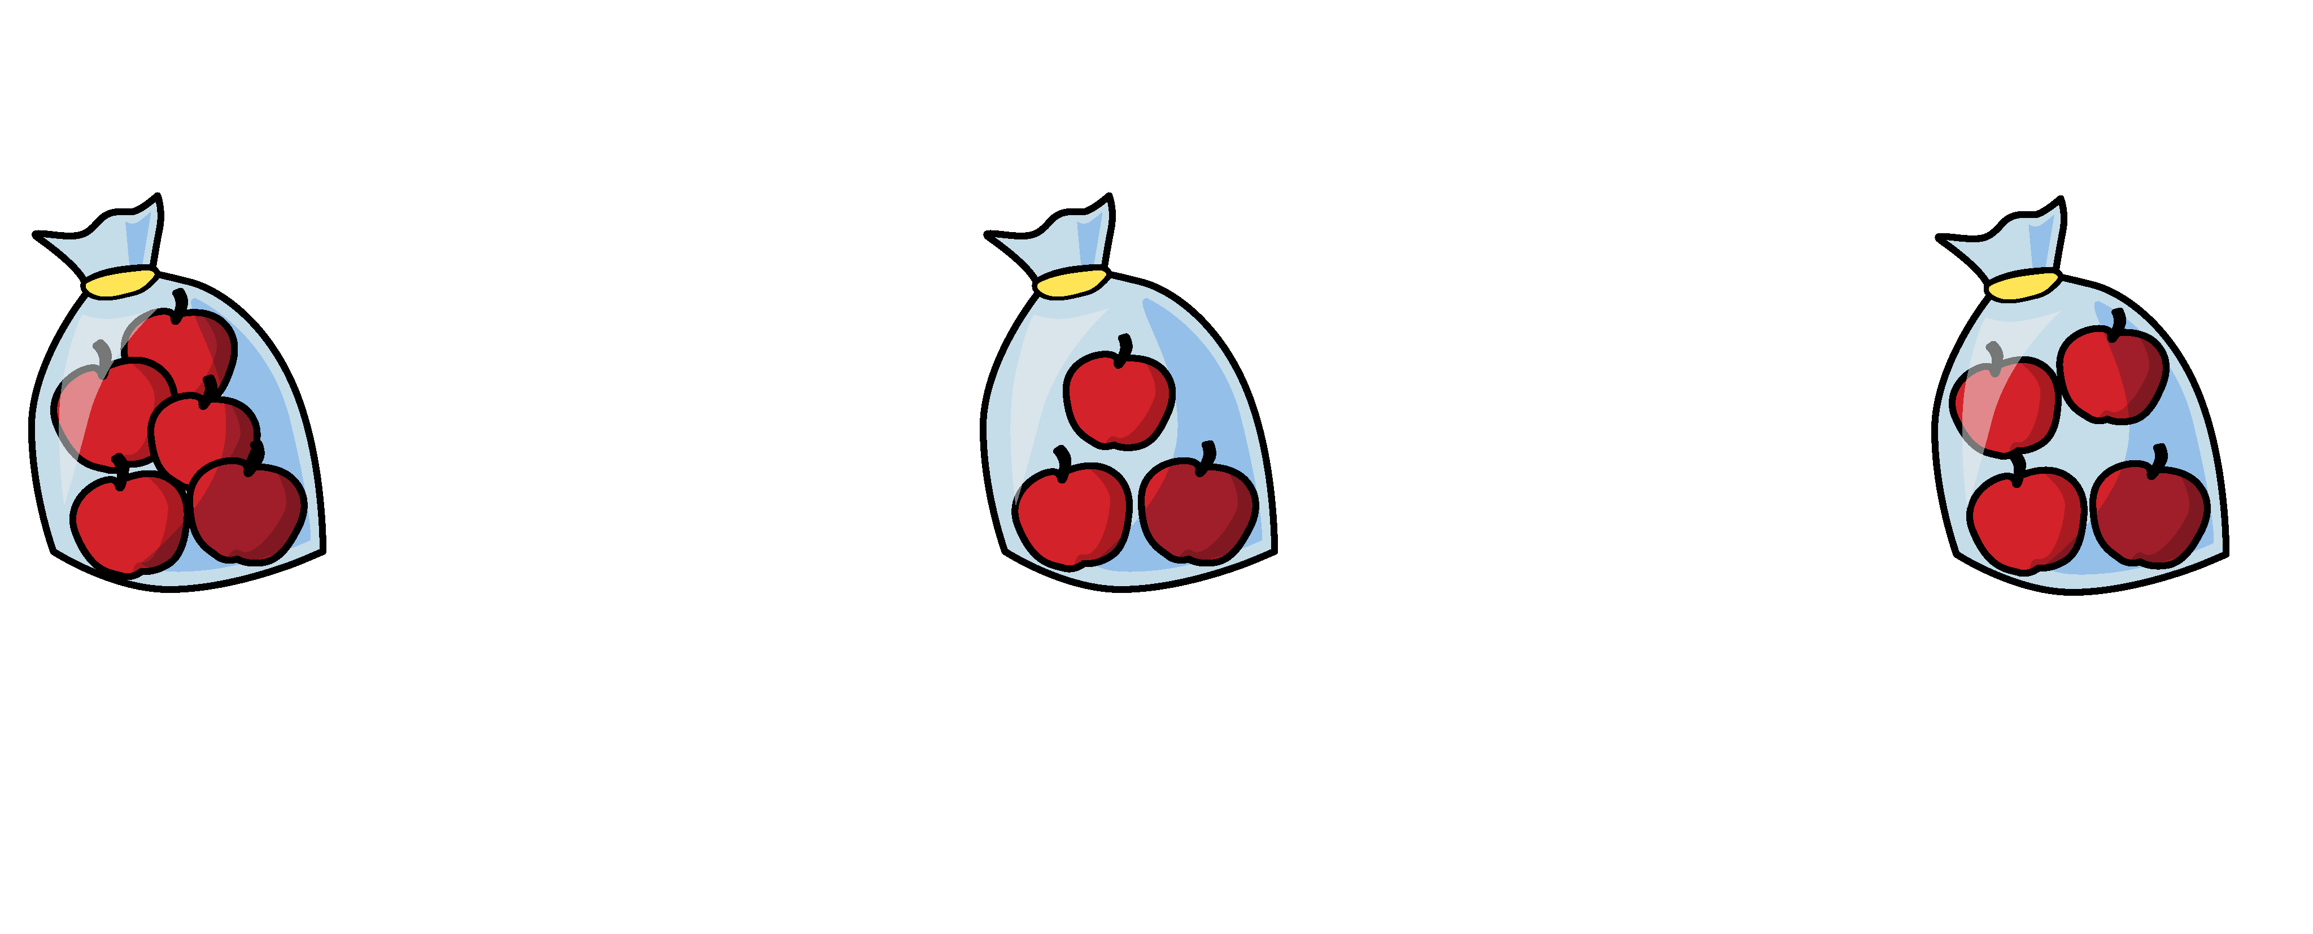


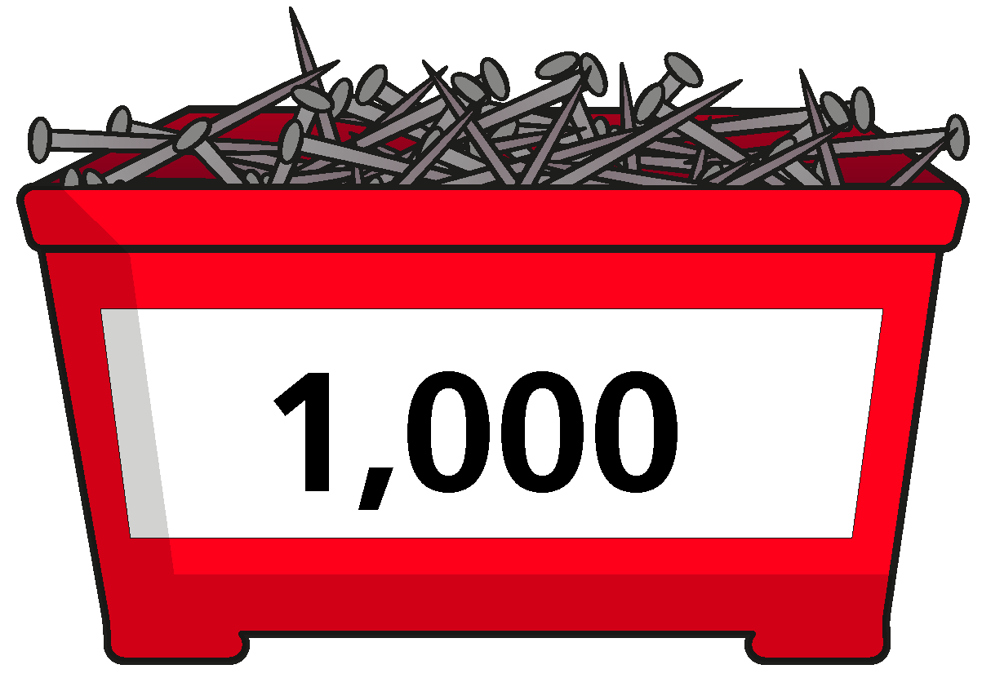
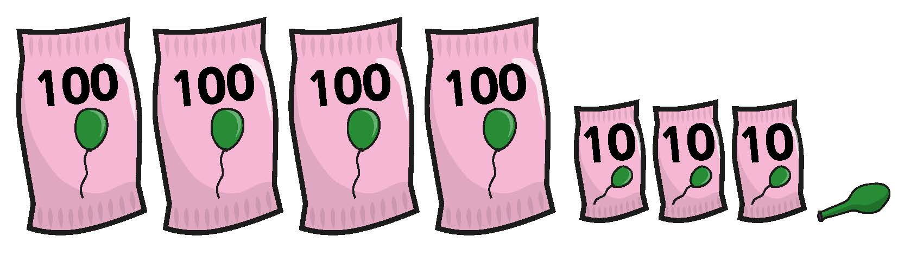

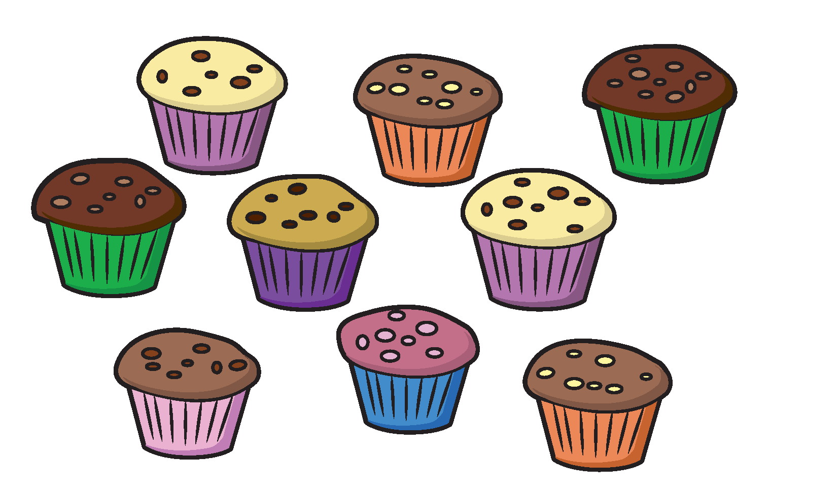
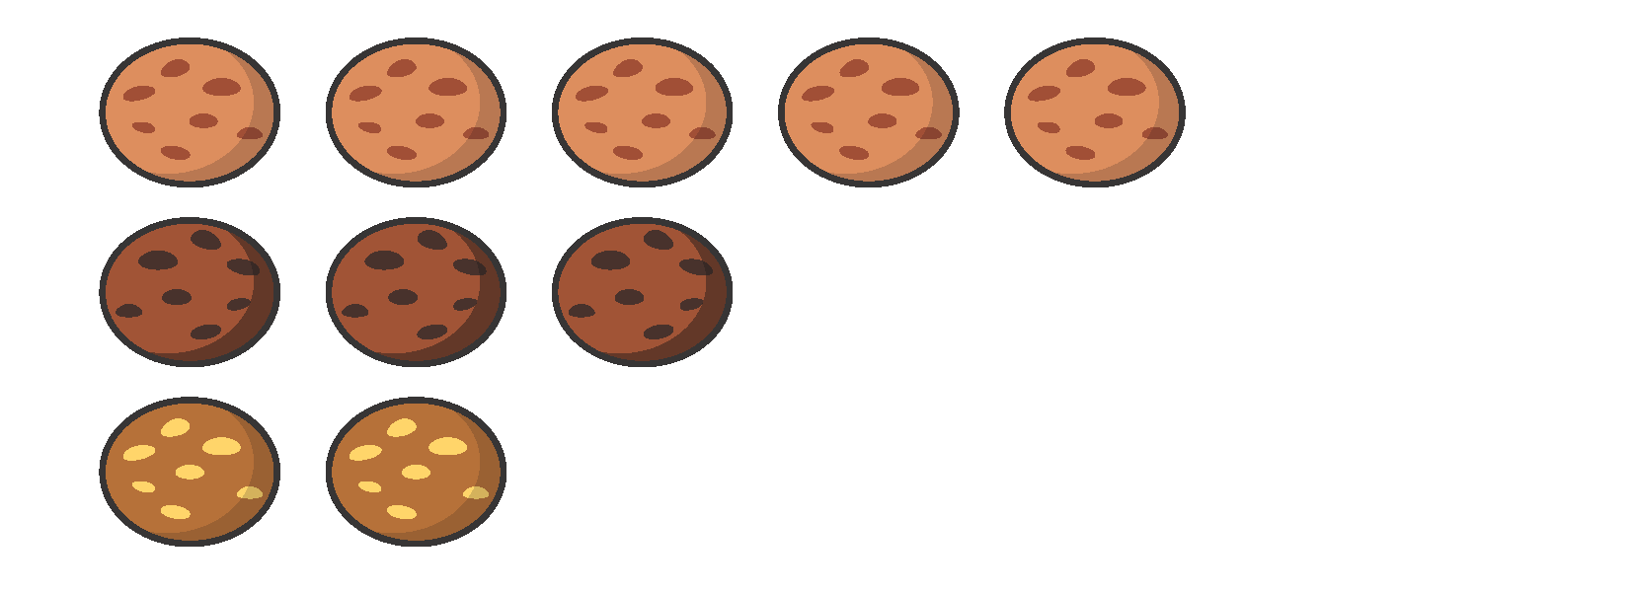

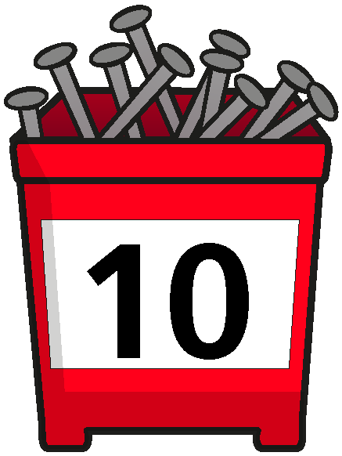

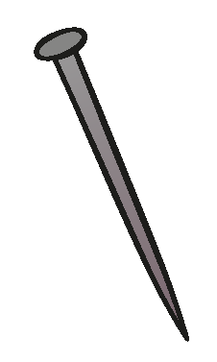
















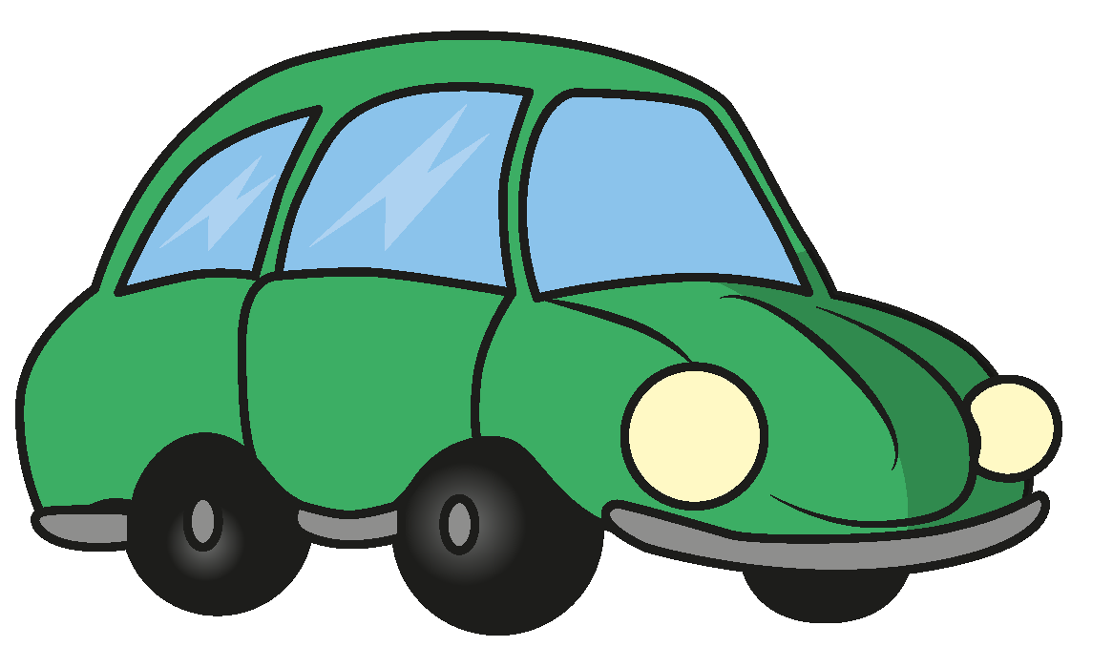
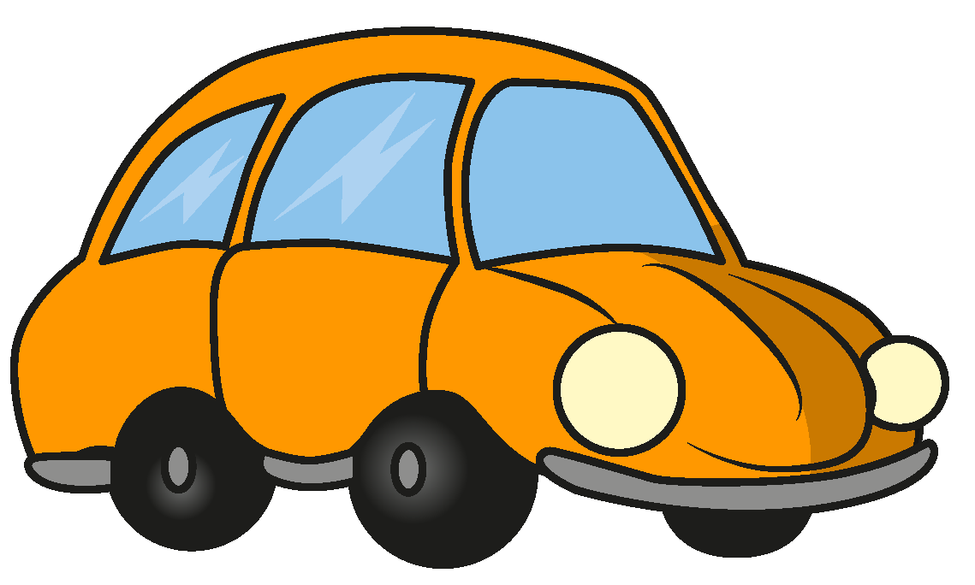




Slide 28


























































