Slide 1

Clonc
Meithrin

Slide 2
Wythnos 1
Teimladau
Feelings

Slide 3



GEIRFA
Teimladau
hapus
trist
wedi blino

Slide 4

GÊM
Beat the Mouse

Slide 5

Happy
hapus

Slide 6
Sad
trist

Slide 7
tired
Wedi blino

Slide 8

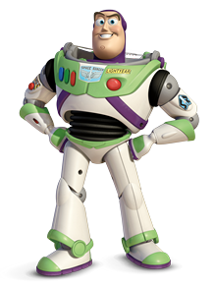
CWESTIWN AC ATEB: PWY WYT TI?
Dewi dw i.
Buzz Lightyear
dw i.

Slide 9
CWESTIWN AC ATEB
Sut wyt ti?
Dw i’n hapus.
Dw i’n drist.
Dw i wedi blino.

Slide 10
GÊM
Word Wall
Match Up
https://wordwall.net/resource/1626642
Find the Match
https://wordwall.net/resource/1673082

Slide 11

CÂN
Mr Hapus ydw i
Mr Hapus ydw i
Mr Trist ydw i
Mr Wedi blino ydw i
Tune: If you’re happy and you know it
https://www.youtube.com/watch?v=20lb7lUOd_s
https://www.youtube.com/watch?v=euLzsUtvVqM

Slide 12
Mr Hapus Ydw i
Mr Hapus ydw i, ydw i.
Mr Hapus ydw i, ydw i.
Mr Hapus ydw i,
Mr Hapus ydw i,
Mr Hapus ydw i, ydw i.
Mr Trist ydw i, ydw i.
Mr Trist ydw i, ydw i.
Mr Trist ydw i,
Mr Trist ydw i,
Mr Trist ydw i, ydw i.
Mr Wedi Blino ydw i, ydw i.
Mr Wedi Blino ydw i, ydw i.
Mr Wedi Blino ydw i,
Mr Wedi Blino ydw i,
Mr Wedi Blino ydw i, ydw i.
https://www.youtube.com/watch?v=20lb7lUOd_s
https://www.youtube.com/watch?v=euLzsUtvVqM

