Slide 1

Clonc
Blwyddyn 1

Slide 2
Wythnos 8
Dillad
Clothes

Slide 3


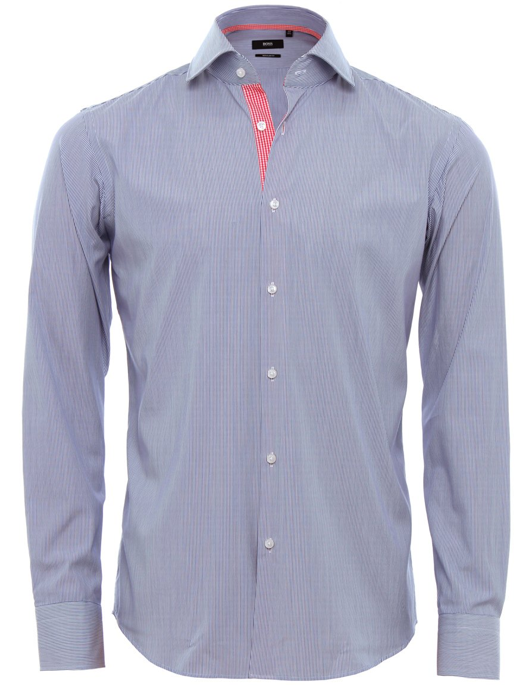
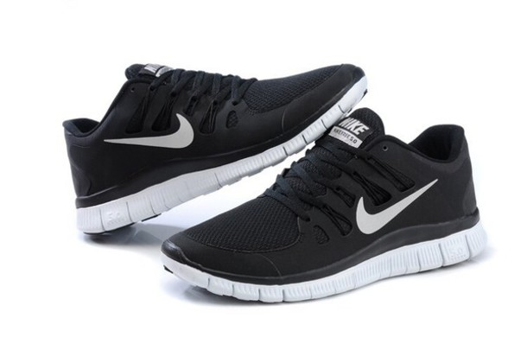
GEIRFA
Dillad
cot law
sgert
treinyrs
crys
a - and
This Photo by Unknown Author is licensed under CC BY-NC
This Photo by Unknown Author is licensed under CC BY-NC

Slide 4
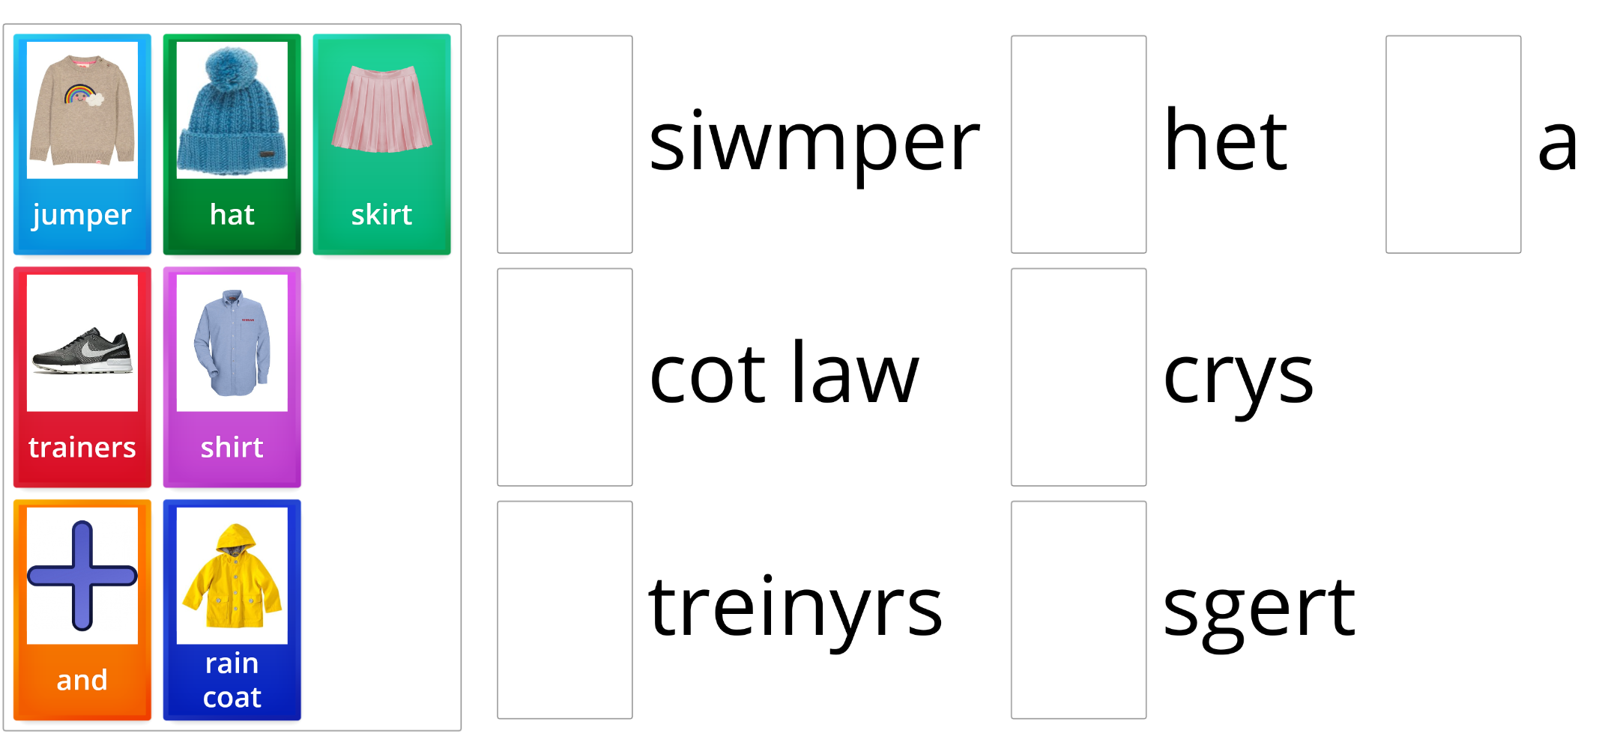
GÊM
Word Wall
Match Up
https://wordwall.net/resource/1909498

Slide 5
CWESTIWN AC ATEB
Beth wyt ti’n hoffi wisgo?
Dw i’n hoffi gwisgo sgert.
Dw i’n hoffi gwisgo cot law.
Dw i’n hoffi gwisgo treinyrs.
Dw i’n hoffi gwisgo crys.
a - and
This Photo by Unknown Author is licensed under CC BY-NC
This Photo by Unknown Author is licensed under CC BY-NC

Slide 6
CWESTIWN AC ATEB
Beth wyt ti ddim yn hoffi wisgo?
Dw i ddim yn hoffi gwisgo sgert.
Dw i ddim yn hoffi gwisgo cot law.
Dw i ddim yn hoffi gwisgo treinyrs.
Dw i ddim yn hoffi gwisgo crys.
a - and

Slide 7
CWESTIWN AC ATEB
Beth wyt ti eisiau gwisgo?
Dw i eisiau gwisgo sgert.
Dw i eisiau gwisgo cot law.
Dw i eisiau gwisgo treinyrs.
Dw i eisiau gwisgo crys.
a - and

Slide 8


CWESTIWN AC ATEB
a - and
Wyt ti’n hoffi gwisgo…?
cot law
sgert
Ydw
treinyrs
crys
Nac ydw
This Photo by Unknown Author is licensed under CC BY-NC
This Photo by Unknown Author is licensed under CC BY-NC

Slide 9
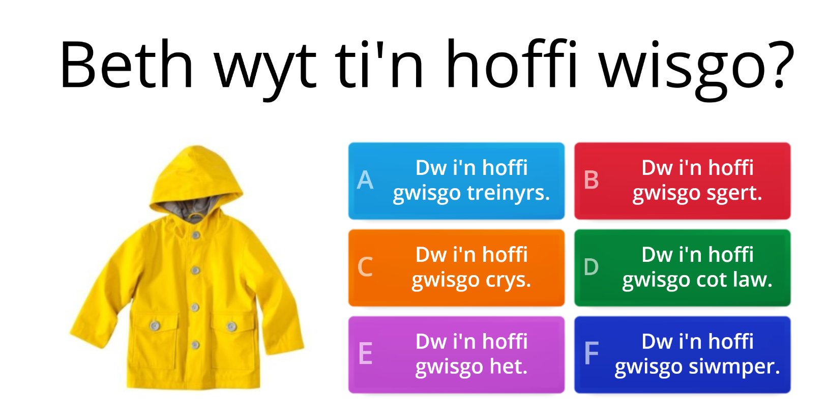
GÊM
Word Wall
Quiz
https://wordwall.net/resource/1909644

Slide 10

GÊM
Beat the Mouse

Slide 11

Beth wyt ti eisiau gwisgo?
Dw i eisiau gwisgo cot law.
This Photo by Unknown Author is licensed under CC BY-NC

Slide 12
Beth wyt ti eisiau gwisgo?
Dw i eisiau gwisgo crys.

Slide 13
Beth wyt ti eisiau gwisgo?
Dw i eisiau gwisgo sgert.

Slide 14
Beth wyt ti eisiau gwisgo?
Dw i eisiau gwisgo treinyrs.

Slide 15

CÂN
Beth wyt ti’n hoffi wisgo?
Beth wyt ti’n hoffi wisgo X 3
i chwarae yn y parc?
Dw i’n hoffi gwisgo….
Smart, smart iawn.
https://www.youtube.com/watch?v=e62pfUicywU
Tune: Thank you Lord

