Slide 2
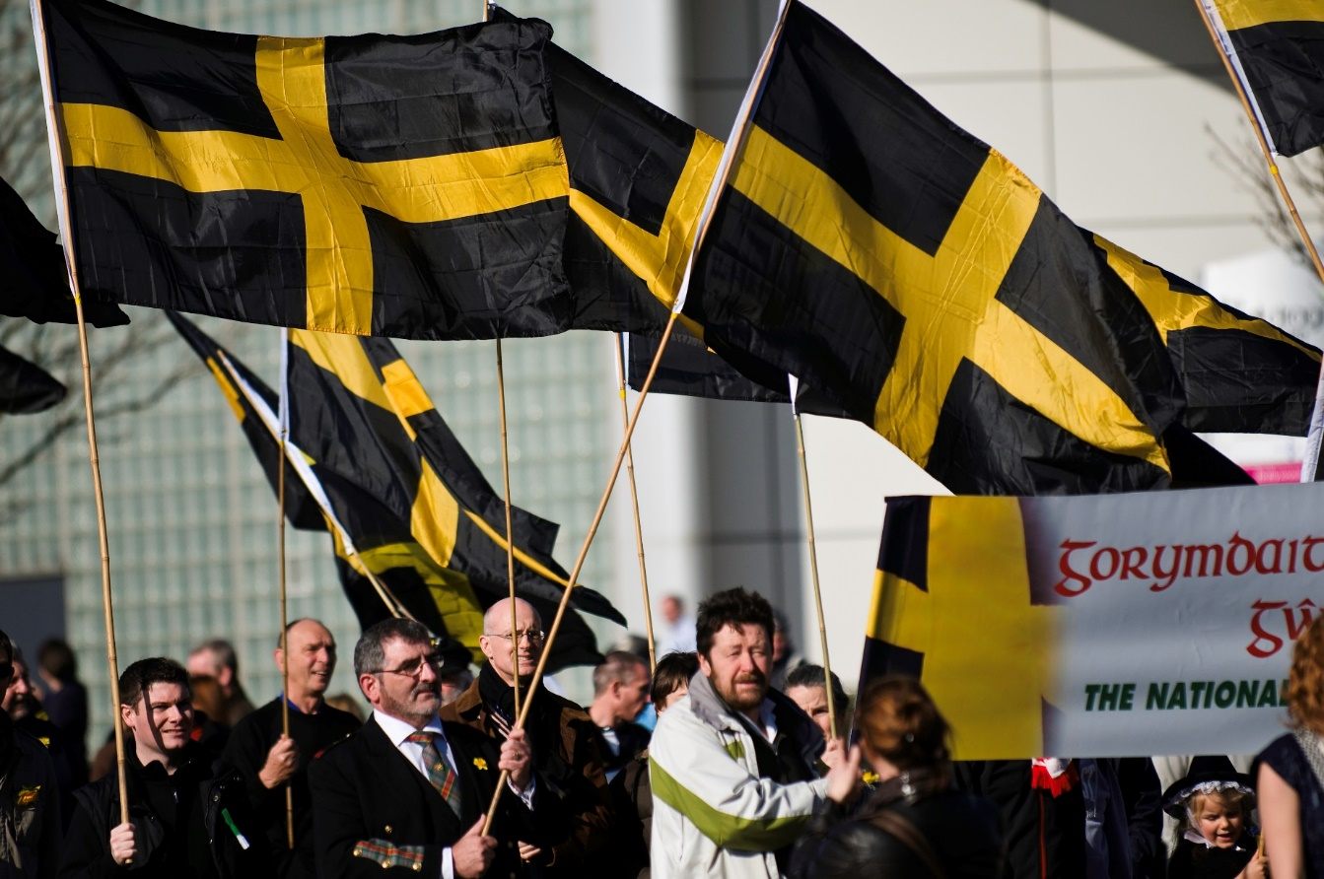
St. David’s Flag
Photo courtesy of National Assembly for Wales (@flickr.com) - granted under creative commons licence – attribution

Slide 3
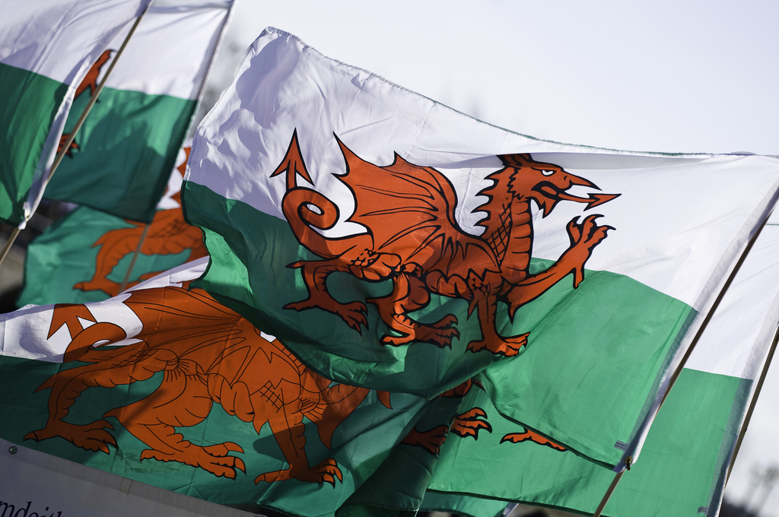
Welsh Flag
Photo courtesy of National Assembly for Wales (@flickr.com) - granted under creative commons licence – attribution

Slide 4
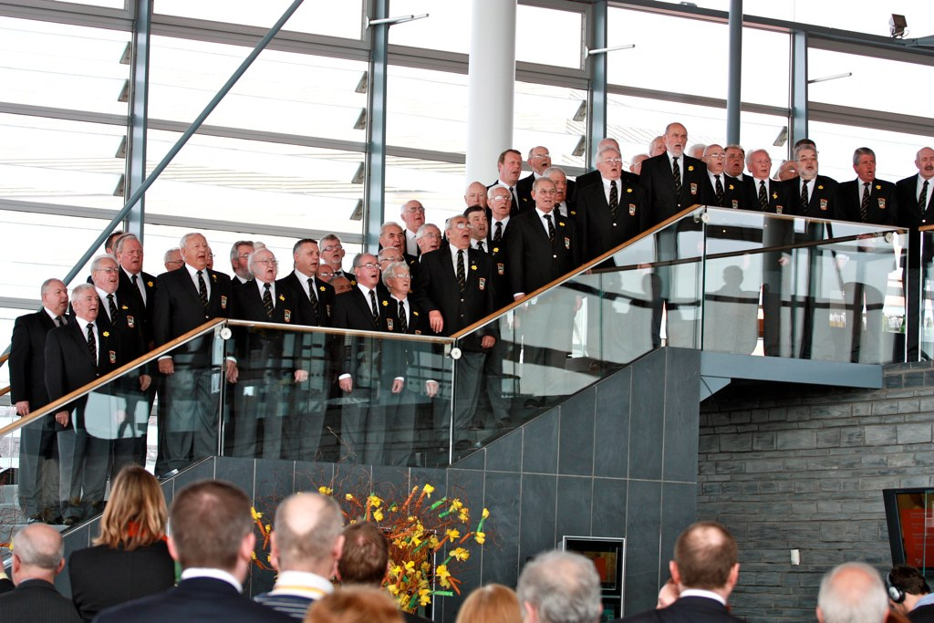
Choir
Photo courtesy of National Assembly for Wales (@flickr.com) - granted under creative commons licence – attribution

Slide 5
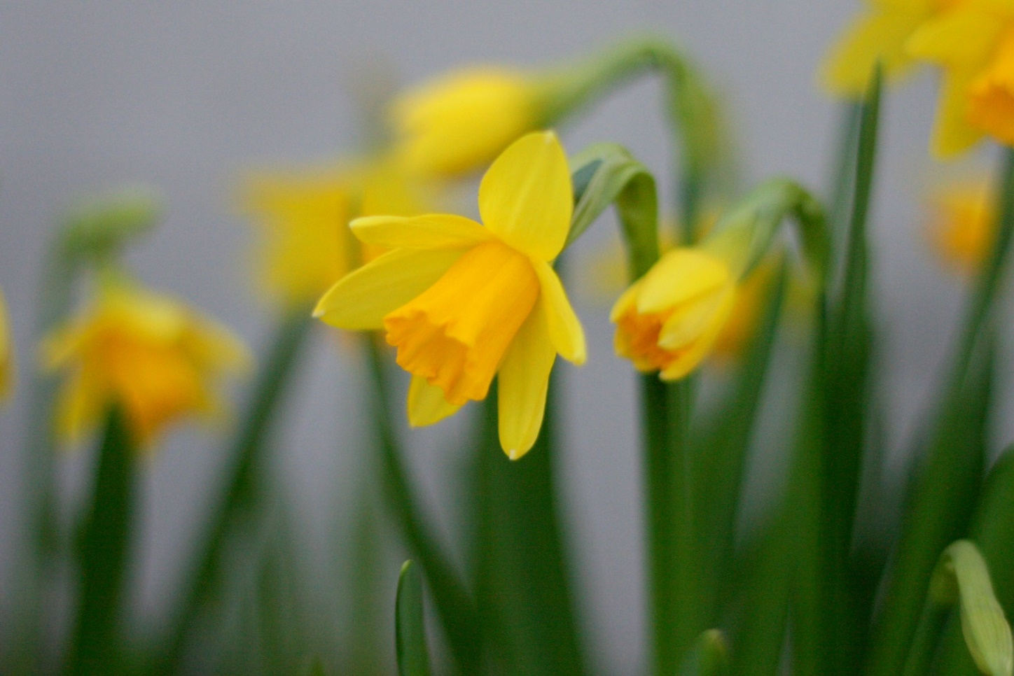
Daffodils
Photo courtesy of National Assembly for Wales (@flickr.com) - granted under creative commons licence – attribution

Slide 6
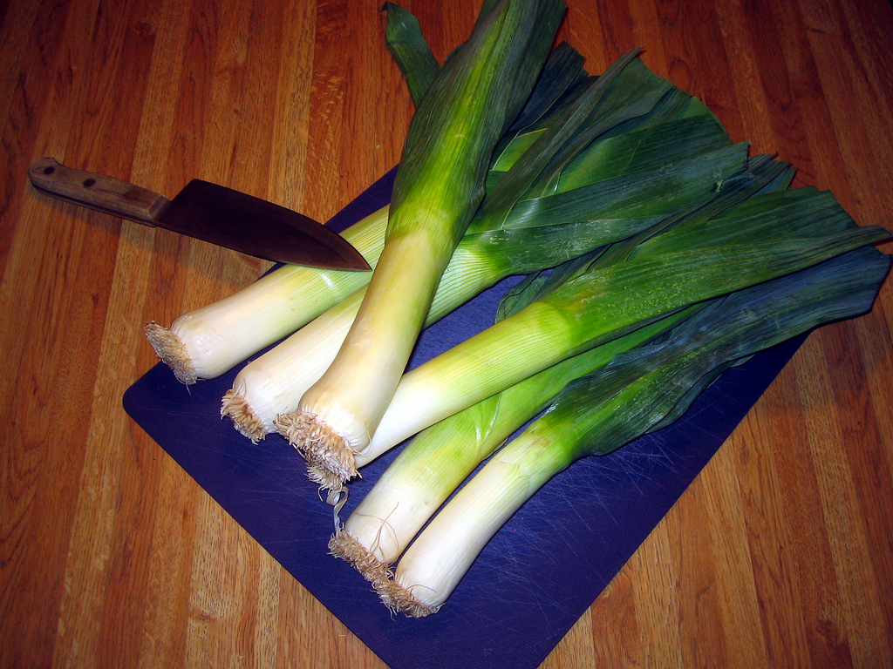
Leeks
Photo courtesy of karenandbradem (@flickr.com) - granted under creative commons licence – attribution

Slide 7
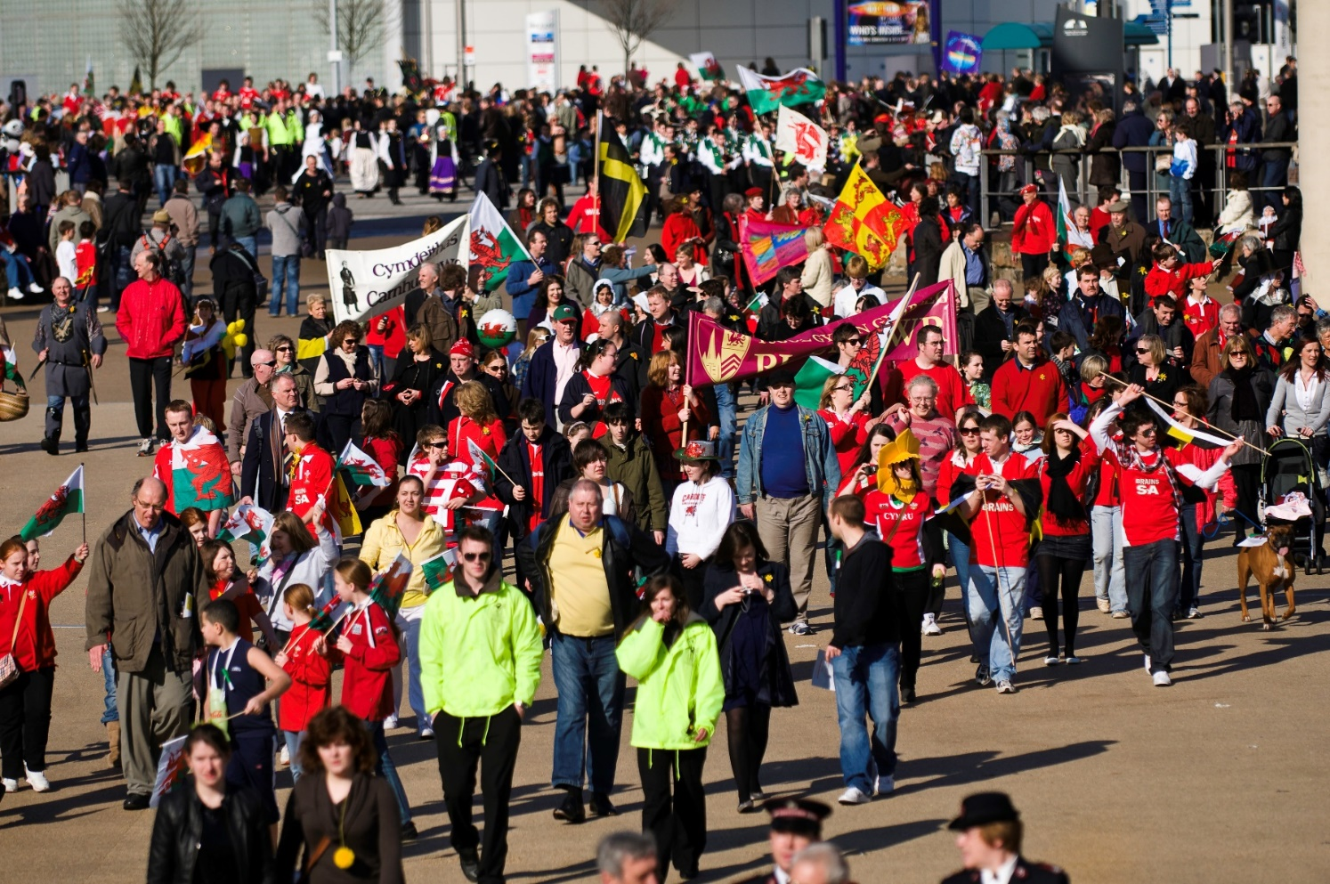
Parade
Photo courtesy of National Assembly for Wales (@flickr.com) - granted under creative commons licence – attribution

Slide 8
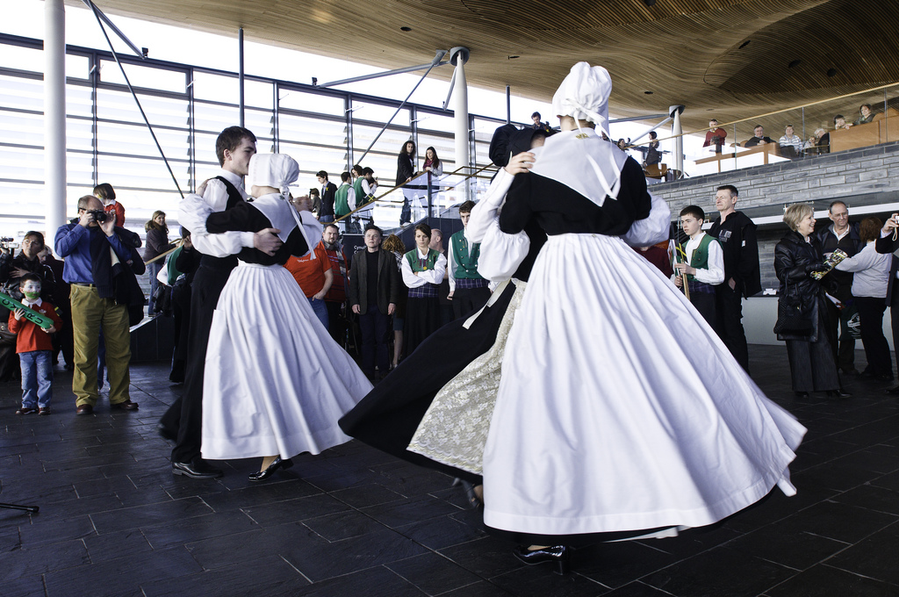
Traditional Dance
Photo courtesy of National Assembly for Wales (@flickr.com) - granted under creative commons licence – attribution

Slide 9
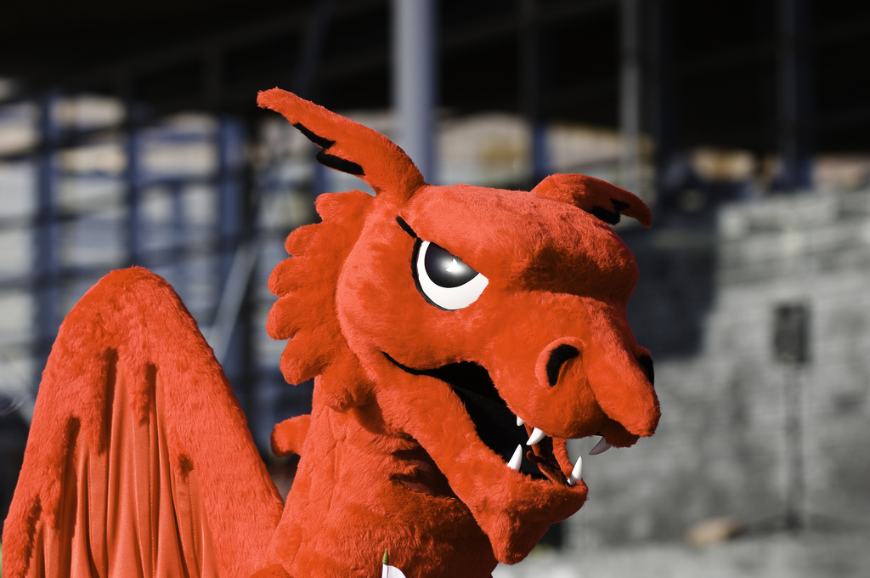
Welsh Dragon
Photo courtesy of National Assembly for Wales (@flickr.com) - granted under creative commons licence – attribution

Slide 10
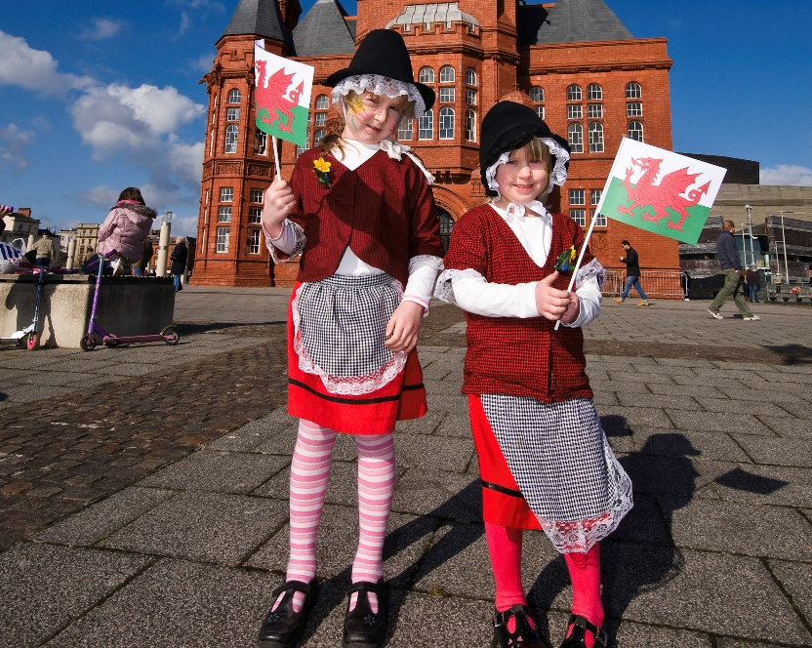
Traditional Dress
Photo courtesy of National Assembly for Wales (@flickr.com) - granted under creative commons licence – attribution

