Slide 1


Slide 3
1) ___ cm = 90 mm
2) 30 = 6 × ___
3) 5 =
4) 100 = ____
2
2

Slide 4
1) ___ cm = 90 mm
2) 30 = 6 × ___
3) 5 =
4) 100 = ____
9
5
2
25
2
10

Slide 6
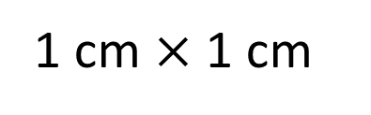
1 cm
1 cm
1 cm $×$ 1 cm
1 cm squared
2
1 cm

Slide 7
1 cm
6 squares
1 cm
2 rows
There are 2 rows.
There are 6 squares in each row.
There are 12 squares altogether.
2 × 6 =
12
The area of the rectangle is 12 cm squared.
12 cm
2

Slide 8

1 square
1 cm
1 cm
3 rows
Have a think
3
There are ___ rows.
1
There is ___ square in each row.
There are ___ squares altogether.
3
3
1
___ × ___ =
3
___
3
The area of the rectangle is ___ cm squared.
3
2
___ cm

Slide 9
What is area?
Area is the space inside a two-dimensional shape.

Slide 10
Have a think
3 cm
4 cm
2 cm
20 mm
7 cm
4 × 2 =
8 cm
2
3 × 7 =
21 cm
2

Slide 11
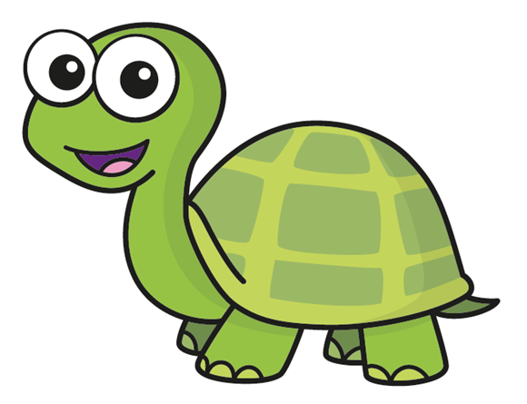
9 mm
2 m
2 m
Square
9 mm
9 × 9 =
2
The area of this rectangle is 4 m
81 mm
2
2
2
9 =
81 mm
Have a think
Explain why Tiny is incorrect.
Tiny only knows the length of this rectangle.

Slide 12
How many different rectangles can you draw that have an area of 28 cm ?
2
Label the lengths.
7 cm
14 cm
2 cm
4 cm
28 cm
1 cm
What do you notice
about your answers?
Have a think

Slide 13
Area = 72 m
2
?
12
12 m
6 m
6 × ___ = 72
?
Have a think
17 cm
2
Area = 17 cm
1 cm
17
1 × ___ = 17

Slide 14
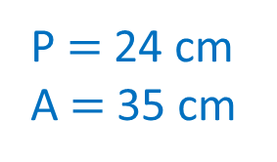
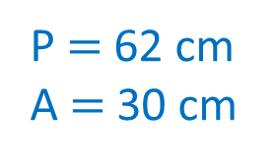
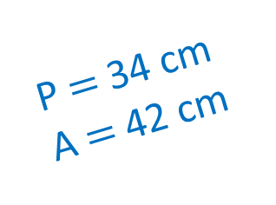
Is the statement always true, sometimes true or never true?
Sometimes true.
A rectangle’s area is always greater than its perimeter.
7 cm
14 cm
P $=$ 24 cm
A $=$ 35 cm
P $=$ 34 cm
A $=$ 42 cm
2
5 cm
2
3 cm
30 cm
P $=$ 62 cm
A $=$ 30 cm
1 cm
2
Have a think

Slide 15
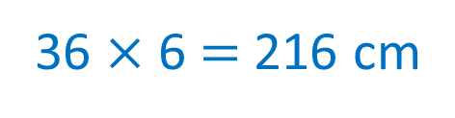
2
Each orange square has an area of 36 cm
Calculate the total orange area.
O
B
O
2
B
2 $×$ 36 $=$ 72 cm
B
O
O
Calculate the total blue area.
B
B
2
O
O
6 $×$ 18 $=$ 108 cm
G
G
B
G
G
Calculate the total green area.
2
4 $×$ 9 $=$ 36 cm
Calculate the total area of the shape.
2
2
72 $+$ 108 $+$ 36 $=$ 216 cm
36 $×$ 6 $=$ 216 cm

Slide 16



Slide 17
Have a go at questions

Slide 18
I do
You do

Slide 19
















Rosie
Alex
Amir
Whitney
Ron
Dexter
Annie
Tommy
Mo
Jack
Eva
Teddy
Max
Kim
Jo
Sam

Slide 20


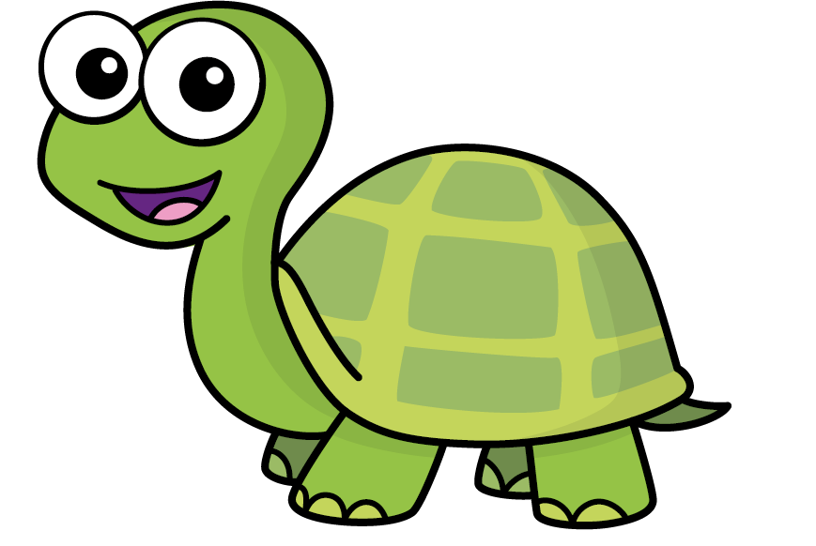
Speech bubble text – replace with any character head.
Speech bubble text – replace with any character head.
Bee
Diddy
Tiny

Slide 21







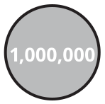
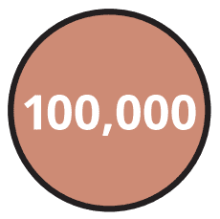
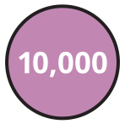












M | HTh | TTh | Th | H | T | O | Tth | Hth | Thth
100
40 | 60
Millions | Thousands |  |  | Ones
O | H | T | O | H | T | O

Slide 22





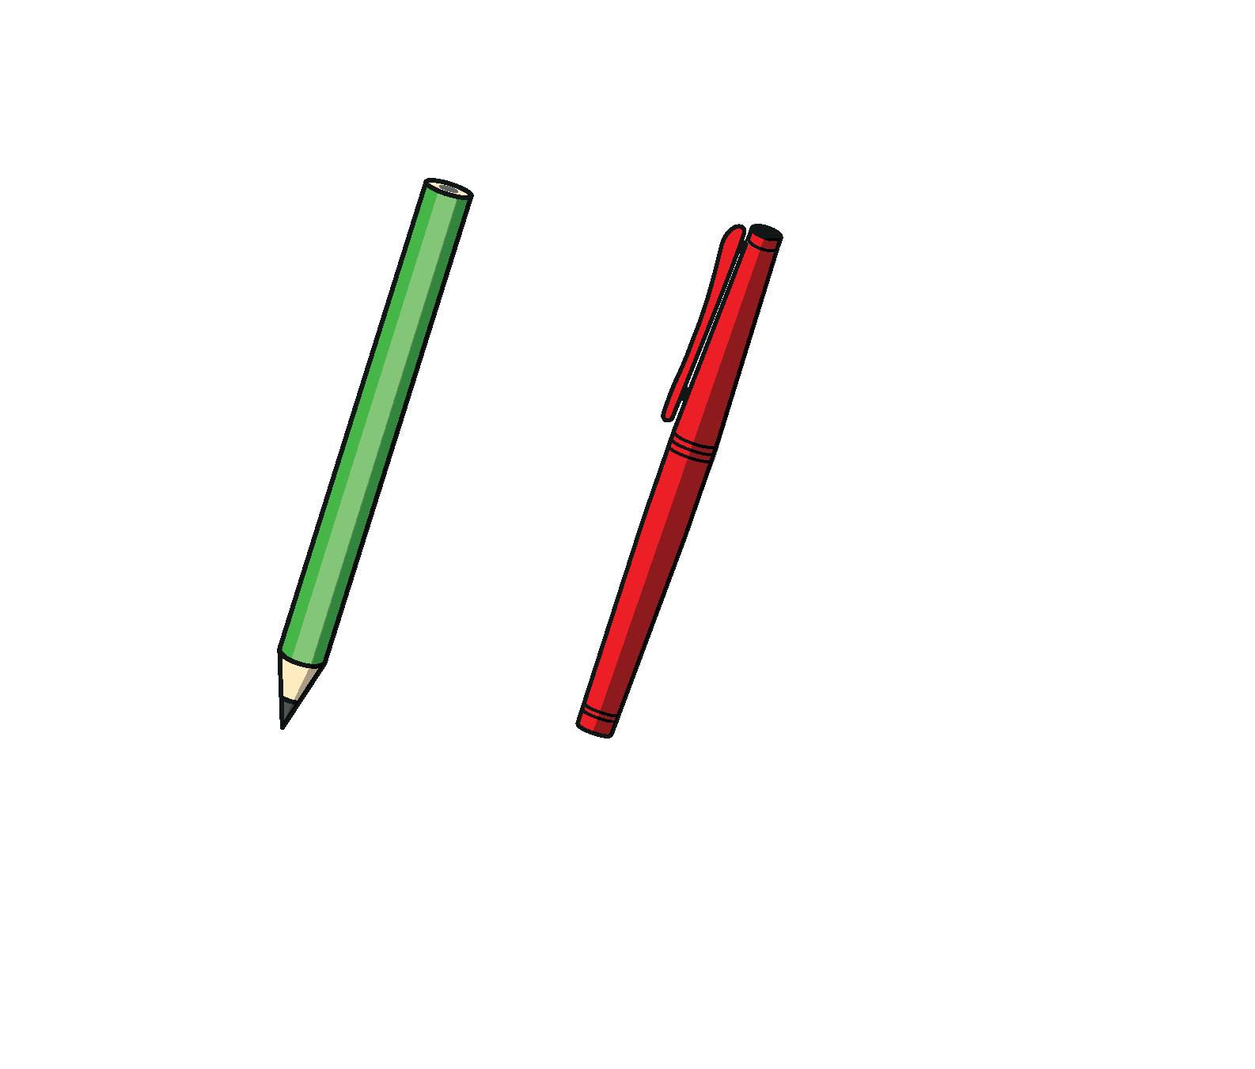

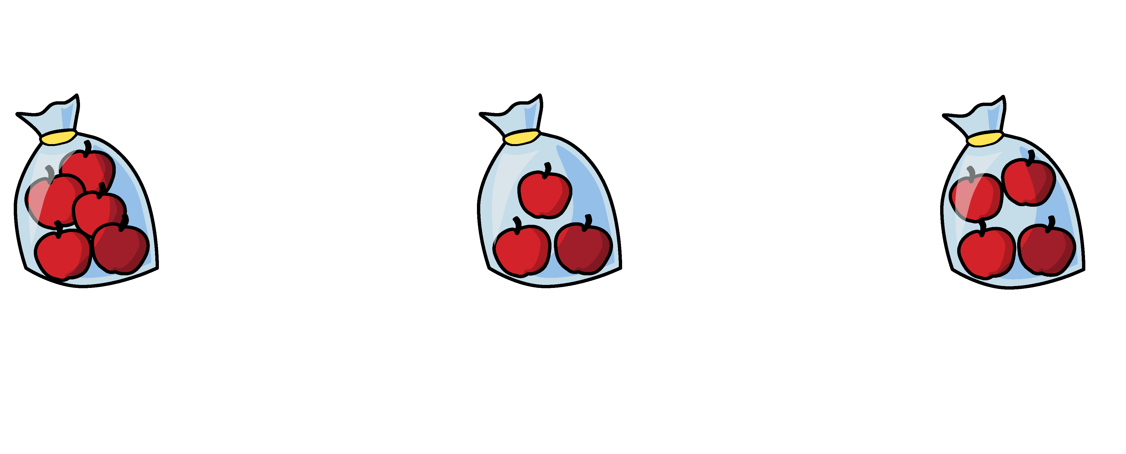


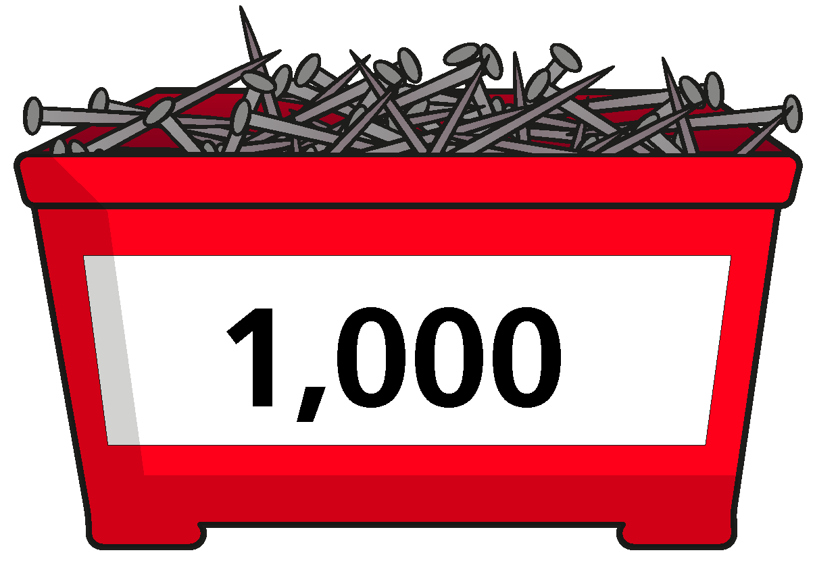
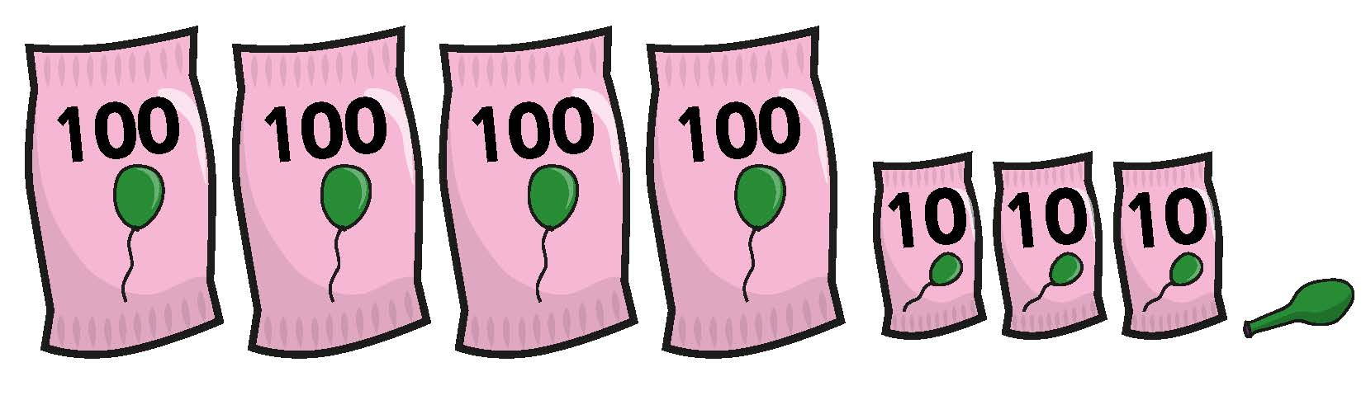

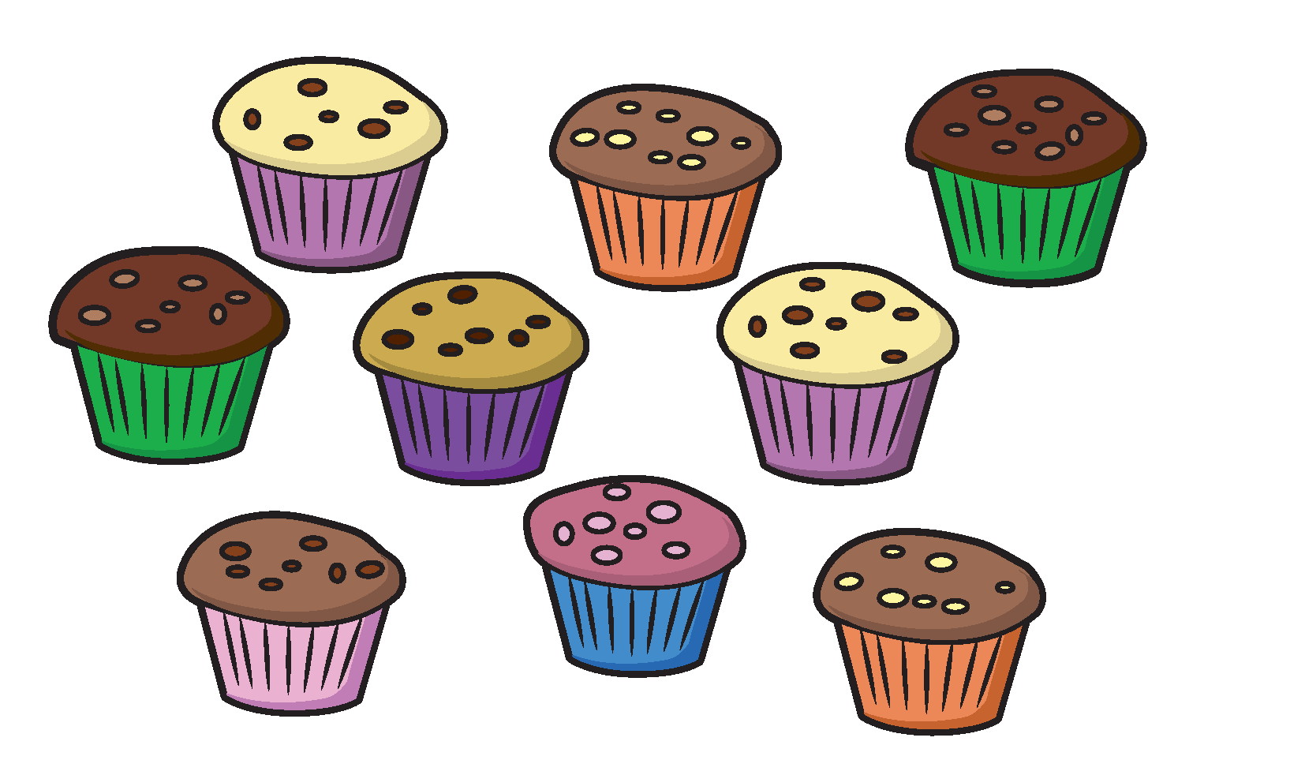
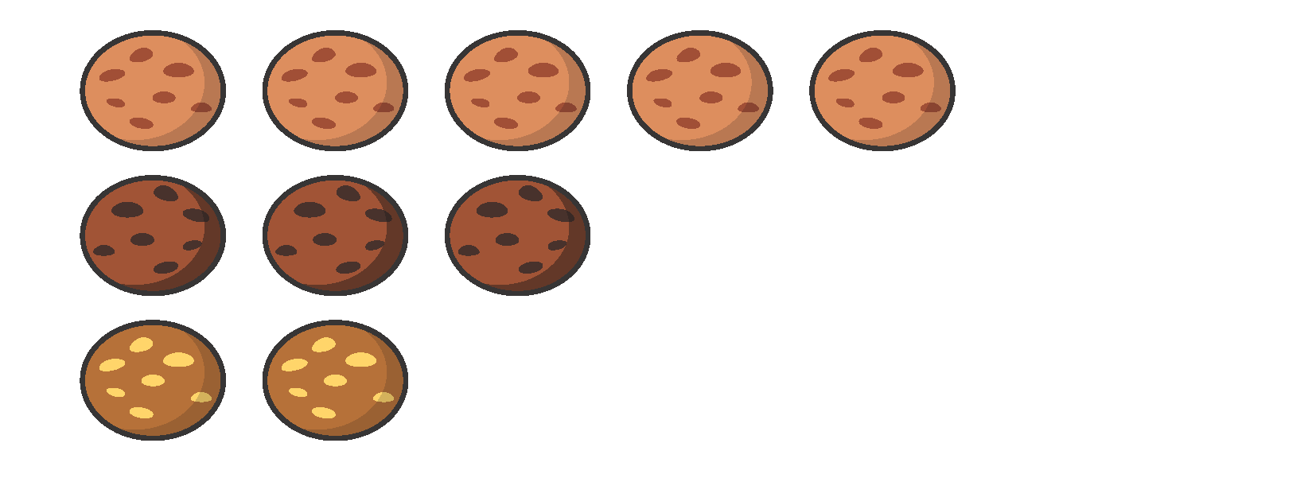



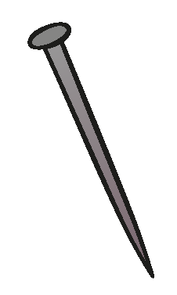
















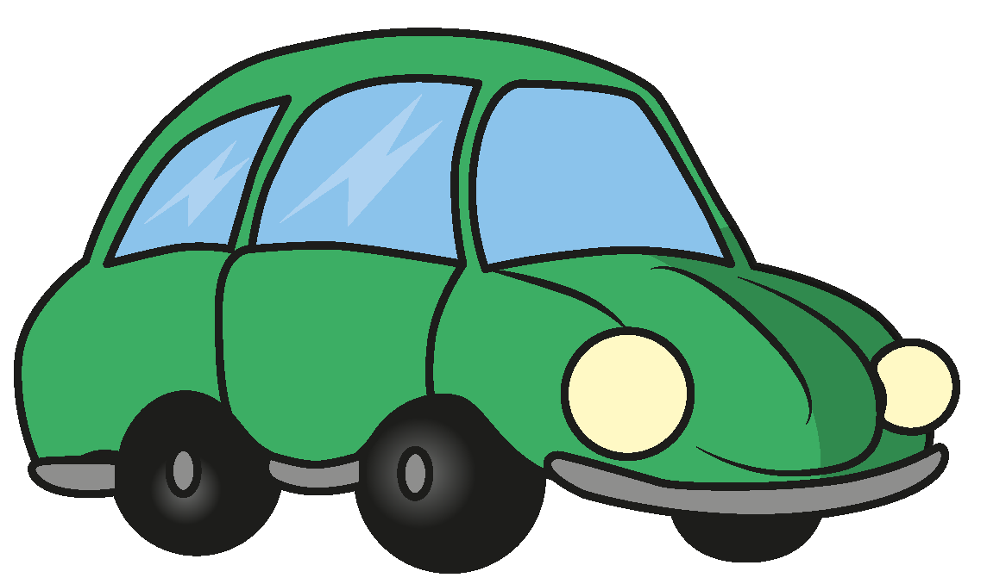





Slide 23


























































