Slide 1
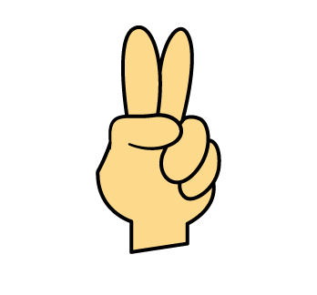

Double or not double?
Double

Slide 2
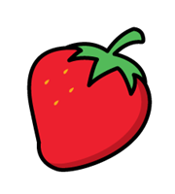
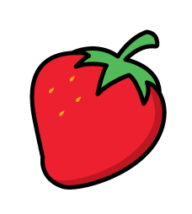

Double or not double?
Not double

Slide 3
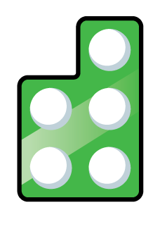

Double or not double?
Not double

Slide 4

Double or not double?
Double

Slide 5
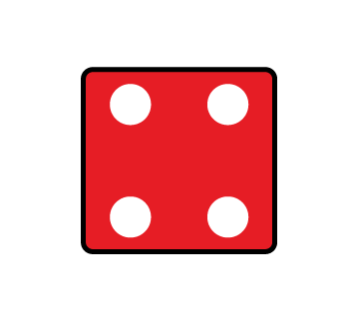
Double or not double?
Double

Slide 6
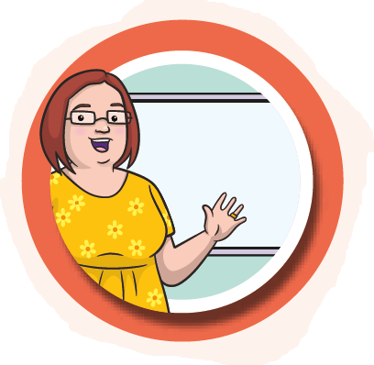
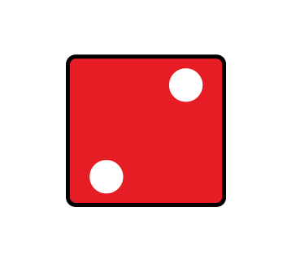
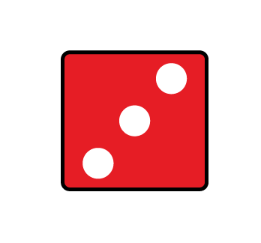
With a partner take turns
to roll two dice.
You score a point if you roll a double.
The first player to reach
3 points wins.

Slide 7
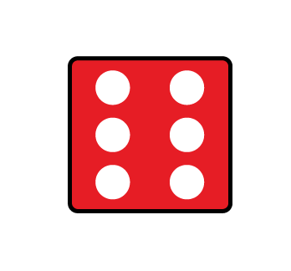
With a partner take turns
to roll two dice.
You score a point if you roll a double.
The first player to reach
3 points wins.

Slide 8
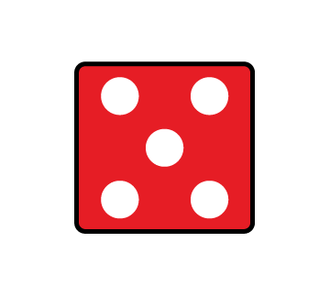
With a partner take turns
to roll two dice.
You score a point if you roll a double.
The first player to reach
3 points wins.

Slide 9


Ask a friend to hide number
pieces outside.
Ask them to give you a number piece.
Find another piece that is the same to make a double.

Slide 10
Ask a friend to hide number
pieces outside.
Ask them to give you a number piece.
What double have you found?
2
4
Double __ is __

Slide 11


Draw counters to work out the doubles.
Have a think
Double 5 is ___
10

Slide 12
Draw counters to work out the doubles.
Have a think
Double 7 is ___
14

Slide 13
Double is 6
3

Slide 14
Double is 10
5
Have a think

Slide 15
5
Double is 10
Double is 12
6
Have a think

Slide 16
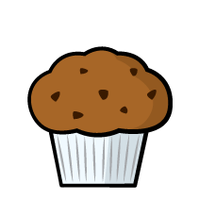
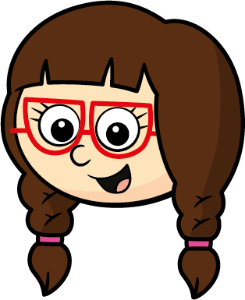
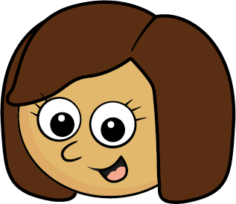
Ben has some cakes.
He doubles the number of cakes.
Here are Ben’s cakes now.
Ben had 4 cakes at the start.
Ben had 16 cakes at the start.
Who do you agree with?
Kim
8 is the double of 4
Have a think

Slide 17
Double each number to complete the table.
Number | Double
1
2
3
4
5
6
7
8
9
10
Have a think

Slide 18
Double each number to complete the table.
Number | Double
1
2
3
4
5
6
7
8
9
10
2

Slide 19
Double each number to complete the table.
Number | Double
1
2
3
4
5
6
7
8
9
10
2
4

Slide 20
Double each number to complete the table.
Number | Double
1
2
3
4
5
6
7
8
9
10
2
4
6
8
10
12
14
16
18
20

Slide 21
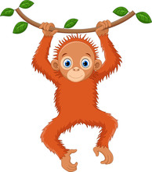

WB:02.03.2026
Otang and Ramona love bananas and wish they had a magic wand to double the amount of bananas that they have in their bowls. Can you practice your doubling skills?
WB:02.03.2026
Otang and Ramona love bananas and wish they had a magic wand to double the amount of bananas that they have in their bowls. Can you practice your doubling skills?

Slide 22
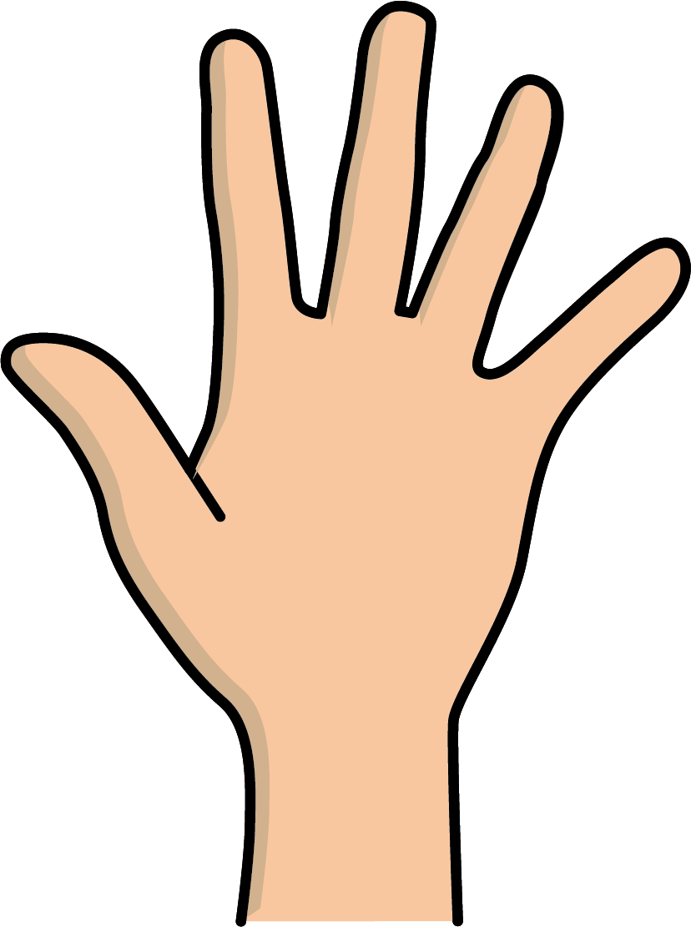

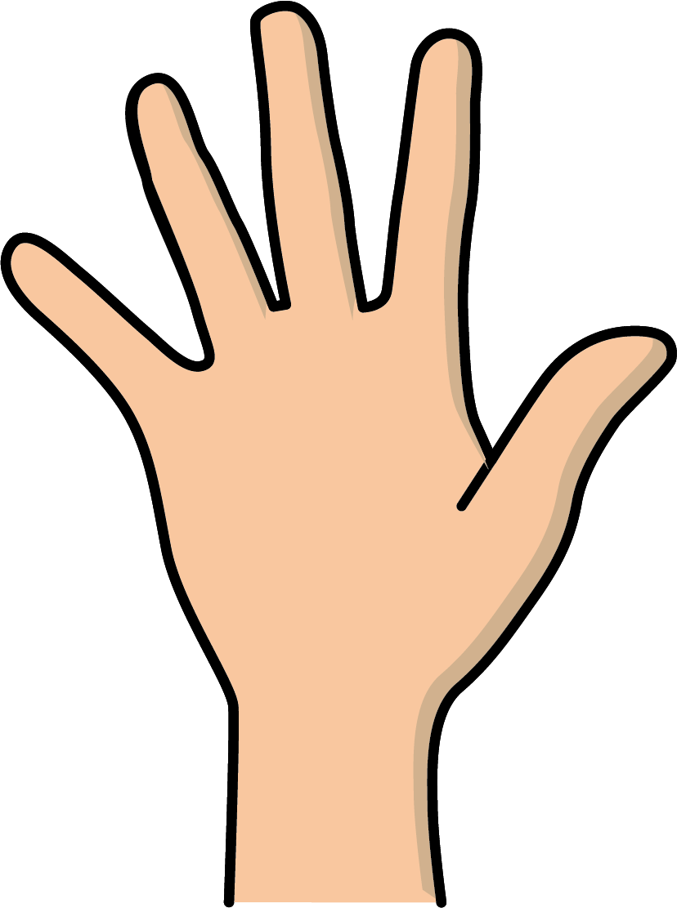
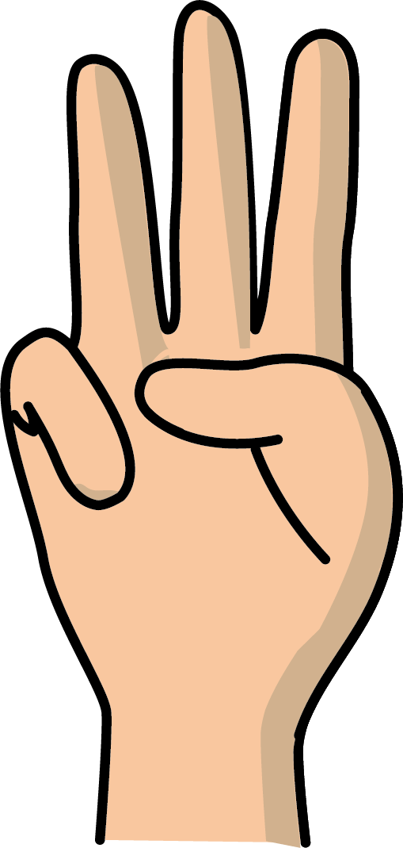
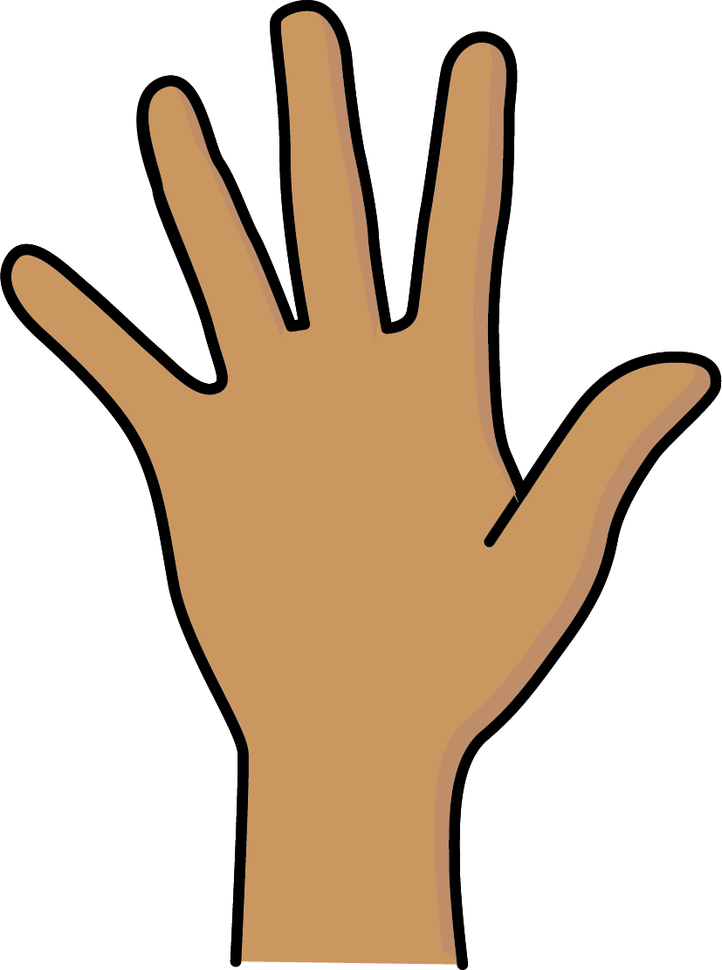
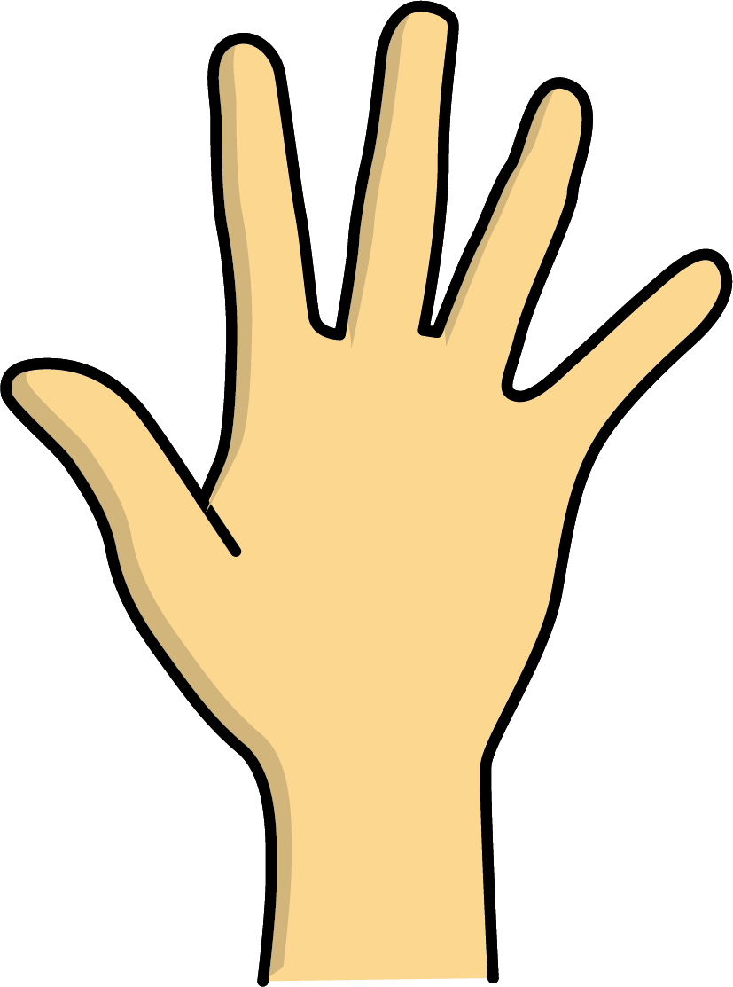

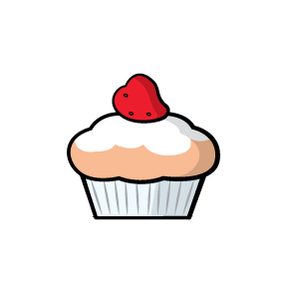
1
2
3
4
5
6

