Slide 1

Dydd Mawrth- Bwyd

Slide 2
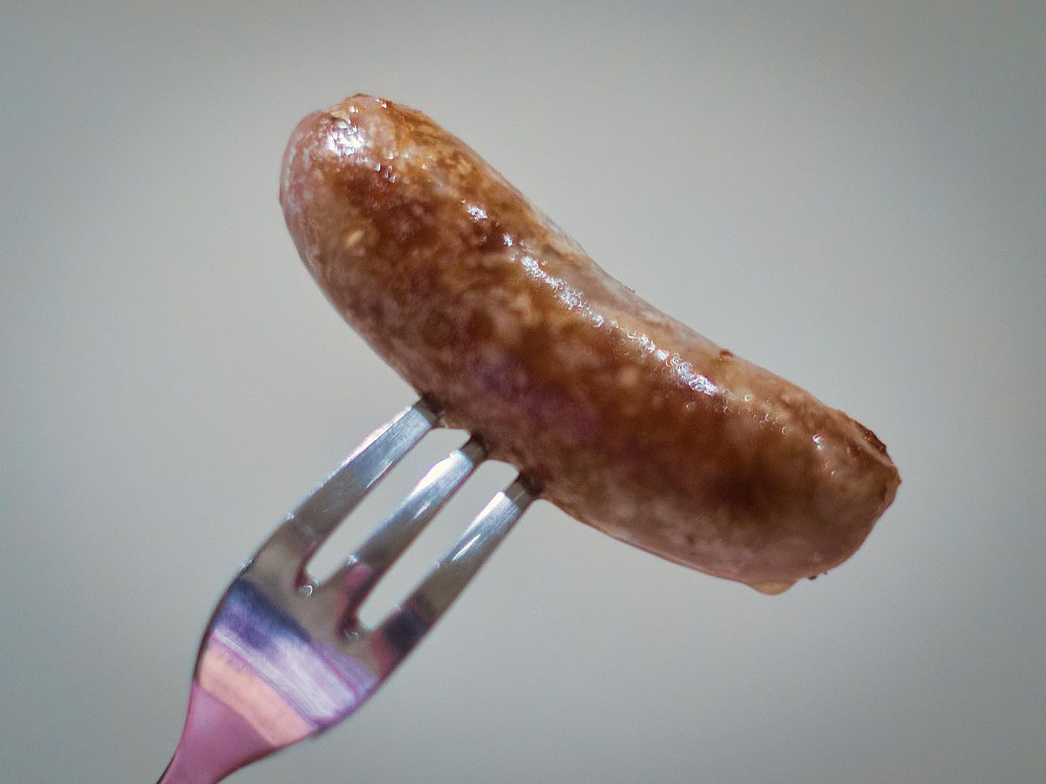
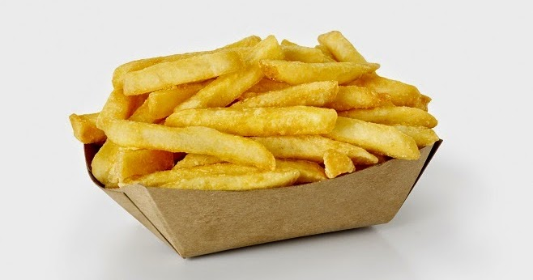
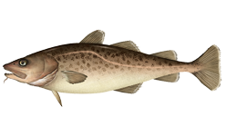
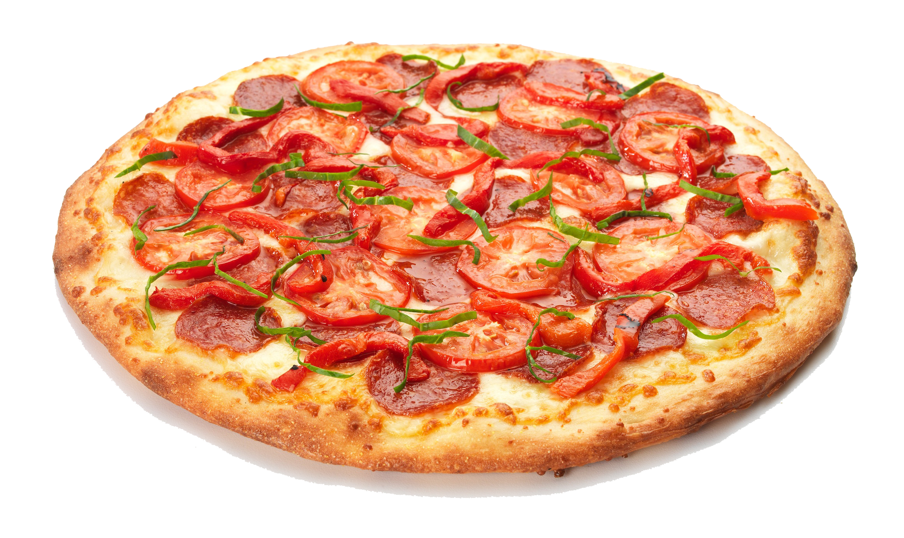


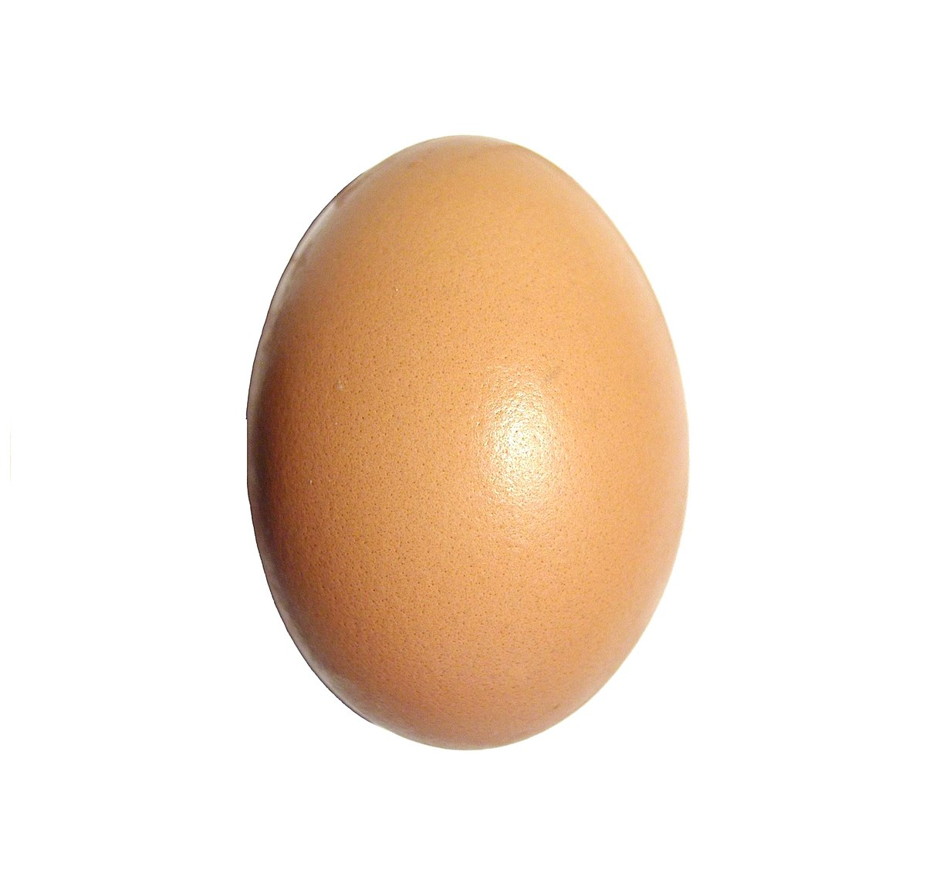
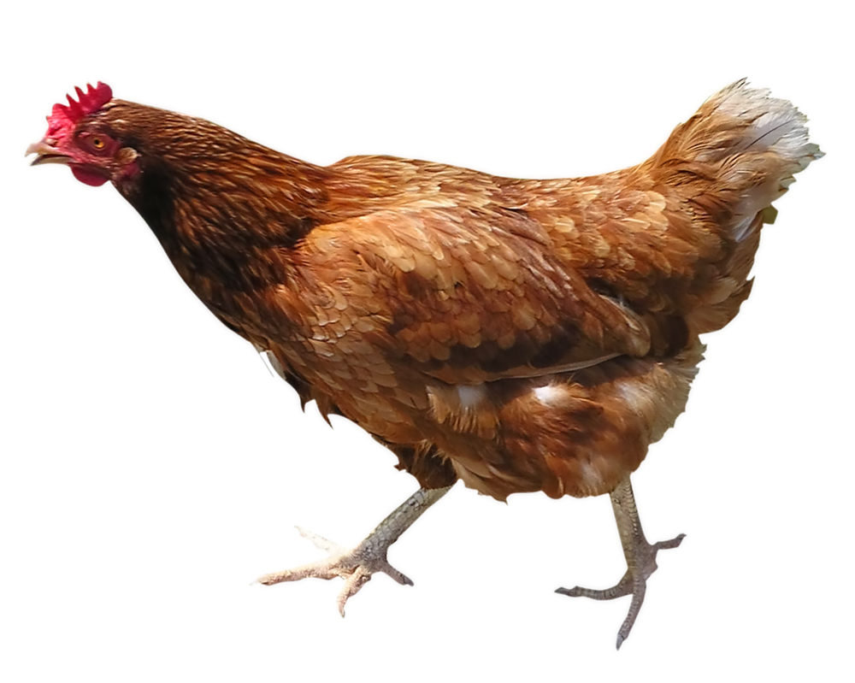
GEIRFA
pysgod
selsig
sglodion
Bwyd
iogwrt
pitsa
cyw iâr
ŵy
ffa pob
This Photo by Unknown Author is licensed under CC BY-SA
This Photo by Unknown Author is licensed under CC BY-NC-ND

Slide 3
CWESTIWN AC ATEB
Dw i eisiau pysgod.
Dw i eisiau selsig.
Dw i eisiau sglodion.
Beth wyt ti eisiau?
Dw i eisiau iogwrt.
Dw i eisiau pitsa.
Dw i eisiau
ffa pob.
Dw i eisiau cyw iâr.
Dw i
eisiau ŵy.
This Photo by Unknown Author is licensed under CC BY-SA
This Photo by Unknown Author is licensed under CC BY-NC-ND

Slide 4
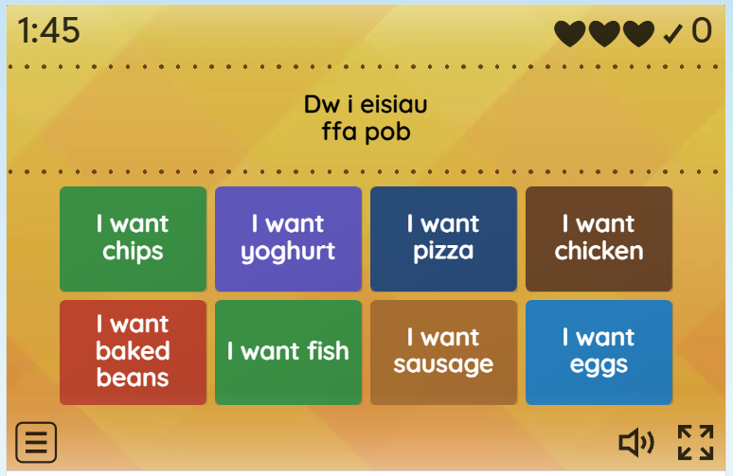
GÊM
Word Wall: Find the match
https://wordwall.net/resource/109057928

