Slide 1


Slide 3



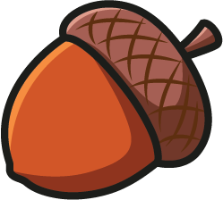



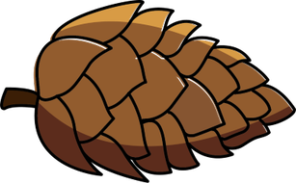

How can you sort the objects?
These are not leaves.
These are leaves.

Slide 4


How can you sort the objects?
These are brown.
These are not brown.

Slide 5

How can you sort the objects?
These are not smooth.
Acorns could be smooth or not smooth.
These are smooth.

Slide 6
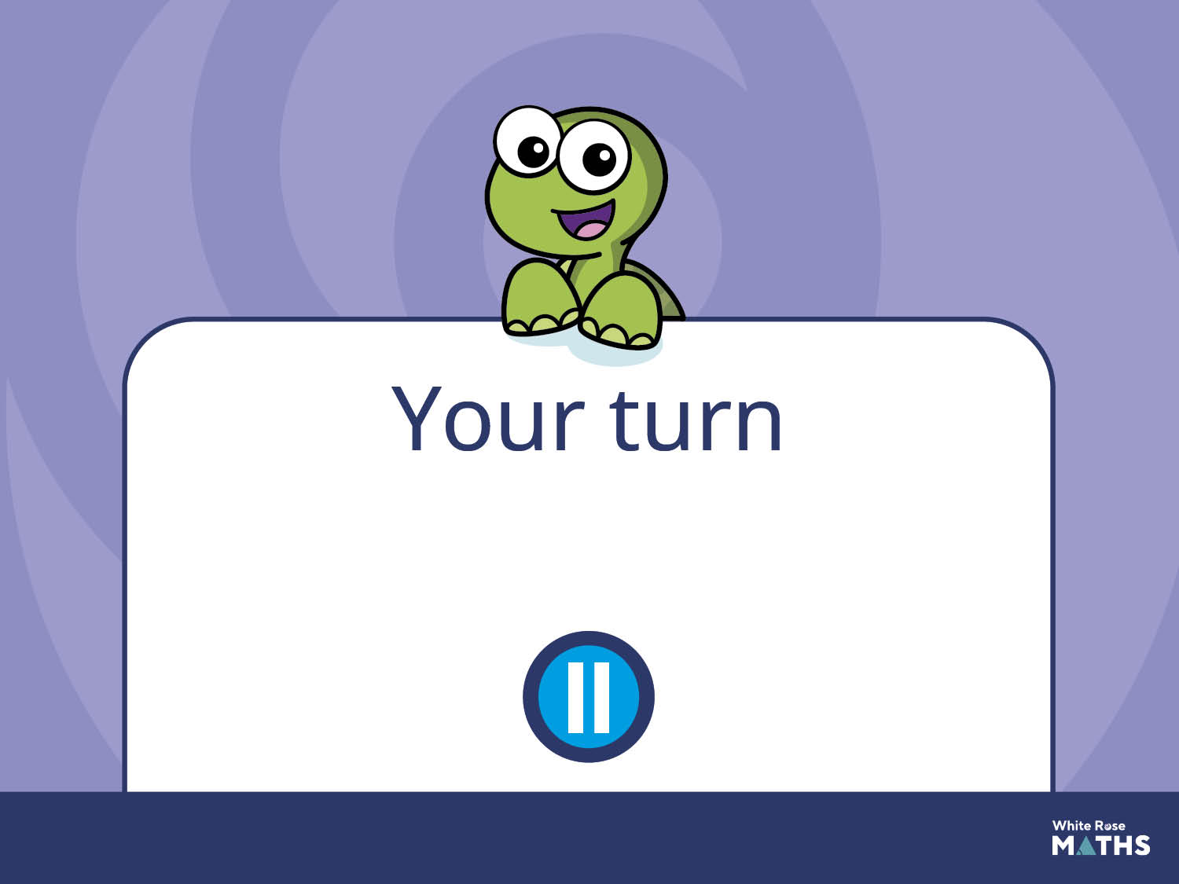
Have a go at the next activity.

Slide 7

Go outside and collect a variety of different natural resources.
How many different ways can you find to sort your objects?

