Slide 1


Slide 3











Guess the rule.
My rule is …
all the buttons are red.

Slide 4
Guess the rule.
My rule is …
all the buttons have 2 holes.

Slide 5
Guess the rule.
My rule is …
all the buttons are round.

Slide 6
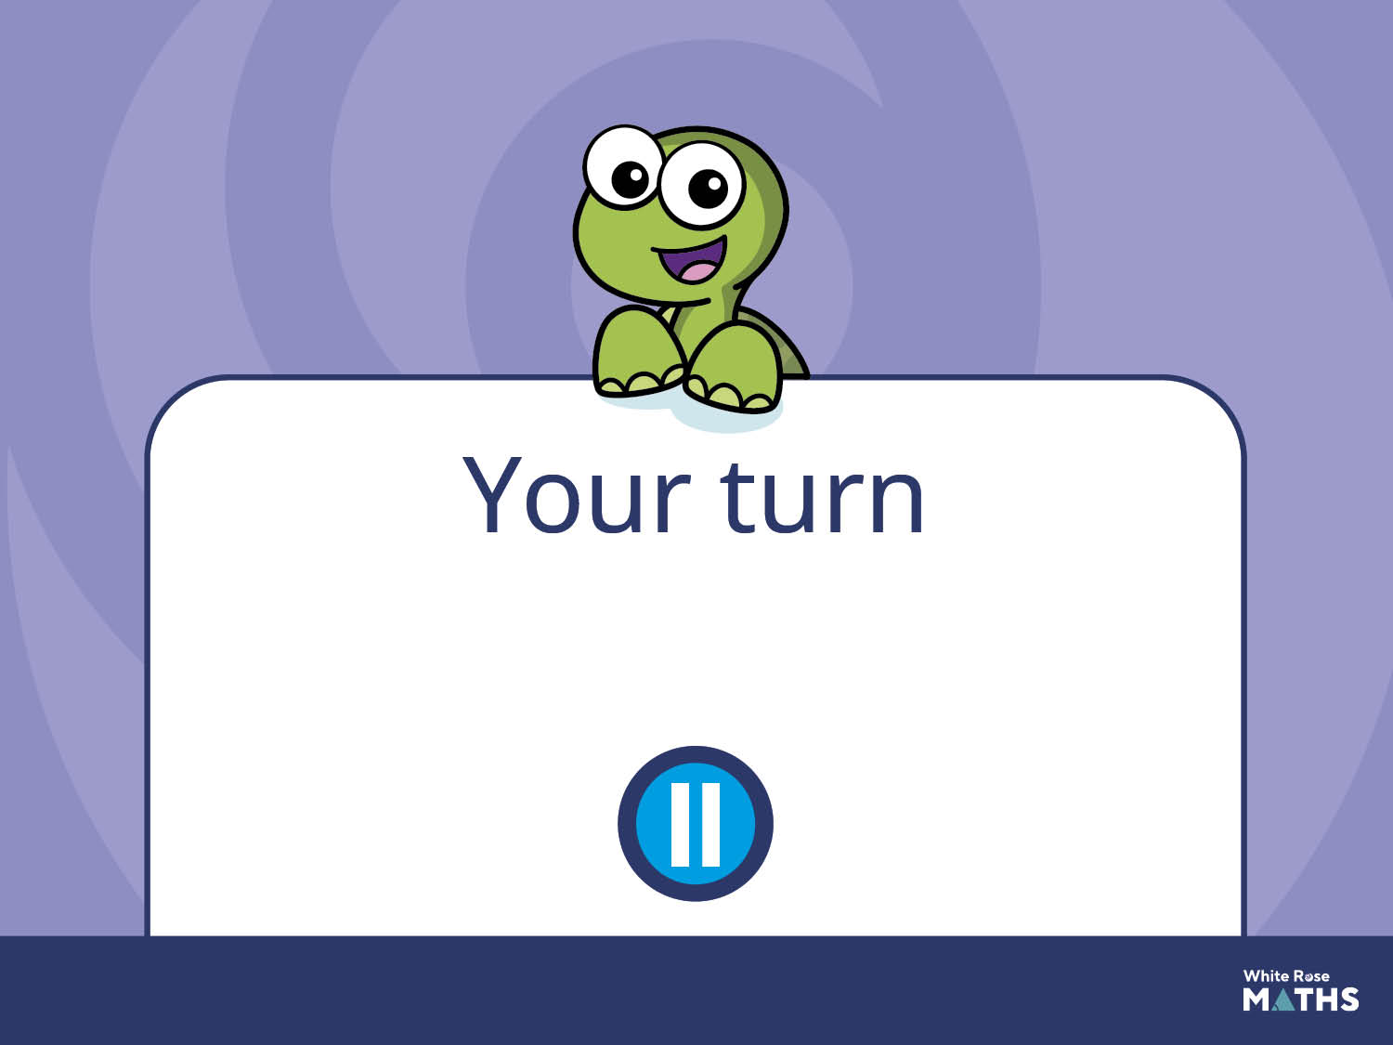
Have a go at the next activity.

Slide 7
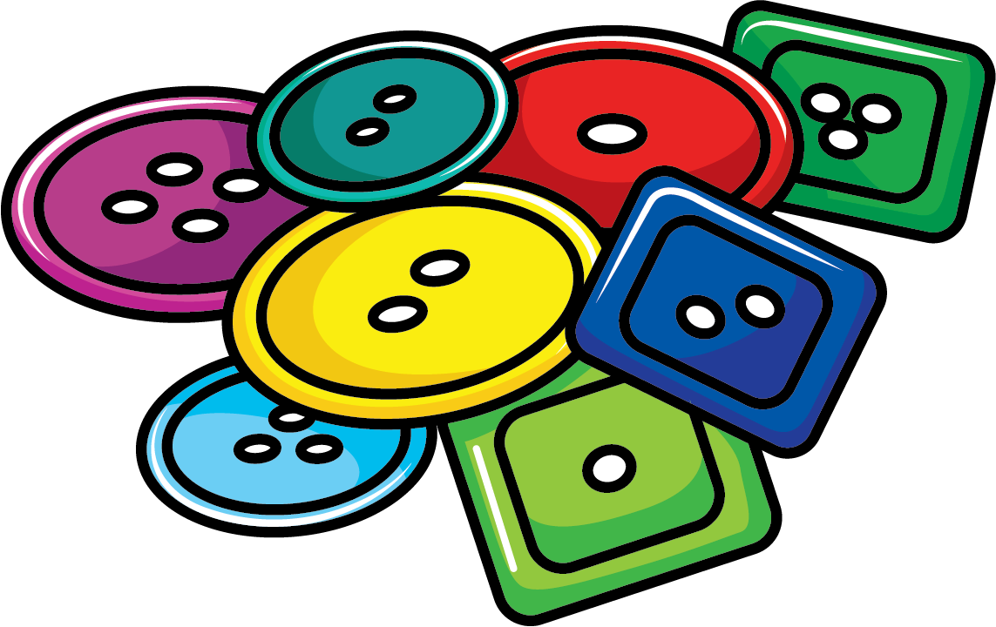
Play ‘Guess my rule’.
One at a time, place buttons
into your set.
Ask children to suggest what your
rule could be.

