Slide 1


Slide 2
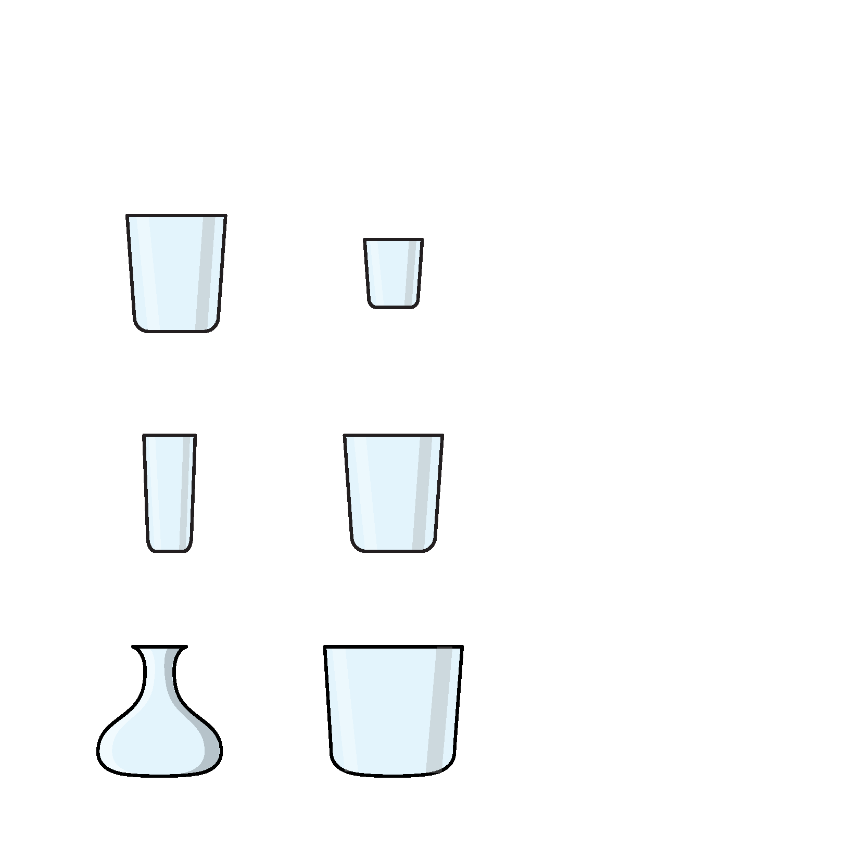
1) Which container is the biggest?
2) What does full mean?
3) What does empty mean?

Slide 3
1) Which container is the biggest?
2) What does full mean?
3) What does empty mean?

Slide 5
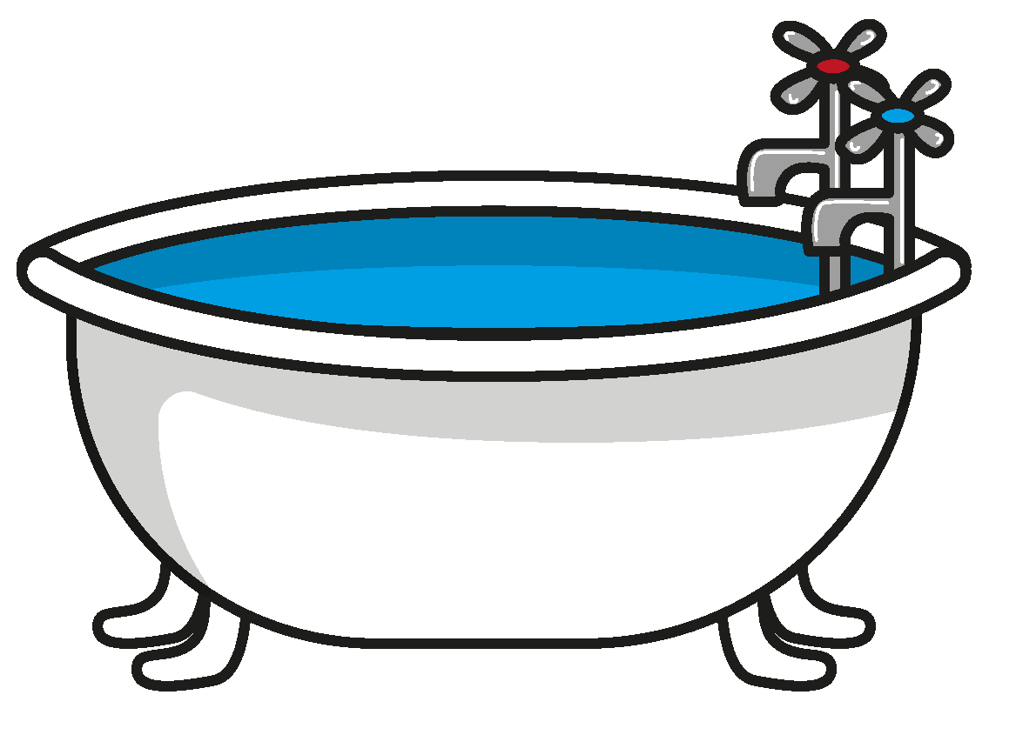
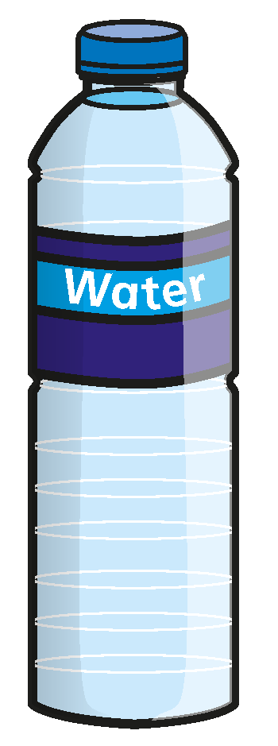

Which do you think can hold more water?
The bath has a greater capacity.
Have a think

Slide 6
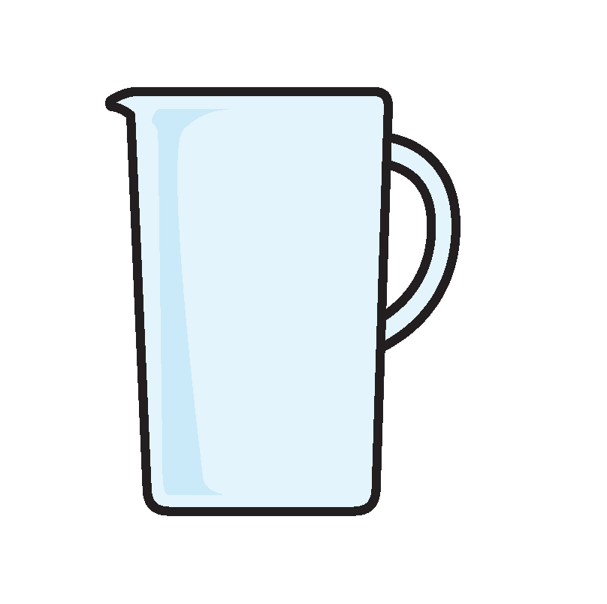
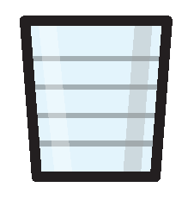
Which do you think can hold more juice?
The jug has a greater capacity.
Have a think

Slide 7

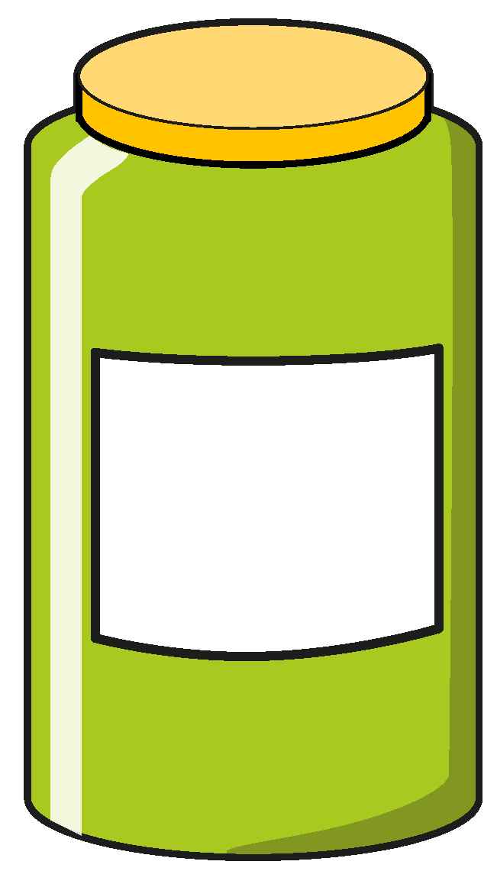
Which do you think can hold more marbles?
The box has a greater capacity.
Have a think

Slide 8
Capacity
The maximum amount that something can hold inside it.

Slide 9

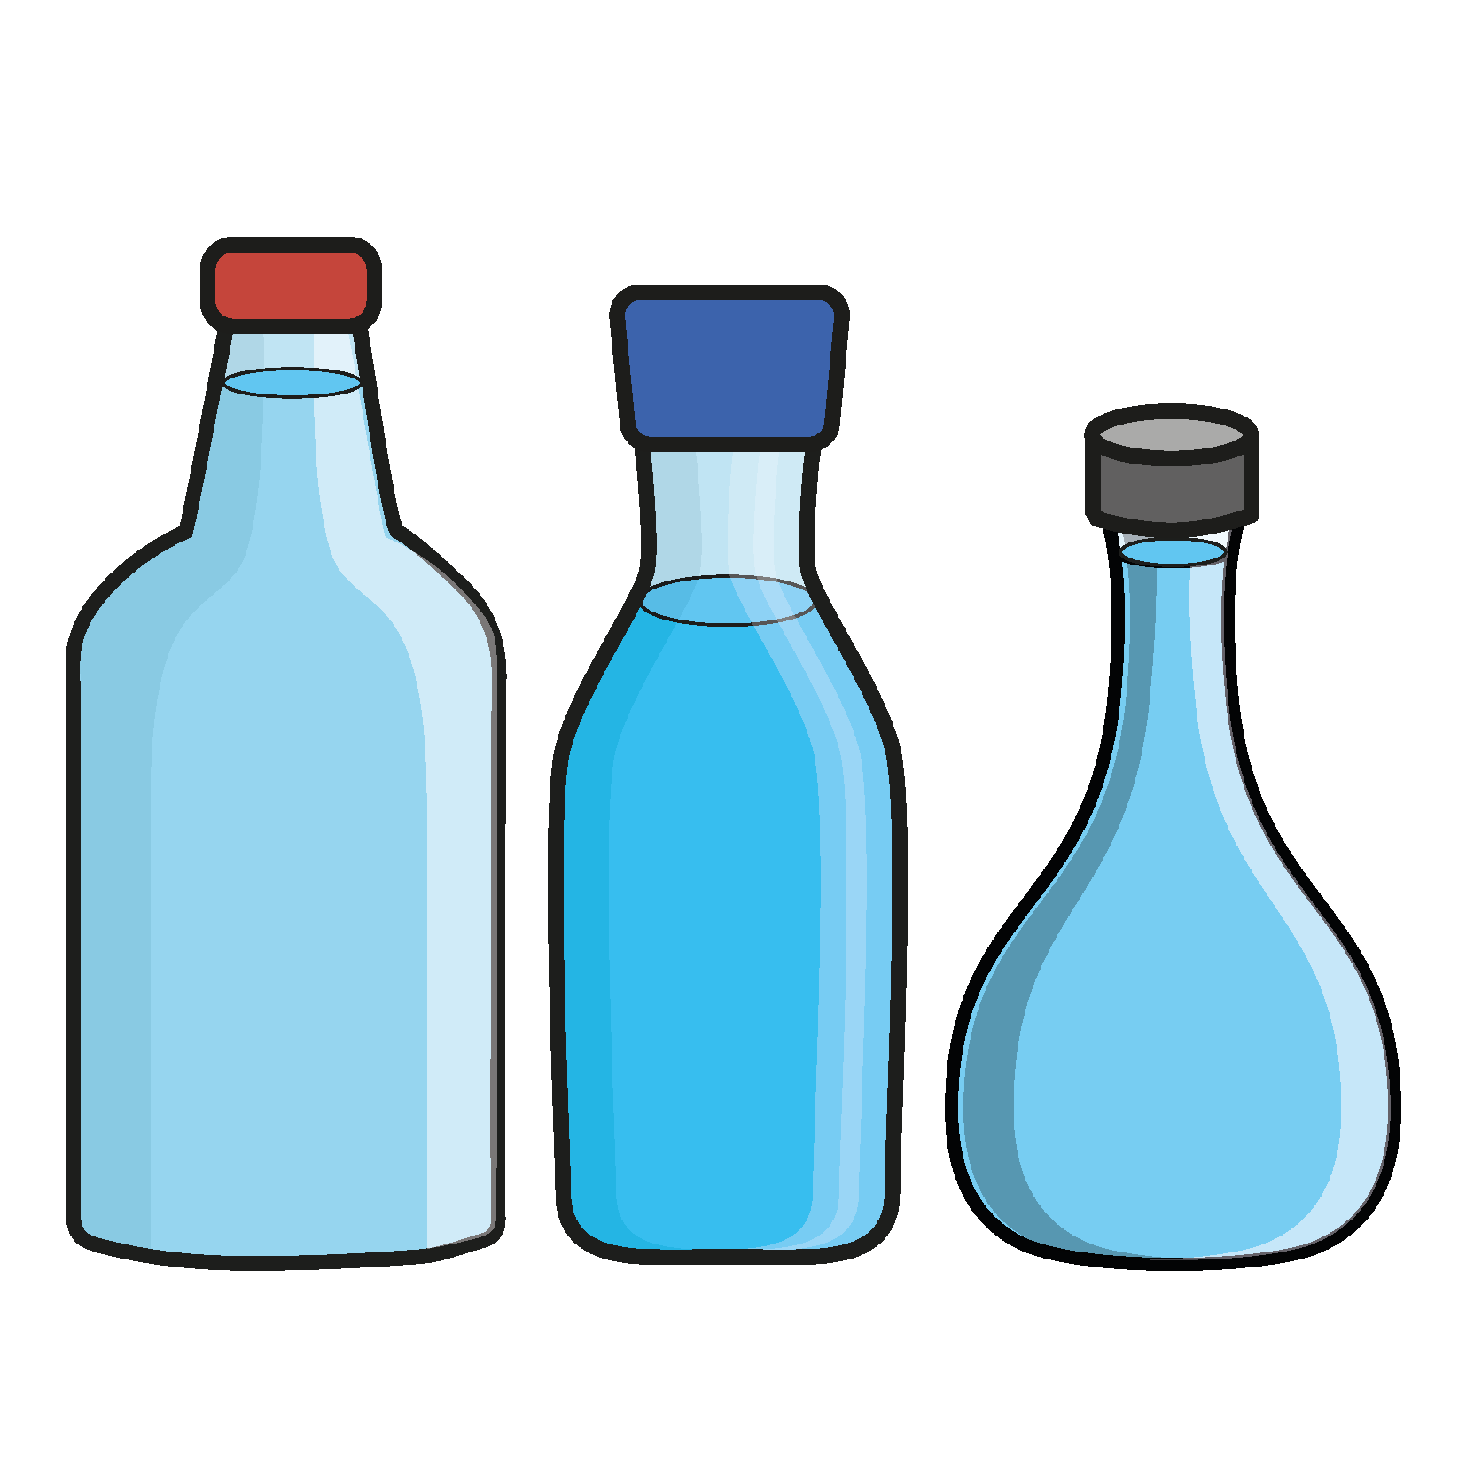

Collect a variety of different containers.
Which do you think has the greatest capacity?
How could you work out which has the greatest capacity?

