Slide 1


Slide 3
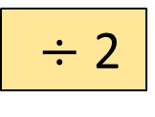
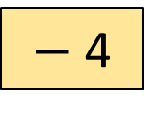

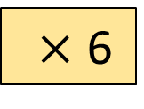
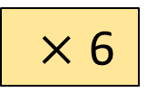
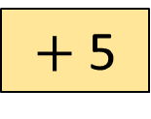
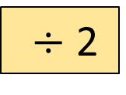

1) Calculate the missing outputs for the function machine.
2) Calculate the missing inputs for the function machine.
Input
Output
10
$×$ 6
$−$ 4
74
$÷$ 2
$+$ 5
Input
Output
$×$ 6
$−$ 4
14
$÷$ 2
$+$ 5
35

Slide 4
1) Calculate the missing outputs for the function machine.
2) Calculate the missing inputs for the function machine.
Input
Output
10
$×$ 6
$−$ 4
56
74
$÷$ 2
$+$ 5
42
Input
Output
3
$×$ 6
$−$ 4
14
60
$÷$ 2
$+$ 5
35

Slide 5

​
​
​

Slide 6

Rosie grows 3 cm
How can you represent what has just happened?
Rosie’s height
3 cm
Rosie’s new height

Slide 7
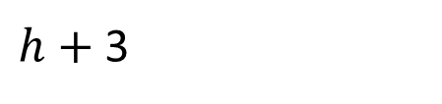

Rosie’s height
$$h$$
3 cm
Rosie’s new height
$h+$ 3

Slide 8


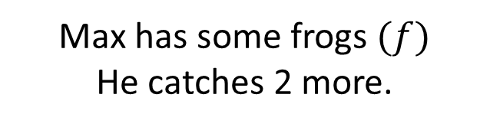
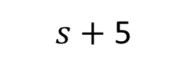
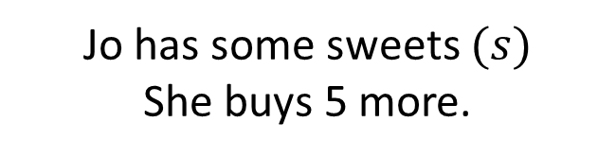
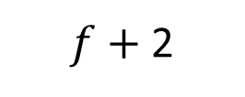
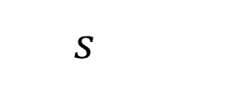
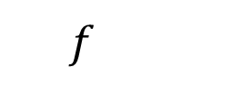

Have a think
How can you represent this expression using a bar model?
Max has some frogs$(f)$
He catches 2 more.
Jo has some sweets $(s)$
She buys 5 more.
$f+$ 2
$s−$ 5
$f+$ 2
$s+$ 5
$$f$$
$$s$$

Slide 9








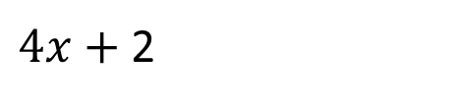


$$y$$
$$x$$
$$x$$
1
1
$$x$$
$$a$$
$$x$$
$$4x$$
$4x+$ 2
$$x+x+x+x$$
2

Slide 10


Have a think
How can you write these as expressions?
$2x$ $+$ 3
$4x+$ 5

Slide 11


Have a think
How can you represent these expressions?
$3x$ $+$ 3
4 $+$ $x$

Slide 12
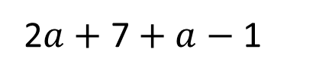
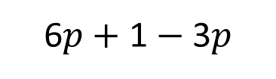
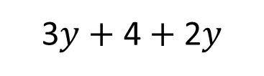

Simplify the expression
3$y$ $+$ 4 $+$ 2$y$
5$y$ $+$ 4
6$p$ $+$ 1 $−$ 3$p$
2$a$ $+$ 7 $+$ $a$ $−$ 1
Have a think

Slide 13
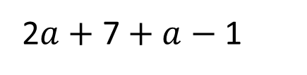

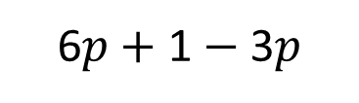

6$p$ $+$ 1 $−$ 3$p$
3$p$ $+$ 1
2$a$ $+$ 7 $+$ $a$ $−$ 1
3$a$ $+$ 6

Slide 14
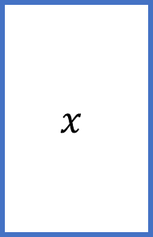
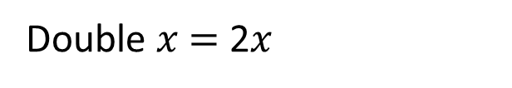
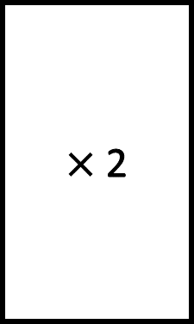
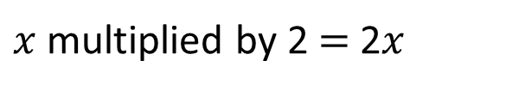
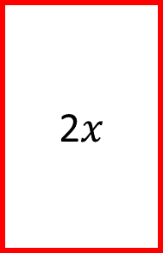
Input
Output
$×$ 2
$$x$$
2$x$
$x$ multiplied by 2 $=$ 2$x$
Double $x$ $=$ 2$x$

Slide 15
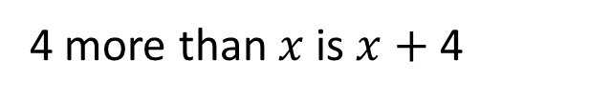

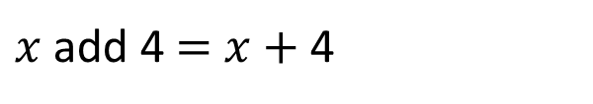
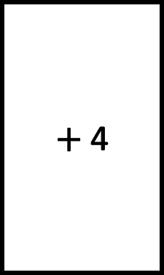
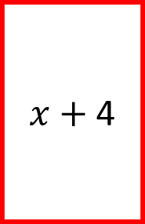
Input
Output
$+$ 4
$$x$$
$x$ $+$ 4
$x$ add 4 $=$ $x$ $+$ 4
4 more than $x$ is $x$ $+$ 4

Slide 16
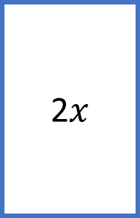

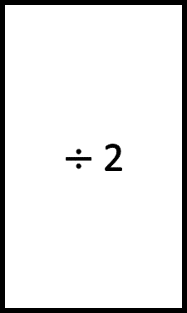

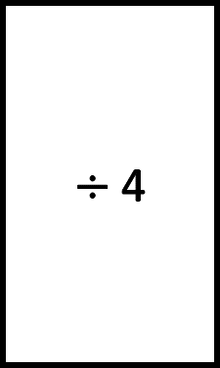
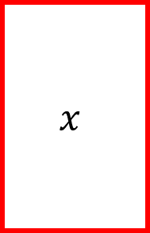
Complete the function machines.
Input
Output
$÷$ 2
2$x$
$$x$$
Input
Output
$÷$ 4
8$x$
2$x$
Have a think

Slide 17


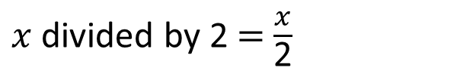
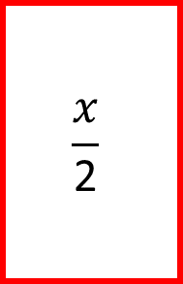
Input
Output
$÷$ 2
$$x$$
$$\frac{x}{\text{2}}$$
$x$ divided by 2 $=$ $\frac{x}{\text{2}}$

Slide 18
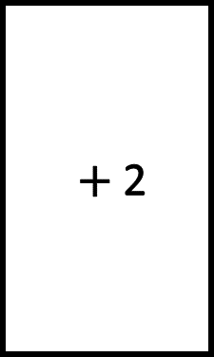
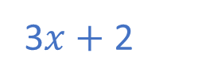

Write an expression for the function machine.
Input
Output
$×$ 3
$+$ 2
3$x$ $+$ 2
Have a think

Slide 19




Write an algebraic expression to represent the perimeter of the rectangle.
$$a$$
$$b$$
I think the expression is $a+b+a+b$
Do you agree with Tiny?
Have a think

Slide 20


Write an algebraic expression to represent the perimeter of the rectangle.
$$a$$
$$b$$
$$b$$
$$a$$
I think the expression is $a+b+a+b$
2$a+$ 2$b$

