Slide 1







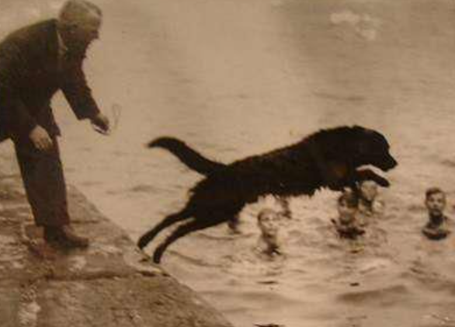

Pwy ydy Jac Abertawe?

Slide 2


What breed of dog was Jack?

Slide 3

What was the name of the park that Jack was thrown out of?

Slide 4

What did jack chase in Llewelyn Park?

Slide 5
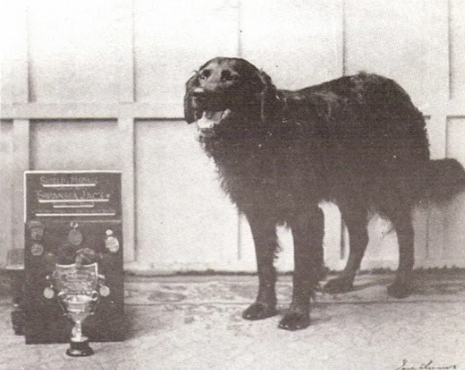
Who was Jack’s new owner?

Slide 6
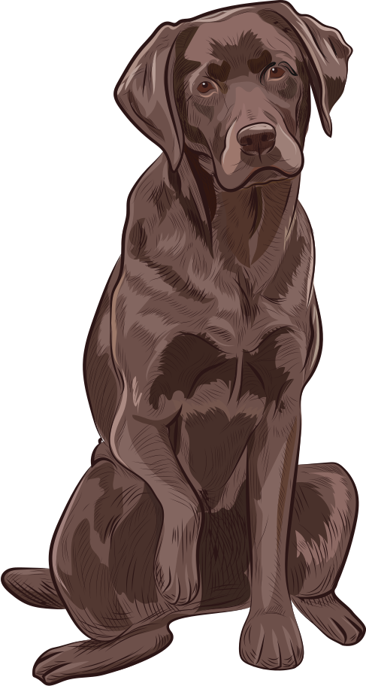
Where did he go to live?

Slide 7

What was Jack’s new favourite hobby?

Slide 8

How many people did Jack save?

Slide 9

How many dogs did Jack save?

