Slide 1


Slide 3
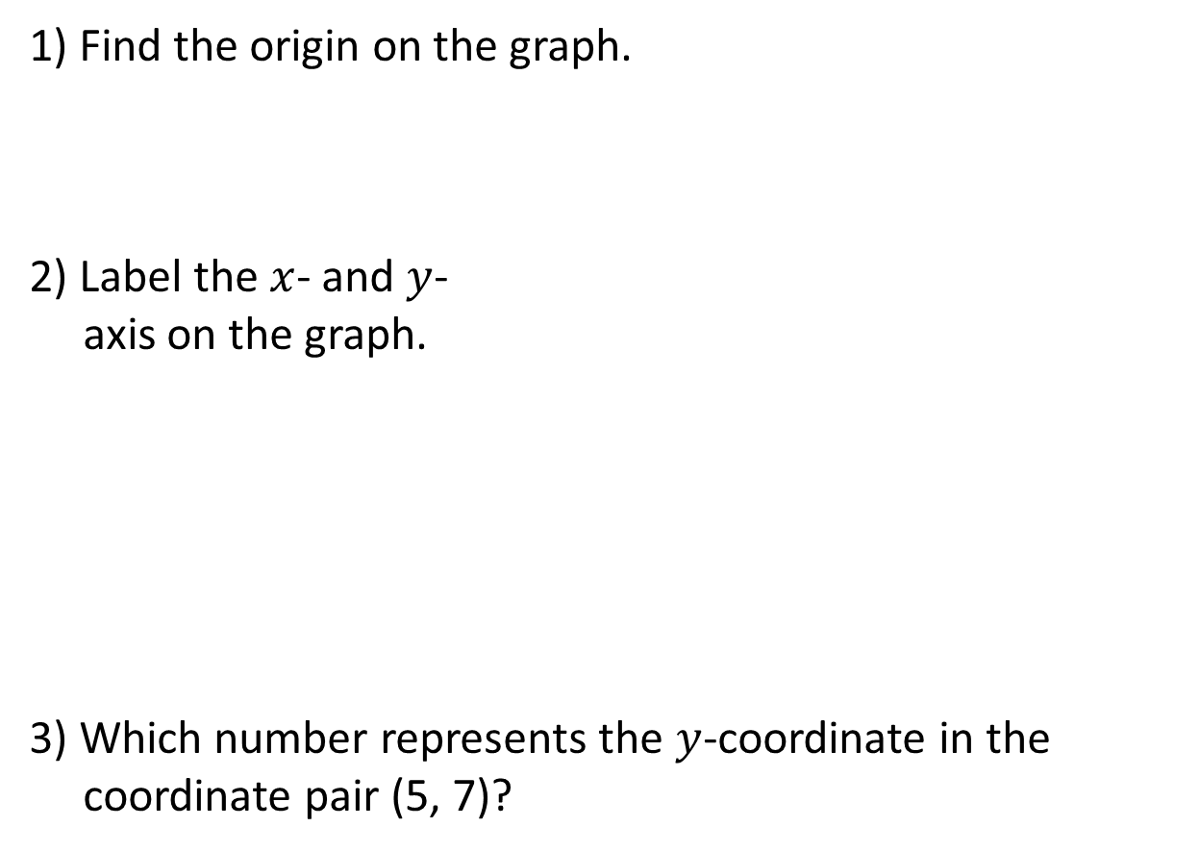
1) Find the origin on the graph.
2) Label the $x$- and $y$-
axis on the graph.
3) Which number represents the $y$-coordinate in the
coordinate pair (5, 7)?
10
9
8
7
6
5
4
3
2
1
0
1
2
3
4
5
6
7
8
9
10

Slide 4


1) Find the origin on the graph.
2) Label the $x$- and $y$-
axis on the graph.
3) Which number represents the $y$-coordinate in the
coordinate pair (5, 7)?
$$y$$
10
9
8
7
6
5
4
3
2
1
0
1
2
3
4
5
6
7
8
9
$$x$$
10
7

Slide 6
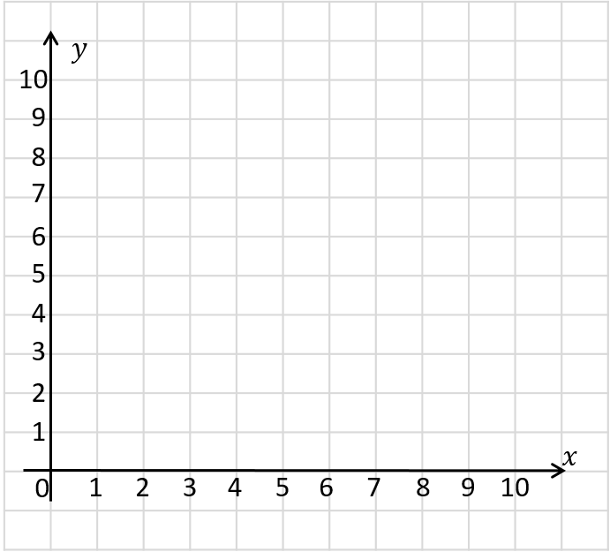
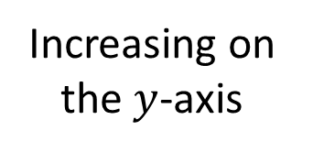
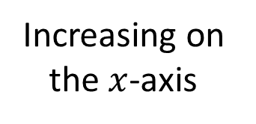
Increasing on the $y$-axis
Increasing on the $x$-axis

Slide 7
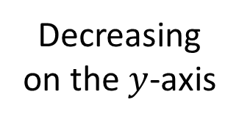
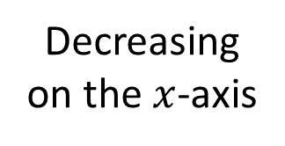
Decreasing on the $y$-axis
Decreasing on the $x$-axis

Slide 8

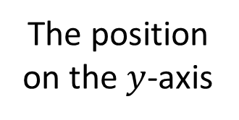
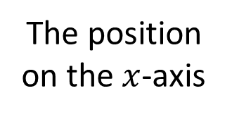
When reading or plotting coordinates, which axis do you look at first?
How can we describe the position of point ?
$($ , $)$
2
4
The position on the $x$-axis
The position on the $y$-axis

Slide 9

Which point has the coordinates of (4, 9)?
A
A
What are the coordinates of the other point?
B
(9, 4)
Have a think

Slide 10








Have a think
$$x$$
$$y$$
$($ , $)$
2
4
$($ , $)$
4
2
$($ , $)$
5
7
$($ , $)$
0
6
$($ , $)$
9
0

Slide 11


Have a think
What’s the same?
What’s different?
$$\text{A}$$
$$\text{B}$$

Slide 12
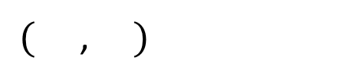
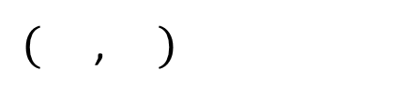


What other points could be on this line?
$($ , $)$
2
4
$$\text{A}$$
$($ , $)$
5
4
$$\text{B}$$
$$\text{A}$$
$$\text{B}$$

Slide 13

Have a think
$$\text{B}$$
What’s the same?
What’s different?
$$\text{A}$$

Slide 14
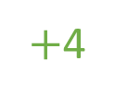
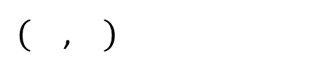
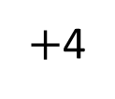
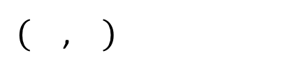


$($ , $)$
2
4
$$\text{B}$$
$$\text{A}$$
$+$4
$+$4
$($ , $)$
2
8
$$\text{B}$$
$$\text{A}$$

Slide 15
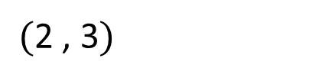
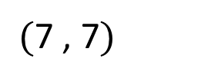
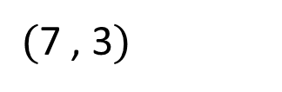
What are the missing coordinates?
$($7 , 7$)$
$($2 , 3$)$
$($7 , 3$)$

Slide 16
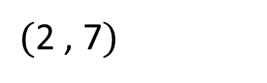
What are the missing coordinates?
$($2 , 7$)$
$($7 , 7$)$
The points are 3 of 4 vertices of a rectangle. Plot the final vertex.
What are the coordinates?
$($2 , 3$)$
$($7 , 3$)$
Have a think

Slide 17



Slide 18
Have a go at questions

Slide 19
I do
You do

Slide 20
















Rosie
Alex
Amir
Whitney
Ron
Dexter
Annie
Tommy
Mo
Jack
Eva
Teddy
Max
Kim
Jo
Sam

Slide 21



Speech bubble text – replace with any character head.
Speech bubble text – replace with any character head.
Bee
Diddy
Tiny

Slide 22







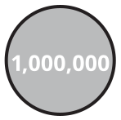
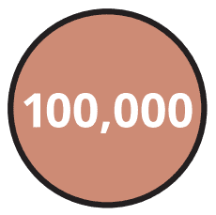
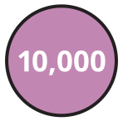


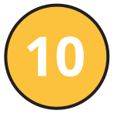

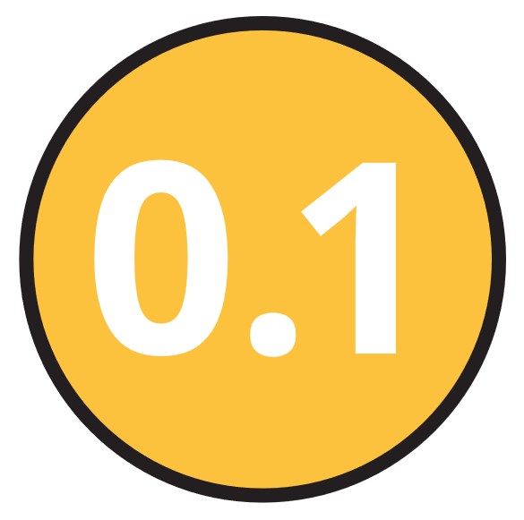
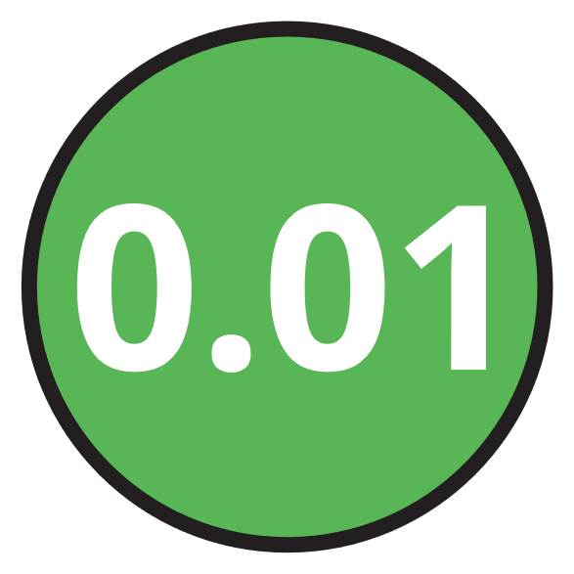
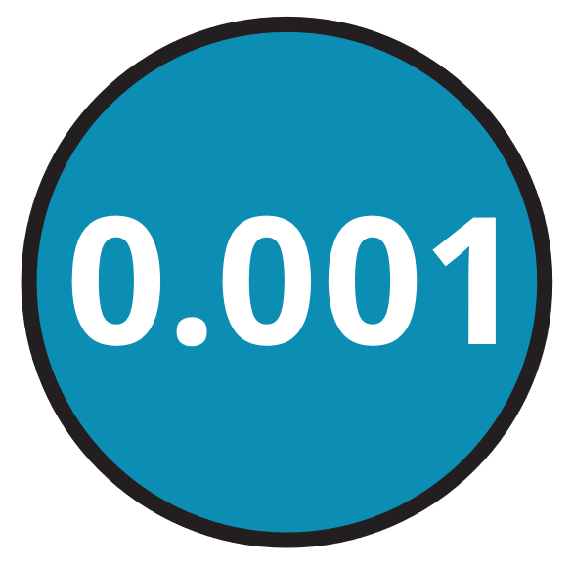
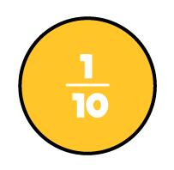

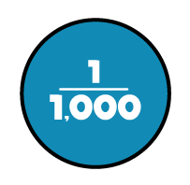


M | HTh | TTh | Th | H | T | O | Tth | Hth | Thth
100
40 | 60
Millions | Thousands |  |  | Ones
O | H | T | O | H | T | O

Slide 23





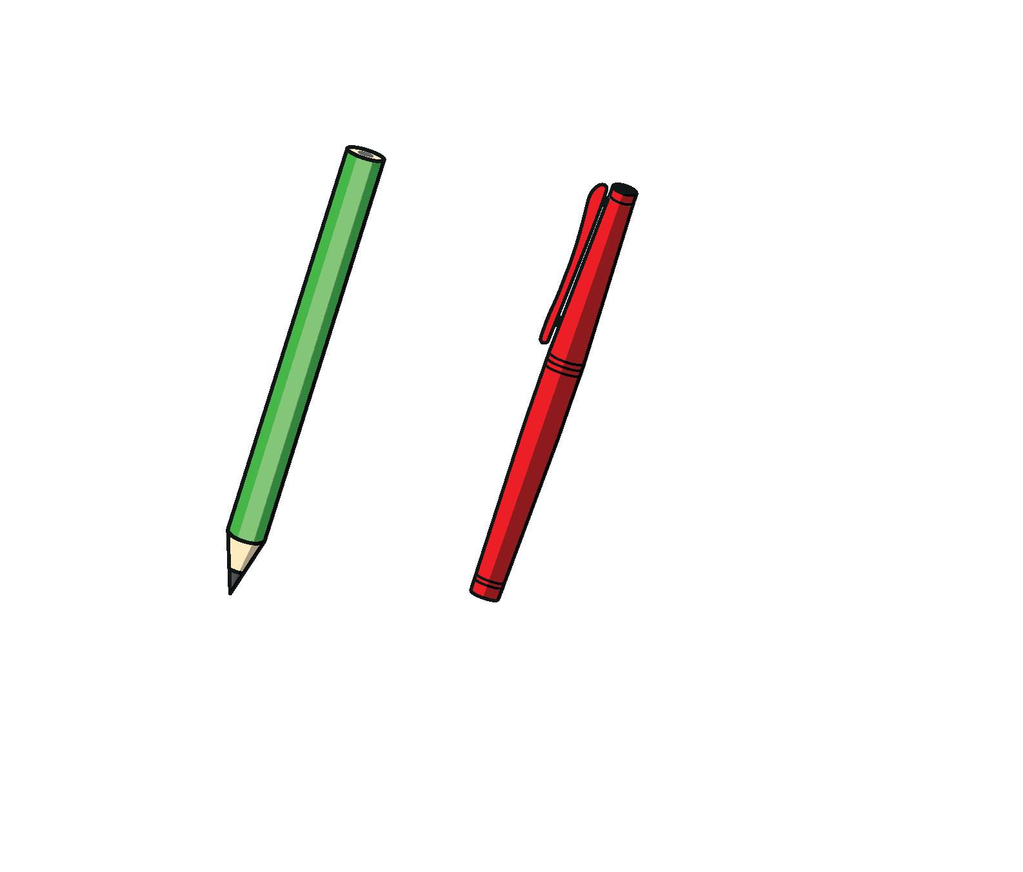




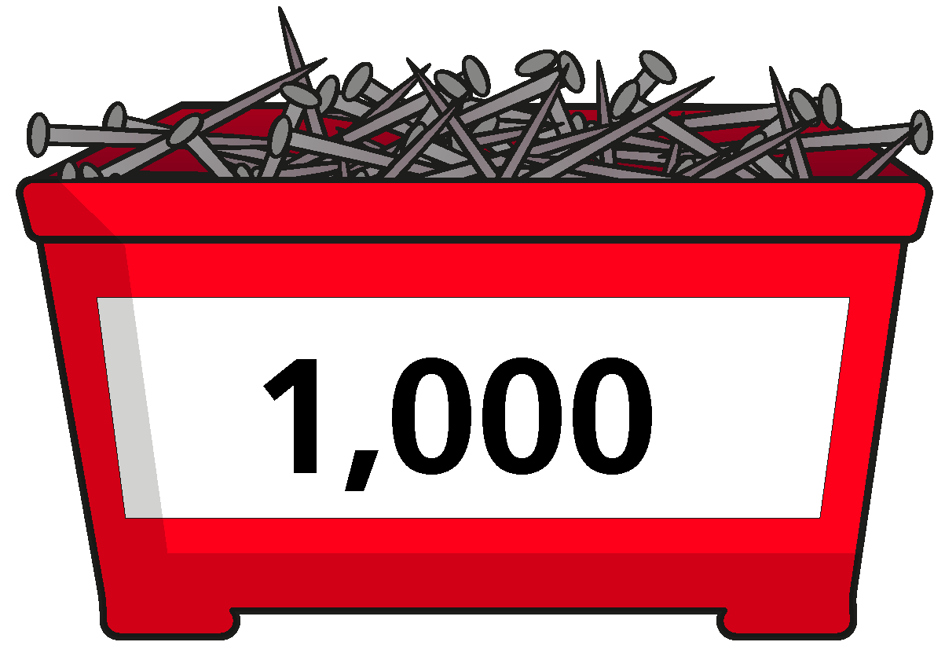


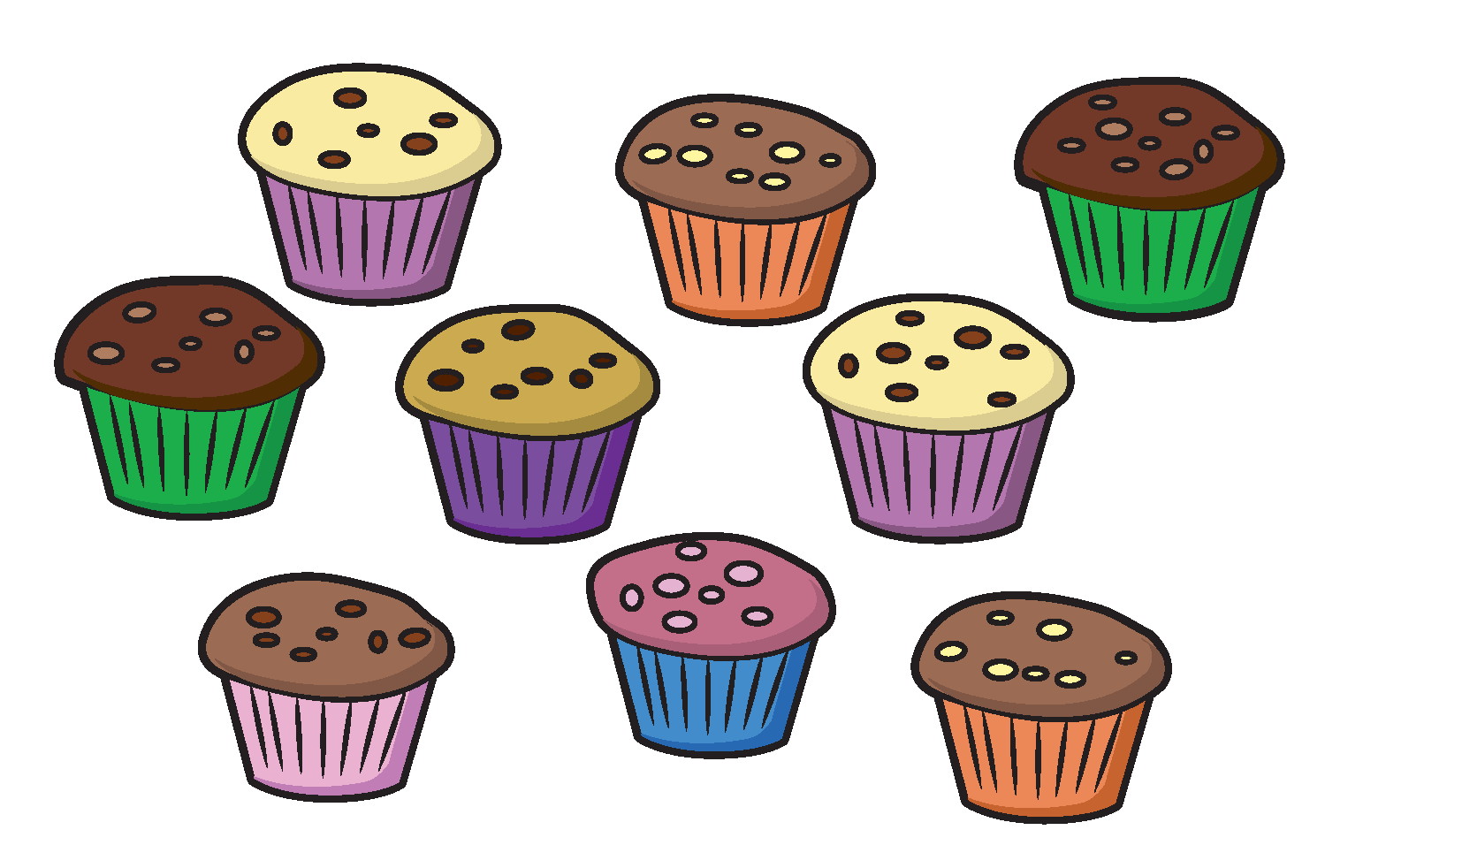
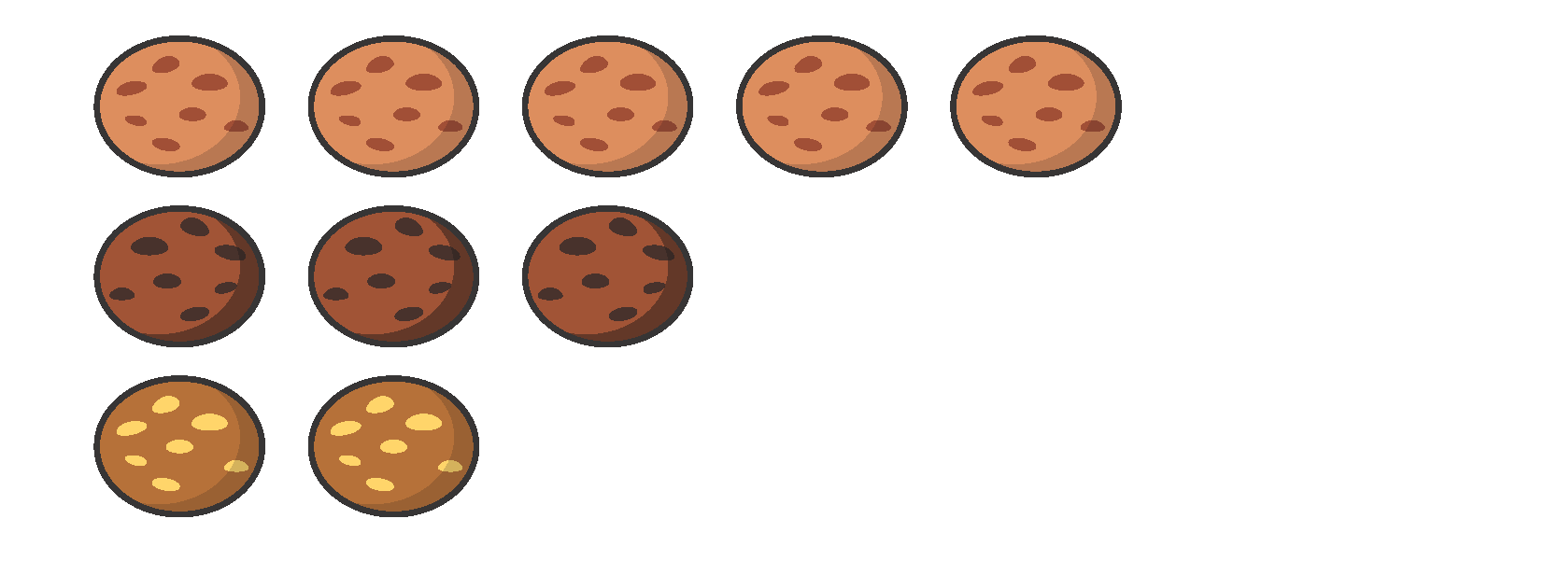



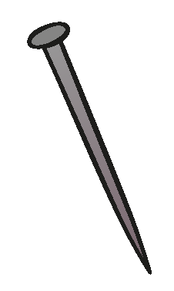
















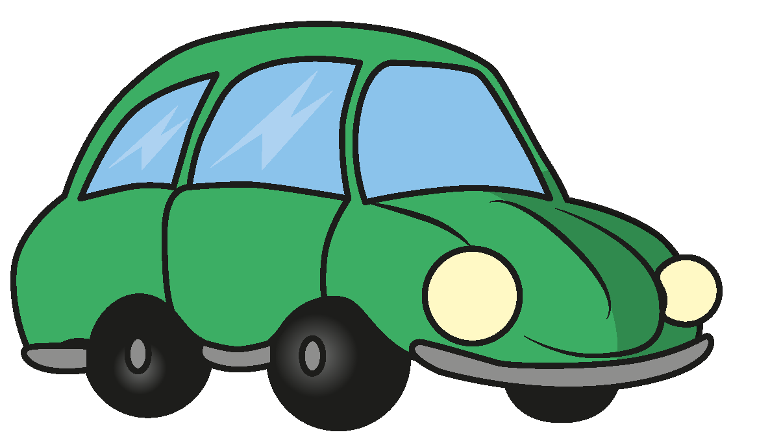





Slide 24


























































