Slide 1


Slide 3
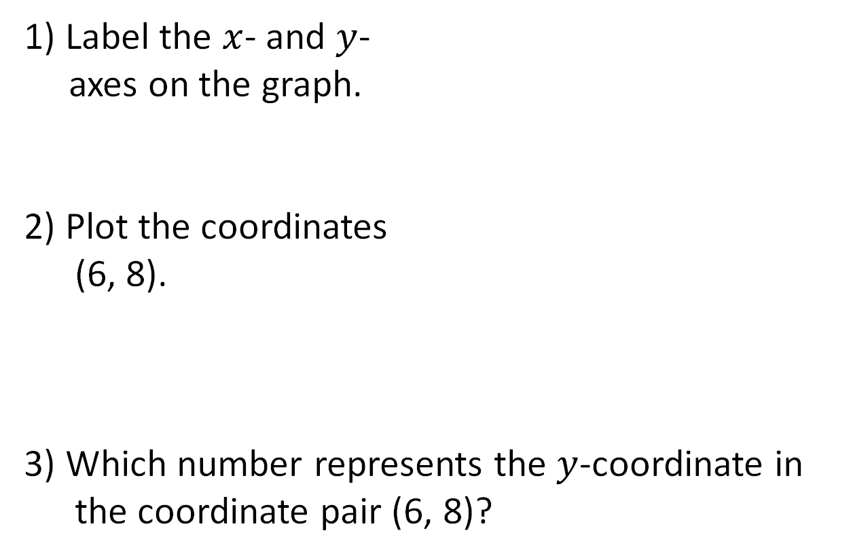
1) Label the $x$- and $y$-
axes on the graph.
2) Plot the coordinates
(6, 8).
3) Which number represents the $y$-coordinate in the coordinate pair (6, 8)?
10
9
8
7
6
5
4
3
2
1
0
1
2
3
4
5
6
7
8
9
10

Slide 4


1) Label the $x$- and $y$-
axes on the graph.
2) Plot the coordinates
(6, 8).
3) Which number represents the $y$-coordinate in the coordinate pair (6, 8)?
$$y$$
10
9
8
7
6
5
4
3
2
1
$$x$$
0
1
2
3
4
5
6
7
8
9
10
8

Slide 6
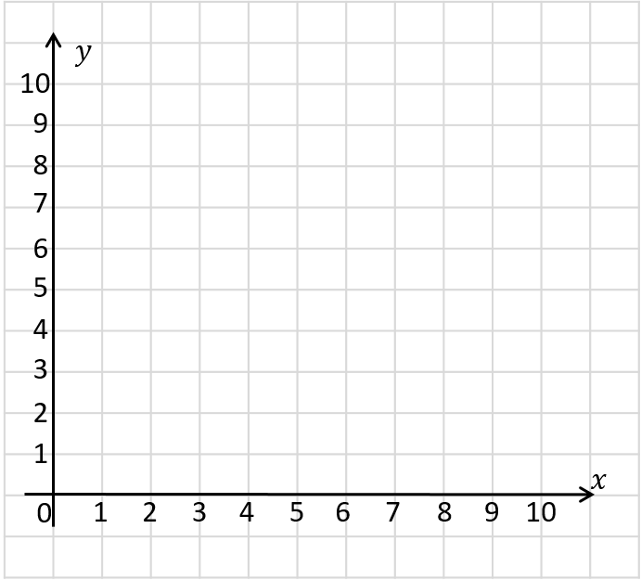

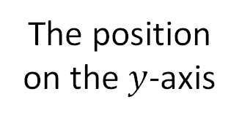
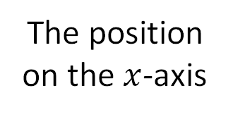
When reading or plotting coordinates, which axis do you look at first?
How can we describe the position of point ?
$($ , $)$
5
4
The position on the $x$-axis
The position on the $y$-axis

Slide 7
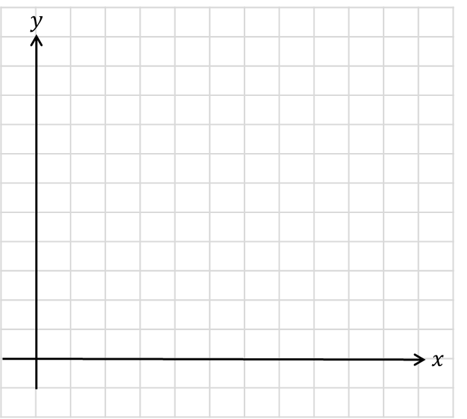
A rectangle has been drawn on a coordinate grid.
How can you use the given coordinates to work out the coordinates of the other vertices?
( , 8)
2
(6, 8)
( , )
2
5
5
(6, )
Do horizontal/vertical lines share a part of their coordinates?

Slide 8

A rectangle has been drawn on a coordinate grid.
How can you use the given coordinates to work out the coordinates of the other vertices?
(9, 6)
Have a think

Slide 9
A rectangle has been drawn on a coordinate grid.
How can you use the given coordinates to work out the coordinates of the other vertices?
( , 6)
(9, 6)
4
( , )
4
4
4
(9, )

Slide 10


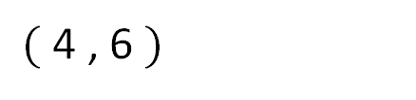

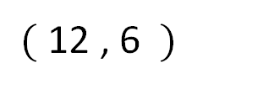
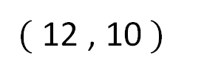
I think we can work out the coordinates of the red point…
$$y$$
Have a think
$($ 12 , 10$)$
$($ 4 , 6 $)$
$($12 , 6 $)$
$$x$$

Slide 11
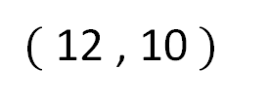
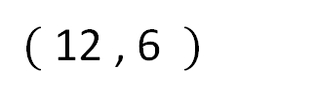
The 3 points form 3 vertices of a rectangle.
What are the coordinates of the missing vertex?
$$y$$
Have a think
$($ 12 , 10$)$
$($ 4 , 6 $)$
$($12 , 6 $)$
$$x$$

Slide 12
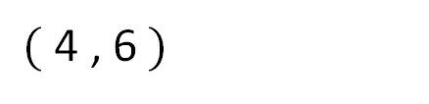
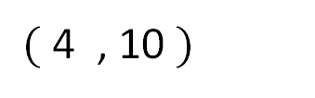
$$y$$
$($4 , 10 $)$
$($ 12 , 10$)$
$($ 4 , 6$)$
$($12 , 6 $)$
$$x$$

Slide 13
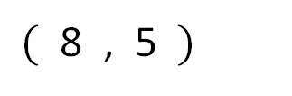
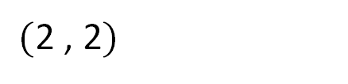
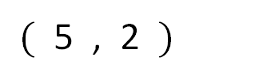

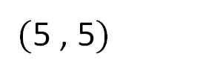
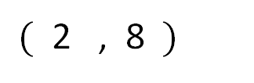
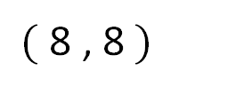
Work out the missing coordinates.
$$y$$
$($ 2 , 8$)$
$($ 8 , 8$)$
$($5 , 5$)$
$($ 8 , 5 $)$
Have a think
$($ 5 , 2 $)$
$($2 , 2$)$
$$x$$

Slide 14
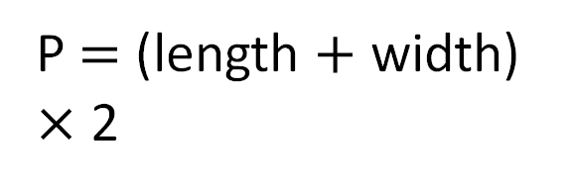

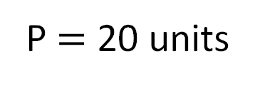



The perimeter of a rectangle is 20 units.
$$y$$
How many other possibilities can you find?
Have a think
P $=$ 20 units
P $=$ (length $+$ width) $×$ 2
Length $=$
7
(3, 8)
(10, 8)
3
Width $=$
(3, 5)
(10, 5)
$$x$$
What could the coordinates of the other vertices be?

Slide 15



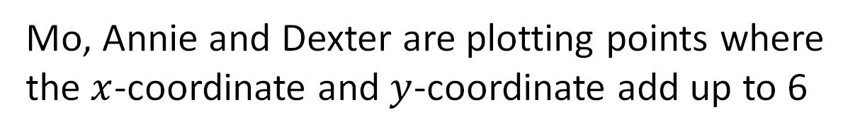
Mo, Annie and Dexter are plotting points where the $x$-coordinate and $y$-coordinate add up to 6
They will then draw a line through all the points.
I know (6, 0) will be a point, so I think the line will be horizontal.
Mo
I think that it will be a vertical line.
Annie
I think that it will be a diagonal line.
Dexter
Have a think
Who do you agree with?

Slide 16


Mo, Annie and Dexter are plotting points where the $x$-coordinate and $y$-coordinate add up to 6
Dexter is correct.
The line is diagonal.
$$y$$
10
9
8
7
(0, 6)
6
(1, 5)
5
(2, 4)
4
(3, 3)
3
(4, 2)
2
(5, 1)
1
(6, 0)
$$x$$
0
1
2
3
4
5
6
7
8
9
10

Slide 17



Slide 18
Have a go at questions

Slide 19
I do
You do

Slide 20
















Rosie
Alex
Amir
Whitney
Ron
Dexter
Annie
Tommy
Mo
Jack
Eva
Teddy
Max
Kim
Jo
Sam

Slide 21



Speech bubble text – replace with any character head.
Speech bubble text – replace with any character head.
Bee
Diddy
Tiny

Slide 22






















M | HTh | TTh | Th | H | T | O | Tth | Hth | Thth
100
40 | 60
Millions | Thousands |  |  | Ones
O | H | T | O | H | T | O

Slide 23





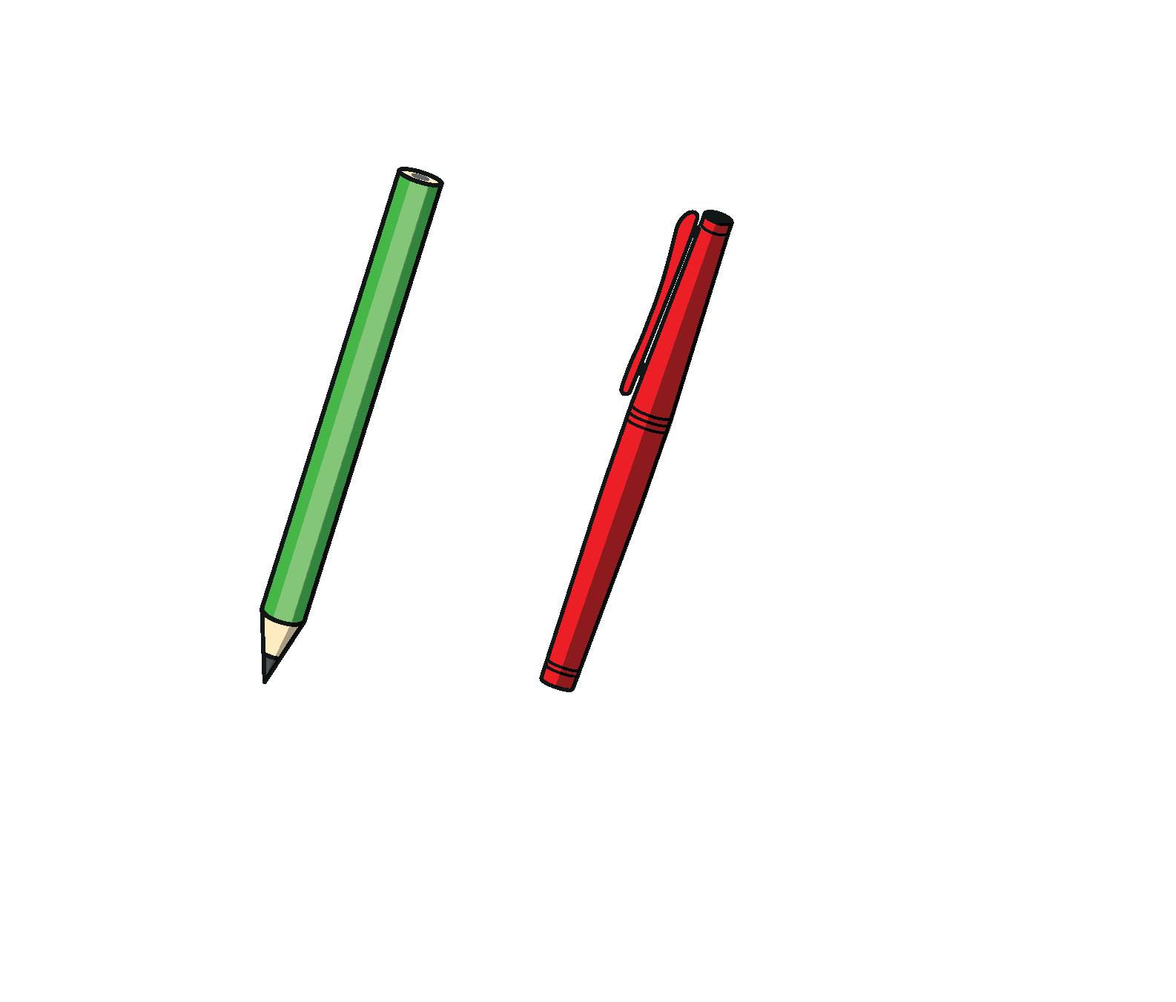




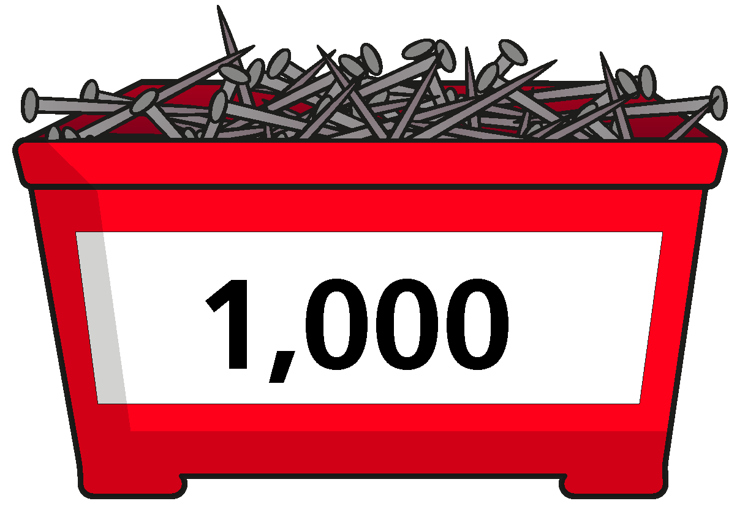
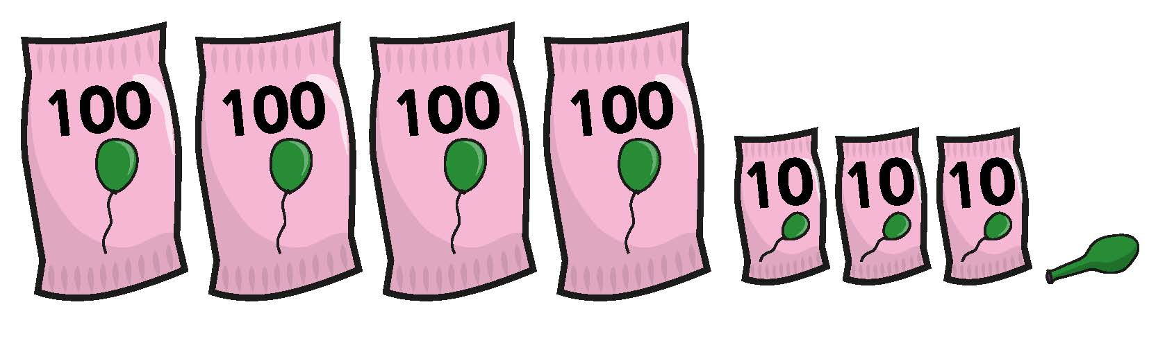






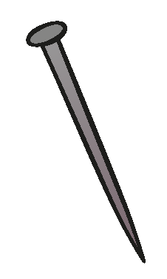






















Slide 24


























































