Slide 1


Slide 3
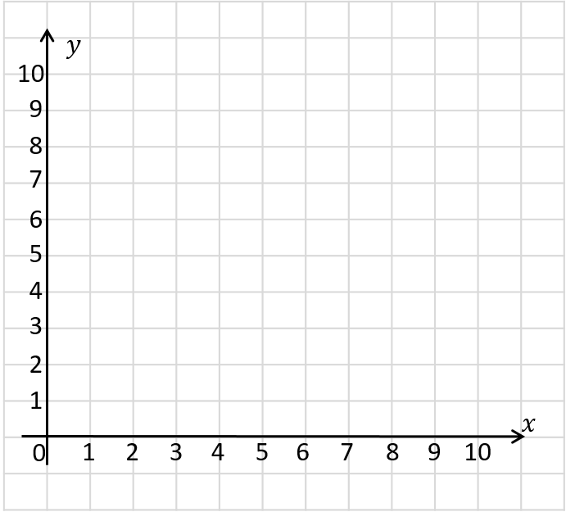
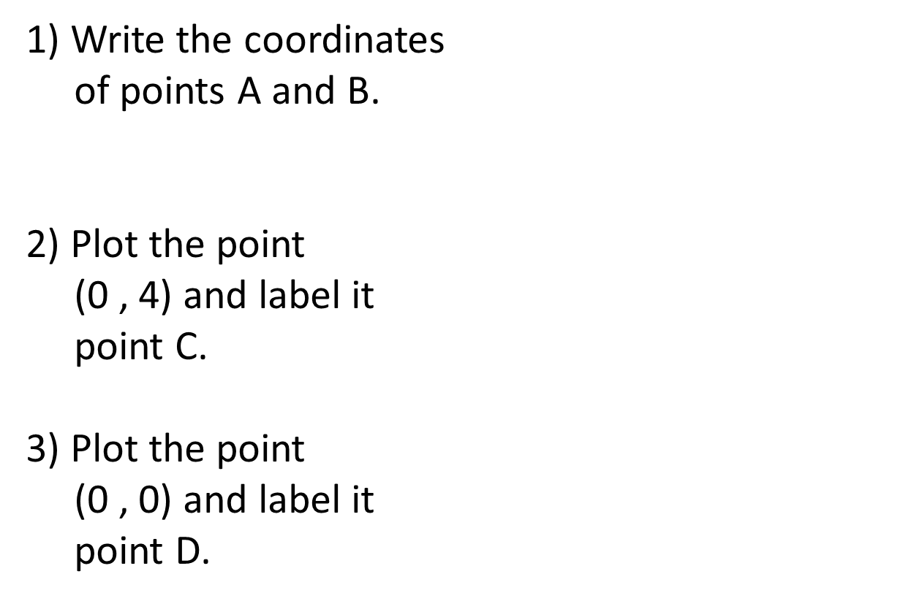
1) Write the coordinates
of points A and B.
2) Plot the point
(0 , 4) and label it
point C.
3) Plot the point
(0 , 0) and label it
point D.
A
B

Slide 4
1) Write the coordinates
of points A and B.
2) Plot the point
(0 , 4) and label it
point C.
3) Plot the point
(0 , 0) and label it
point D.
(2 , 9)
(6 , 0)
A
C
D
B

Slide 6
2 up
4 right
What does translation mean?
The point has been translated 4 squares right and 2 squares up.

Slide 7

Have a think
3 right
3 down
Describe the translation.
The point has been translated 3 squares right and 3 squares down.

Slide 8
How does a shape change when it is translated?
How does it stay the same?
Translate the rectangle 2 squares left and 4 squares down.

Slide 9
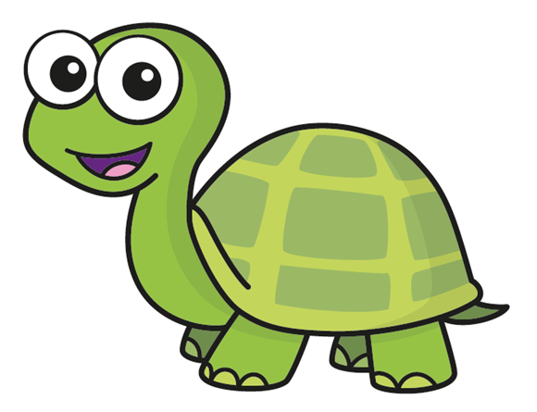
Translate shape A 3 squares left and 4 squares down.
Have a think
A
B
I think I’ve got this one!

Slide 10
Translate shape A 3 squares left and 4 squares down.
A
B

Slide 11
Describe the translations.
Have a think
A
B
A
6 right
2 down
B
B
C
C
4 left
3 down
B
A
6 left
2 up

Slide 12
What is the translation of triangle A to triangle B?
5 squares right and 5 squares down
5 squares right
A
Have a think
5 squares down
B
Do you need to do this for all of the vertices?

Slide 13
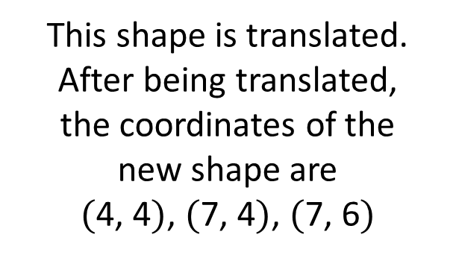
Have a think
This shape is translated.
After being translated,
the coordinates of the
new shape are
$($4, 4$)$, $($7, 4$)$, $($7, 6$)$
What was the
translation?

Slide 14
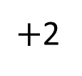
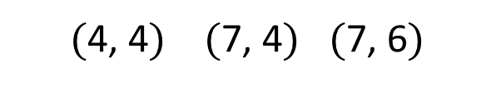
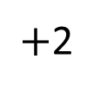
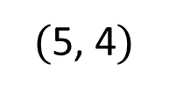
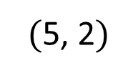
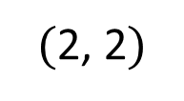
Original shape
$($2, 2$)$
$($5, 2$)$
$($5, 4$)$
$+$2
$+$2
$($4, 4$)$ $($7, 4$)$ $($7, 6$)$
New shape
2 squares right and 2 squares up
What’s stayed the same? What’s changed?

Slide 15
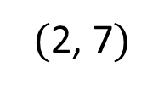
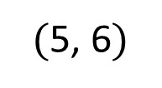
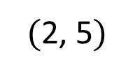
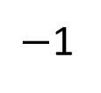
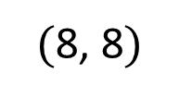
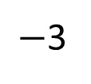
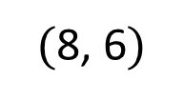
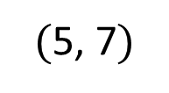
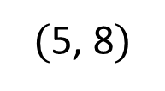
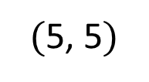
What was the translation?
Have a think
Original shape
$($5, 6$)$
$($5, 8$)$
$($8, 6$)$
$($8, 8$)$
$−$3
$−$1
$($2, 5$)$
$($2, 7$)$
$($5, 5$)$
$($5, 7$)$
New shape
3 left squares,
1 square down

Slide 16



Slide 17
Have a go at questions

Slide 18
I do
You do

Slide 19
















Rosie
Alex
Amir
Whitney
Ron
Dexter
Annie
Tommy
Mo
Jack
Eva
Teddy
Max
Kim
Jo
Sam

Slide 20


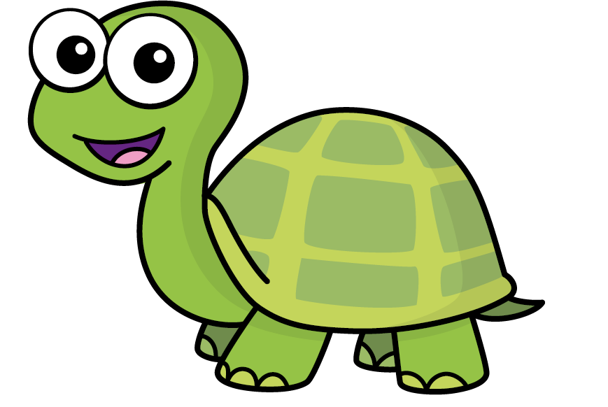
Speech bubble text – replace with any character head.
Speech bubble text – replace with any character head.
Bee
Diddy
Tiny

Slide 21







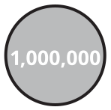
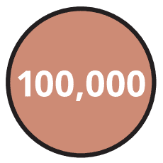
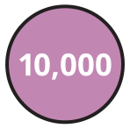





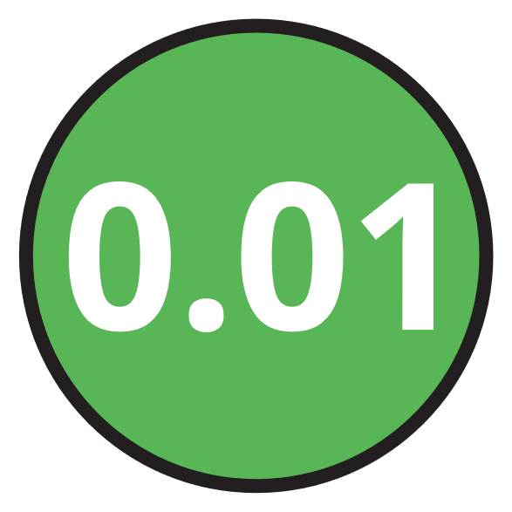






M | HTh | TTh | Th | H | T | O | Tth | Hth | Thth
100
40 | 60
Millions | Thousands |  |  | Ones
O | H | T | O | H | T | O

Slide 22





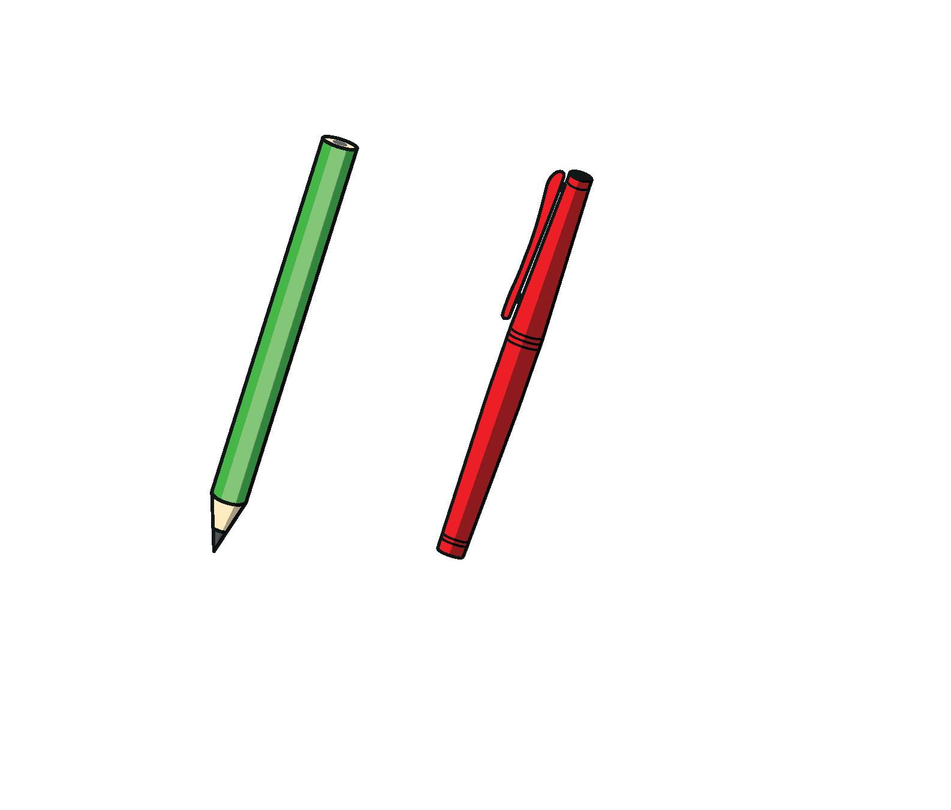

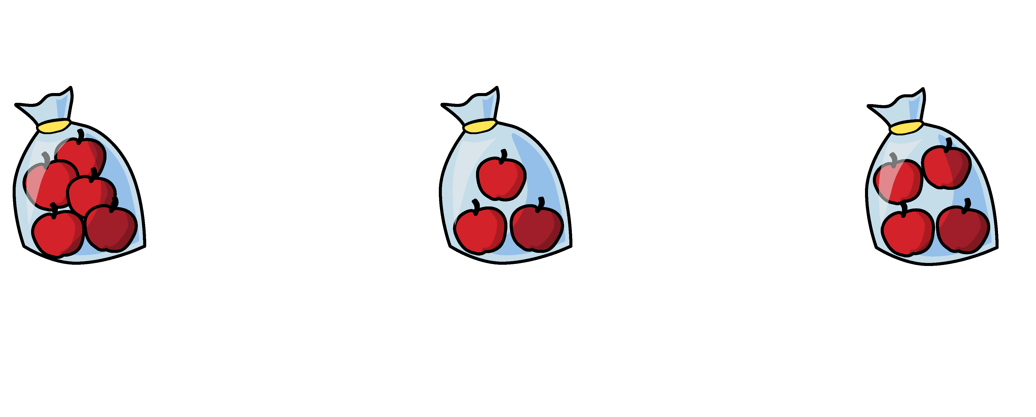


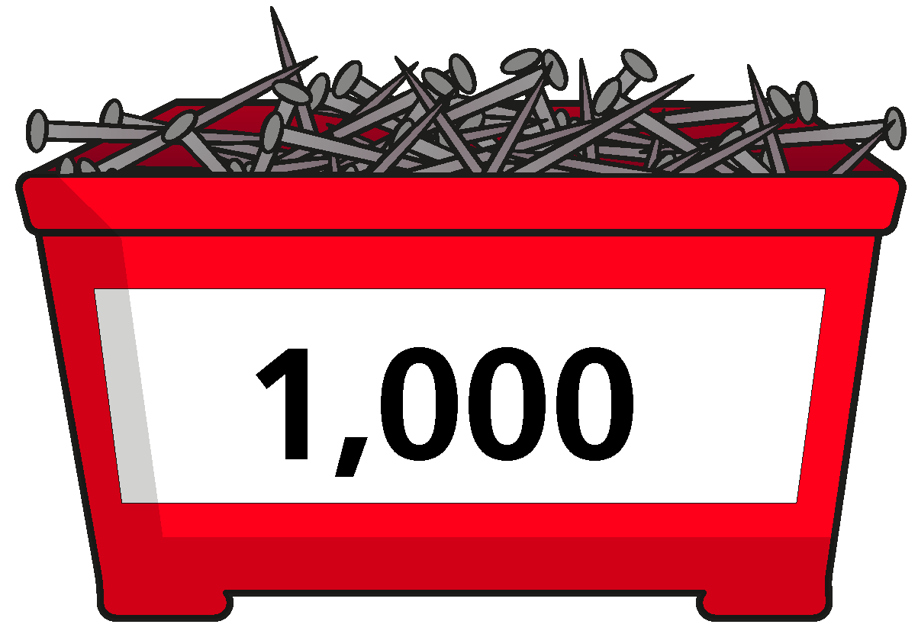
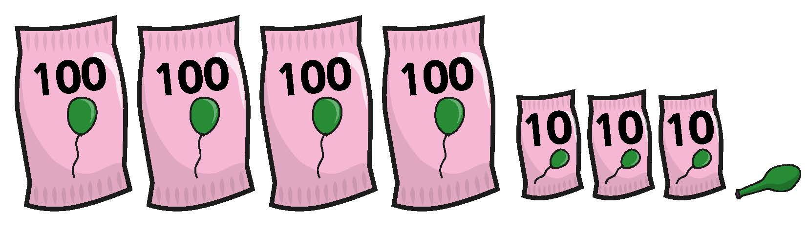

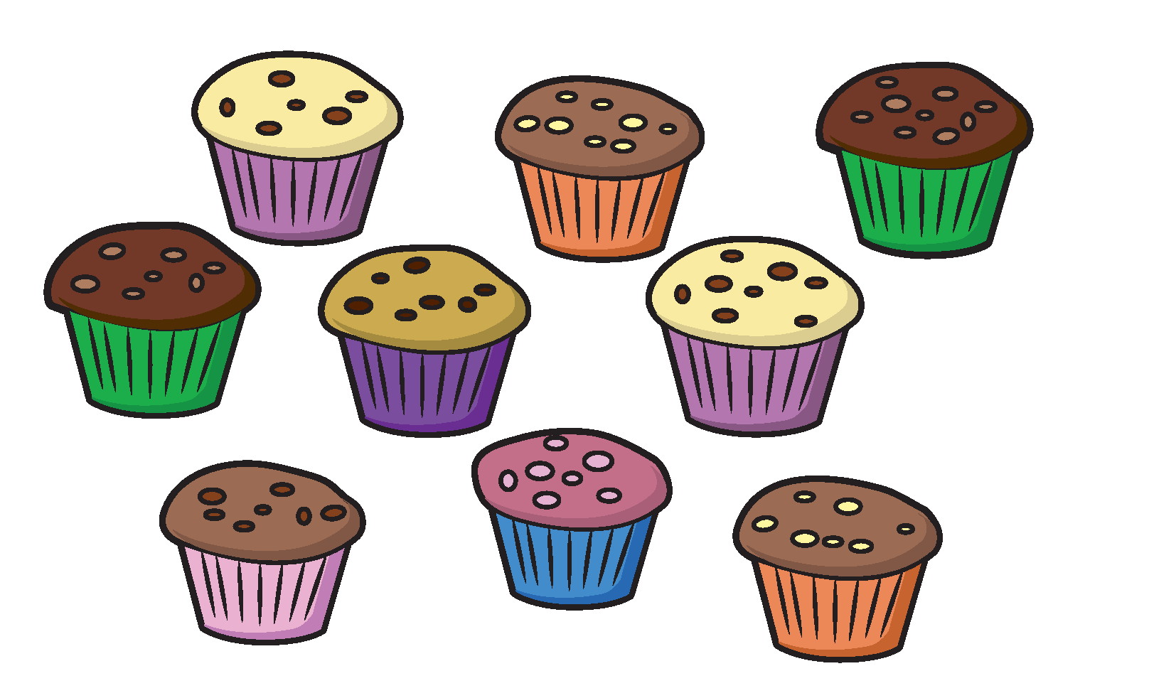
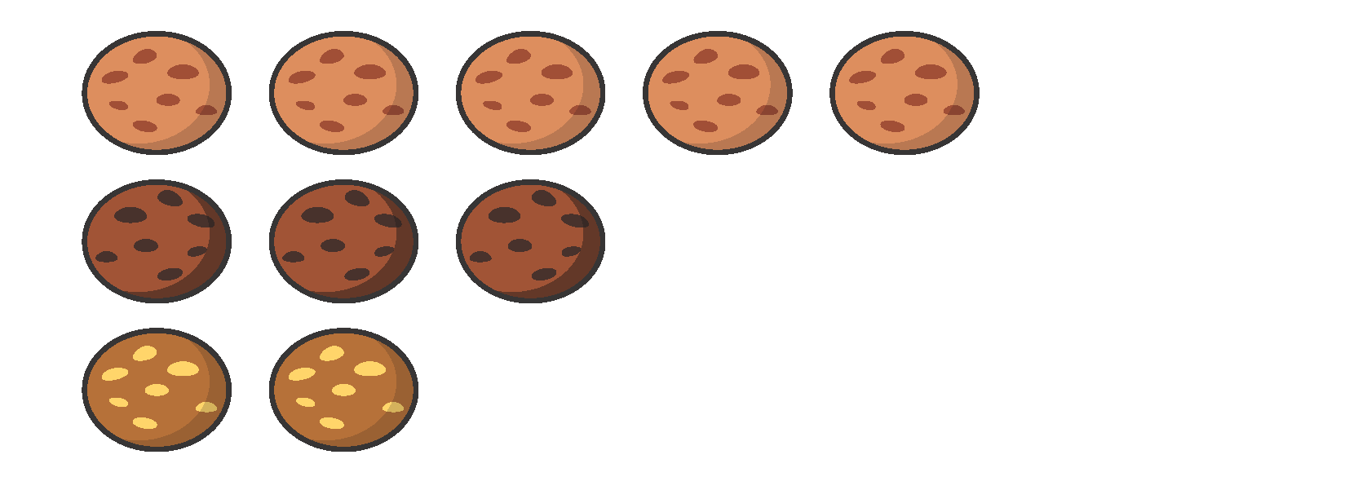



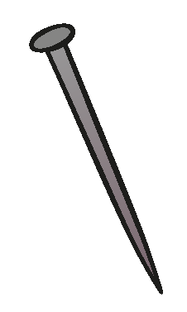






















Slide 23


























































