Slide 1


Slide 3
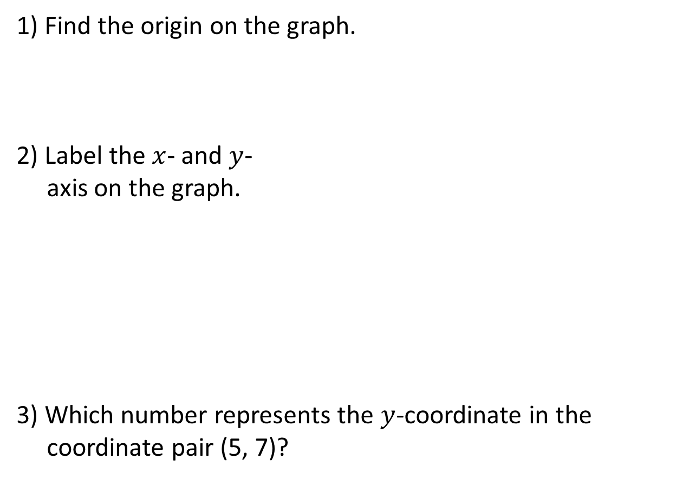
1) Find the origin on the graph.
2) Label the $x$- and $y$-
axis on the graph.
3) Which number represents the $y$-coordinate in the
coordinate pair (5, 7)?
10
9
8
7
6
5
4
3
2
1
0
1
2
3
4
5
6
7
8
9
10

Slide 4


1) Find the origin on the graph.
2) Label the $x$- and $y$-
axis on the graph.
3) Which number represents the $y$-coordinate in the
coordinate pair (5, 7)?
$$y$$
10
9
8
7
6
5
4
3
2
1
0
1
2
3
4
5
6
7
8
9
$$x$$
10
7

Slide 6
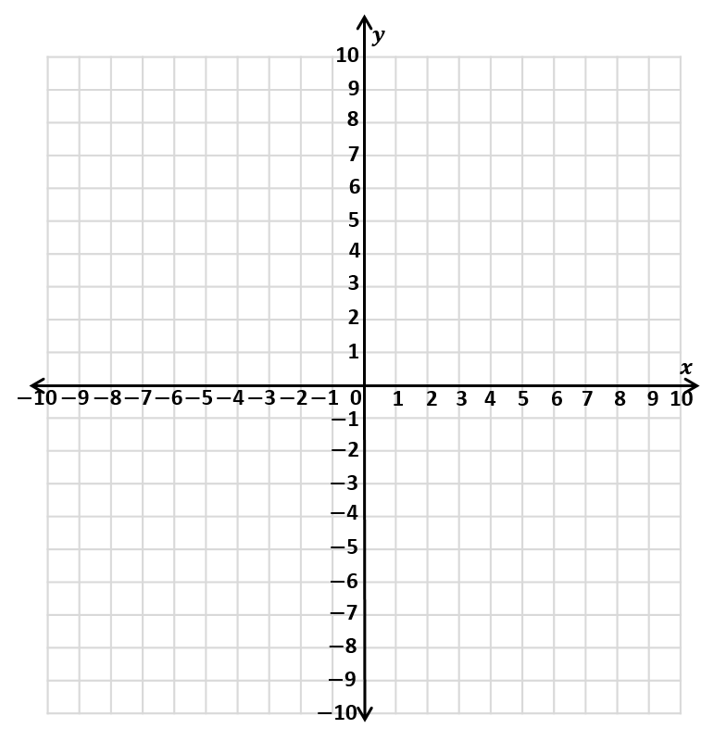
The first quadrant
2nd quadrant
1st quadrant
3rd quadrant
4th quadrant

Slide 7
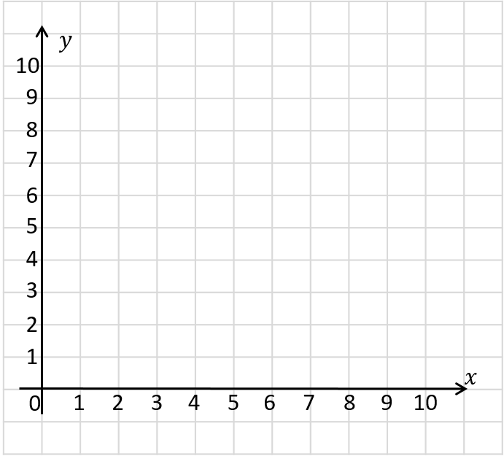
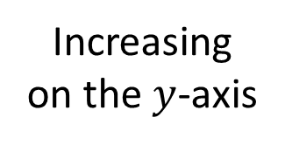
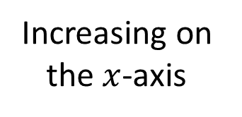
Increasing on the $y$-axis
Increasing on the $x$-axis

Slide 8
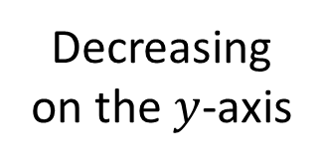
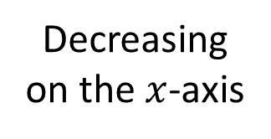
Decreasing on the $y$-axis
Decreasing on the $x$-axis

Slide 9
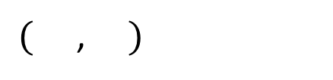
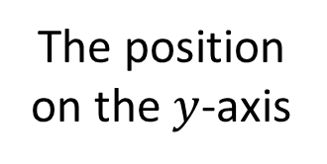
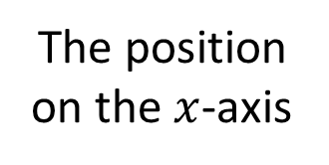
How can we describe the position of point ?
2
4
$($ , $)$
The position on the $x$-axis
The position on the $y$-axis

Slide 10


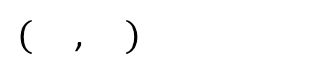
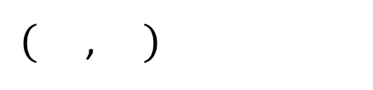
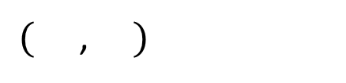
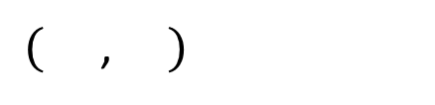
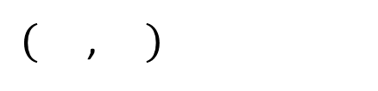

Have a think
$$x$$
$$y$$
$($ , $)$
2
4
$($ , $)$
4
2
$($ , $)$
5
7
$($ , $)$
0
6
$($ , $)$
9
0

Slide 11
Have a think
What’s the same?
What’s different?
A
B

Slide 12
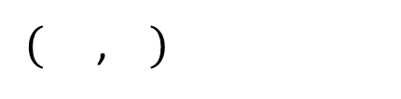
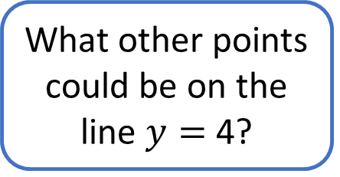
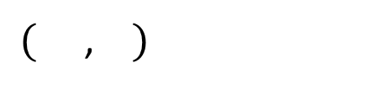


What other points could be on the line $y=$ 4?
$($ , $)$
2
4
$$\text{A}$$
$($ , $)$
5
4
$$\text{B}$$
A
B

Slide 13


Have a think
$$\text{B}$$
What’s the same?
What’s different?
$$\text{A}$$

Slide 14
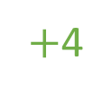
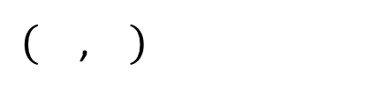
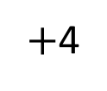
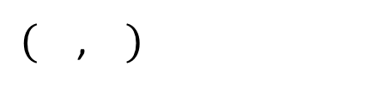


$($ , $)$
2
4
$$\text{B}$$
$$\text{A}$$
$+$4
$+$4
$($ , $)$
2
8
$$\text{B}$$
$$\text{A}$$

Slide 15

Tommy is drawing a rectangle on a coordinate grid.
Find the coordinates of the fourth vertex of the rectangle.
Have a think

Slide 16

Tommy is drawing a rectangle on a coordinate grid.
Find the coordinates of the fourth vertex of the rectangle.
$($9, 1$)$

Slide 17
Plot the points (7, 1), (7, 4) and (10, 1) on a coordinate grid.
Join the points to form a polygon.
Have a think
What polygon have you drawn?

Slide 18
Plot the points (7, 1), (7, 4) and (10, 1) on a coordinate grid.
Join the points to form a polygon.
Right-angled triangle
What polygon have you drawn?

Slide 19



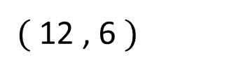
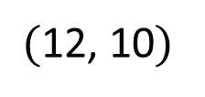
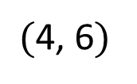
I think we can work out the coordinates of the red point…
$$y$$
Have a think
$($12, 10$)$
$($4, 6$)$
$($12 , 6 $)$
$$x$$

Slide 20
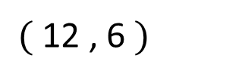
The 3 points form 3 vertices of a rectangle.
What are the coordinates of the missing vertex?
$$y$$
Have a think
$($12, 10$)$
$($4, 6$)$
$($12 , 6 $)$
$$x$$

Slide 21
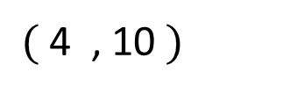
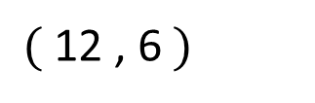
$$y$$
$($4 , 10 $)$
$($12, 10$)$
$($4, 6$)$
$($ 12 , 6 $)$
$$x$$

Slide 22



Slide 23
Have a go at questions

Slide 24
I do
You do

Slide 25
















Rosie
Alex
Amir
Whitney
Ron
Dexter
Annie
Tommy
Mo
Jack
Eva
Teddy
Max
Kim
Jo
Sam

Slide 26



Speech bubble text – replace with any character head.
Speech bubble text – replace with any character head.
Bee
Diddy
Tiny

Slide 27







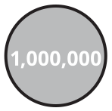
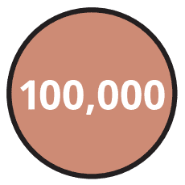






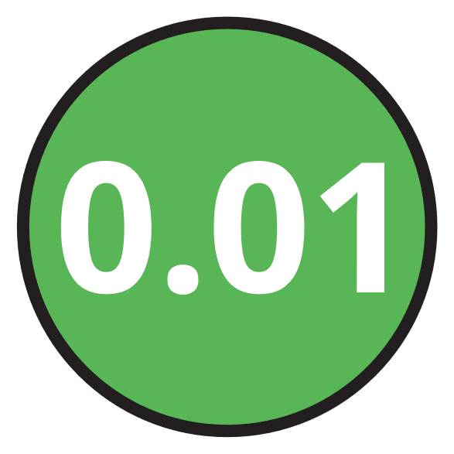
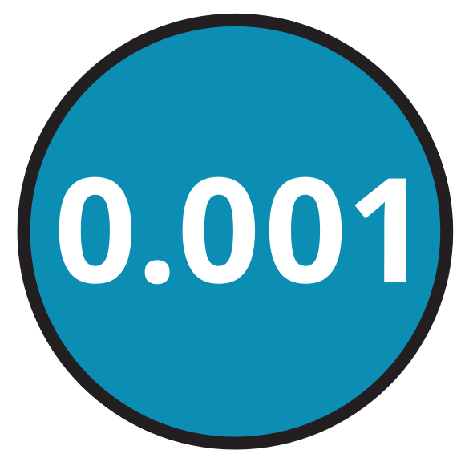





M | HTh | TTh | Th | H | T | O | Tth | Hth | Thth
100
40 | 60
Millions | Thousands |  |  | Ones
O | H | T | O | H | T | O

Slide 28





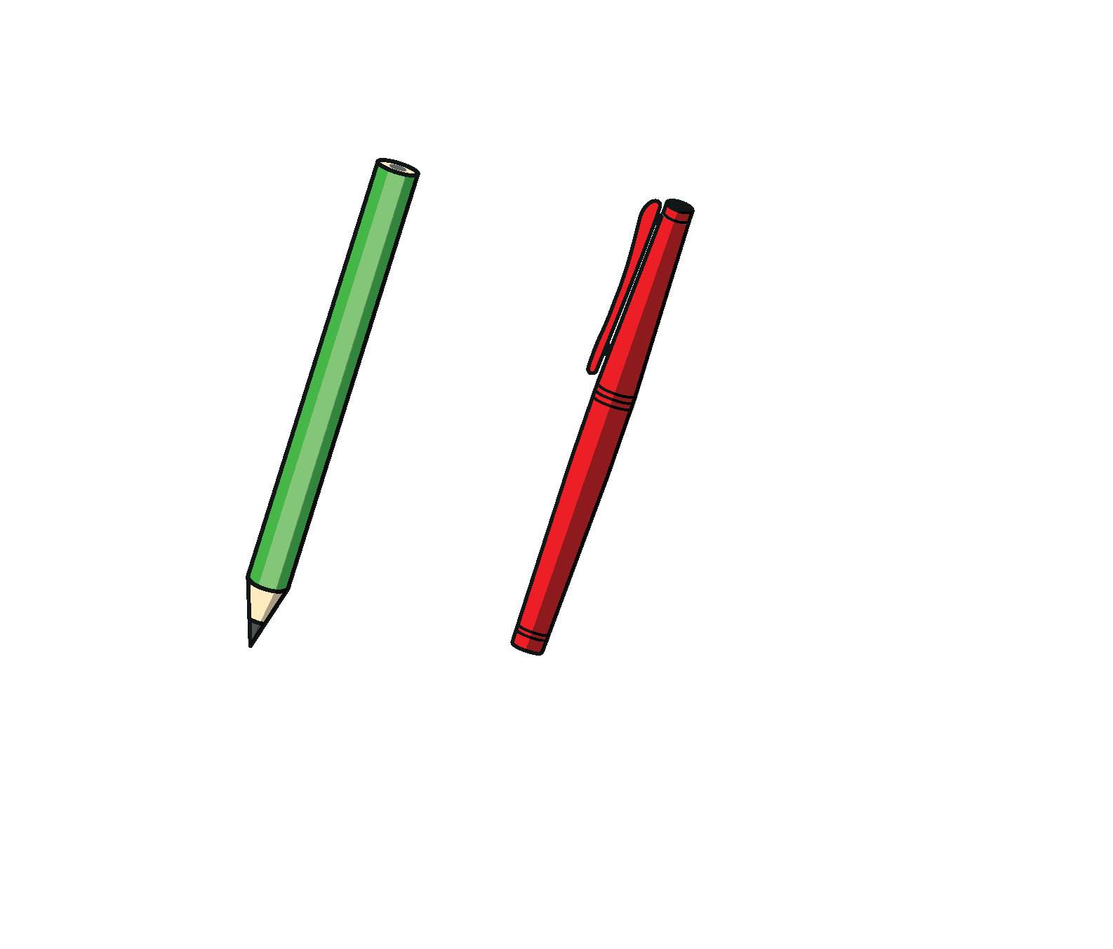




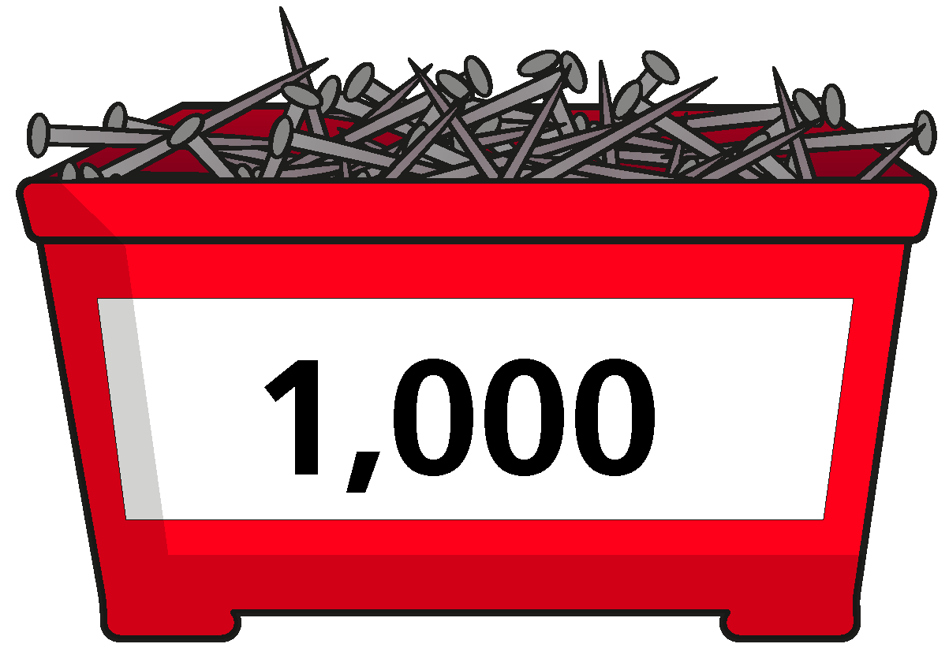
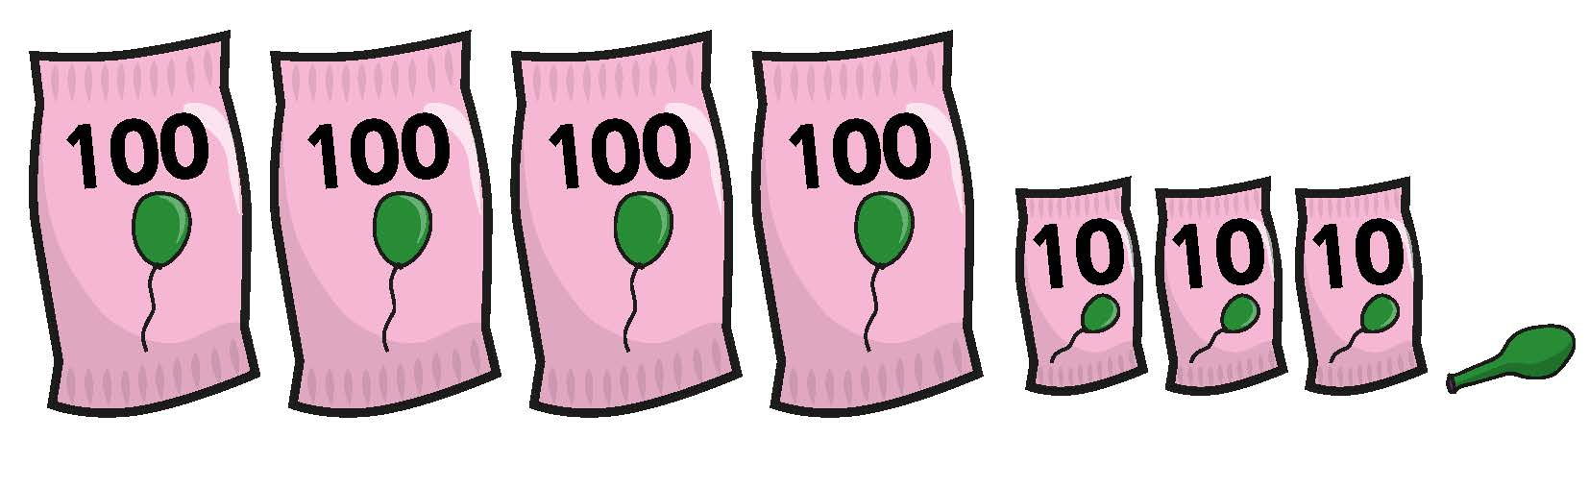


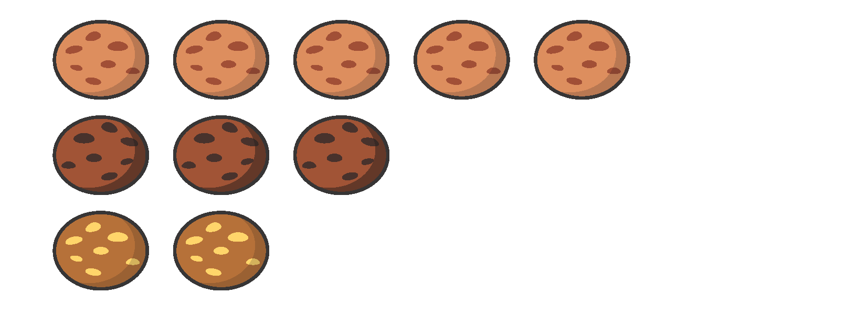



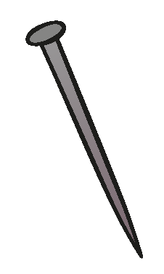






















Slide 29


























































