Slide 1


Slide 3
1) Write the coordinates
of point A and B.
2) Plot the coordinate
(4, 6)
3) Plot the coordinate
(8, 3)
4) Join the points. What is the name of the quadrilateral?
10
9
8
7
B
6
5
4
A
3
2
1
0
1
2
3
4
5
6
7
8
9
10

Slide 4
1) Write the coordinates
of point A and B.
2) Plot the coordinate
(4, 6)
3) Plot the coordinate
(8, 3)
4) Join the points. What is the name of the quadrilateral?
10
A (3, 3)
B (9, 6)
9
8
7
B
6
5
4
A
3
2
1
0
1
2
3
4
5
6
7
8
9
10
Parallelogram

Slide 6
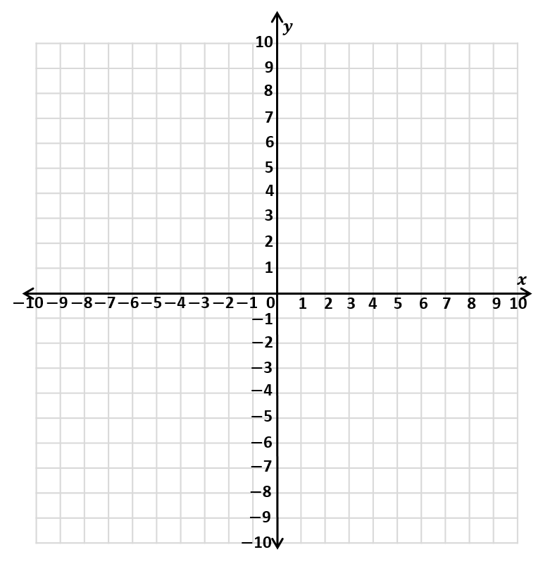
Four quadrants
2nd quadrant
1st quadrant
3rd quadrant
4th quadrant

Slide 7

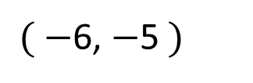
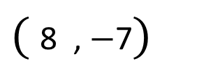
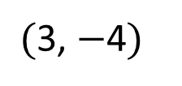
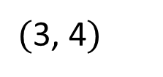
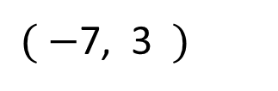
Have a think
$( −$7, 3 $)$
$($3, 4$)$
$($3, $−$4$)$
$( −$6, $−$5 $)$
$($8 , $−$7$)$

Slide 8
$( −$7, 3 $)$
$($3, 4$)$
$($3, $−$4$)$
$( −$6, $−$5 $)$
$($8 , $−$7$)$

Slide 9

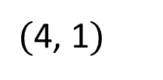
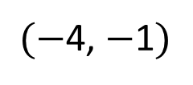
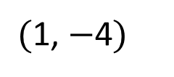
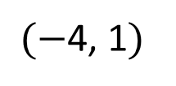
Plot the coordinates.
Have a think
$(−$4, 1$)$
$($1, $−$4$)$
$(−$4, $−$1$)$
$($4, 1$)$
There’s a point in every quadrant!

Slide 10
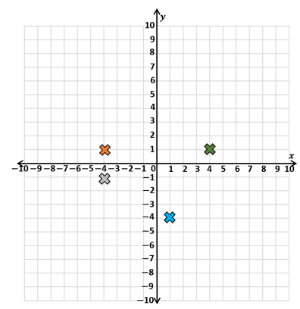
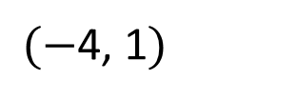
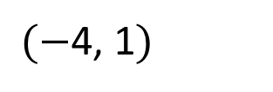
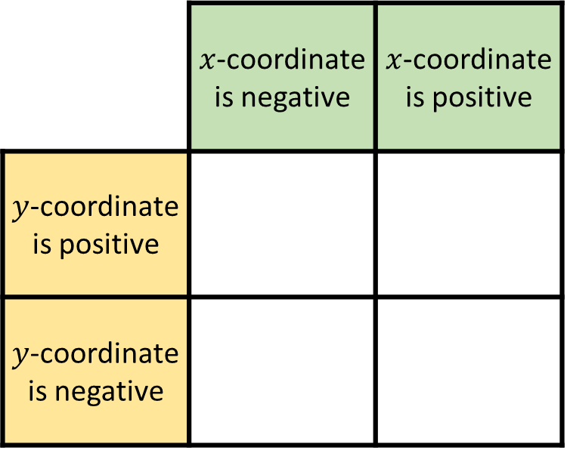
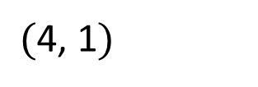
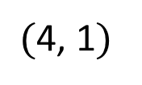
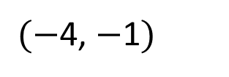
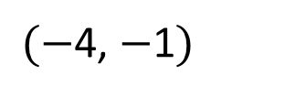
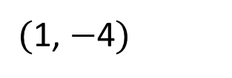
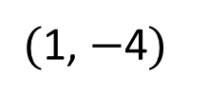
$(−$4, 1$)$
Have a think
$($1, $−$4$)$
$(−$4, $−$1$)$
$($4, 1$)$
 | $x$-coordinate is negative | $x$-coordinate is positive
$y$-coordinate is positive
$y$-coordinate is negative
$(−$4, 1$)$
$($4, 1$)$
$(−$4, $−$1$)$
$($1, $−$4$)$

Slide 11

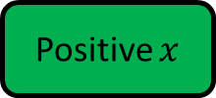
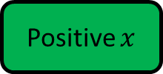

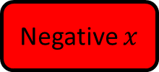


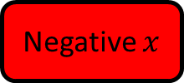
2nd quadrant
1st quadrant
Negative $x$
Positive $x$
Positive $y$
Positive $y$
3rd quadrant
4th quadrant
Negative $x$
Positive $x$
Negative $y$
Negative $y$

Slide 12
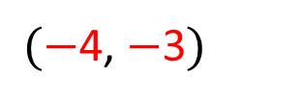
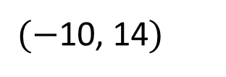
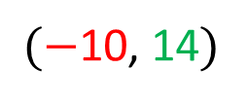
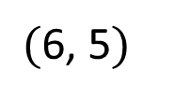
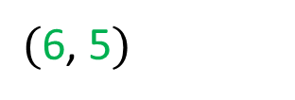
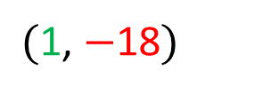

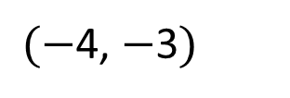

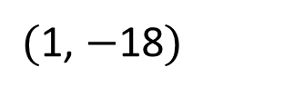
Which quadrant would the coordinates be placed?
$$y$$
Have a think
2nd quadrant
1st quadrant
$($6, 5$)$
$($6, 5$)$
$($1, $−$18$)$
$$x$$
$($1, $−$18$)$
$(−$10, 14$)$
$(−$10, 14$)$
$(−$4, $−$3$)$
$(−$4, $−$3$)$
3rd quadrant
4th quadrant

Slide 13












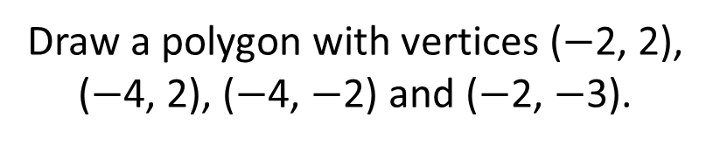
Draw a polygon with vertices ($−$2, 2), ($−$4, 2), ($−$4, $−$2) and ($−$2, $−$3).
$$y$$
5
4
3
Have a think
2
1
$−$5
$−$4
$−$3
$−$2
$−$1
0
1
2
3
4
5
$$x$$
$−$1
$−$2
$−$3
$−$4
$−$5
What is the mathematical name of the shape?

Slide 14
Draw a polygon with vertices ($−$2, 2), ($−$4, 2), ($−$4, $−$2) and ($−$2, $−$3).
$$y$$
5
4
3
2
1
$−$5
$−$4
$−$3
$−$2
$−$1
0
1
2
3
4
5
$$x$$
$−$1
$−$2
$−$3
$−$4
$−$5
What is the mathematical name of the shape?

Slide 15
Draw a polygon with vertices ($−$2, 2), ($−$4, 2), ($−$4, $−$2) and ($−$2, $−$3).
$$y$$
5
4
3
2
1
$−$5
$−$4
$−$3
$−$2
$−$1
0
1
2
3
4
5
$$x$$
$−$1
$−$2
$−$3
$−$4
Trapezium
$−$5
What is the mathematical name of the shape?

Slide 16



Slide 17
Have a go at questions

Slide 18
I do
You do

Slide 19
















Rosie
Alex
Amir
Whitney
Ron
Dexter
Annie
Tommy
Mo
Jack
Eva
Teddy
Max
Kim
Jo
Sam

Slide 20



Speech bubble text – replace with any character head.
Speech bubble text – replace with any character head.
Bee
Diddy
Tiny

Slide 21






















M | HTh | TTh | Th | H | T | O | Tth | Hth | Thth
100
40 | 60
Millions | Thousands |  |  | Ones
O | H | T | O | H | T | O

Slide 22





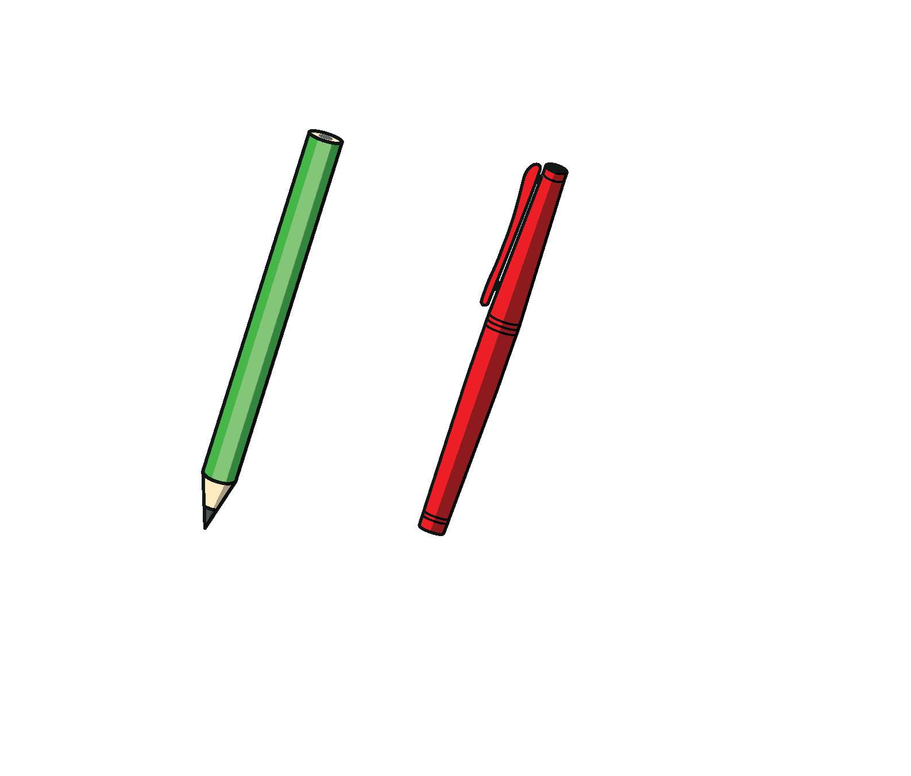




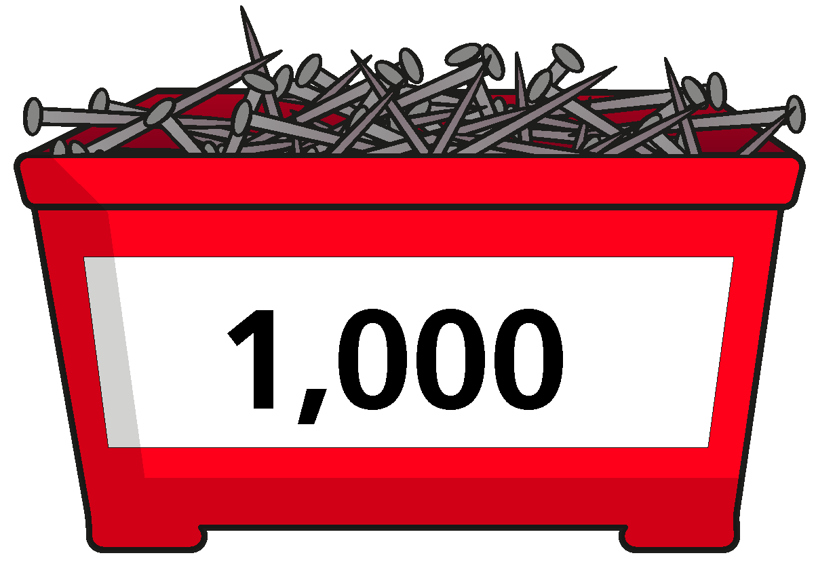


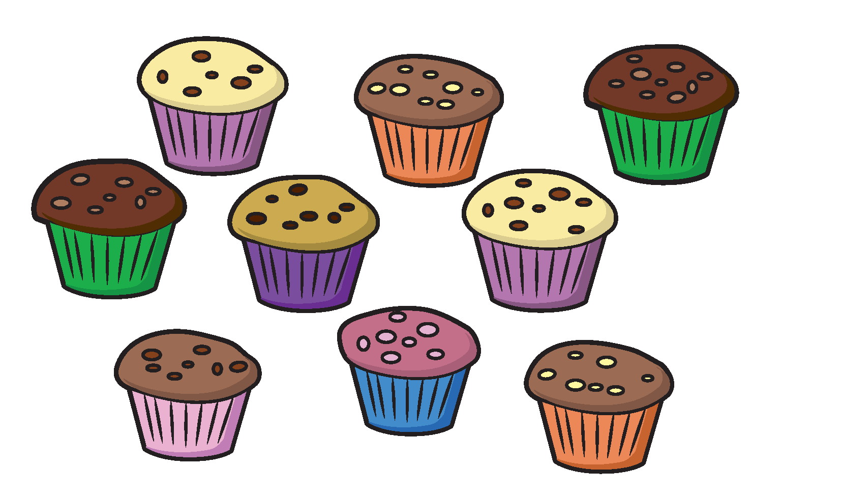




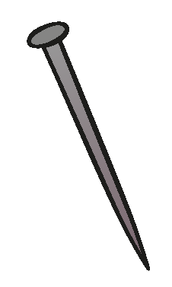






















Slide 23


























































