Slide 1


Slide 2


Slide 3


1) What colour is the circle?
2) What shape is this?
3) What is the same? What is different?
4) What is the same? What is different?

Slide 5



How can we sort these objects?
Have a think

Slide 6
This set of objects has
been sorted by .
colour

Slide 7

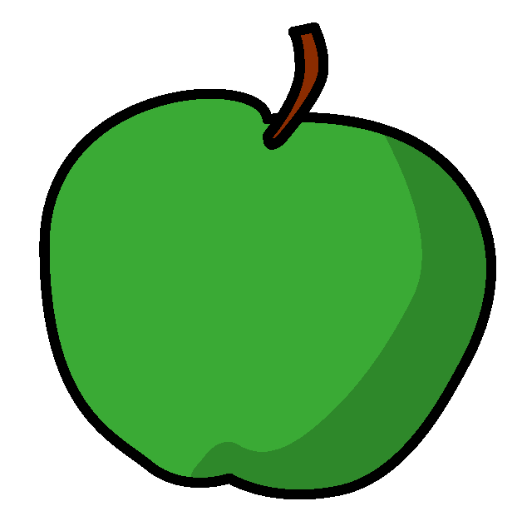
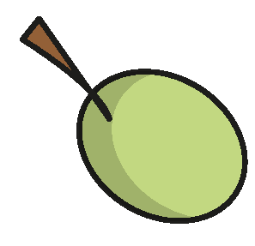
How can we sort these objects?
Have a think

Slide 8
apples
grapes
This set of objects has
been sorted by .
type of fruit

Slide 9
How else can we sort these objects?
Have a think

Slide 10
red
green
I could also sort the
objects by .
colour

