Slide 1


Slide 2

1) Count to 5
2) What number comes after 8?
3) How many counters fill the frame?
4) What number is missing? 1, 2, __, 4

Slide 3
1) Count to 5
2) What number comes after 8?
3) How many counters fill the frame?
4) What number is missing? 1, 2, __, 4
1
2
3
4
5
9
10
3

Slide 5




1
2
3
4
5
6
Have a think
How many cubes are there?
The last number I said was , so there are cubes in total.
6
6

Slide 6


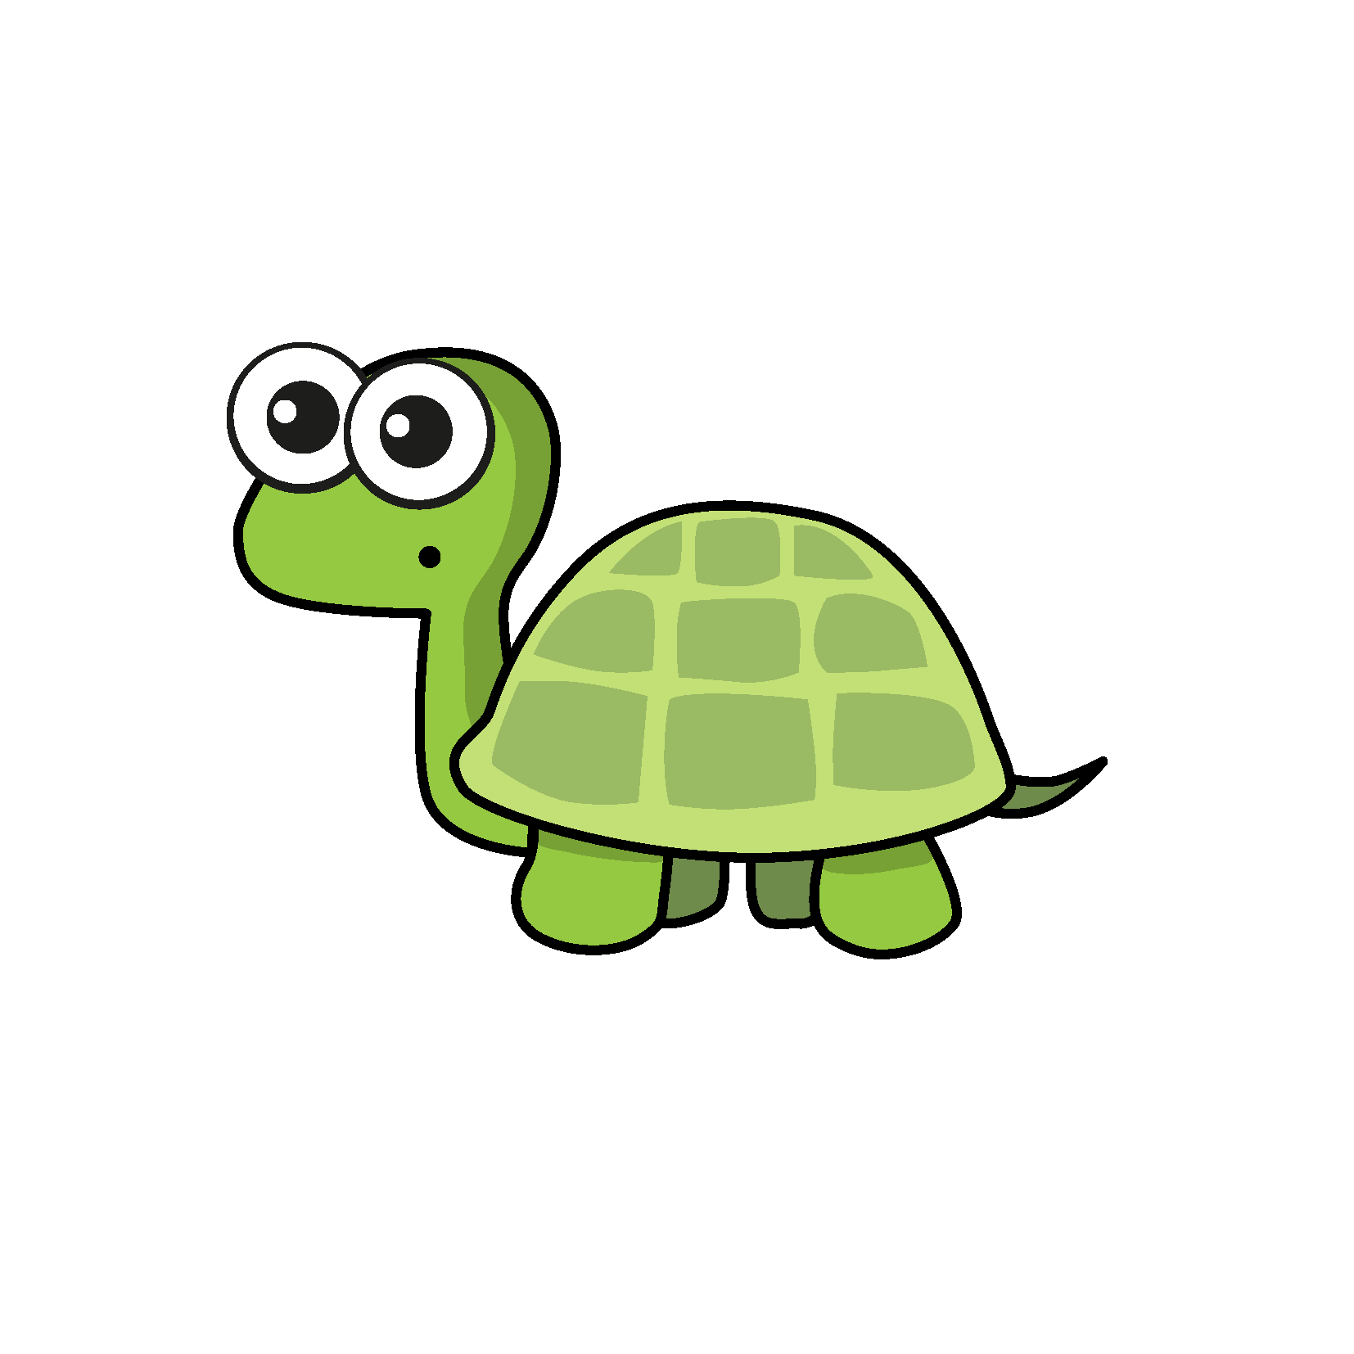
How many leaves are there?
4
3
2
1
There are 4 leaves.
Have a think
Do you agree with Tiny?
Yes

Slide 7

How many apples are there?
3
6
2
5
5
4
1
0
2
7
1
4
6
3
The last number I said was 6, so there are 6 apples.
Have a think
Do you agree with Tiny?
No – Tiny should not start counting at zero

Slide 8

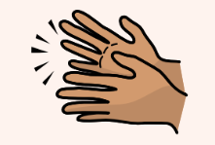
Can you count how many times I clap my hands?

Slide 9
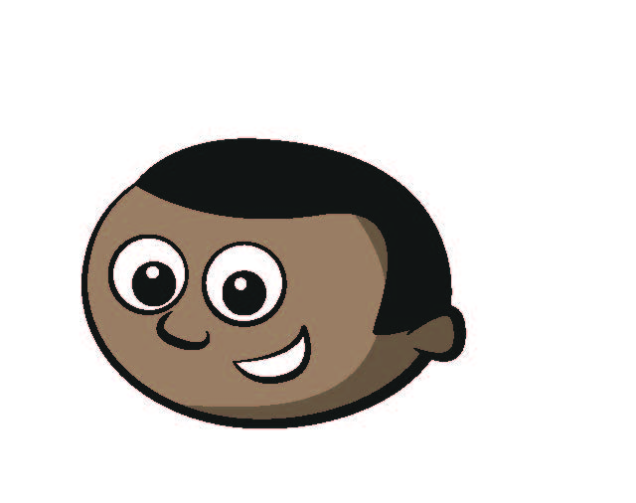
How many counters are there?
1
3
5
7
9
2
4
6
8
I counted like this.
Have a think

Slide 10
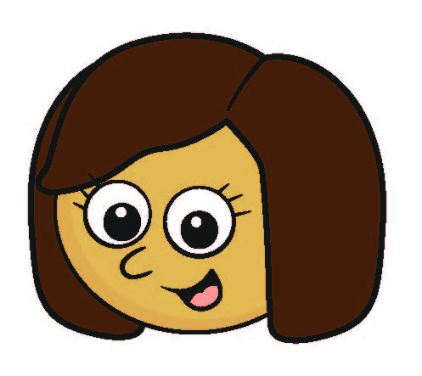
How many counters are there?
9
8
7
6
5
4
3
2
1
I counted like this.
How else could you have counted them?

Slide 11

How many ice creams are there?
1
2
3
4
5
6
7
8
There must be 10 because it is full.
Have a think
Do you agree with Tiny?
No

