Slide 1


Slide 3
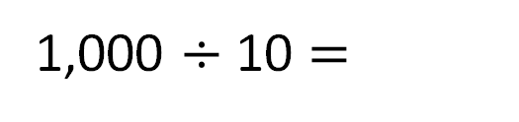
Complete the number line.
1,000
0
100
200
300
400
500
600
700
800
900
1,000
The difference in value between the start and the end of the number line is
1,000
There are intervals.
10
1,000 $÷$ 10 $=$
100

Slide 4

What numbers are the arrows pointing to?
200
700
0
100
200
500
700
800
900
1,000
Have a think

Slide 5
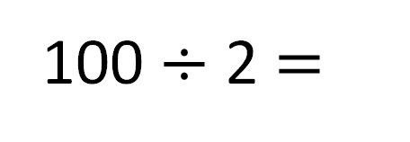
What numbers are the arrows pointing to?
250
850
0
100
200
300
500
800
900
1,000
100 $÷$ 2 $=$
50
Have a think

Slide 6
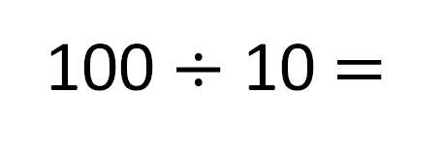
Complete the number line.
100
300
310
320
330
340
350
360
370
380
390
400
100 $÷$ 10 $=$
10

Slide 7
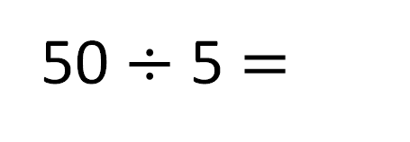
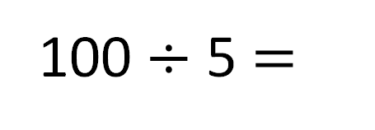
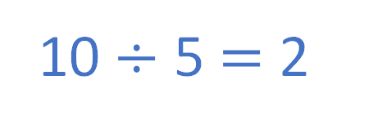
100
300
320
340
360
380
400
Same start points
20
100 $÷$ 5 $=$
What’s different?
What’s the same?
Same number of intervals
10 $÷$ 5 $=$ 2
Different end points
50
300
310
320
330
340
350
Have a think
10
50 $÷$ 5 $=$

Slide 8

Number lines always go up in 10s, 20s or 100s.
Do you agree with Tiny?
0
50
100
150
200
250
300
350
400
450
500
Have a think

Slide 9
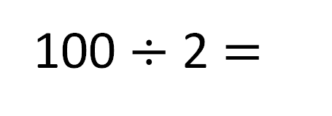
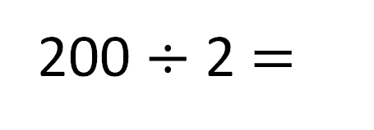
Estimate where 175 goes on the number line.
200
100
0
100
150
175
200
400
100
200 $÷$ 2 $=$
100 $÷$ 2 $=$
50

