Slide 1


Slide 3

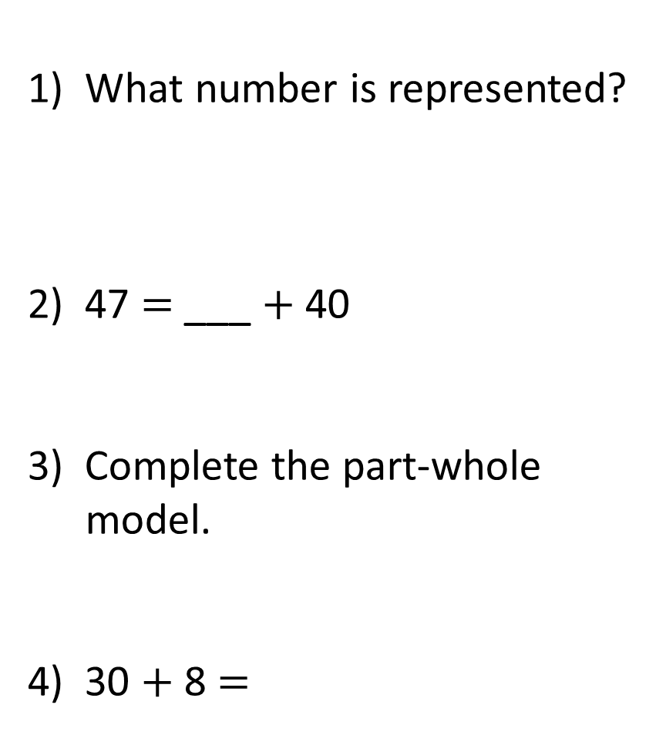
1) What number is represented?
2) 47 $=$ ___ $+$ 40
3) Complete the part-whole model.
4) 30 $+$ 8 $=$
93
3

Slide 4
1) What number is represented?
2) 47 $=$ ___ $+$ 40
3) Complete the part-whole model.
4) 30 $+$ 8 $=$
124
7
90
93
3
38

Slide 6

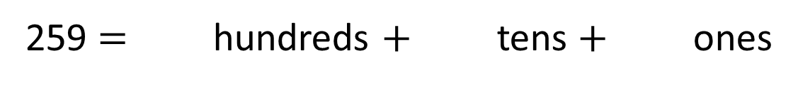
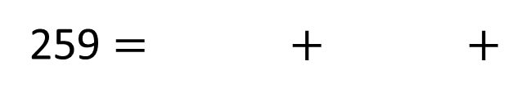
Complete the sentences.
Have a think
2
5
9
259 $=$ hundreds $+$ tens $+$ ones
200
9
259 $=$ $+$ $+$
50

Slide 7




Complete the sentence.
Have a think
425 $=$ 400 $+$ $+$
20
5

Slide 8


Partition 182 and complete the number sentence.
182
100
80
2
Have a think
100
80
2
182 $=$ $+$ $+$

Slide 9
What is the same?
What is different?
700
600
731
631
30
1
Same number of tens
Different whole
Same number of ones
Have a think
Same number of parts missing

Slide 10

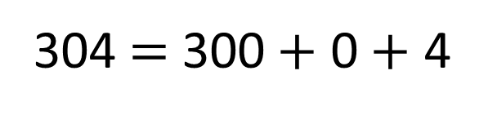
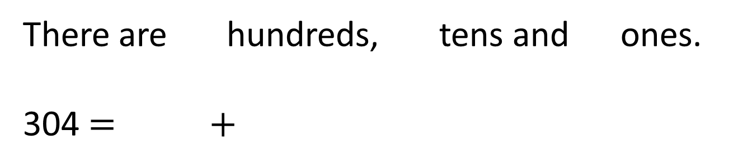
Tiny partitions 304
304 $=$ 300 $+$ 0 $+$ 4
How can Tiny’s partitioning be improved?
Have a think
0
4
There are hundreds, tens and ones.
304 $=$ $+$
3
300
4

Slide 11

Dexter is making numbers using digit cards.
What 3-digit numbers could Dexter make?
3
6
7
367
376
Have a think

Slide 12

Dexter is making numbers using digit cards.
What 3-digit numbers could Dexter make?
3
7
6
367
376
673
637
736
763
367 is equal to 3 hundreds, 6 tens, 7 ones
367 $=$ 300 $+$ 60 $+$ 7

