Slide 1
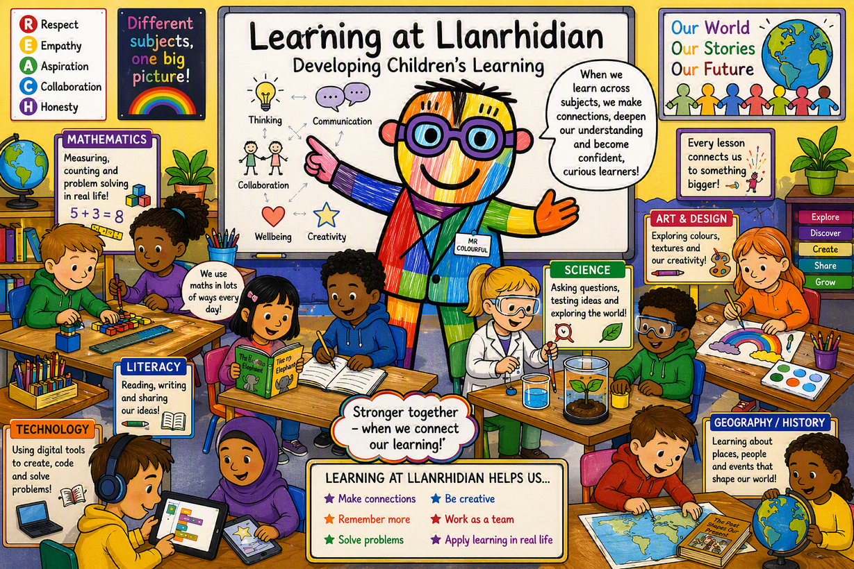

Slide 2

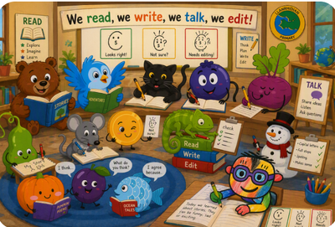
Planning for Learning
Literacy
Genre: Information text.
Statement of What Matters: Language Connects Us WM1
DOL(s):
  I can respond to what I hear, read and see. (PS1)
Domain: Responding and interacting
Learning Objectives:PS1
  To ask relevant questions about something they have heard.
  To join in conversations by offering their own ideas, linked to what has been said.
  To sort and categorise pictures related to a theme.
  To know different ways of showing others what they have learnt.
  To make links between pictures and text.
  To record a fact in their own way
Characteristics of Independence: Collaboration
Integral Skills:
To listen to others.
To work with other people.

Slide 3

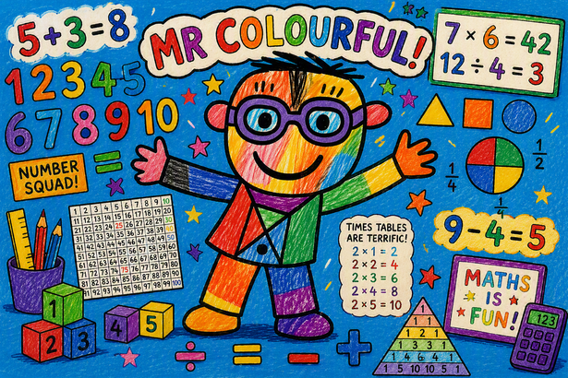
Planning for Learning
Numeracy
Unit of Learning - Number
Statement of What Matters: Numeracy WM1
DOL(s):
  The number system is used to represent and compare relationships between numbers and quantities.
Domain:The Number system.
Learning Objectives:
I can count confidently and solve problems (PS1)
I can order, group and write numbers to 20(PS2)
Characteristics of Independence: Resilience.
Integral Skills:
  I can share what I have done well.

Slide 4

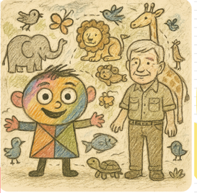
Planning for Learning
Amser Sgwn i
Big Question: I wonder what animals live in Y Goedwig?
Statement of What Matters: Science and Technology WM3
DOL(s):
  The world around us is full of living things that depend on each other for survival.
Domain: Variation and Evolution.
Learning Objectives: (PS1)
  To talk about what I noticed and what I have found out.
  I can recognise that plants and animals are living things which grow.
  To identify, follow and begin to create sequences and patterns in everyday activities I.e. daytime animals and night time animals
  To know that animals live in different places, e.g. land, sea, air, underground
Characteristics of Independence: Collaboration
Integral Skills:
  I can work with other people.
  I can ask questions if I don’t understand

