Slide 1

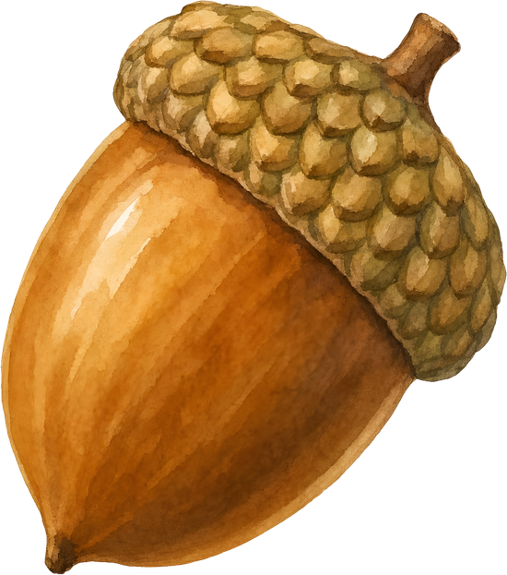
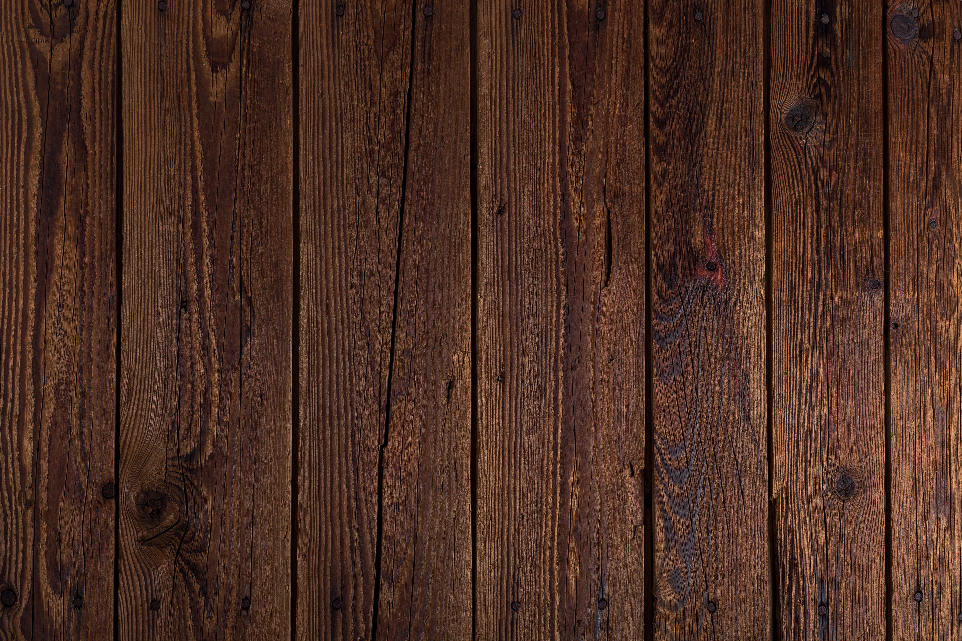


LOST
Have you seen Will Wiwer’s nuts?

