Slide 1
nocturnal
nocturnal
diurnal
nocturnal
nocturnal
diurnal
nocturnal
diurnal
diurnal
nocturnal
diurnal
diurnal

Slide 2
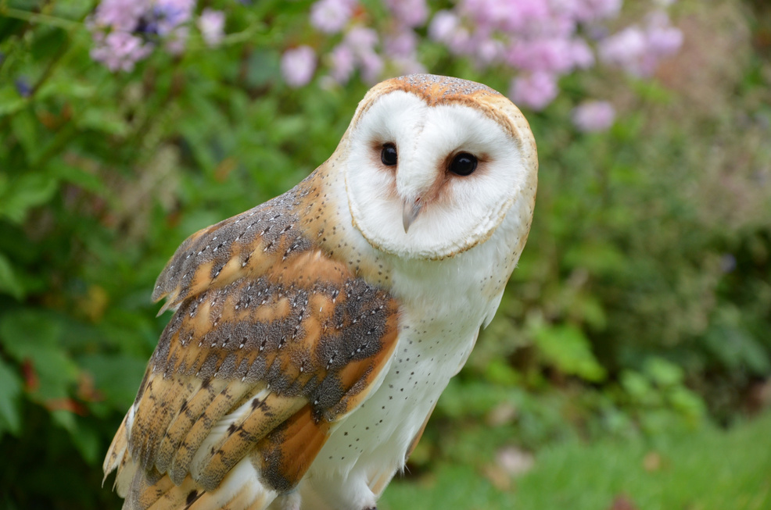
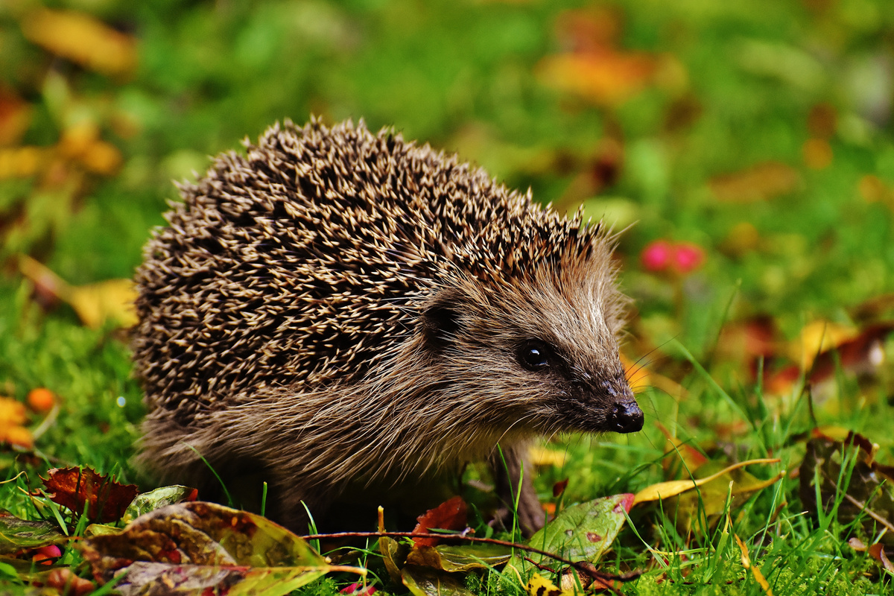
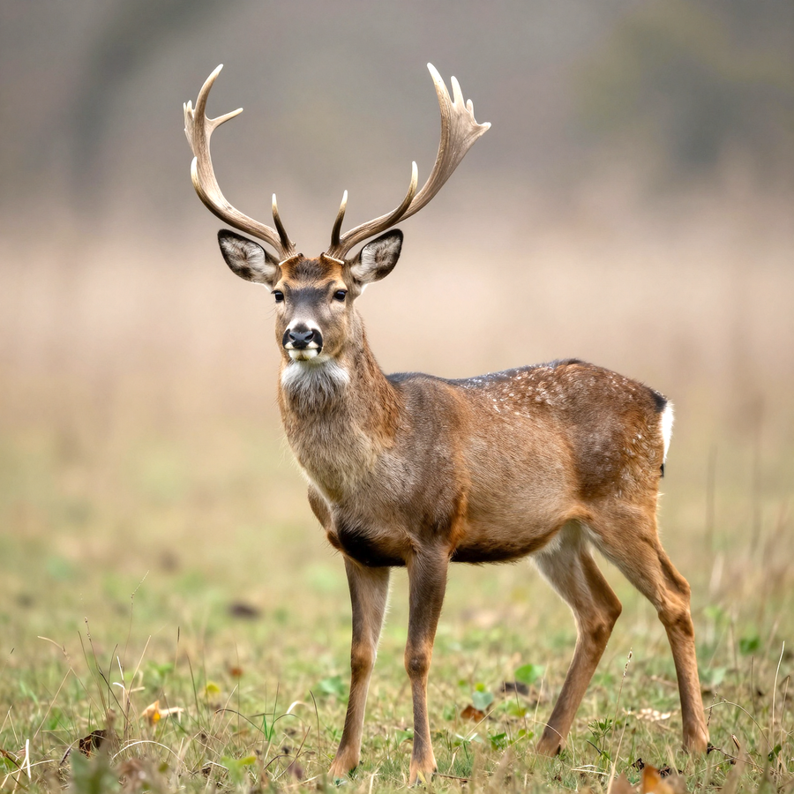
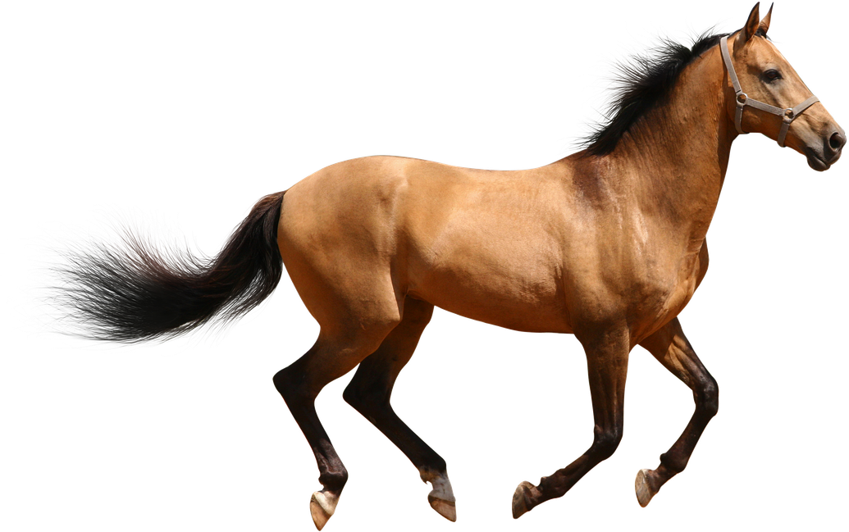
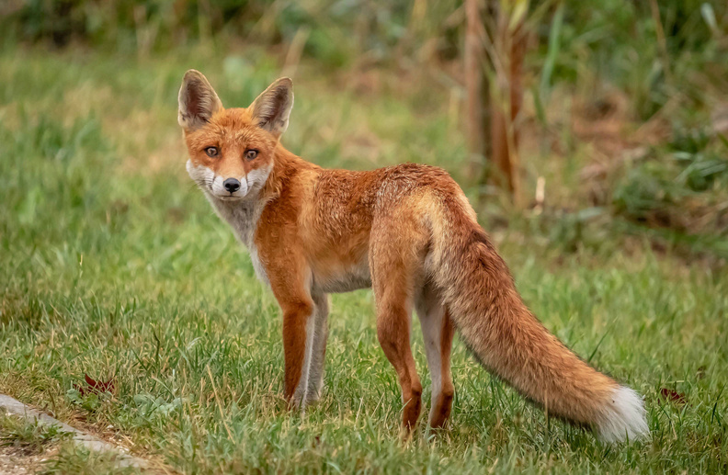
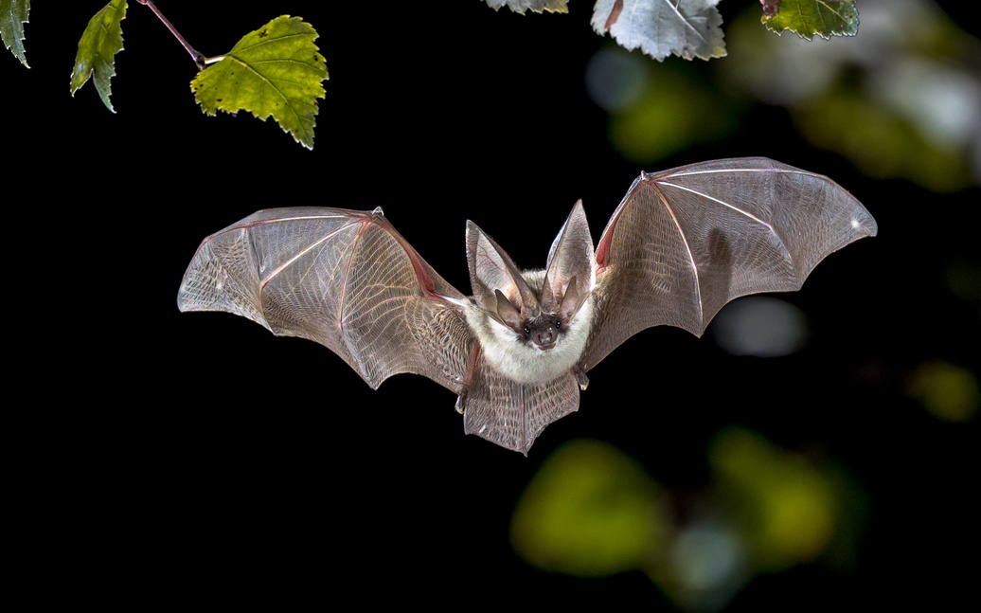
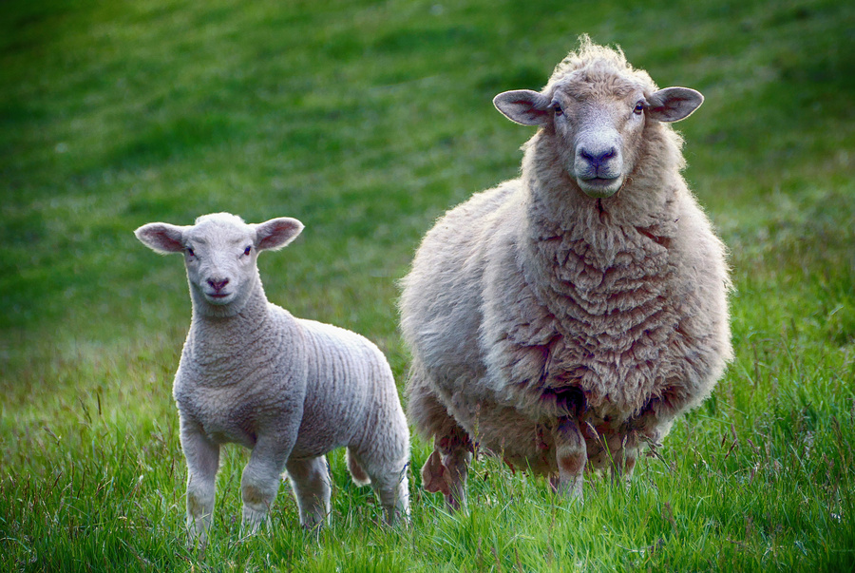
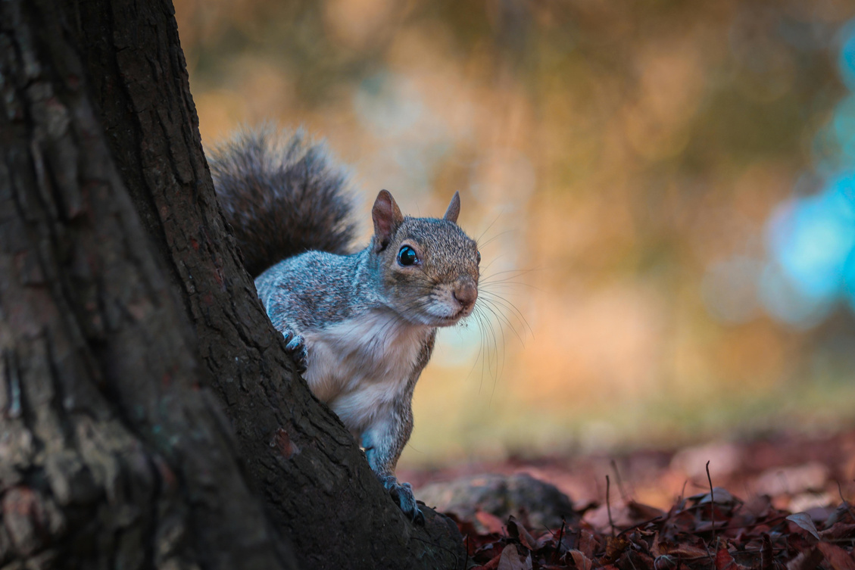
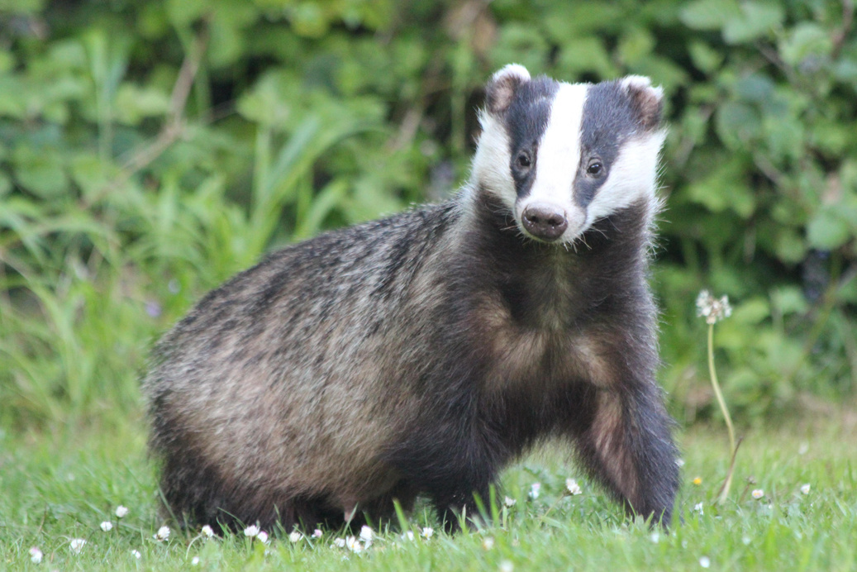
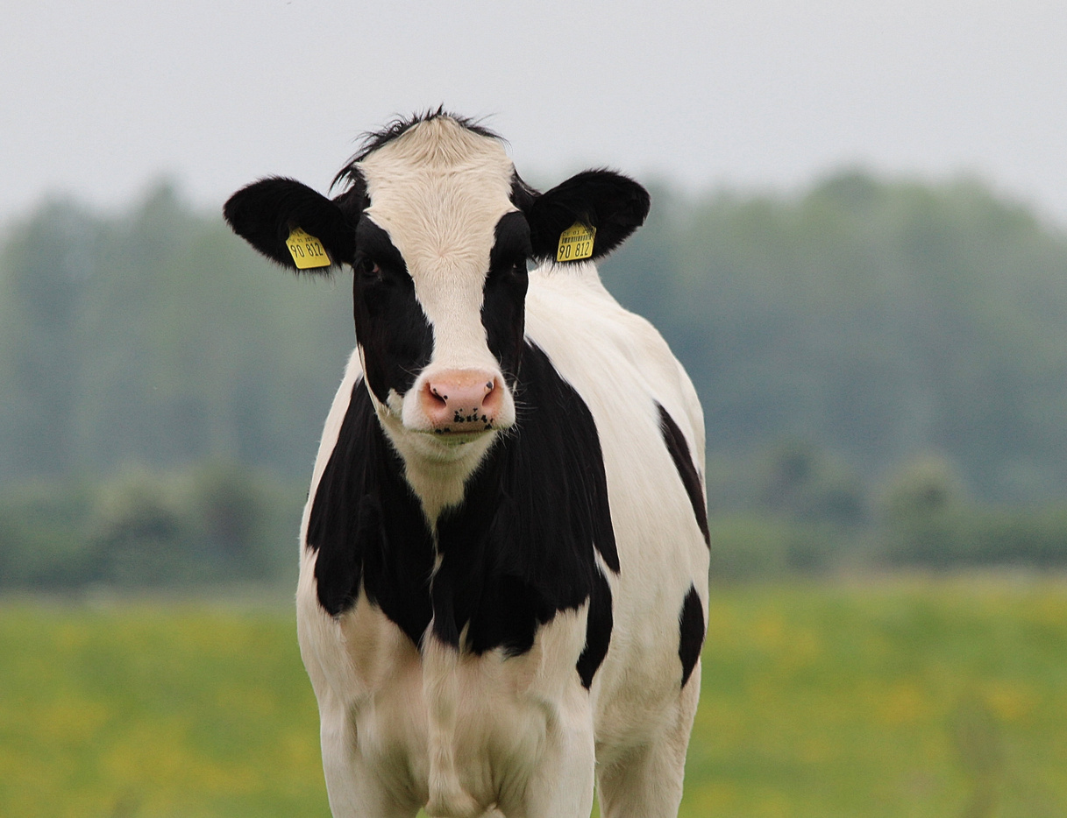

Slide 3



LO:I can group and sort objects.#LlanNum
To use time-related language to describe when events happen. #LlanHum
Will Wiwer remembers that his nuts were all safe a sound in the day time but had vanished by the morning. It must have been a nocturnal animal that stole his nuts. Can you sort these animals into day and night creatures?

