Slide 1
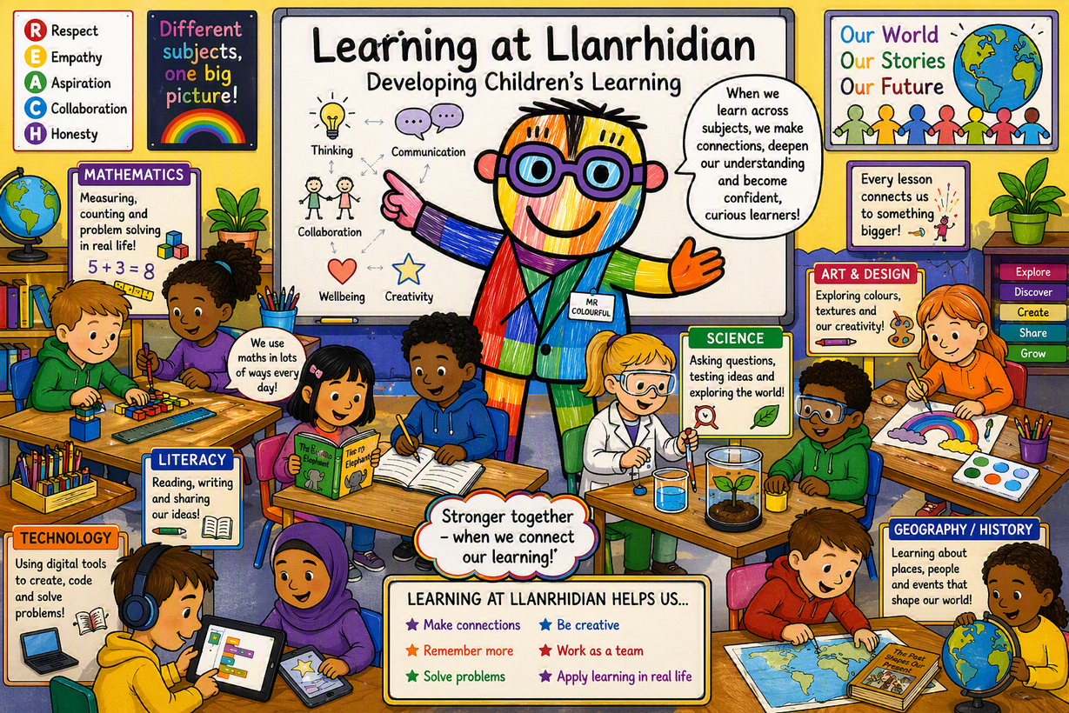

Slide 2

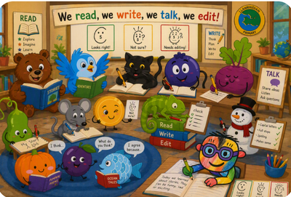
Planning for Learning
Literacy
Genre: Information text.
Statement of What Matters: Language Connects Us WM1
DOL(s):
  I can respond to what I hear, read and see. (PS1)
Domain: Responding and interacting
Learning Objectives:PS1
  To ask relevant questions about something they have heard.
  To join in conversations by offering their own ideas, linked to what has been said.
  To sort and categorise pictures related to a theme.
  To know different ways of showing others what they have learnt.
  To make links between pictures and text.
  To record a fact in their own way
Characteristics of Independence: Collaboration
Integral Skills:
To listen to others.
To work with other people.

Slide 3
Planning for Learning
Literacy
Genre: Story Writing.
Statement of What Matters: Language and Literacy WM3
DOL(s): Expressing ourselves through languages is key to communication.
I can communicate by making marks, drawing symbols or writing letters and words in a range of contexts.
Domain: Writing to communicate.
Learning Objectives:PS1
To write simple words and phrases by using knowledge of letters and the sounds they represent.
To explore writing for different purposes and audiences.
To show understanding of different formats, e.g., cards, lists, letters.
To begin to use story telling vocabulary.
To describe settings and characters
Characteristics of Independence: Collaboration
Integral Skills:
To be curious
To think up new ideas.

Slide 4


Planning for Learning
Numeracy
Unit of Learning - Number
Statement of What Matters: Numeracy WM1
DOL(s):
  The number system is used to represent and compare relationships between numbers and quantities.
Domain:The Number system.
Learning Objectives:
I can count confidently and solve problems (PS1)
I can explore sets and how they can change (PS1)
I can combine, change and compare amounts.
Characteristics of Independence: Resilience.
Integral Skills:
  I can share what I have done well.

Slide 5

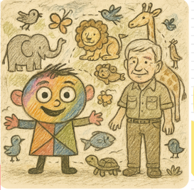
Planning for Learning
Amser Sgwn i
Big Question: I wonder what animals live in Y Goedwig?
Statement of What Matters: Science and Technology WM3
DOL(s):
  The world around us is full of living things that depend on each other for survival.
Domain: Variation and Evolution.
Learning Objectives: (PS1)
  To talk about what I noticed and what I have found out.
  I can recognise that plants and animals are living things which grow.
  To identify, follow and begin to create sequences and patterns in everyday activities I.e. daytime animals and night time animals
  To know that animals live in different places, e.g. land, sea, air, underground
Characteristics of Independence: Collaboration
Integral Skills:
  I can work with other people.
  I can ask questions if I don’t understand

Slide 6
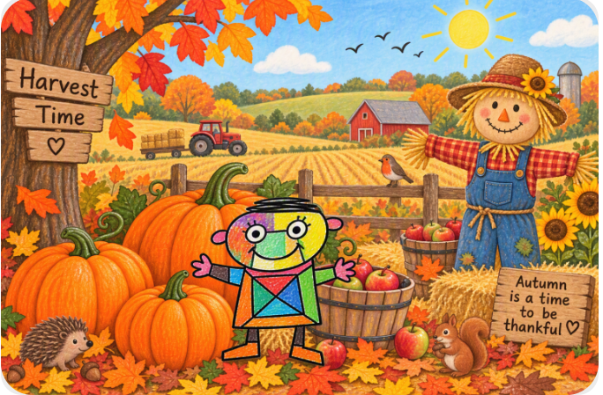
Planning for Learning
Amser Sgwn i
Big Question:I wonder what happens during Harvest?
Statement of What Matters: Humanities WM1
DOL(s): Curiosity
  Enquiry, exploration and investigation inspire curiosity about the world,
  its past, present and future
Domain: Mapwork and fieldwork
Learning Objectives: (PS1)
To explore and observe the local environment through simple fieldwork
To identify and describe features of their locality using simple geographical language
To develop early understanding of place, identity and change over time
Characteristics of Independence: Curiosity
Integral Skills:
I can ask questions about the world around me.
I can share my ideas and discoveries with others.

